Slide 1
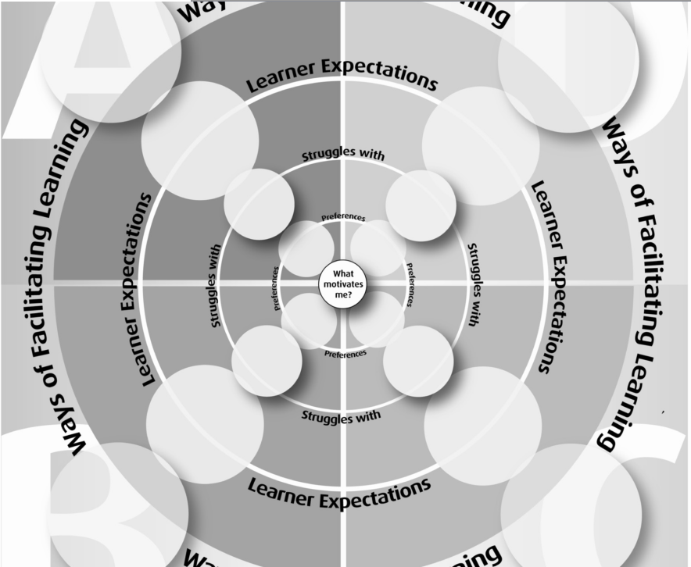
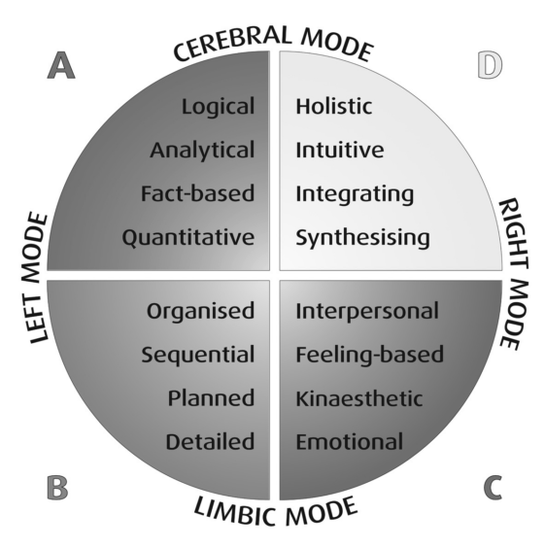
Passive Programming for Information Literacy
Target Population:
Folks with cognitive impairments, learning disabilities, atypical learning styles.
Self-directed learners.
Public library users.
Amy Leota Shropshire
Learning Style Research:
More detailed analysis of learning styles than the usual generalized theories.
de Boer, A., du Toit, P. H., Bothma, T., & Scheepers, D. (2012). Constructing a comprehensive learning style flexibility model for the innovation of an information literacy module. Libri, 62, 186-196.

Slide 2
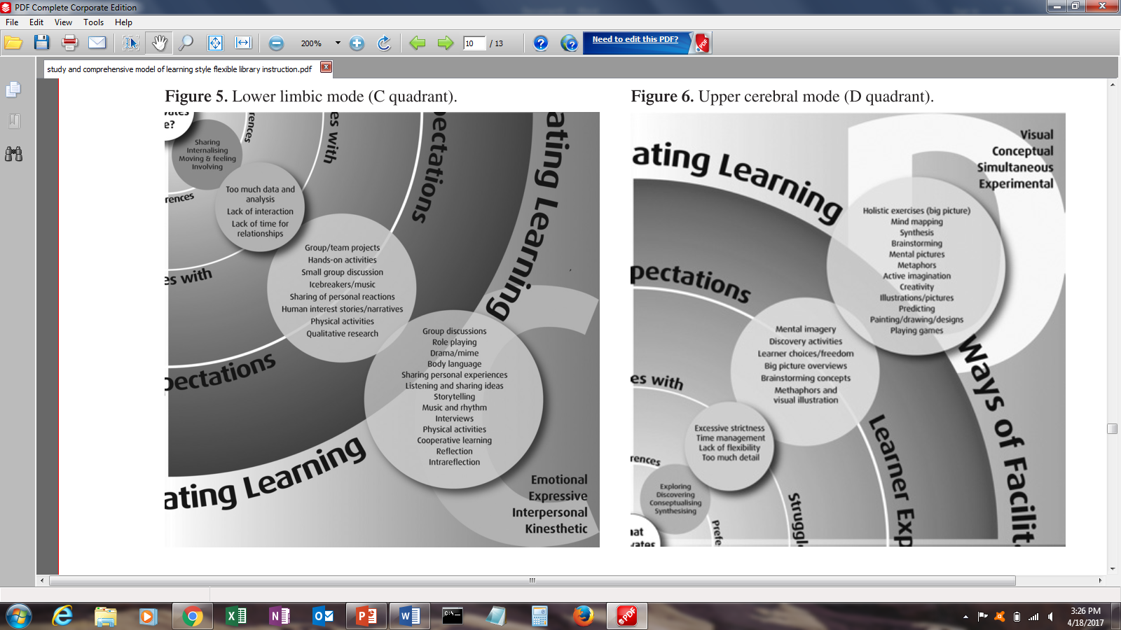
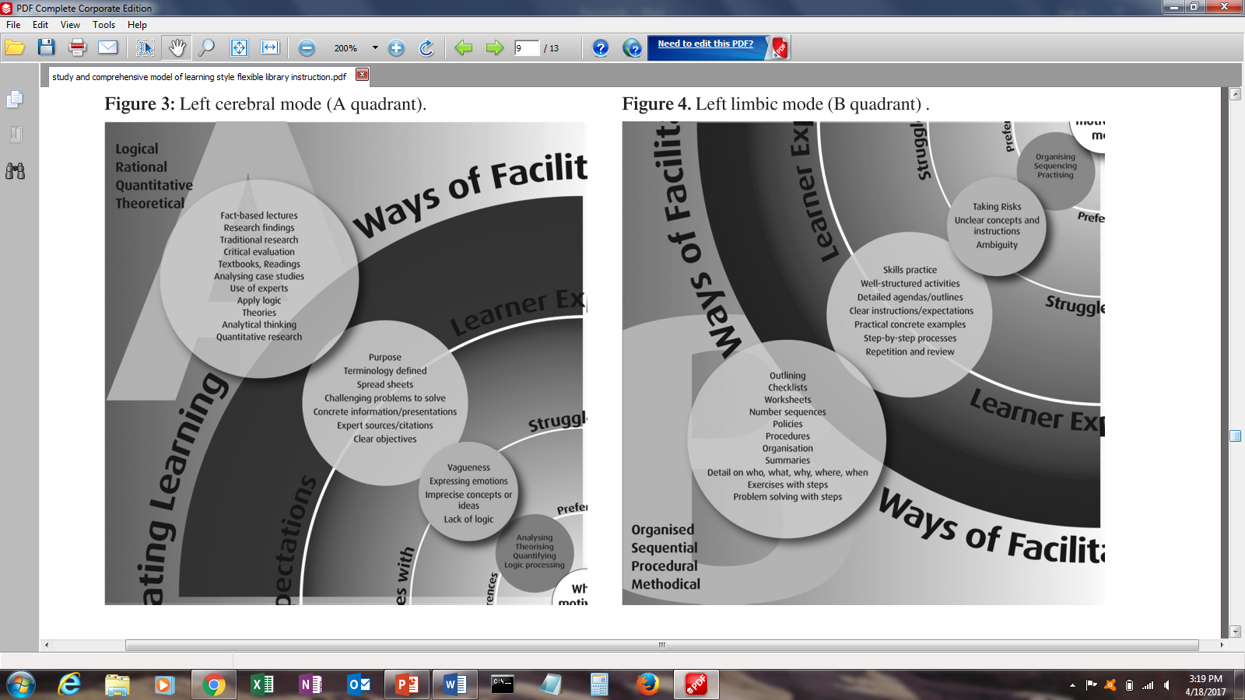
Content
Style A & B:
Heavily emphasized in academic settings.
Organized, detail-oriented, audiovisual learning.
Style D:
“Kinesthetic” – Motor memory and learning by doing and practice.
More common for self-directed learners.
Style C:
Least readily available.
Most difficult to automate.
Interaction, discussion, and cooperative learning.
Learning in concepts rather than terminology.
Most common for self-directed learners.
Jackson, S. A. (2014). Student reflections on multimodal course content delivery. Reference Services Review, 42(3), 467-483.

Slide 3

Tool
?
?
Features:
Simple visual interface
Four different learning styles, with no set starting point
Various options for each stage of understanding
Recommended order for greatest likelihood of knowledge retention
Low reading level materials, accessible to both self-directed learners and children
Multi-functional, to help many groups
Things to avoid:
Condescending signage and advertising, with an emphasis on helping children
Overly boring, repetitious content in each section
Structured, one-size-fits all approaches
Descriptions and use of tools as “remedial” rather than “simple”
Exclusionary complexities
Long extended mandatory sections and activities

Slide 4
Assessment
Implementation
Asses:
How well the app is working for people based on number of completed tutorials.
How well the app is teaching using brief quizzes of random reputable and non-reputable information sources before and after full tutorial.
How much the app is being used based on amount of server traffic
How engaging the app is based on number of completed final quizzes.
Implement:
A publicly available web app maximizes potential access points.
Extensive advertising necessary for in-house library patrons.
If possible devote a computer or two with headphones in an area devoted to this type of instruction.
Workshops on digital literacy can begin with previews or run-throughs of the tutorial.
Even the most savvy digital native may know the material, but find benefit in a brief foundational refresher.

Slide 5
Costs
Funding
Web-based apps are fairly cheap to implement.
Server costs for hosting are about $20-$40/month to support around 1000 synchronous users.
Data rate servers can often be rented for $5/month but don’t scale as well beyond the cap.
It would be available to anyone, anywhere with an internet connection.
The Institute of Museum & Library Services has many grants and is specifically committed to serving underserved and diverse populations.
Particularly, the National Leadership Grants for Libraries have many grants focused on technology innovation and library community sharing.
Could be used to offset webhosting costs, to purchase a server for running this and other app-based passive programming, and app building software tools for libraries.
Any additional could be put toward information literacy workshops featuring the app, community advertising, and dedicated tutorial machines for the library.

