Slide 1
PANDORA SOCIAL MEDIA TOOLS
BY CORINNE CHATNIK, DANIEL MOUNT, AMY SHROPSHIRE, AND SUNNY ZHANG

Slide 2
Our Group’s Role

Slide 3
Identifying users of Pandora
We will determine the technographic makep of Pandora’s user by using a survey.
Questions will be developed and worded in such a way to best pinpoint how users currently use Pandora and it’s social media sites.

Slide 4
Pandora’s User Stats
As of April 2016, there are roughly 80 million users of Pandora.
The number of followers on various social media sites are as follows:
Twitter - 544,000 followers
Facebook - 6.9 million likes and 1,240 followers
Instagram - 73,800 followers
YouTube - 84,500 subscribers

Slide 5
Survey Question Examples
Check all of the following social media sites on which you follow Pandora.
□ Facebook
□ Twitter
□ Instagram
□ YouTube
□ Google+
□ Pandora’s On-Site Blog
□ None

Slide 6
Survey Question Examples
2. How do you typically interact with Pandora through social media?
(Check all the appy)
□ Follow/Like Pandora’s page
□ Comment or share Pandora’s posts
□ Watch videos or read articles posted by Pandora
□ No interaction at all

Slide 7
Survey Results
Surveys will help shape how proceed with our objectives.
For the purposes of this assignment, we are assuming that the majority of Pandora users fall into the Inactive category.

Slide 8
Groundswell Plan Outline
P - Identify current users as Inactives with a goal of changing them to Spectators
O - Establish operational goals, with the Listening and Energizing objectives forming our primary social media strategy.
S - To find a tool that allows us to follow and engage with our users on multiple platforms and analyze the data to promote our service to a larger audience
T - AgoraPulse is our social media management tool

Slide 9
Profile
Little user engagement on social media
Most use Pandora only for listening purposes
The vast majority of Pandora users fall into the inactive category
Goal of our groundswell plan is to convert inactive user to spectators

Slide 10
Objectives
Pandora has a strict ethical standard against music being pre-judged based on popularity, which limits our objectives
Objectives are also narrowed by the particular way in which Pandora markets and monetizes its business
Pandora should employ a Listening objective in very specific ways limited by these factors
Pandora’s main objective should be to Energize.

Slide 11
Objective limitations - Ethical priorities
Where social media can help:
Pandora relies heavily on constant and ongoing updates.
Pandora welcomes input on music delivery.
Where social media can not help:
Pandora has a trained staff responsible for musicological organization.
Pandora does not value popularity as a categorical factor, but rather the opposite.

Slide 12
Objective Priorities - Listening
Pandora needs to rely on user input to keep abreast of constantly changing musical trends, shifting terminologies, and newest releases.
Pandora needs to ask for user input on new delivery methods and features that users would value.
This is an objective used for constant updating and development, and also creates greater user satisfaction which leads to direct monetary results.

Slide 13
Objective Limitations - Economic factors
Monetary Target Points
User Satisfaction with Delivery
Leads to increases in paid subscriptions
Direct funds to Pandora
User Satisfaction with Content
Leads to purchasing links
Provides purchase referral revenue.
How much the service is used
Leads to More in depth ad targeting leads to more clicks and greater ad revenuemore ads being shown and greater potential for ad revenue

Slide 14
Objective Priorities - Energizing
Pandora’s primary objective is to energize its users.
Creating social “buzz” is a major marketing factor that assists in promoting the service and gaining more users.
This objective leads to greater numbers of users, more listening hours, and greater user satisfaction, which are all indirectly monetized, but more extensively so.

Slide 15
Strategy - Resources
Pandora should have a resource to smoothly manage the social media responses and tasks. The strategy is focused on energizing.
Organized publishing strategy to multiple networks: We need a resource that have cool features encouraging audiences to create their own content and share with other audiences
Listen for the keywords that are important
Scheduled posting strategy: post news during specific time intervals.
Track mentions on networks
Communication Forum
Analytics

Slide 16
Strategy - Budget
Visual design , professional designer.
Invest in analytics software which tracks visitors in good ways.
Staff will need to be trained technically and to monitor daily postings well, we need people who learn media security awareness, ethics, posting policy, and digital posting techniques. Visual design: cover photos for audiences’ profile covers, icons; Professional designers
Electronic technology professionals to create web-made tools
Invests in analytics software which tracks visitors in good ways.
Invests in great educational resources on wed design to develop skillful employees.

Slide 17
Strategy - Staff needs
Someone is in need to be trained technically and literally. To monitor daily postings well, we need people who learn media security awareness, ethics, posting policy, and digital posting techniques. He/she should know which information is appropriated to be posted and which one posted will violate the law. There are so many ethical issues and copyright issues which need to be supervised by well trained people.

Slide 18
Strategy - Incorporation
The social technologies will be incorporated into our organization’s website where it is easier to find.
We will embed links to the web-page.
Not all contents of social technologies are displayed in the same page and web space is enlarged.

Slide 19
Strategy - Social Media Team
Aaron Morgan is the Senior Social Media Manager at Pandora.
There are currently six “Listener Advocates” on the Pandora Social Support Team

Slide 20
Strategy - Performance Indicators
Analytic tools to measure which methods are most effective.
The plan will initially be measured by comparing our stats to other competitors and by the amount of increased users. After the initial stats are gathered Pandora will compare the baseline stats month to month.

Slide 21
Strategy - Assessment Plan
Posts will be reviewed daily
There will be a weekly report generated that contains Pandoras stats along with a comparison of competitors

Slide 22
Technology
Agorapulse is the ideal social media monitoring tool for Pandora
The tool must show who is talking about and interacting with Pandora.
The time of day and the day of the week users are interacting with Pandora.
Any complaints about technical or design issues.
The amount of influential people and celebrities are using Pandora and do they bring in other users.
The types of posts and messages users send to Pandora.
The popularity or failure of individual posts.
Compare activity to other similar music streaming services.
Easy report generation.

Slide 23
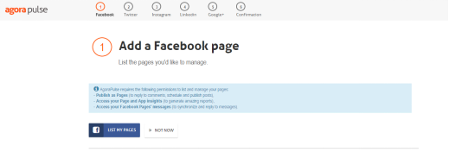
Features-Intro
1. After connection with face-book profile to begin, agorapulse drops the user into an interface where entries to different social technologies are available.

Slide 24
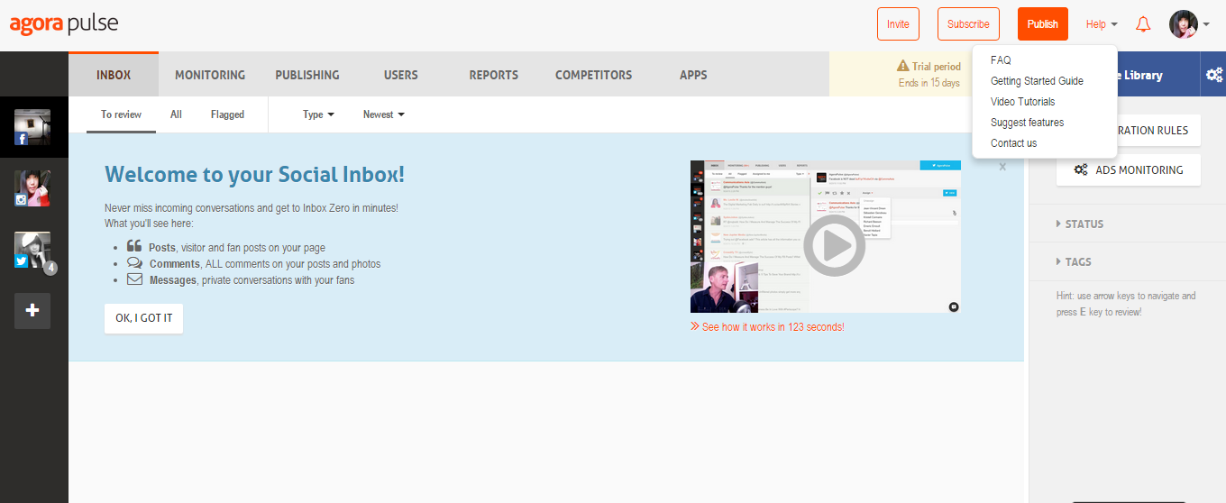
2. After attachment of accounts, management of social tools started

Slide 25
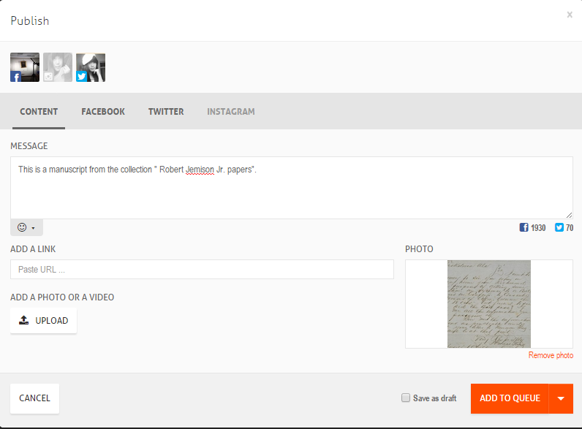
3. Publishing began

Slide 26
More features-advanced
Collecting and managing comments on your ads, adding a separate bit.ly account for easch Twitter profile, inviting teammates to manage on Agorapulse, rearranging, and creating folders on the dashboard.
Each piece of information sent by users can be easily kept track of and monitored in the conversation box.
All posts are visually organised in a calendar.
Content analysis

Slide 27
Technology - Features
Analytics
For content analysis, agorapulse uses very comprehensive powerpoints to report all your performance. It is understood by awesome graphics with key metrics focused on and ample data demonstrating your work .

Slide 28
Technology - Features
Planning Posts
The Social media team member can select one, multiple, or preset social media platform group profile to use to publish posts in the format the platform requires.
There is permissions feature that allows the approver to look at drafts and make notes or edit the post themselves and either send it back to the original team member or push it through to publishing.

Slide 29
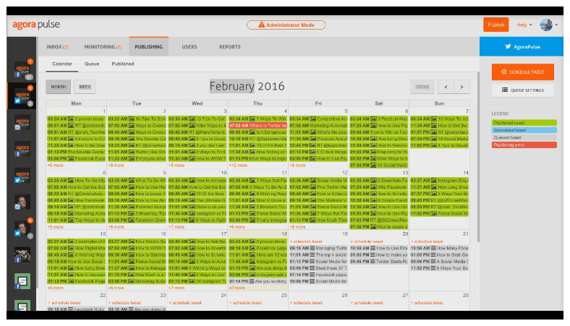
Technology - Features
Planning Posts
Businesses can set up what specific day and/or time they want the profile to publish. These are organized on on a calendar with certain levels of permission per social media team member.

Slide 30
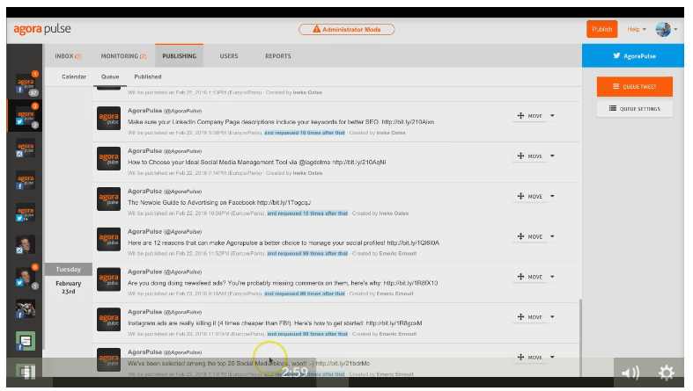
Technology - Features
Planning Posts
When publishing a post businesses can choose how many times it will be published, easily reorganize the order of tweets, and preview the look of posts before queuing and publishing.

Slide 31
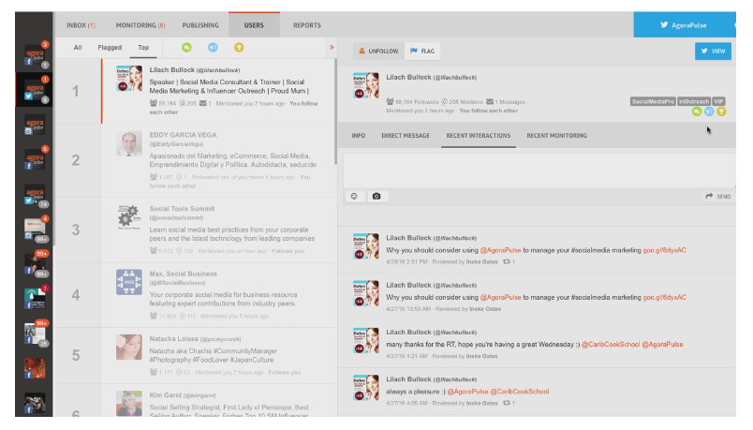
Technology - Features
Feeds and Metrics
Ambassadors and influencers
Detailed records help keep the context of the conversation
Audience profiling

Slide 32
Summary Report
Utilize Agorapulse for content management and analytic assessment.
Enable and encourage greater user communication and social “buzz.”
Transition existing staff and optimize operations using appropriate tools.
Generate frequent assessment and reconfiguration strategies.

