Slide 1
GAMESPARKS, GAME BACKEND-AS-A-SERVICE
BY CORINNE CHATNIK, DANIEL MOUNT, AMY SHROPSHIRE, AND SUNNY ZHANG

Slide 2
Groundswell Plan Outline
P - Identify current users as Inactives with a goal of changing them to Spectators
O - Establish operational goals, with the objectives of matching users with shared music interests forming our primary social media strategy.
S - To find a tool that allows us to match players with similar musical interests and analyze the data to promote our service to a larger audience
T -Gamesparks is our unconventional information management tool

Slide 3
Profile
Little user engagement on social media
Most use Pandora only for listening purposes
The vast majority of Pandora users fall into the inactive category
Goal of our groundswell plan is to establish the connections among like-minded listeners.

Slide 4
Objectives
Pandora has a strict ethical standard against music being pre-judged based on popularity, which limits our objectives
Our plan’s main objective should be preference matching

Slide 5
Where the unconventional tool can help
Pandora relies heavily on constant and ongoing updates
Pandora welcomes input on music delivery
Increases in paid subscriptions
More ads being shown and greater potential for ad revenue
Providing purchase referral and links revenue

Slide 6
Strategy - Resources
We need a resource that has cool features and share their interests with other users
Communication Forum
Setup and configure the multi-listener mechanics of our music station
Recording events
Online exchange of virtual goods
Reward users
Script Android programming logic
Track mentions on networks
Analytics

Slide 7
Strategy - Budget and Staff Needs
Funds reallocated for the cost of the Gamesparks service
Added training and responsibility would be required for the following departments:
Visual design, professional designer
Information technology
User services
We would hire the following:
Gamesparks manager
Several IT personnel with knowledge of java, JSON, NoSQL, SQL, HTML or CSS, showing outstanding analytical and programming skills.

Slide 8
Strategy - Incorporation
Gamesparks will be incorporated into Pandora’s website where it is easier to find
Links are embedded

Slide 9
Strategy-Performance Indicators
The unconventional information management tool must have analytic tools to measure which methods are most effective
The amount of increased users
User traffic
Error messages
Online questionnaire report

Slide 10
Strategy-Assessment Plan
An outside analytical tool will be necessary for generating the following:
Posts reviewed daily
Weekly reports that contain Pandora's stats along with a comparison of competitors
Notes:
CUT

Slide 11
Technology
Gamespark is the ideal tool for Pandora’s information management
1. Matching users
2. Virtual goods
3. Generate report easily
4. Promote communication between listeners and station creators
5. Recording events
6. Reward achievements of customers
7. Flexible programming capabilities
8. Manage messages

Slide 12
Database Analysis
Gamesparks is run on Microsoft Azure, a cloud computing platform and runs data centers all over the world.
The three components of GameSparks is Infrastructure-as-a-Service (IaaS), which is Azure, Platform-as-a-Service (PaaS), and Software-as-a-Service (SaaS), both of which were created by GameSparks.

Slide 13
Database Access
Gamesparks is run through database called MongoDB and accessed through NoSQL. Information is stored in MongoDB in Json format.
A JSON file is a JavaScript Object Notation.
NoSQL is a query language that uses key/value pairs.
The benefit of a NoSQL database is it is scalable. Something like GameSparks needs to handle millions of queries a second which is possible with SQL but more complicated and larger. Therefore NoSQL is cheaper and easier.

Slide 14
NoSQL Key/Value pairs explained
Key | Value
Name | John Smith
Age | 45
Phone# | 555-5555
Email | jsmith@gmail.com
Key | Value
user | 7798
user7798_name | jsmith
user7798_password | Ilovecats12!
user7798_email | jsmith@gmail.com

Slide 15
Queries
SQL:
SELECT * FROM users WHERE age > 10
NoSQL:
function (doc)
{
if (doc.objType == "users") {
if (doc.age > 10) {
emit(doc._id, null)
}
}
}

Slide 16
Table: Accounts
There are three different types of accounts:
Developer accounts
Third party social network account
Anonymous player account

Slide 17
Table: Player Accounts Fields
Player ID
Player name
Password
positions on leaderboards
achievements
currency
virtual goods
online status
other linked accounts
game configurations
Skill level - Necessary for matching in multiplayer games

Slide 18
Table: Teams
Team ID
Team Name
Team Display Name
Player ID’s
Team type

Slide 19
Table: Game Match
Match ID
Name
Description
Minimum Players
Maximum Players
Drop In/Out
Manual Match- Custom

Slide 20
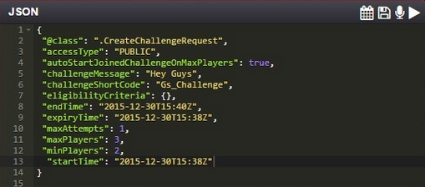
Table: In Event
Virtual goods
Virtual Currency
Number of players
Time constraints
Challenges

Slide 21
Table: Developer side
Permissions
Collaborator Groups
Game admin - Full permissions

Slide 22
Table: Chat
Player ID’s
Message ID
Message Type

Slide 23
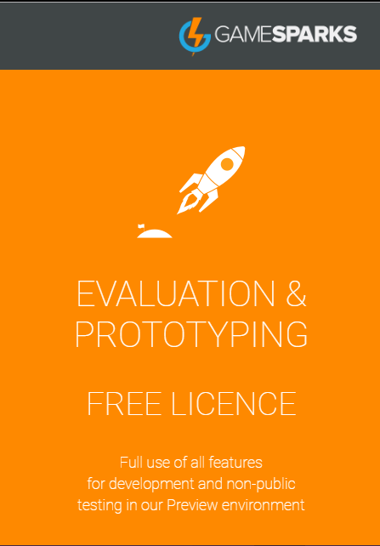
In Depth Tool Analysis
Messaging
Matchmaking
Group building
Social integration
Virtual property
Basic analytics
Notes:
Amy’s first slide

Slide 24
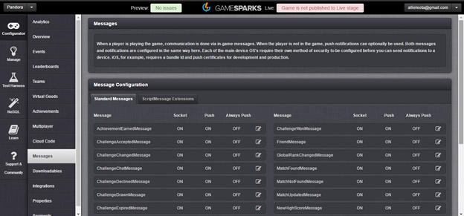
In Depth Analysis - Messaging

Slide 25
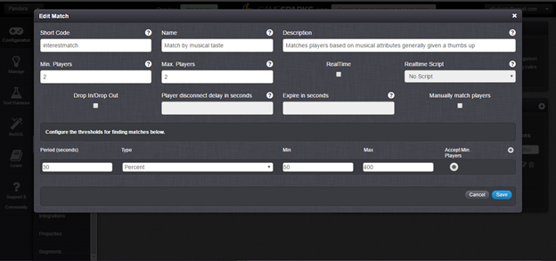
In Depth Analysis - Matchmaking

Slide 26
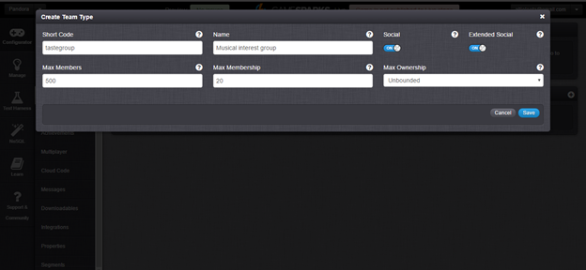
In Depth Analysis - Group Building

Slide 27
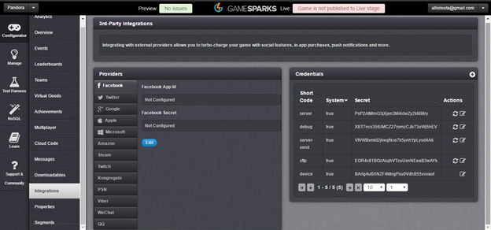
In Depth Analysis - Social Media Integration

Slide 28
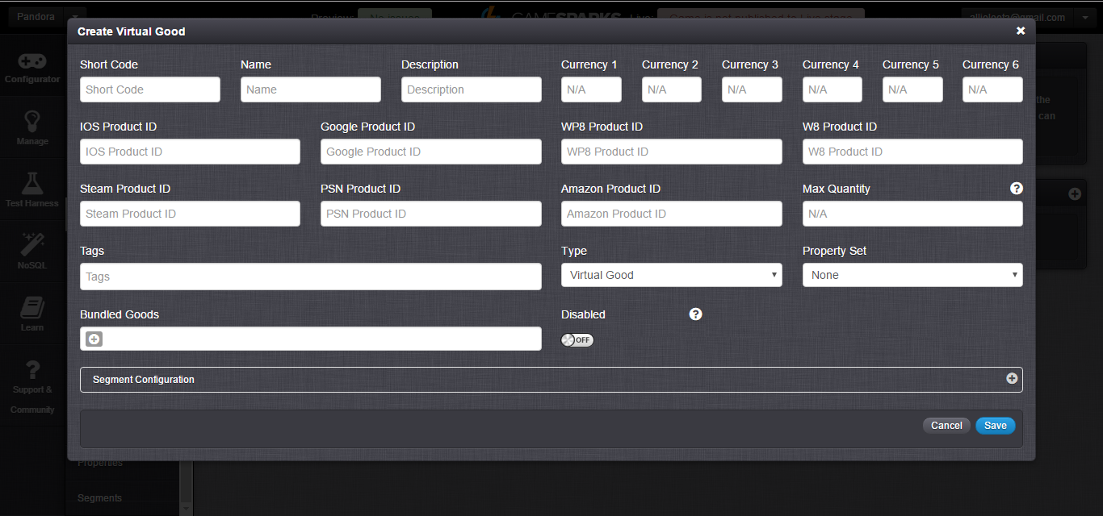
In Depth Analysis - Virtual Property

Slide 29
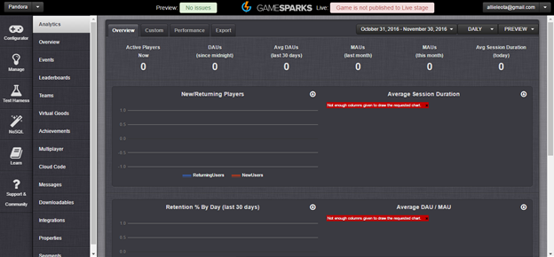
In Depth Analysis - Basic Analytics

Slide 30
In Depth Analysis - Other Features
Automatic error checking with script logs
Multiple “game” scenario management
Event creation
NoSQL queries

Slide 31
Application of GameSparks
Goals include:
Matching users based on listening interests
Providing already created stations by other users
Messaging service
Implementation of virtual goods
Notes:
Daniel’s first slide

Slide 32
Matching Users
The primary goal of using GameSparks would be to match users with other users who have similar tastes in music.
This service would be voluntary and only available to users with a paid subscription.

Slide 33
Working with GameSparks
GameSparks is not currently designed to work with music and music related information.
GameSparks is highly customizable right away so many of its features usable by Pandora right away
We will work closely with GameSparks employees to modify any of their uncustomizable or hard to customize parameters.

Slide 34
Virtual Goods
Pandora can also offer users a host of new virtual goods.
Users can earn achievements/virtual currency by reaching certain milestones.
Matching with X number of users
Using Pandora for X number of days in a row
Joining X number of groups

Slide 35
Virtual Currency
Virtual currency can either be earned or purchased by the user.
Virtual currency can be used on “cheap” items such as avatars for their online profiles all the way to more “expensive” items such as a Pandora subscription.

Slide 36
Benefits for the User
This proposed matchup service has many benefits for the user.
Discovery of new artists and music
Creation of a new social network centered on music
Users can message individuals
Users can create “teams”
Contests based on achievement and leaderboards with prizes

Slide 37
Benefits for Pandora
Integrating a modified version of GameSparks has many benefits for Pandora.
More incentive for users to subscribe = more money
More interaction by users on Pandora’s website = more money
Introduction of virtual goods and achievements = more money

