Slide 1
Numerical Computing Project Presentation
Project Name:
Implementation (GUI Based) , Graphical Representation & Comparison of Numerical Methods For Finding The Roots Of A Function
Language : Python
Name | SID | CID
Shams Ur Rehman | 9347 | 103747
Muhammad Ali | 9363 | 103747

Slide 2
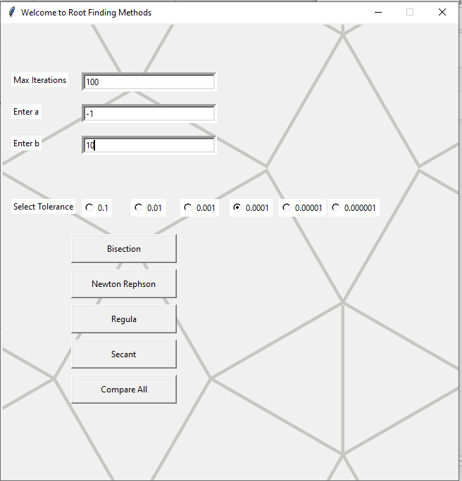
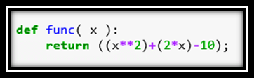

Slide 3
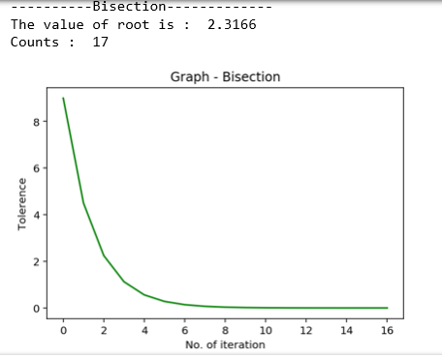
Bisection Method

Slide 4
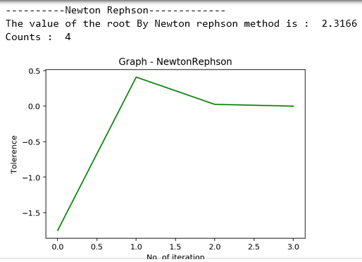
Newton Methods

Slide 5
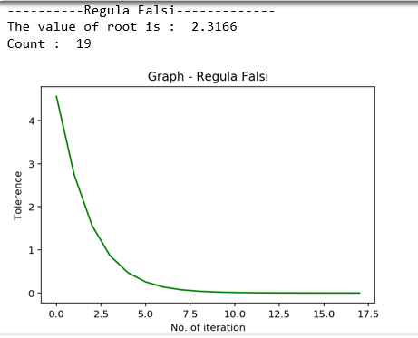
Regula Falsi

Slide 6
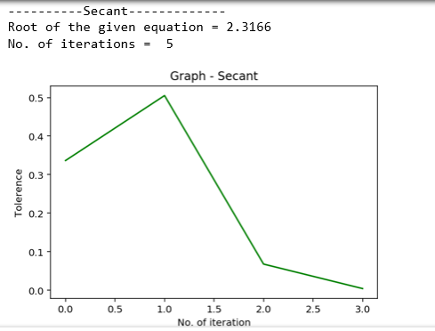
Secant Method

Slide 7
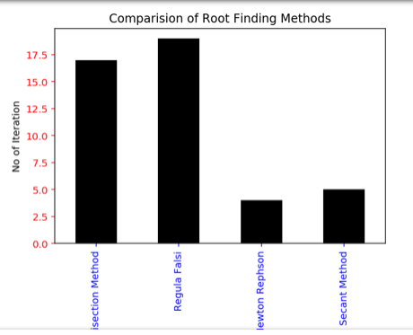
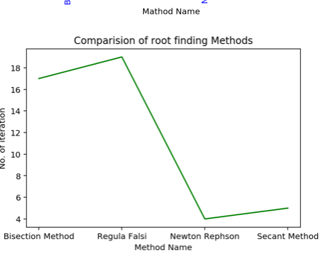
Comparing All Methods

Slide 8
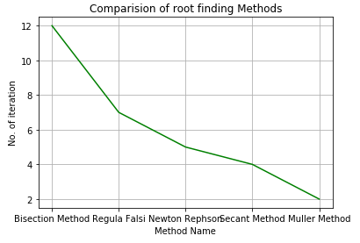
Implemented Comparisons Of Different Root Finding Methods

Slide 9
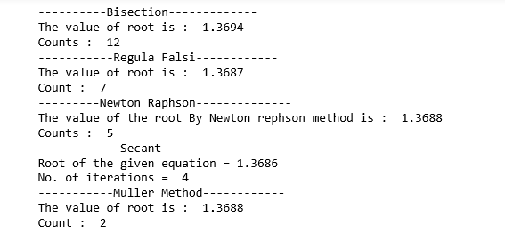
Implemented Comparisons Of Different Root Finding Methods

Slide 10
Numerical methods for finding the roots of a function
The roots of a function f (x) are defined as the values for which the value of the function becomes equal to zero. So, finding the roots of f (x) means solving the equation
f (x) = 0.

Slide 11
Definition: The equation f (x) = 0 is called an algebraic, if it is purely a polynomial in x;
it is a transcendental if f (x) contains trigonometric, exponential or logarithmic functions

Slide 12

Bisection Method

Slide 13
To find the solution of an equation f (x) = 0, we find those values of x for which
f (x) = 0
is satisfied.
Such values of x are called the roots of
f (x) = 0.
Thus a is a root of an equation f (x) = 0, if and only if, f (a) = 0.

Slide 14
Numerical methods for solving either a transcendental equation or an algebraic equation are classified into two groups:
Direct methods, which require no knowledge of the initial approximation of a root of the equation f (x) = 0.
Iterative methods, require first approximation to initiate iteration.

Slide 15
Analytical method
This method is based on ‘intermediate value property’.

Slide 16
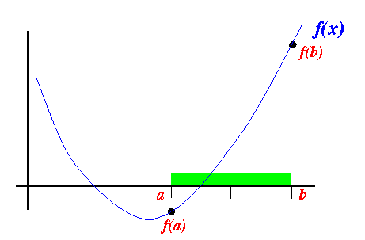
Introduction

Slide 17
Hence, in analytical method, we must always start with an initial interval (a, b), so that f (a) and f (b) have opposite signs.

Slide 18
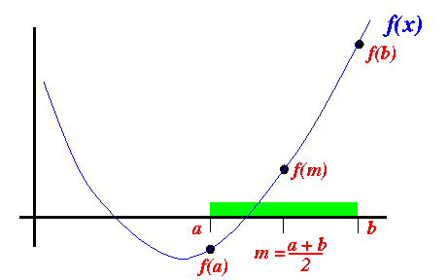
Introduction

Slide 19
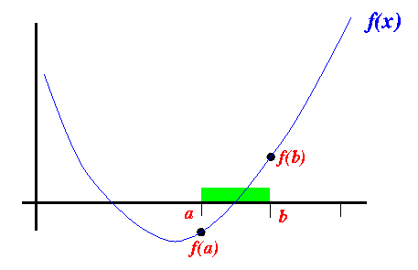
Introduction

Slide 20
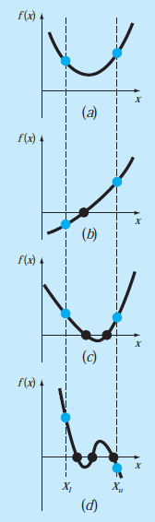
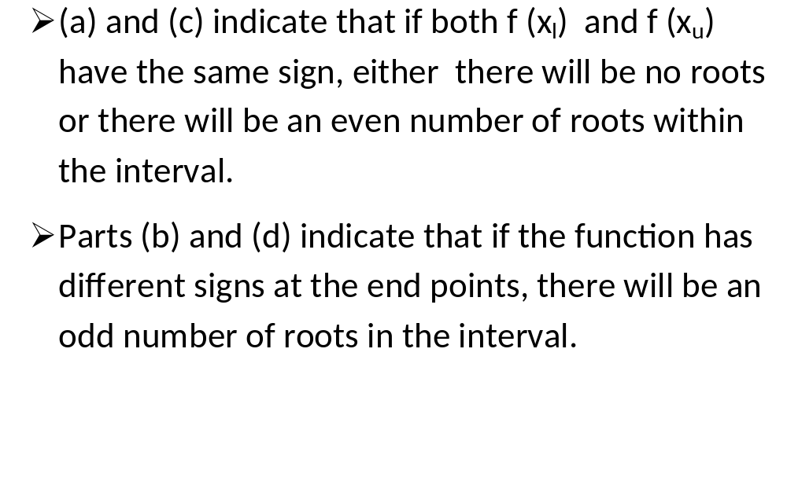
THE BISECTION METHOD
Nasir Uddin Spring 2016

Slide 21
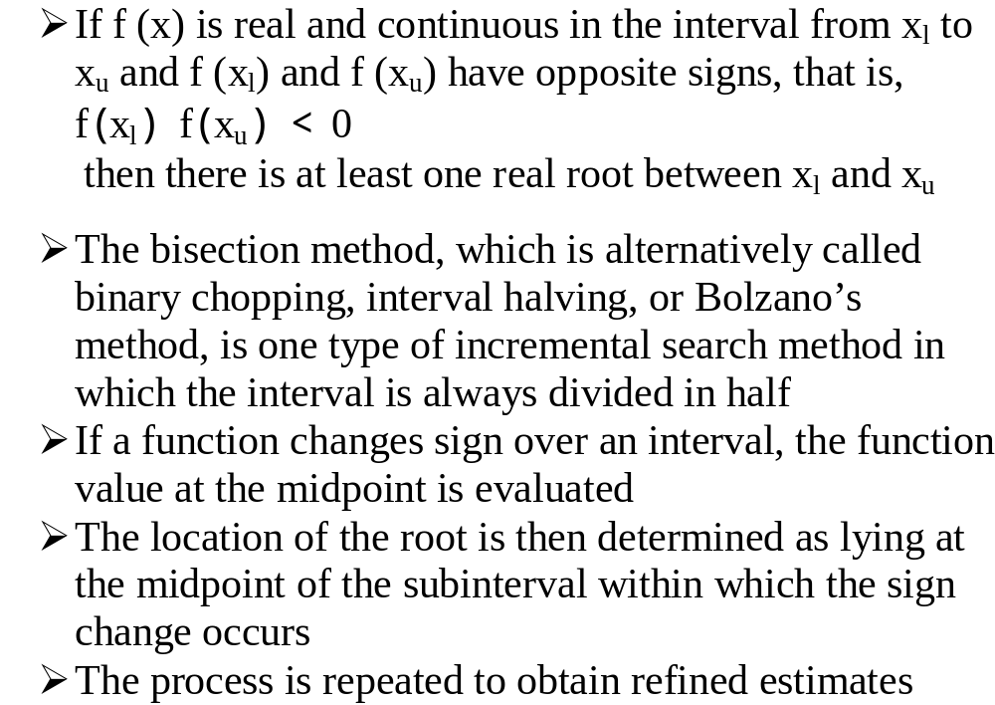
THE BISECTION METHOD

Slide 22
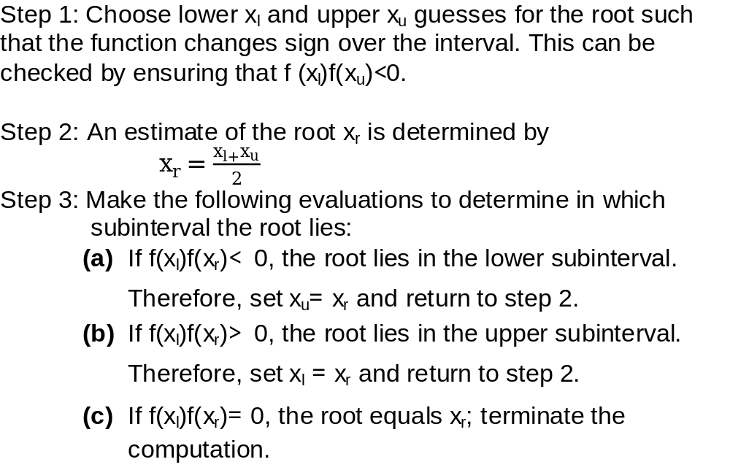
Algorithm for Bisection Method

Slide 23
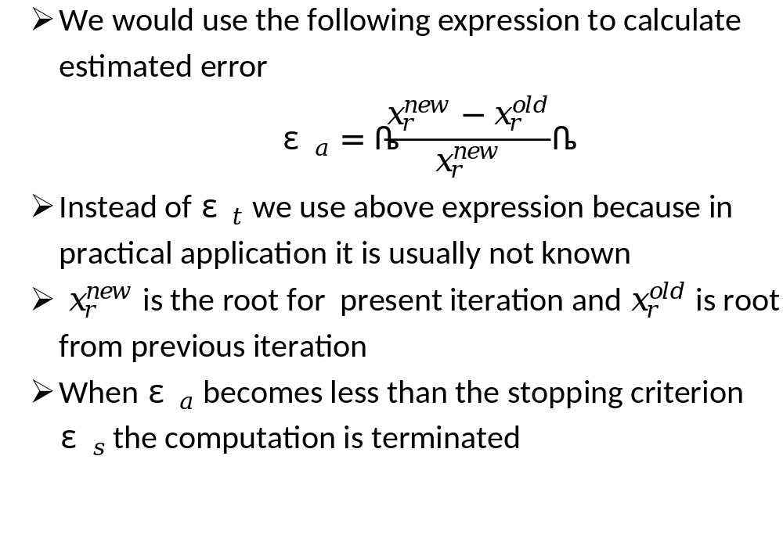
Termination Criteria and Error Estimates

Slide 24
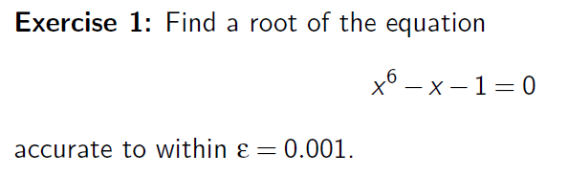
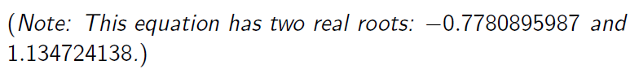
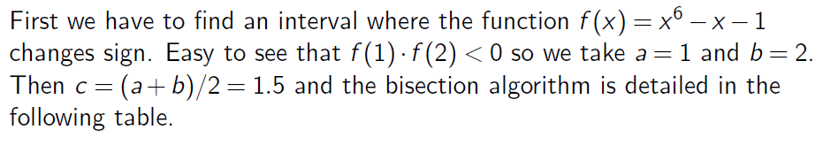
Example

Slide 25
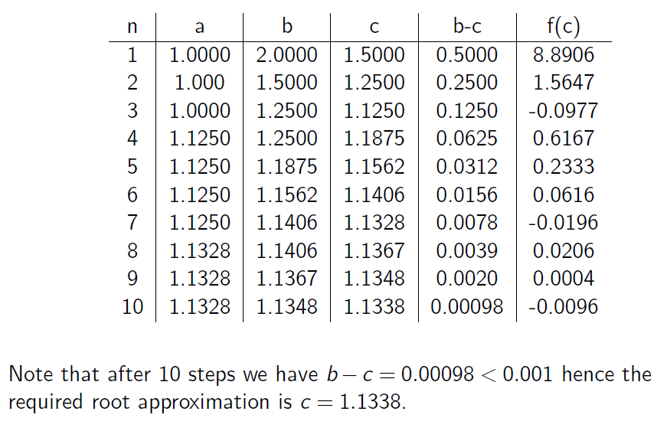
Example

Slide 26
Advantages and Disadvantages
The method is guaranteed to converge
The error bound decreases by half with each iteration
The bisection method converges very slowly
The bisection method cannot detect multiple roots

Slide 27
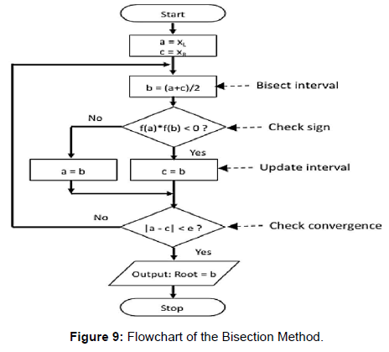
Flow Chart:

Slide 28
Algorithm:
Start
1. Decide initial values for x1 and x2 and stopping criterion, E.
2. Compute f1 = f(x1) and f2 = f(x2).
If f1 * f2>0, x1 and x2 do not bracket any root and go to step 7;
Otherwise continue.
Compute x0 = (x1+x2)/2 and compute f0 = f(x0)
If f1*f0 < 0 then
set x2 = x0
else
set x1 = x0
set f1 = f0
If absolute value of (x2 – x1)/x2 is less than error E, then
root = (x1 + x2)/2
write the value of root
go to step 7
else
go to step 4
7. Stop.

Slide 29
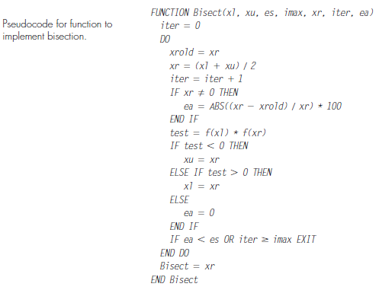

Slide 30
Newton Raphson Method

Slide 31
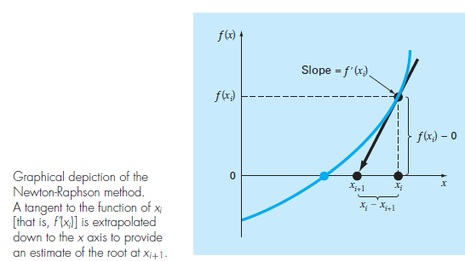
NEWTON-RAPHSON METHOD

Slide 32
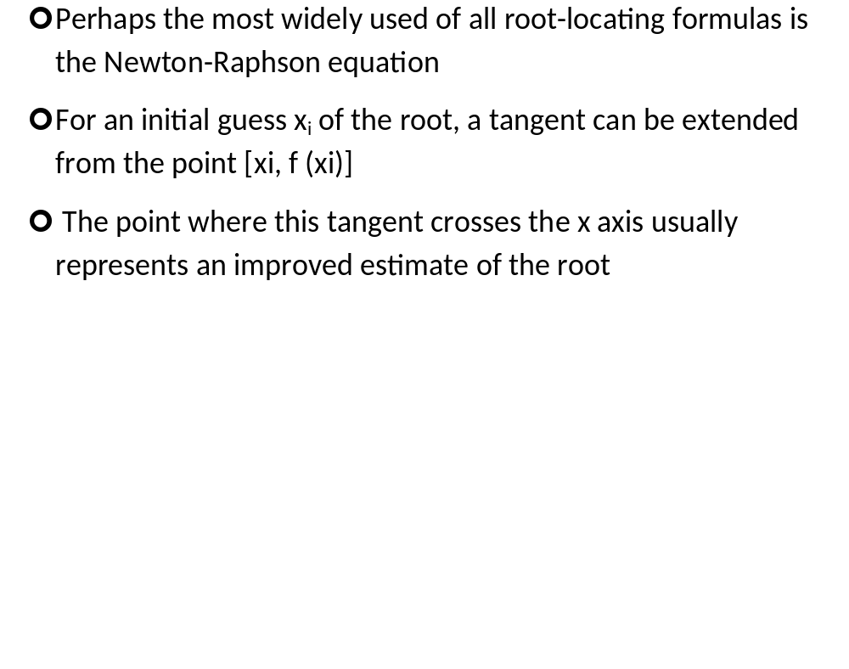
NEWTON-RAPHSON METHOD

Slide 33
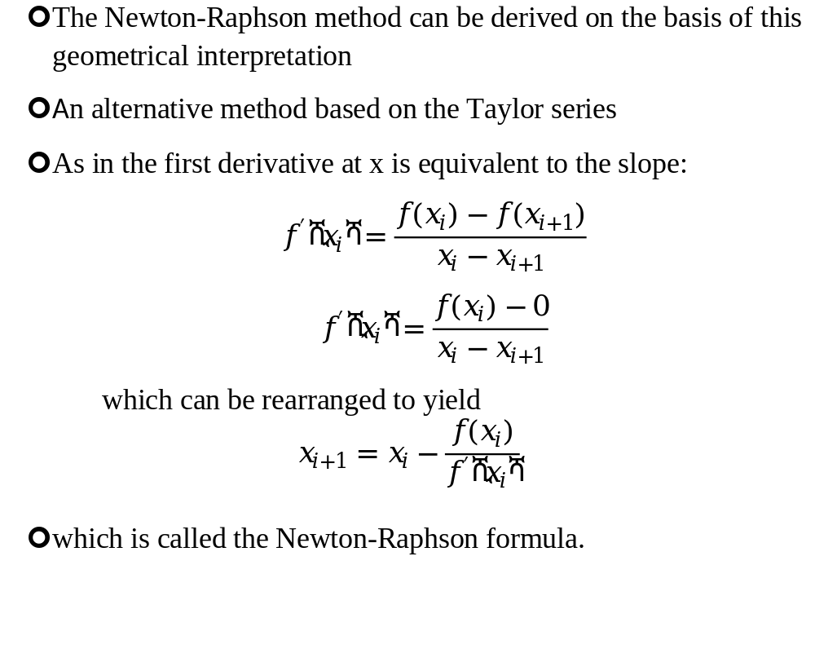
NEWTON-RAPHSON METHOD

Slide 34
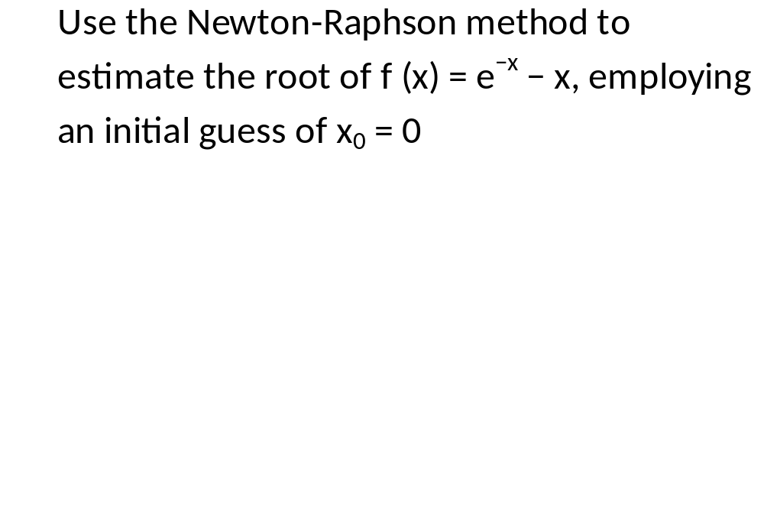
Exercise

Slide 35
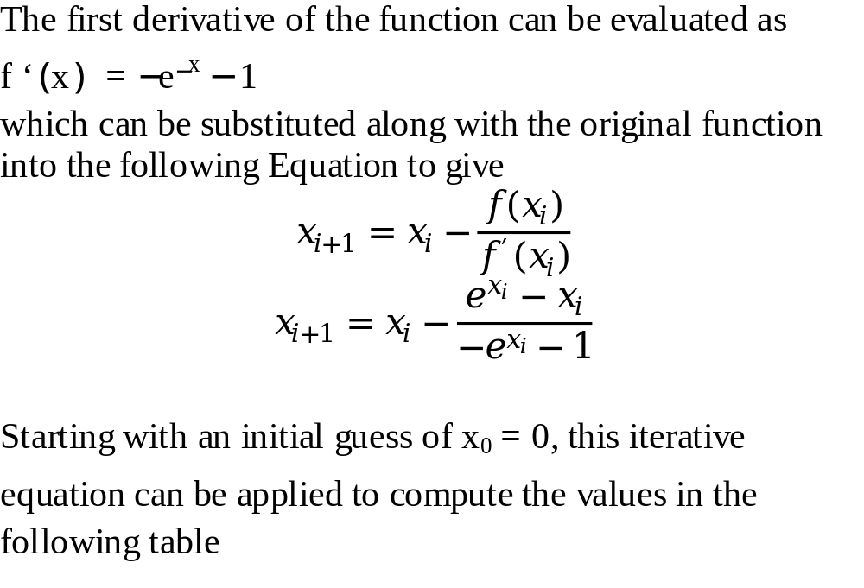
Solution

Slide 36
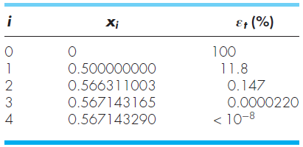
Solution Cont.

Slide 37
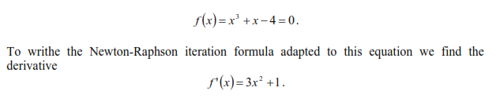

Slide 38
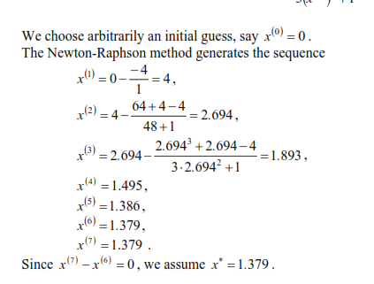

Slide 39
Pitfalls of the Newton-Raphson Method
Although the Newton-Raphson method is often very efficient, there are situations where it performs poorly
Besides performing poorly in case of multiple roots difficulties can also arise even when dealing with simple roots

Slide 40
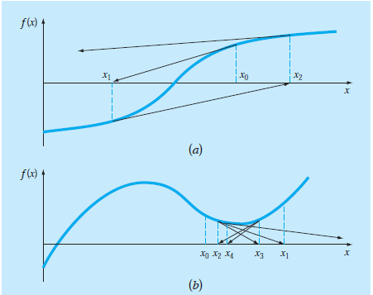
Pitfalls of the Newton-Raphson Method
Fig. a depicts the case where an inflection point [that is, f (x) = 0] occurs in the vicinity of a root and figure b illustrates the tendency of the Newton-Raphson technique to oscillate around a local maximum or minimum

Slide 41
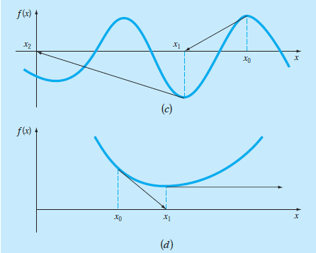
Pitfalls of the Newton-Raphson Method
Figure c shows how an initial guess that is close to one root can jump to a location several roots away and Fig. d shows a zero slope case

Slide 42
Algorithm for Newton-Raphson
An algorithm for the Newton-Raphson method is readily obtained by using Newton-Raphson Formula that we derived
The computer program must compute the first derivative
This can be simply accomplished by the inclusion of a user-defined function

Slide 43
Algorithm for Newton-Raphson
The program would be improved by incorporating several additional features:
  A plotting routine should be included in the program
  At the end of the computation, the final root estimate should always be substituted into the original function to compute whether the result is close to zero. This check partially guards against those cases where slow or oscillating convergence may lead to a small value of ε_{a} while the solution is still far from a root.

Slide 44
Algorithm for Newton-Raphson
  The program should always include an upper limit on the number of iterations to guard against oscillating, slowly convergent, or divergent solutions that could persist interminably.
  The program should alert the user and take account of the possibility that f’(x) might equal zero at any time during the computation.

Slide 45
Secent Method

Slide 46
THE SECANT METHOD
A potential problem in implementing the Newton-Raphson method is the evaluation of the derivative
Although this is not inconvenient for polynomials and many other functions, there are certain functions whose derivatives may be extremely difficult or inconvenient to evaluate

Slide 47
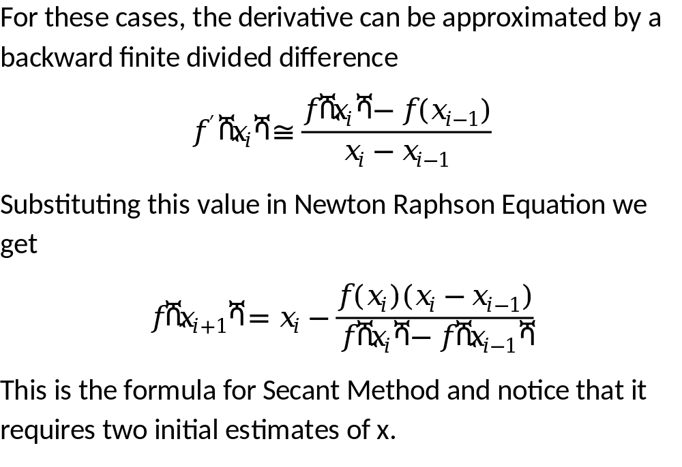
THE SECANT METHOD

Slide 48
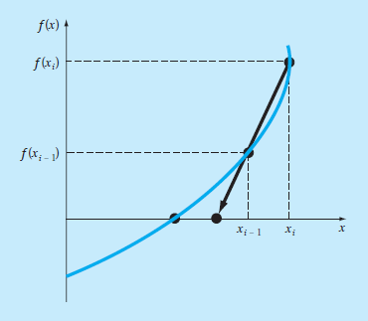
Graphical Depiction of Secant Method

Slide 49
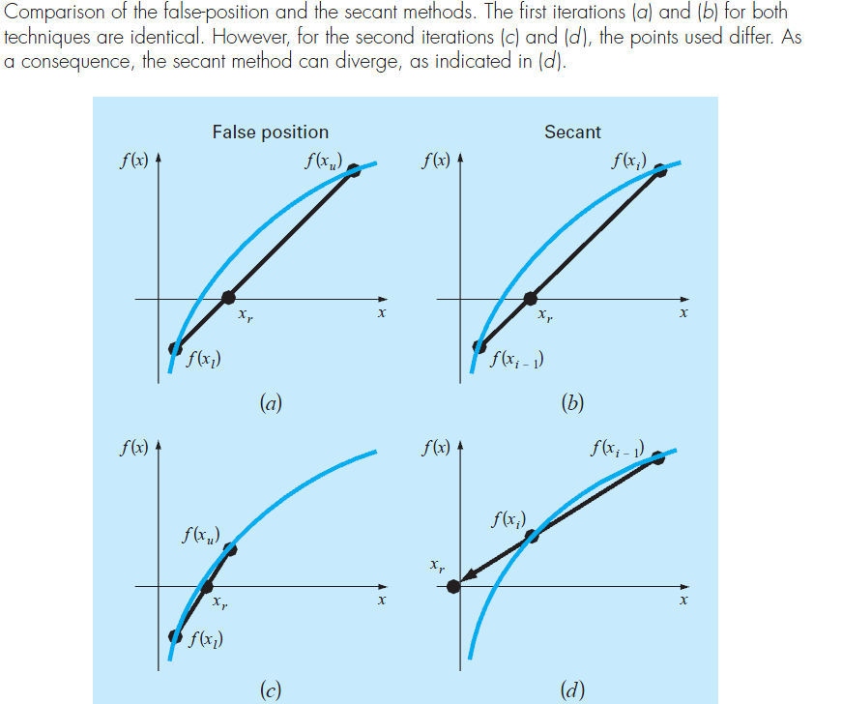
The Difference Between the Secant and False-Position Methods
.

Slide 50
The secant method applied to f(x) = cos(x) + 2 sin(x) + x².
n x_{n − 1} x_{n} x_{n + 1} |f(x_{n + 1})| |x_{n + 1} - x_{n}|
1 0.0 -0.1 -0.5136 0.1522 0.4136
2 -0.1 -0.5136 -0.6100 0.0457 0.0964
3 -0.5136 -0.6100 -0.6514 0.0065 0.0414
4 -0.6100 -0.6514 -0.6582 0.0013 0.0068
5 -0.6514 -0.6582 -0.6598 0.0006 0.0016
6 -0.6582 -0.6598 -0.6595 0.0002 0.0003

Slide 51
Regula False Method

Slide 52
False position is another bracketing method based on a graphical insight
A shortcoming of the bisection method is that, in dividing the interval from x_{l} to x_{u} into equal halves, no account is taken of the magnitudes of f (x_{l}) and f (x_{u})
False position technique joins f (x_{l}) and f (x_{u}) by a straight line
The intersection of this line with the x axis represents an improved estimate of the root
The fact that the replacement of the curve by a straight line gives a “false position” of the root is the origin of the name, method of false position, or in Latin, regula falsi
It is also called the linear interpolation method

Slide 53
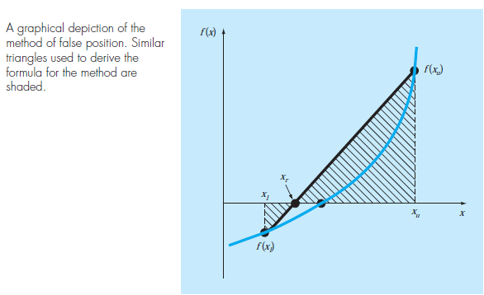

Slide 54
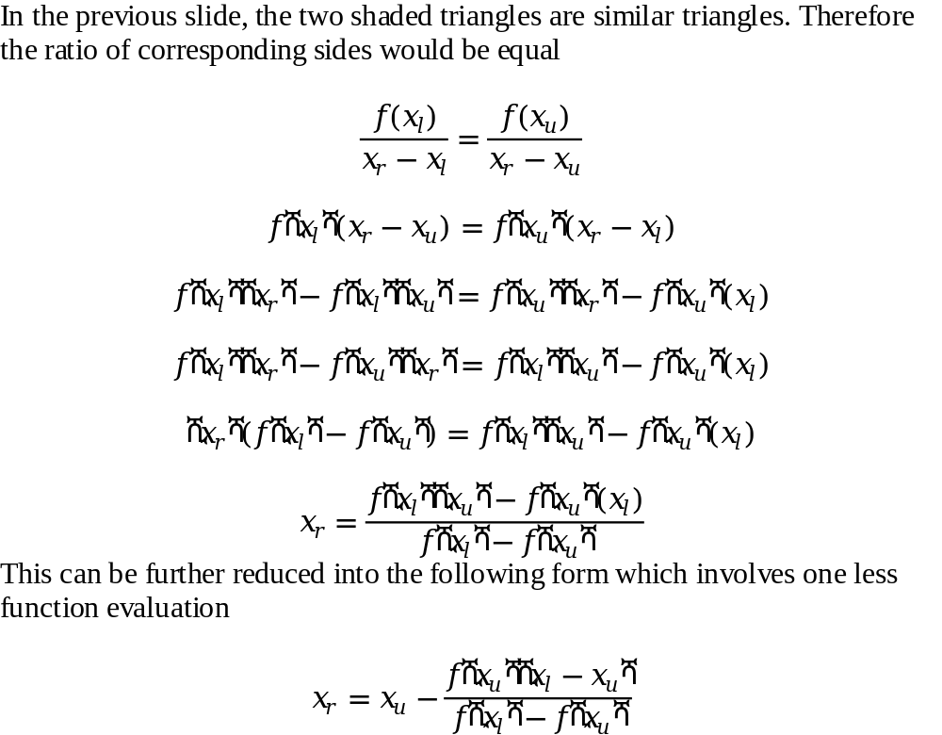
Derivation of the Method of False Position

Slide 55
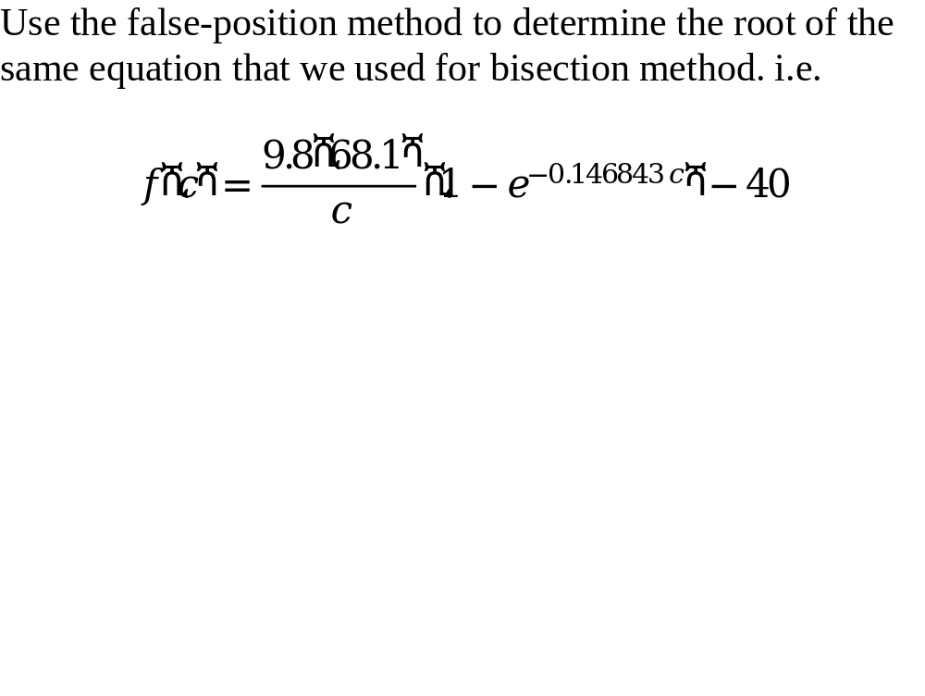
Example

Slide 56
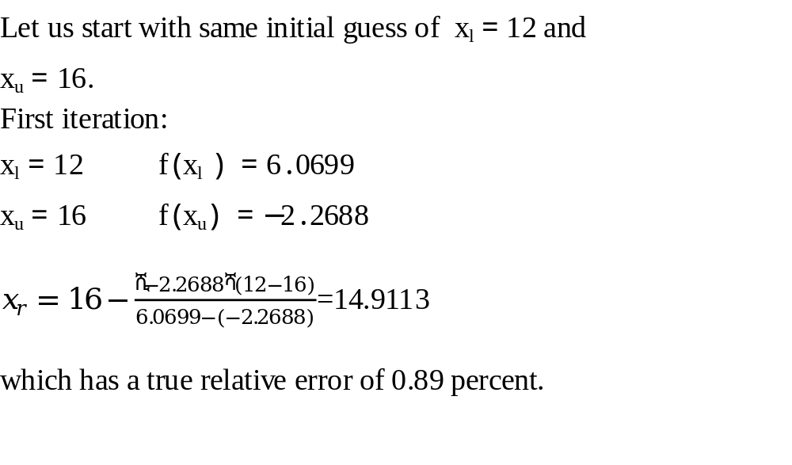

Slide 57
Properties
Usually false-position method would converge faster than the bisection method
There are cases where it performs poorly
The following example illustrates cases where bisection yields superior results

Slide 58
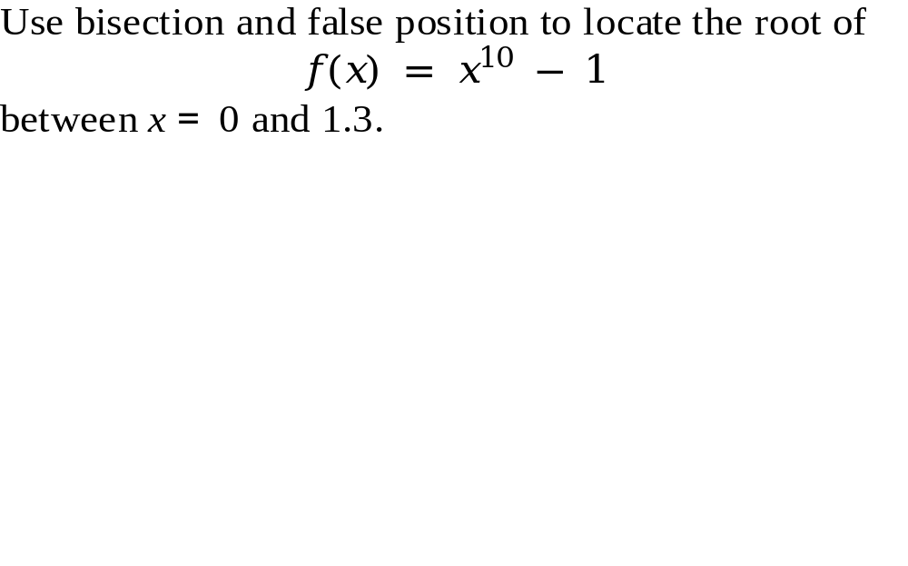
Example

Slide 59
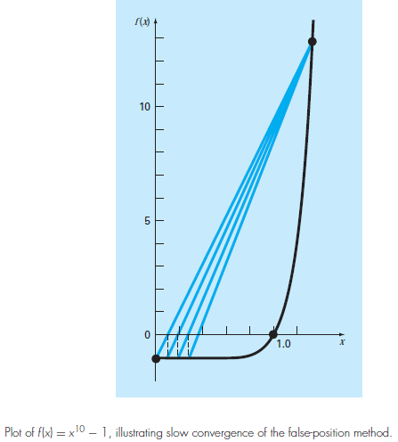

Slide 60
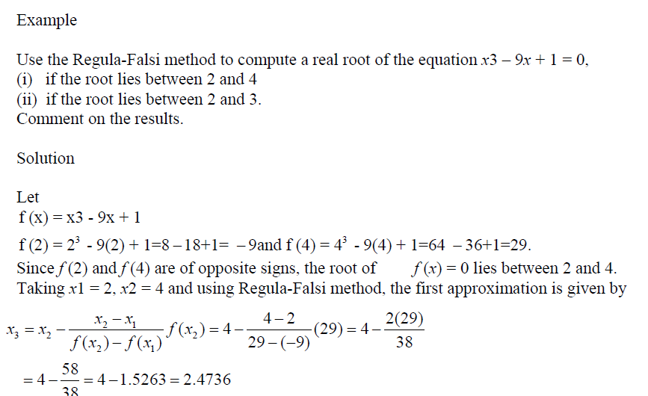

Slide 61
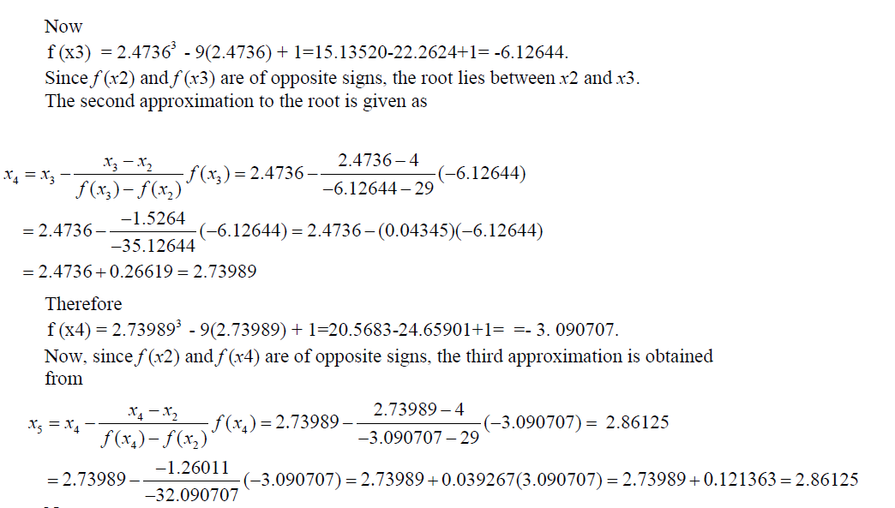

Slide 62
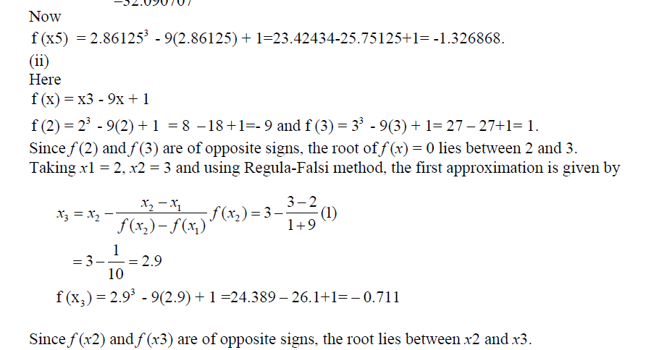

Slide 63
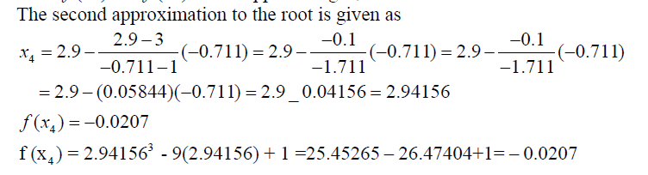
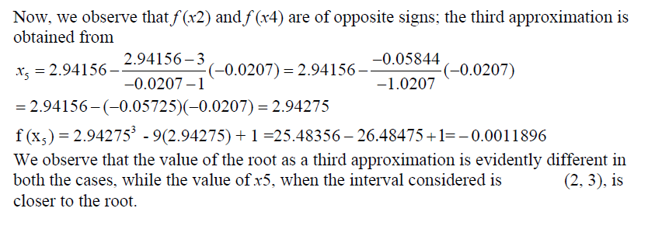

Slide 64
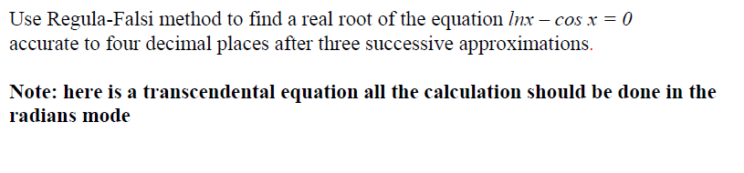
Example

Slide 65
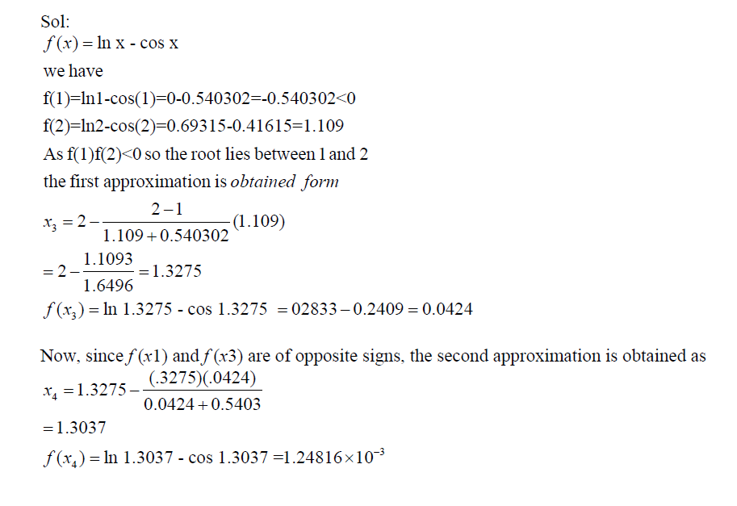
Example

Slide 66


Slide 67


Slide 68

Example

Slide 69


Slide 70
Thank You

