Slide 1
GUI based implementation & Comparison Of Root Finding Methods
Project NC-103747
Shams Ur Rehman : 9347
Muhammad Ali : 9363

Slide 2
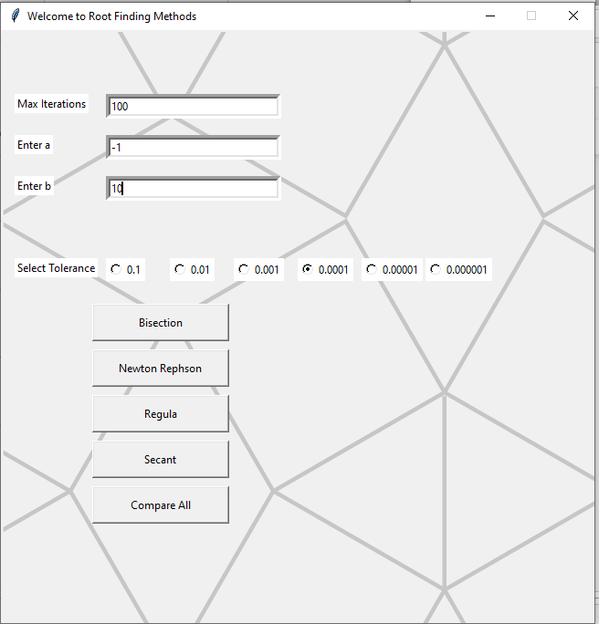


Slide 3
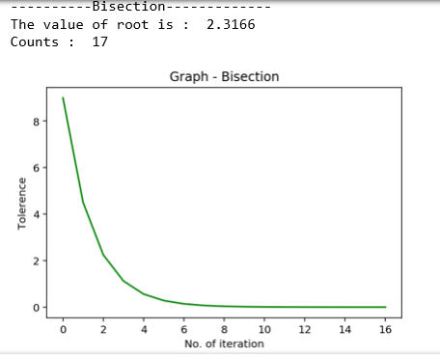
Bisection Method

Slide 4
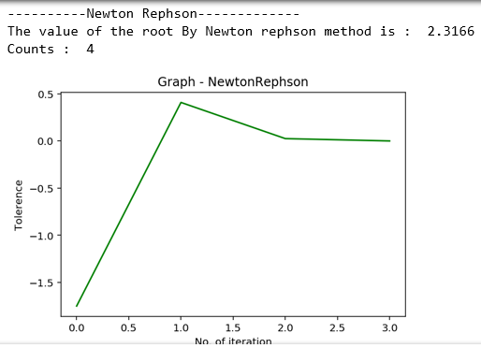
Newton Methods

Slide 5
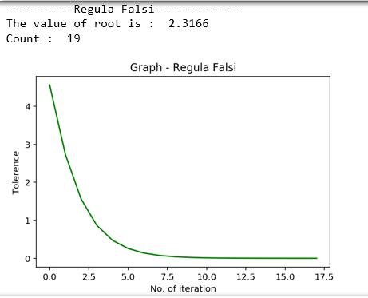
Regula Falsi

Slide 6
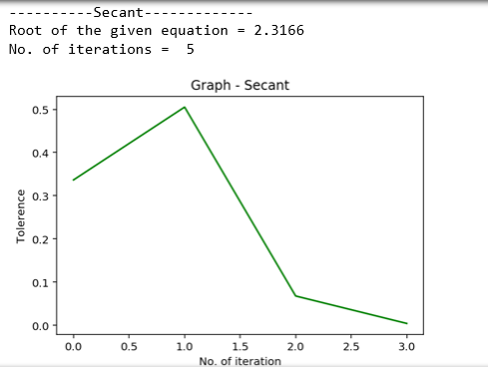
Secant Method

Slide 7
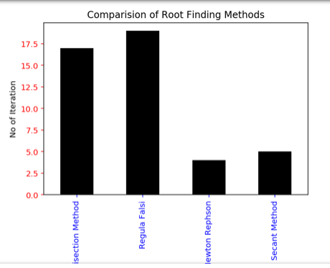
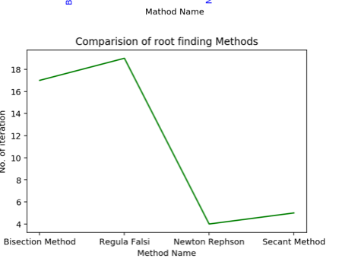
Comparing All Methods

