Slide 1
Numerical Computing Project Presentation
Project Name:
Implementation (GUI Based) , Graphical Representation & Comparison of Numerical Methods For Finding The Roots Of A Function
Language : Python
Name | SID | CID
Shams Ur Rehman | 9347 | 103747
Muhammad Ali | 9363 | 103747

Slide 2

Implemented All Root Finding Methods

Slide 3
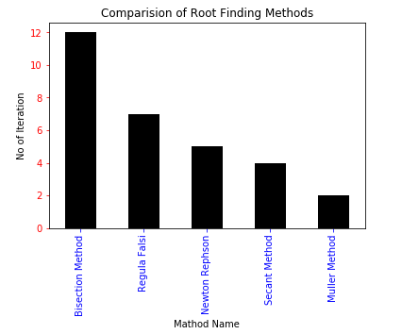
Implemented Comparisons Of Different Root Finding Methods

Slide 4
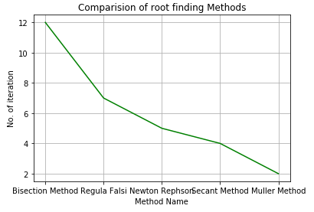
Implemented Comparisons Of Different Root Finding Methods

Slide 5
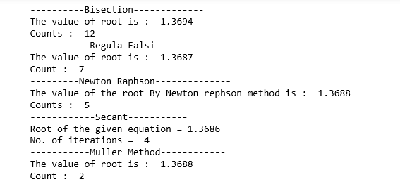
Implemented Comparisons Of Different Root Finding Methods

Slide 6
Numerical methods for finding the roots of a function
The roots of a function f (x) are defined as the values for which the value of the function becomes equal to zero. So, finding the roots of f (x) means solving the equation
f (x) = 0.

Slide 7
Definition: The equation f (x) = 0 is called an algebraic, if it is purely a polynomial in x;
it is a transcendental if f (x) contains trigonometric, exponential or logarithmic functions

Slide 8

Bisection Method

Slide 9
To find the solution of an equation f (x) = 0, we find those values of x for which
f (x) = 0
is satisfied.
Such values of x are called the roots of
f (x) = 0.
Thus a is a root of an equation f (x) = 0, if and only if, f (a) = 0.

Slide 10
Numerical methods for solving either a transcendental equation or an algebraic equation are classified into two groups:
Direct methods, which require no knowledge of the initial approximation of a root of the equation f (x) = 0.
Iterative methods, require first approximation to initiate iteration.

Slide 11
Analytical method
This method is based on ‘intermediate value property’.

Slide 12
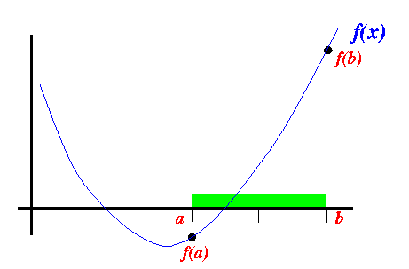
Introduction

Slide 13
Hence, in analytical method, we must always start with an initial interval (a, b), so that f (a) and f (b) have opposite signs.

Slide 14
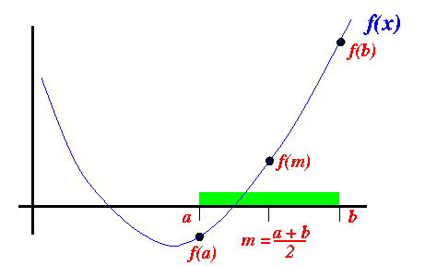
Introduction

Slide 15
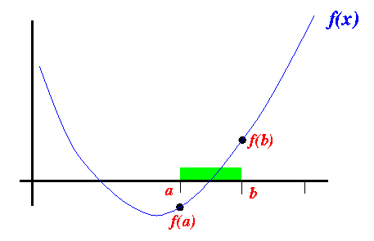
Introduction

Slide 16
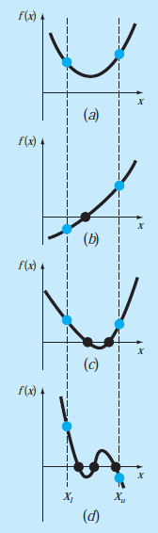
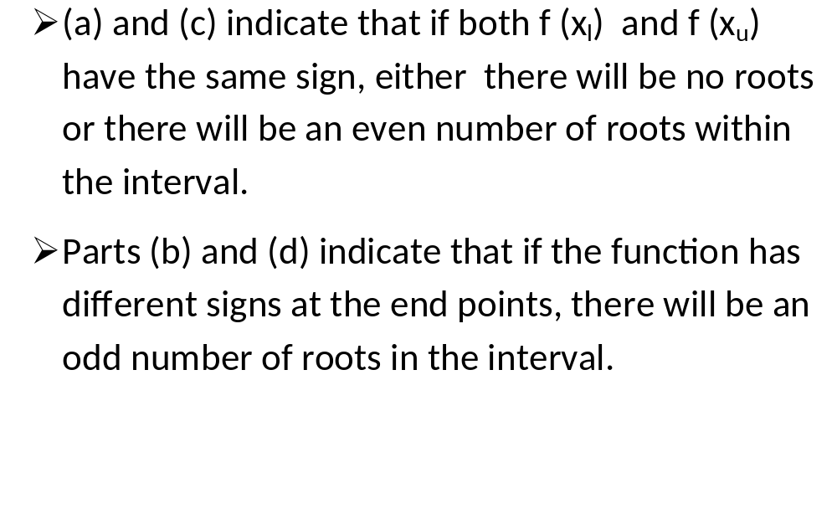
THE BISECTION METHOD
Nasir Uddin Spring 2016

Slide 17
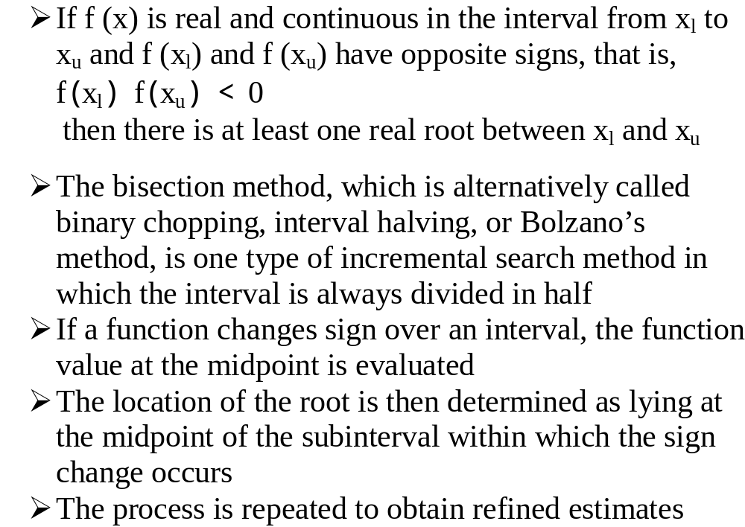
THE BISECTION METHOD

Slide 18
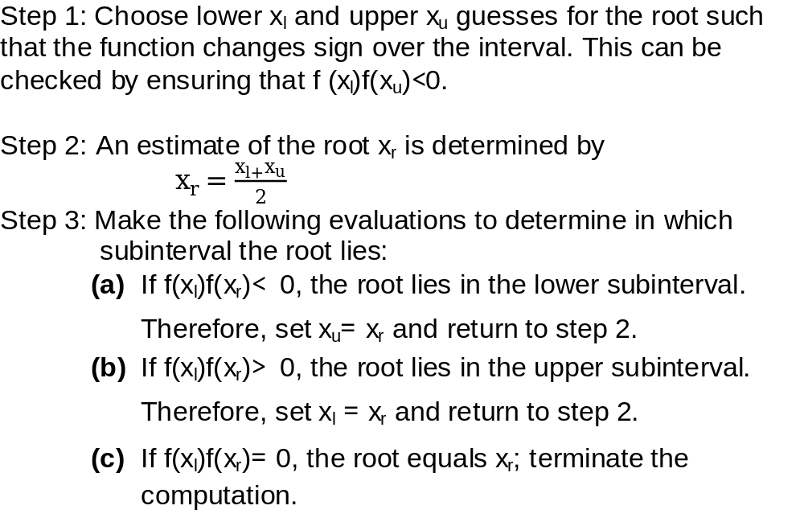
Algorithm for Bisection Method

Slide 19
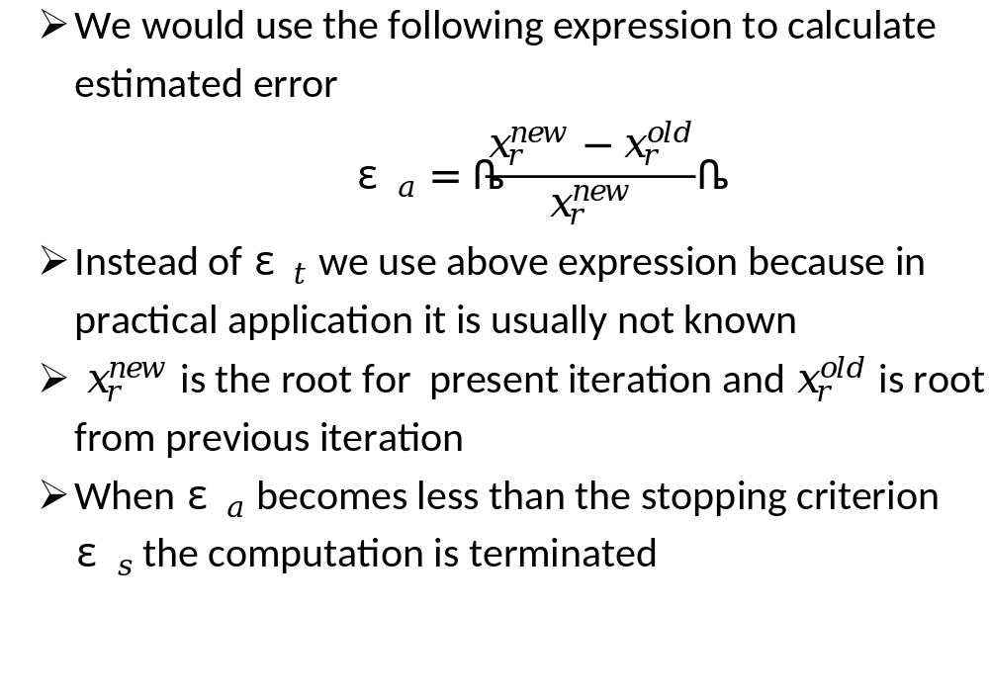
Termination Criteria and Error Estimates

Slide 20
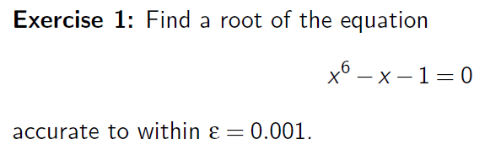
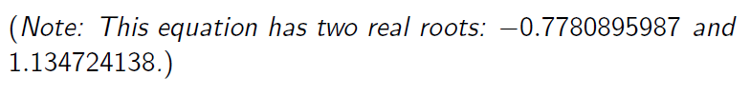
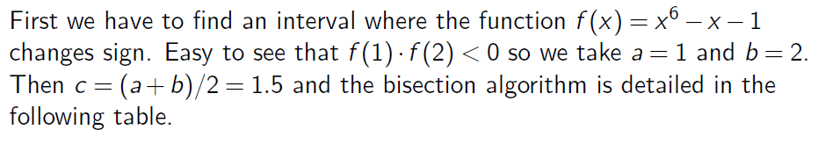
Example

Slide 21
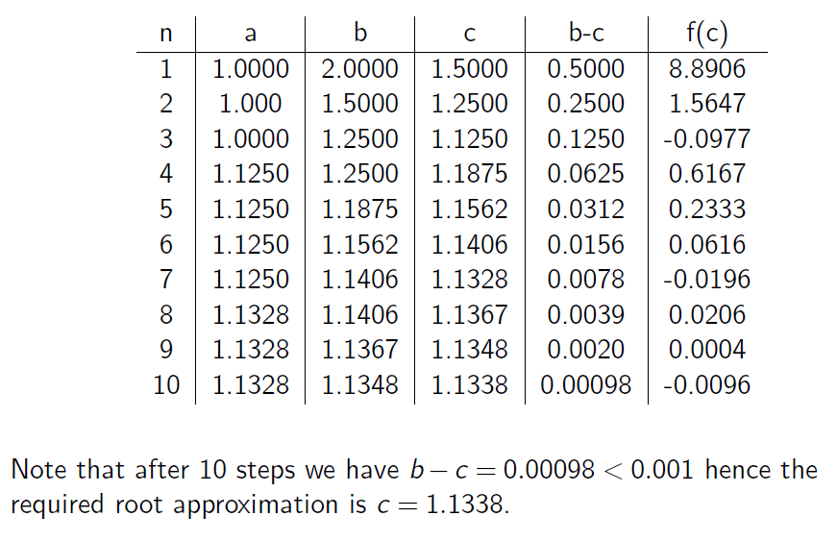
Example

Slide 22
Advantages and Disadvantages
The method is guaranteed to converge
The error bound decreases by half with each iteration
The bisection method converges very slowly
The bisection method cannot detect multiple roots

Slide 23
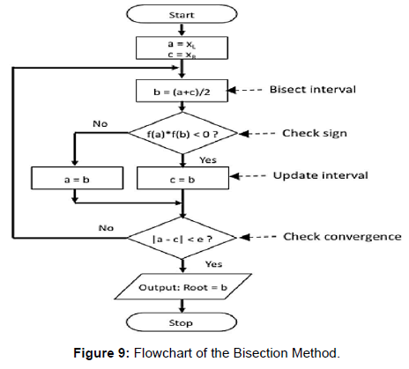
Flow Chart:

Slide 24
Algorithm:
Start
1. Decide initial values for x1 and x2 and stopping criterion, E.
2. Compute f1 = f(x1) and f2 = f(x2).
If f1 * f2>0, x1 and x2 do not bracket any root and go to step 7;
Otherwise continue.
Compute x0 = (x1+x2)/2 and compute f0 = f(x0)
If f1*f0 < 0 then
set x2 = x0
else
set x1 = x0
set f1 = f0
If absolute value of (x2 – x1)/x2 is less than error E, then
root = (x1 + x2)/2
write the value of root
go to step 7
else
go to step 4
7. Stop.

Slide 25
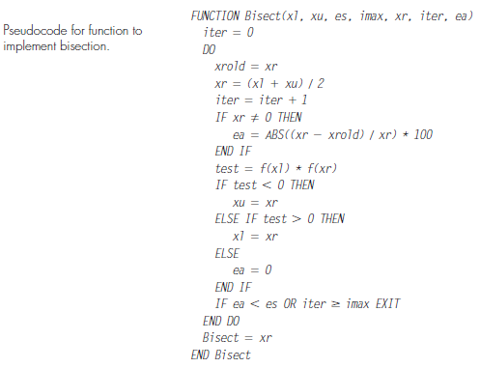

Slide 26
Newton Raphson Method

Slide 27
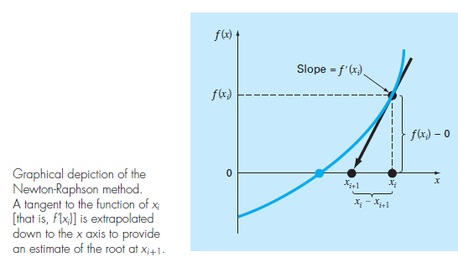
NEWTON-RAPHSON METHOD

Slide 28
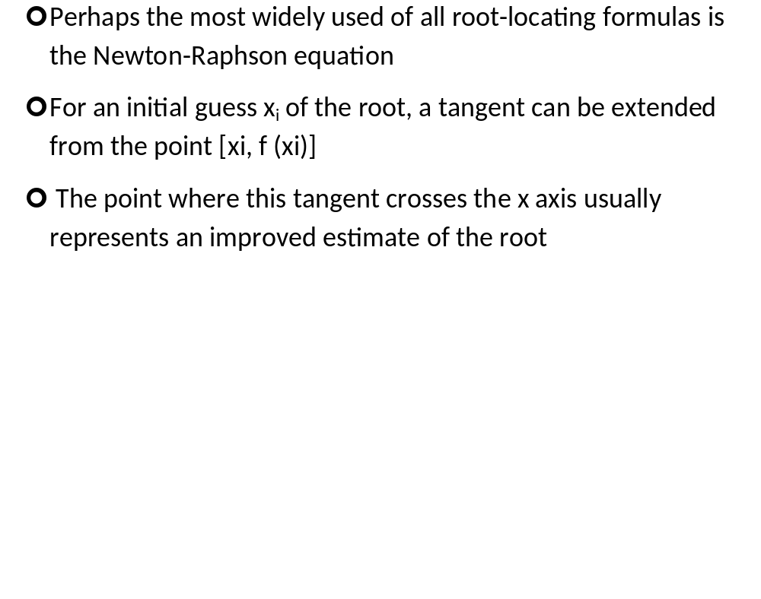
NEWTON-RAPHSON METHOD

Slide 29
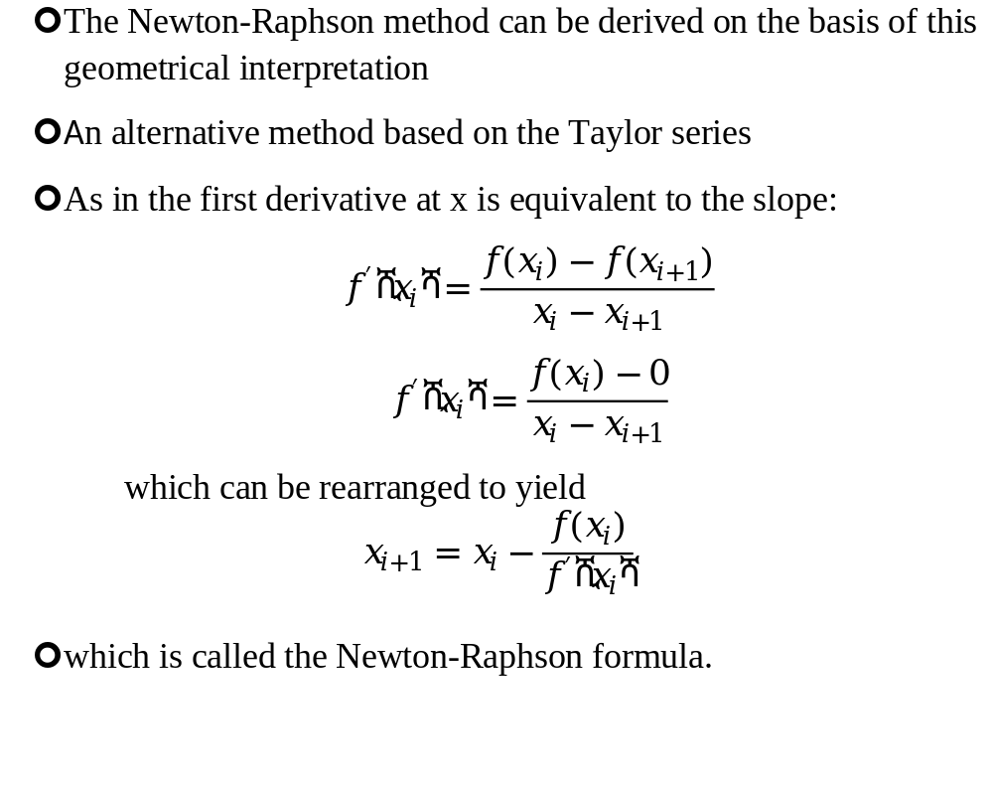
NEWTON-RAPHSON METHOD

Slide 30
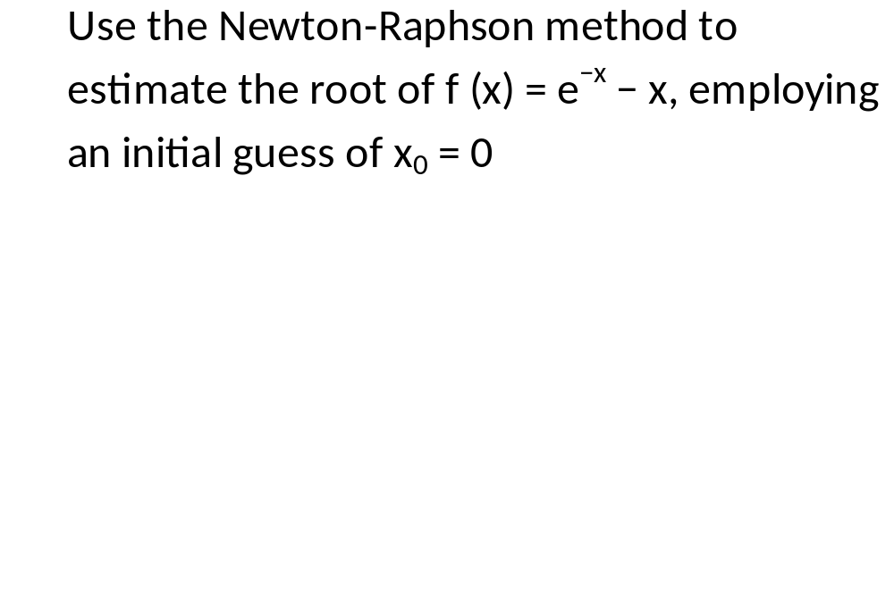
Exercise

Slide 31
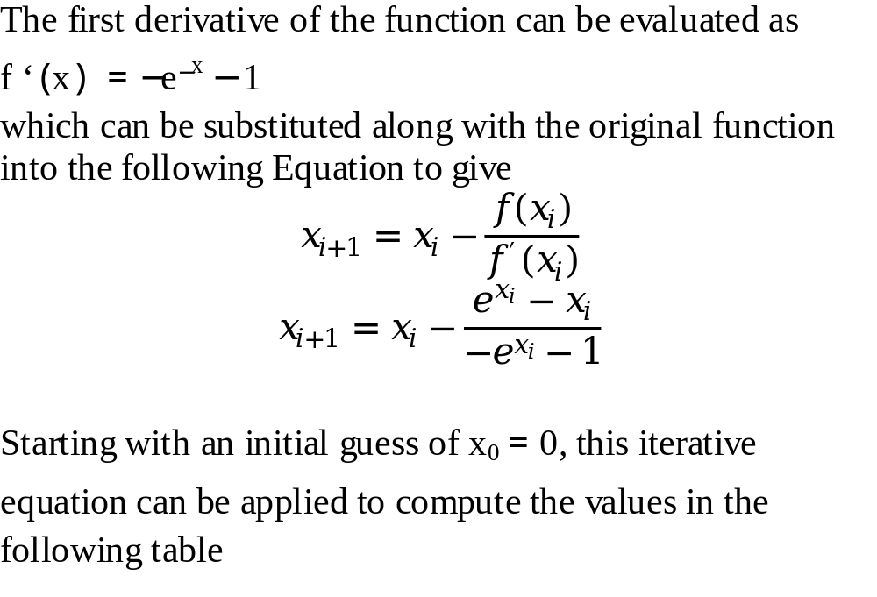
Solution

Slide 32
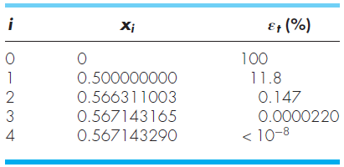
Solution Cont.

Slide 33
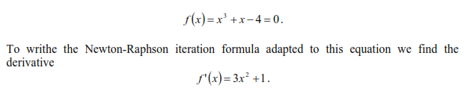

Slide 34
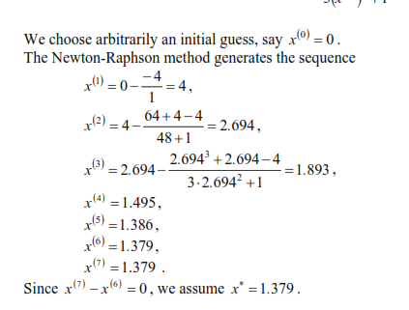

Slide 35
Pitfalls of the Newton-Raphson Method
Although the Newton-Raphson method is often very efficient, there are situations where it performs poorly
Besides performing poorly in case of multiple roots difficulties can also arise even when dealing with simple roots

Slide 36
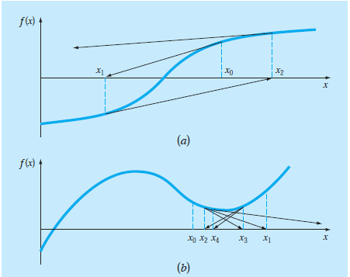
Pitfalls of the Newton-Raphson Method
Fig. a depicts the case where an inflection point [that is, f (x) = 0] occurs in the vicinity of a root and figure b illustrates the tendency of the Newton-Raphson technique to oscillate around a local maximum or minimum

Slide 37
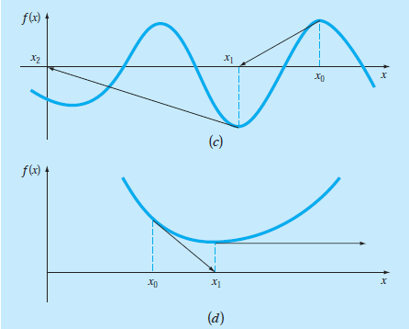
Pitfalls of the Newton-Raphson Method
Figure c shows how an initial guess that is close to one root can jump to a location several roots away and Fig. d shows a zero slope case

Slide 38
Algorithm for Newton-Raphson
An algorithm for the Newton-Raphson method is readily obtained by using Newton-Raphson Formula that we derived
The computer program must compute the first derivative
This can be simply accomplished by the inclusion of a user-defined function

Slide 39
Algorithm for Newton-Raphson
The program would be improved by incorporating several additional features:
  A plotting routine should be included in the program
  At the end of the computation, the final root estimate should always be substituted into the original function to compute whether the result is close to zero. This check partially guards against those cases where slow or oscillating convergence may lead to a small value of ε_{a} while the solution is still far from a root.

Slide 40
Algorithm for Newton-Raphson
  The program should always include an upper limit on the number of iterations to guard against oscillating, slowly convergent, or divergent solutions that could persist interminably.
  The program should alert the user and take account of the possibility that f’(x) might equal zero at any time during the computation.

Slide 41
Secent Method

Slide 42
THE SECANT METHOD
A potential problem in implementing the Newton-Raphson method is the evaluation of the derivative
Although this is not inconvenient for polynomials and many other functions, there are certain functions whose derivatives may be extremely difficult or inconvenient to evaluate

Slide 43
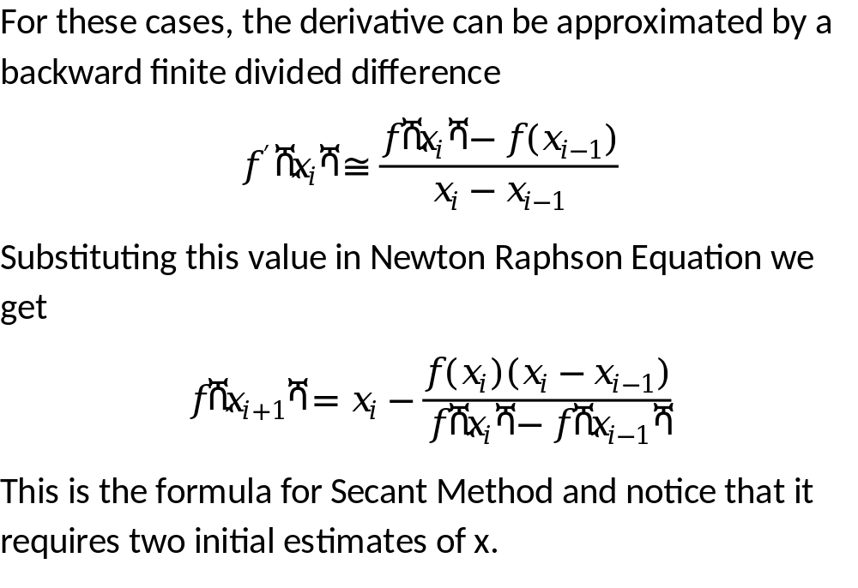
THE SECANT METHOD

Slide 44
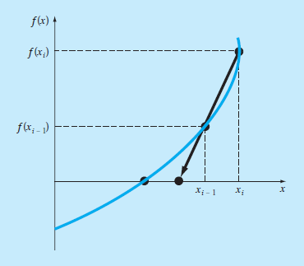
Graphical Depiction of Secant Method

Slide 45
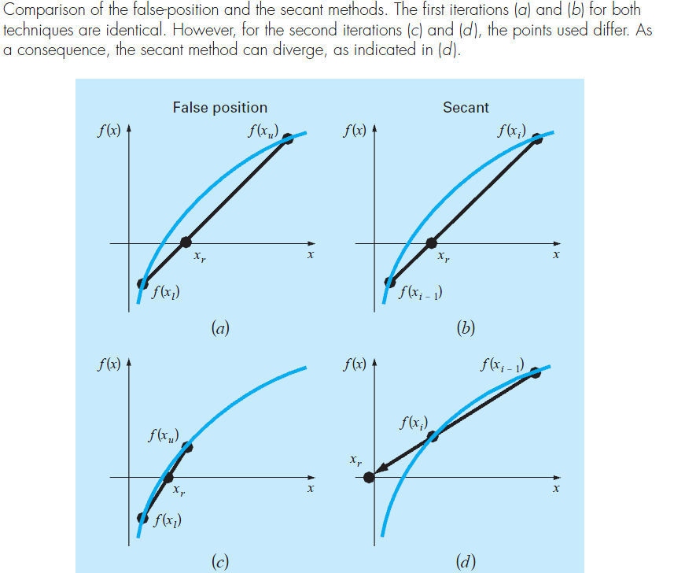
The Difference Between the Secant and False-Position Methods
.

Slide 46
The secant method applied to f(x) = cos(x) + 2 sin(x) + x².
n x_{n − 1} x_{n} x_{n + 1} |f(x_{n + 1})| |x_{n + 1} - x_{n}|
1 0.0 -0.1 -0.5136 0.1522 0.4136
2 -0.1 -0.5136 -0.6100 0.0457 0.0964
3 -0.5136 -0.6100 -0.6514 0.0065 0.0414
4 -0.6100 -0.6514 -0.6582 0.0013 0.0068
5 -0.6514 -0.6582 -0.6598 0.0006 0.0016
6 -0.6582 -0.6598 -0.6595 0.0002 0.0003

Slide 47
Regula False Method

Slide 48
False position is another bracketing method based on a graphical insight
A shortcoming of the bisection method is that, in dividing the interval from x_{l} to x_{u} into equal halves, no account is taken of the magnitudes of f (x_{l}) and f (x_{u})
False position technique joins f (x_{l}) and f (x_{u}) by a straight line
The intersection of this line with the x axis represents an improved estimate of the root
The fact that the replacement of the curve by a straight line gives a “false position” of the root is the origin of the name, method of false position, or in Latin, regula falsi
It is also called the linear interpolation method

Slide 49
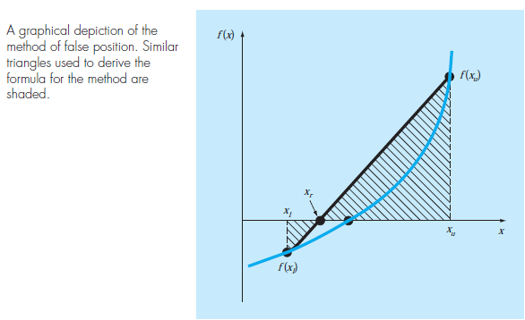

Slide 50
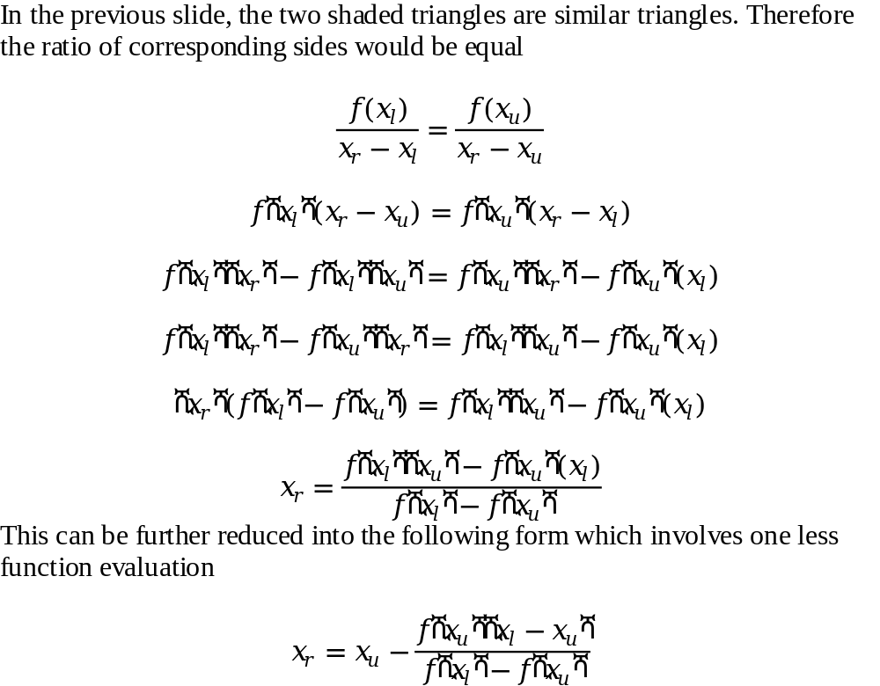
Derivation of the Method of False Position

Slide 51
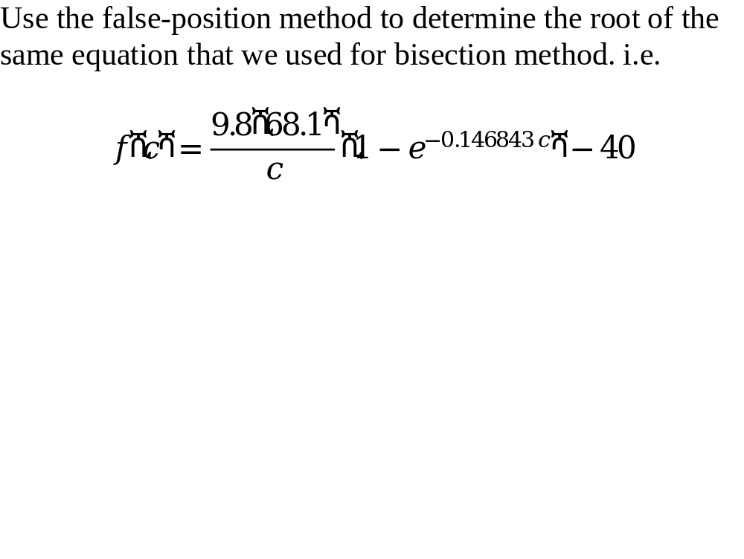
Example

Slide 52
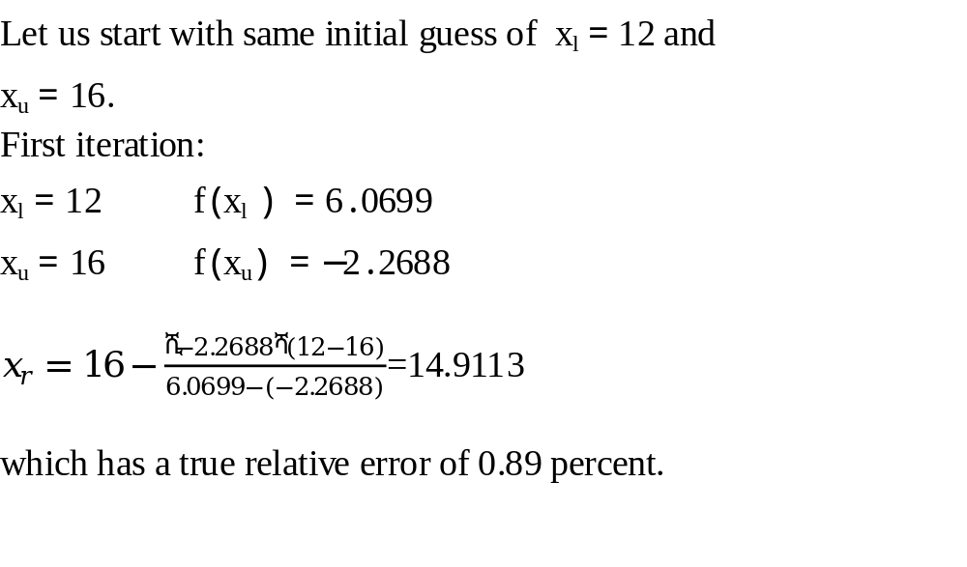

Slide 53
Properties
Usually false-position method would converge faster than the bisection method
There are cases where it performs poorly
The following example illustrates cases where bisection yields superior results

Slide 54
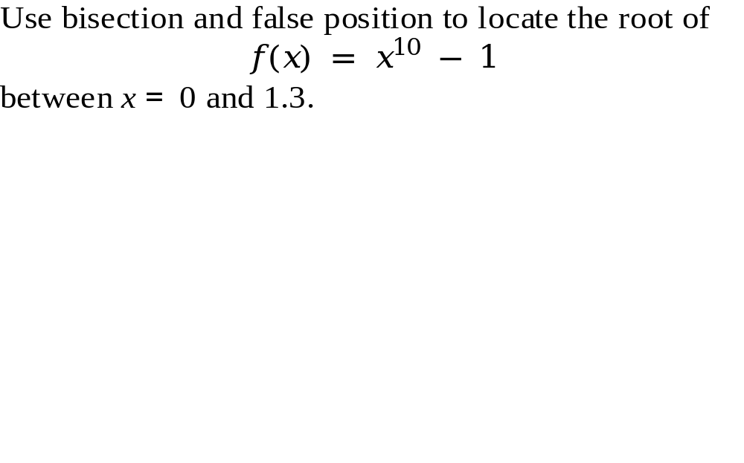
Example

Slide 55
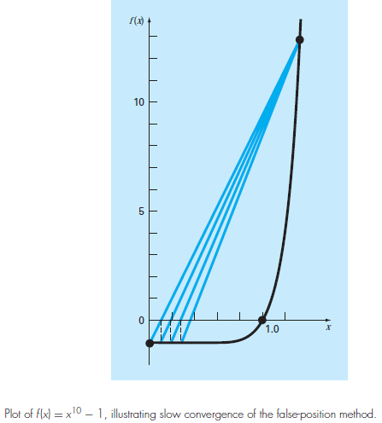

Slide 56
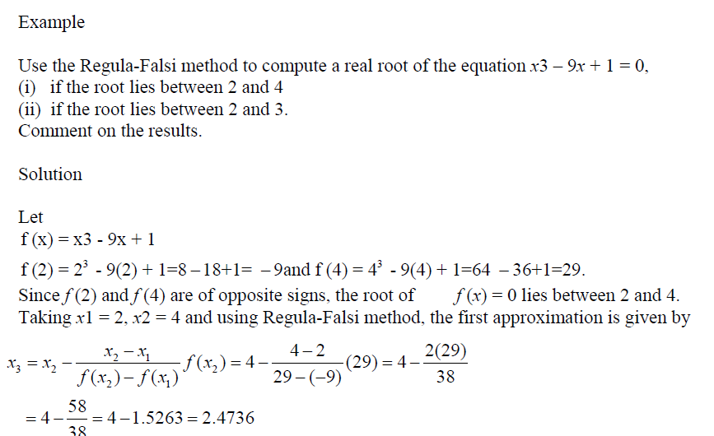

Slide 57
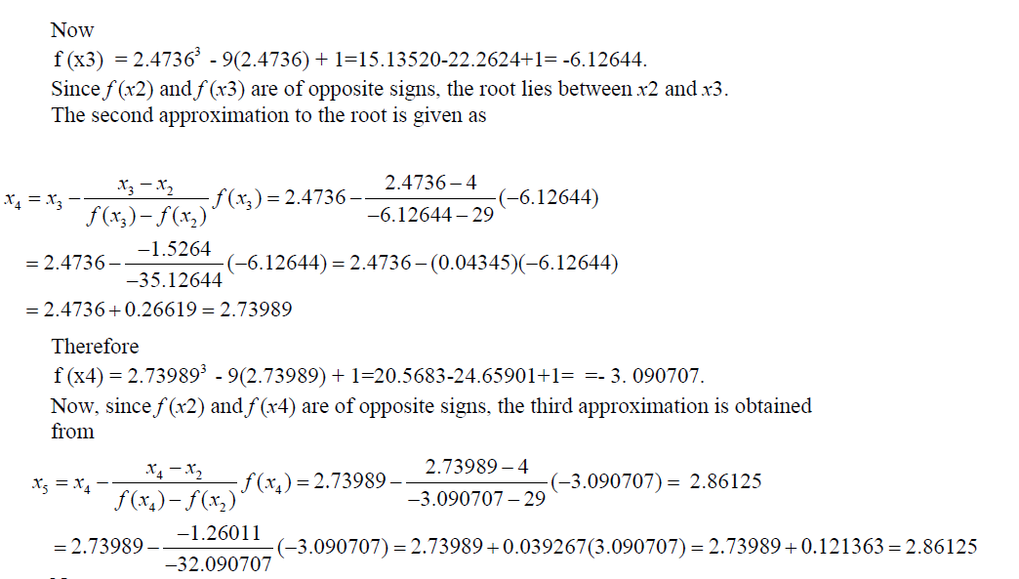

Slide 58
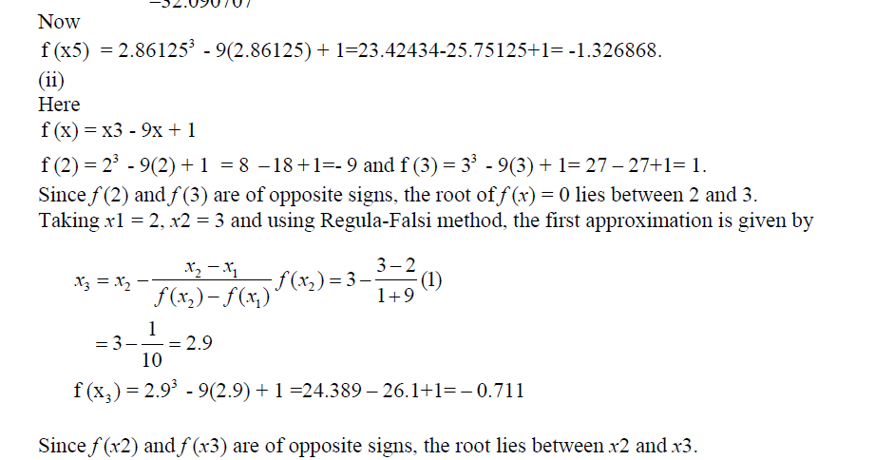

Slide 59
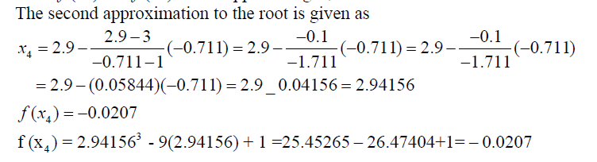
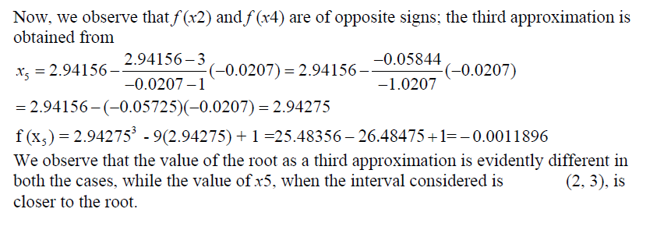

Slide 60
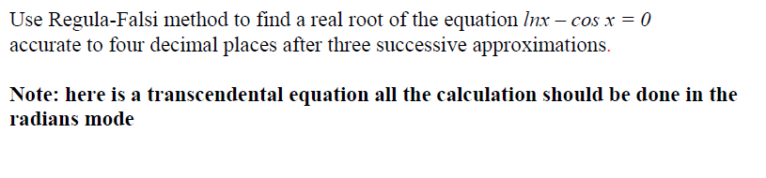
Example

Slide 61
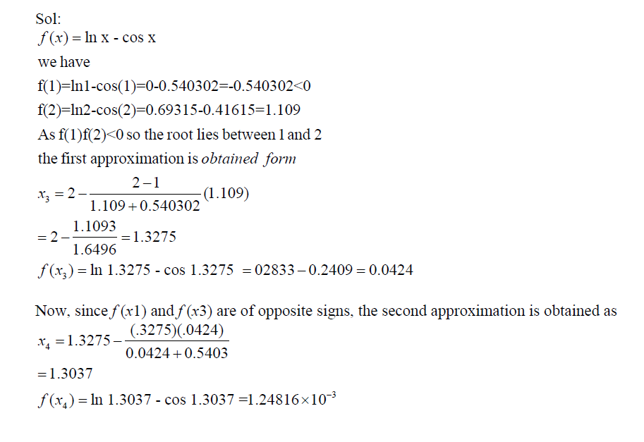
Example

Slide 62
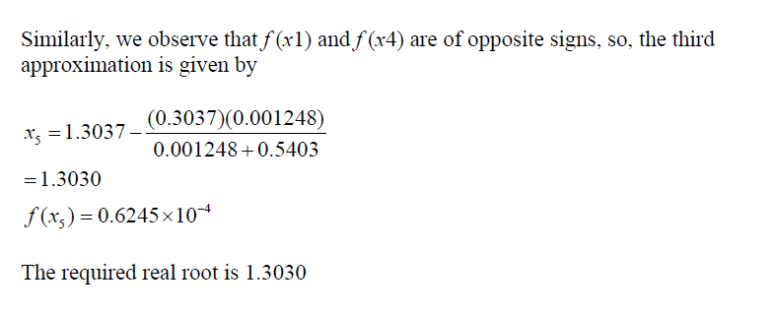

Slide 63
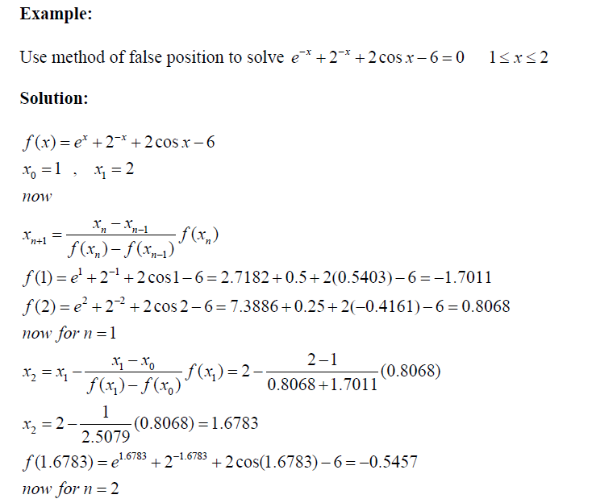

Slide 64
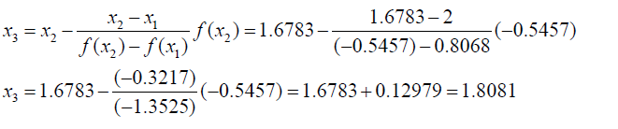
Example

Slide 65
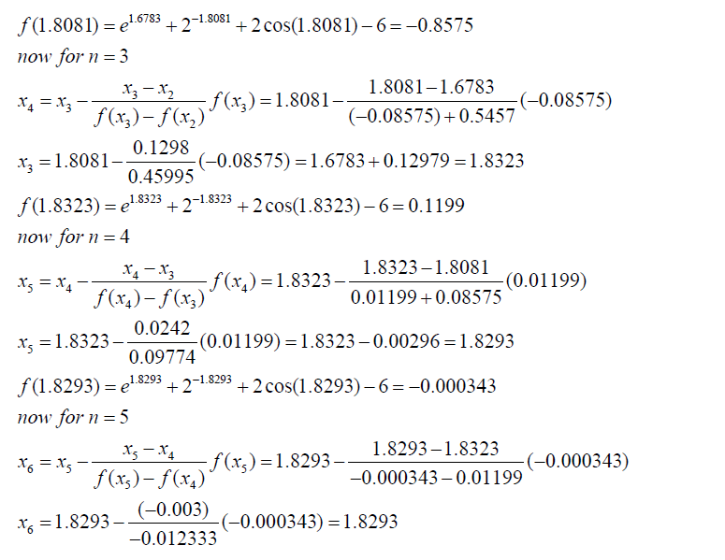

Slide 66
Project GUI Based Code
from tkinter import *
import numpy as np
import pandas as pd
import matplotlib.pyplot as plt
from IPython.core.display import HTML
from sympy import Symbol, Derivative
%matplotlib inline
%config InlineBackend.figure_format = 'retina'
window = Tk()
window.title("Welcome to Root Finding Methods")
window.geometry('650x650')
window.resizable(width=False, height=False)
bg_image = PhotoImage(file ="bg.png")
x = Label (image = bg_image)
x.grid(row = 0, column = 0)
selected = DoubleVar()
lsta=[]
lstb=[]
lstc=[]
lstfa=[]
lstfb=[]
lstfc=[]
lstca=[]
def bisection():
lsta=[]
lstb=[]
lstc=[]
lstfa=[]
lstfb=[]
lstfc=[]
lstca=[]
print("Its Bisection")
func=txt1.get()
a=txt2.get()
b=txt3.get()
c=(float(a)+float(b))/2
tolerance=selected.get()
BisectionIteration=[0]
function=""
for char in func:
if(char.isalpha()):
char=char.replace(char, a)
function=function+char
fa=eval(function)
function=""
for char in func:
if(char.isalpha()):
char=char.replace(char, b)
function=function+char
fb=eval(function)
function=""
for char in func:
if(char.isalpha()):
char=char.replace(char, str(c))
function=function+char
fc=eval(function)
lsta.append(a)
lstb.append(b)
lstc.append(c)
lstfa.append(fa)
lstfb.append(fb)
lstfc.append(fc)
lstca.append(float(c-float(a)))
while(abs(c-float(a))>=tolerance):
BisectionIteration.append(BisectionIteration[-1]+1)
if((fa*fc)>0):
a=c
lsta.append(a)
lstb.append(b)
else:
b=c
lstb.append(b)

Slide 67
lsta.append(a)
c=(float(a)+float(b))/2
lstc.append(c)
function=""
for char in func:
if(char.isalpha()):
char=char.replace(char, str(a))
function=function+char
fa=eval(function)
lstfa.append(fa)
function=""
for char in func:
if(char.isalpha()):
char=char.replace(char, str(b))
function=function+char
fb=eval(function)
lstfb.append(fb)
function=""
for char in func:
if(char.isalpha()):
char=char.replace(char, str(c))
function=function+char
fc=eval(function)
lstfc.append(fc)
lstca.append(float(c-float(a)))
BisectionFinalArray=np.array([lsta,lstb,lstc,lstfa,lstfb,lstfc,lstca])
#print(BisectionFinalArray)
table = pd.DataFrame({
'a':lsta,
'b':lstb,
'c':lstc,
'f(a)':lstfa,
'f(b)':lstfb,
'f(c)':lstfc,
'c-a':lstca,
})
display(HTML(table.to_html()))
plt.plot(BisectionIteration, lstca, label="Bisection");
plt.legend()
plt.xlabel("Iteration Number")
plt.ylabel("Error")
plt.show()
def regula():
lsta=[]
lstb=[]
lstc=[]
lstfa=[]
lstfb=[]
lstfc=[]
lstca=[]
print("Its Regula")
func=txt4.get()
a=txt5.get()
b=txt6.get()
guess=txt7.get()
tolerance=selected.get()
RegulaFalsiIteration=[0]
function=""
for char in func:
if(char.isalpha()):
char=char.replace(char, a)
function=function+char
fa=eval(function)
function=""
for char in func:
if(char.isalpha()):
char=char.replace(char, b)
function=function+char
fb=eval(function)
c=((float(b)*fa)-(float(a)*fb))/(fa-fb)
function=""
for char in func:
if(char.isalpha()):

Slide 68
char=char.replace(char, str(c))
function=function+char
fc=eval(function)
lsta.append(a)
lstb.append(b)
lstc.append(c)
lstfa.append(fa)
lstfb.append(fb)
lstfc.append(fc)
lstca.append(float(c-float(a)))
while(abs(c-float(guess))>=tolerance):
RegulaFalsiIteration.append(RegulaFalsiIteration[-1]+1)
guess=c
if((fa*fc)>0):
a=c
lsta.append(a)
lstb.append(b)
else:
b=c
lstb.append(b)
lsta.append(a)
function=""
for char in func:
if(char.isalpha()):
char=char.replace(char, str(a))
function=function+char
fa=eval(function)
lstfa.append(fa)
function=""
for char in func:
if(char.isalpha()):
char=char.replace(char, str(b))
function=function+char
fb=eval(function)
lstfb.append(fb)
c=((float(b)*fa)-(float(a)*fb))/(fa-fb)
lstc.append(c)
function=""
for char in func:
if(char.isalpha()):
char=char.replace(char, str(c))
function=function+char
fc=eval(function)
lstfc.append(fc)
lstca.append(float(c-float(a)))
RegulaFalsiFinalArray=np.array([lsta,lstb,lstc,lstfa,lstfb,lstfc,lstca])
#print(RegulaFalsiFinalArray)
table = pd.DataFrame({
'a':lsta,
'b':lstb,
'c':lstc,
'f(a)':lstfa,
'f(b)':lstfb,
'f(c)':lstfc,
'c-a':lstca,
})
display(HTML(table.to_html()))
plt.plot(RegulaFalsiIteration, lstca, label="Regula Falsi");
plt.legend()
plt.xlabel("Iteration Number")
plt.ylabel("Error")
plt.show()
def newton():
lsta=[]
lstb=[]
lstca=[]

Slide 69
print("Its newton")
func=txt11.get()
a=txt12.get()
tolerance=selected.get()
NewtonRophsonIteration=[0]
x = Symbol('x')
f = x**3+x-4
#f=str(f)
f_prime = f.diff(x)
#print(f_prime)
#deriv=float(a)-(float(func)/float(function))
function=""
for char in str(f):
if(char.isalpha()):
char=char.replace(char, a)
function=function+char
fa=eval(function)
function=""
for char in str(f_prime):
if(char.isalpha()):
char=char.replace(char, a)
function=function+char
fb=eval(function)
b=float(a)-(fa/fb)
lsta.append(a)
lstb.append(b)
lstca.append(b-float(a))
while(abs(b-float(a))>=tolerance):
NewtonRophsonIteration.append(NewtonRophsonIteration[-1]+1)
a=str(b)
function=""
#print(str(f))
for char in str(f):
if(char.isalpha()):
char=char.replace(char, a)
function=function+char
fa=eval(function)
#print(fa)
function=""
for char in str(f_prime):
if(char.isalpha()):
char=char.replace(char, a)
function=function+char
fb=eval(function)
b=float(a)-(fa/fb)
lsta.append(a)
lstb.append(b)
lstca.append(b-float(a))
NewtonRophsonFinalArray=np.array([lsta,lstb,lstca])
#print(NewtonRophsonFinalArray)
table = pd.DataFrame({
'Xi':lsta,
'Xi+1':lstb,
'(Xi+1)-(Xi)':lstca,
})
display(HTML(table.to_html()))
plt.plot(NewtonRophsonIteration,
lstca, label="Newton Rophson");
plt.legend()
plt.xlabel("Iteration Number")
plt.ylabel("Error")
plt.show()
def secant():
lsta=[]
lstb=[]
lstc=[]
lstca=[]
print("Its secant")
func=txt8.get()
a=txt9.get()
b=txt10.get()
tolerance=selected.get()
SecantIteration=[0]
function=""

Slide 70
for char in func:
if(char.isalpha()):
char=char.replace(char, a)
function=function+char
fa=eval(function)
function=""
for char in func:
if(char.isalpha()):
char=char.replace(char, b)
function=function+char
fb=eval(function)
c=float(b)-((fb*(float(b)-float(a)))/(fb-fa))
lsta.append(a)
lstb.append(b)
lstc.append(c)
lstca.append(float(c-float(b)))
while(abs(c-float(b))>=tolerance):
SecantIteration.append(SecantIteration[-1]+1)
c=float(b)-((fb*(float(b)-float(a)))/(fb-fa))
a=b
b=c
lsta.append(a)
lstb.append(b)
lstc.append(c)
function=""
for char in func:
if(char.isalpha()):
char=char.replace(char, str(a))
function=function+char
fa=eval(function)
function=""
for char in func:
if(char.isalpha()):
char=char.replace(char, str(b))
function=function+char
fb=eval(function)
lstca.append(float(c-float(b)))
SecantFinalArray=np.array([lsta,lstb,lstc,lstca])
#print(SecantFinalArray)
table = pd.DataFrame({
'Xi-1':lsta,
'Xi':lstb,
'Xi+1':lstc,
'(Xi+1)-(Xi)':lstca,
})
display(HTML(table.to_html()))
plt.plot(SecantIteration, lstca, label="Secant");
plt.legend()
plt.xlabel("Iteration Number")
plt.ylabel("Error")
plt.show()
lbl = Label(window, text="Root Finding Method",font=("Arlia",25))
lbl.place(x=150,y=15)
lbl.config(bg="white")
#Bisection GUI
lbl = Label(window, text="Enter Function")
lbl.place(x=15,y=70)
lbl.config(bg="white")
txt1 =Entry(window,bd=5,width="30")
txt1.place(x=115,y=70)
lbl = Label(window, text="Enter a")
lbl.place(x=15,y=115)

Slide 71
lbl.config(bg="white")
txt2 =Entry(window,bd=5,width="30")
txt2.place(x=115,y=115)
lbl = Label(window, text="Enter b")
lbl.place(x=15,y=160)
lbl.config(bg="white")
txt3 =Entry(window,bd=5,width="30")
txt3.place(x=115,y=160)
lbl = Label(window, text="Select Tolerance")
lbl.place(x=15,y=250)
lbl.config(bg="white")
rad1 = Radiobutton(window,text='0.1', value=0.1, variable=selected)
rad2 = Radiobutton(window,text='0.01', value=0.01, variable=selected)
rad3 = Radiobutton(window,text='0.001', value=0.001, variable=selected)
rad4 = Radiobutton(window,text='0.0001', value=0.0001, variable=selected)
rad1.place(x=115, y=250)
rad1.config(bg="white")
rad2.place(x=155, y=250)
rad2.config(bg="white")
rad3.place(x=200, y=250)
rad3.config(bg="white")
rad4.place(x=250, y=250)
rad4.config(bg="white")
btn = Button(window, text="Bisection",
height="2", width="20", command=bisection)
btn.place(x=100,y=300)
#Regula falsi GUI
lbl = Label(window, text="Enter Function")
lbl.place(x=330,y=70)
lbl.config(bg="white")
txt4 =Entry(window,bd=5,width="30")
txt4.place(x=430,y=70)

Slide 72
lbl = Label(window, text="Enter a")
lbl.place(x=330,y=115)
lbl.config(bg="white")
txt5 =Entry(window,bd=5,width="30")
txt5.place(x=430,y=115)
lbl = Label(window, text="Enter b")
lbl.place(x=330,y=160)
lbl.config(bg="white")
txt6 =Entry(window,bd=5,width="30")
txt6.place(x=430,y=160)
lbl = Label(window, text="Enter guess")
lbl.place(x=330,y=205)
lbl.config(bg="white")
txt7 =Entry(window,bd=5,width="30")
txt7.place(x=430,y=205)
lbl = Label(window, text="Select Tolerance")
lbl.place(x=330,y=250)
lbl.config(bg="white")
rad5 = Radiobutton(window,text='0.1', value=0.1, variable=selected)
rad6 = Radiobutton(window,text='0.01', value=0.01, variable=selected)
rad7 = Radiobutton(window,text='0.001', value=0.001, variable=selected)
rad8 = Radiobutton(window,text='0.0001', value=0.0001, variable=selected)
rad5.place(x=430, y=250)
rad5.config(bg="white")
rad6.place(x=470, y=250)
rad6.config(bg="white")
rad7.place(x=515, y=250)
rad7.config(bg="white")
rad8.place(x=565, y=250)
rad8.config(bg="white")
btn = Button(window, text="Regula Falsi", height="2", width="20", command=regula)
btn.place(x=420,y=300)

Slide 73
#Newton Raphson GUI
lbl = Label(window, text="Enter Function")
lbl.place(x=10,y=350)
lbl.config(bg="white")
txt11 =Entry(window,bd=5,width="30")
txt11.place(x=115,y=350)
lbl = Label(window, text="Enter Xi")
lbl.place(x=10,y=395)
lbl.config(bg="white")
txt12 =Entry(window,bd=5,width="30")
txt12.place(x=115,y=395)
lbl = Label(window, text="Select Tolerance")
lbl.place(x=10,y=485)
lbl.config(bg="white")
rad1 = Radiobutton(window,text='0.1', value=0.1, variable=selected)
rad2 = Radiobutton(window,text='0.01', value=0.01, variable=selected)
rad3 = Radiobutton(window,text='0.001', value=0.001, variable=selected)
rad4 = Radiobutton(window,text='0.0001', value=0.0001, variable=selected)
rad1.place(x=115, y=485)
rad1.config(bg="white")
rad2.place(x=155, y=485)
rad2.config(bg="white")
rad3.place(x=200, y=485)
rad3.config(bg="white")
rad4.place(x=250, y=485)
rad4.config(bg="white")
btn = Button(window, text="Newton Raphson", height="2", width="20", command=newton)
btn.place(x=100,y=575)
#Secant GUI
lbl = Label(window, text="Enter Function")
lbl.place(x=330,y=350)
lbl.config(bg="white")
txt8 =Entry(window,bd=5,width="30")
txt8.place(x=430,y=350)
lbl = Label(window, text="Enter Xi-1")
lbl.place(x=330,y=395)
lbl.config(bg="white")
txt9 =Entry(window,bd=5,width="30")
txt9.place(x=430,y=395)
lbl = Label(window, text="Enter Xi")
lbl.place(x=330,y=440)
lbl.config(bg="white")
txt10 =Entry(window,bd=5,width="30")
txt10.place(x=430,y=440)
lbl = Label(window, text="Select Tolerance")
lbl.place(x=330,y=485)
lbl.config(bg="white")
rad1 = Radiobutton(window,text='0.1', value=0.1, variable=selected)

Slide 74
rad2 = Radiobutton(window,text='0.01', value=0.01, variable=selected)
rad3 = Radiobutton(window,text='0.001', value=0.001, variable=selected)
rad4 = Radiobutton(window,text='0.0001', value=0.0001, variable=selected)
rad1.place(x=430, y=485)
rad1.config(bg="white")
rad2.place(x=470, y=485)
rad2.config(bg="white")
rad3.place(x=515, y=485)
rad3.config(bg="white")
rad4.place(x=565, y=485)
rad4.config(bg="white")
btn = Button(window, text="Secant", height="2", width="20", command=secant)
btn.place(x=420,y=575)
window.mainloop()

Slide 75
Thank You

