Slide 1
Activity Diagrams
Can model a task (for example in business modelling)
Can describe a function of a system represented by use cases
Can describe the logic of an operation
Also
  It is used to model the activities that make up the life cycle in the Unified Process

Slide 2
Case Study - Agate Ltd
Agate is an advertising company
Many companies are its clients
Clients have advertising campaigns
Each campaign includes one or more adverts
Staff may work on several campaigns at a time
Bonus is calculated depending on salary grade

Slide 3
Notation of Activity Diagrams
Activities
  rectangle with rounded ends
  meaningful name
Transitions
  arrows with open
  arrowheads
Add a New
Client
Assign Staff
Contact

Slide 4
Notation of Activity Diagrams
Start state
  black circle
Decision points
  diamond
Guard conditions
  in square brackets
Final state
  black circle in white circle
Add a New
Client
Assign Staff
Contact
[no campaign to add]
[campaign to add]
Add New
Campaign

Slide 5
Notation of Activity Diagrams
Add a New
Client
Alternative notation for
branching:
  alternative transitions
  are shown leaving the
  activity with guard
  conditions
Note that guard conditions do not have to be mutually exclusive, but it is advisable that they should be
Assign Staff
Contact
[no campaign to add]
[campaign to add]
Add New
Campaign

Slide 6
Notation of Activity Diagrams
:Campaign
[Active]
Object flows
  dashed arrow
Objects
  rectangle
  with name of object underlined
  optionally shows the state of the object in square brackets
Record completion
of a campaign
:Campaign
[Completed]

Slide 7
Notation of Activity Diagrams
Swim-lanes
  vertical columns
  labelled with the
  person, organisation
  or department
  responsible for the
  activities in that
  column
Campaign
Manager
Accountant
Client
Record Completion
of a campaign
Issue invoice
Pay invoice
Record client
payment

Slide 8
Drawing Activity Diagrams
What is the purpose?
  This will influence the kind of activities that are shown
What is being shown in the diagram?
  What is the name of the business process, use case or operation?
What level of detail is required?
  Is it high level or more detailed?

Slide 9
Drawing Activity Diagrams
Identify activities
  What happens when a new client is added in the Agate system?
    Add a New Client
    Assign Staff Contact
    Add New Campaign
    Assign Staff to Campaign
Organise the activities in order with transitions

Slide 10
Drawing Activity Diagrams
Add a New
Client
Assign Staff
Contact
Add New
Campaign
Assign Staff
to Campaign

Slide 11
Drawing Activity Diagrams
Identify any alternative transitions and the conditions on them
  sometimes there is a new campaign to add for a new client, sometimes not
  sometimes they will want to assign staff to the campaign, sometimes not
Add transitions and guard conditions to the diagram

Slide 12
Drawing Activity Diagrams
Add a New
Client
Assign Staff
Contact
[no campaign to add]
[campaign to add]
Add New
Campaign
[no staff to assign]
[staff to assign]
Assign Staff
to Campaign

Slide 13
Drawing Activity Diagrams
Identify any processes that are repeated
  they will want to assign staff to the campaign until there are no more staff to add
Add transitions and guard conditions to the diagram

Slide 14
Drawing Activity Diagrams
Add a New
Client
Assign Staff
Contact
[no campaign to add]
[campaign to add]
Add New
Campaign
[no staff to assign]
[staff to assign]
Assign Staff
to Campaign
[no more staff to assign]
[more staff to assign]

Slide 15
Drawing Activity Diagrams
Are all the activities carried out by the same person, organisation or department?
If not, then add swim lanes to show the responsibilities
Name the swim lanes
Show each activity in the appropriate swim lane

Slide 16
Administrator
Campaign Manager
Add a New
Client
Assign Staff
Contact
[no campaign to add]
[campaign to add]
Add New
Campaign
[no staff to assign]
[staff to assign]
Assign Staff
to Campaign

Slide 17
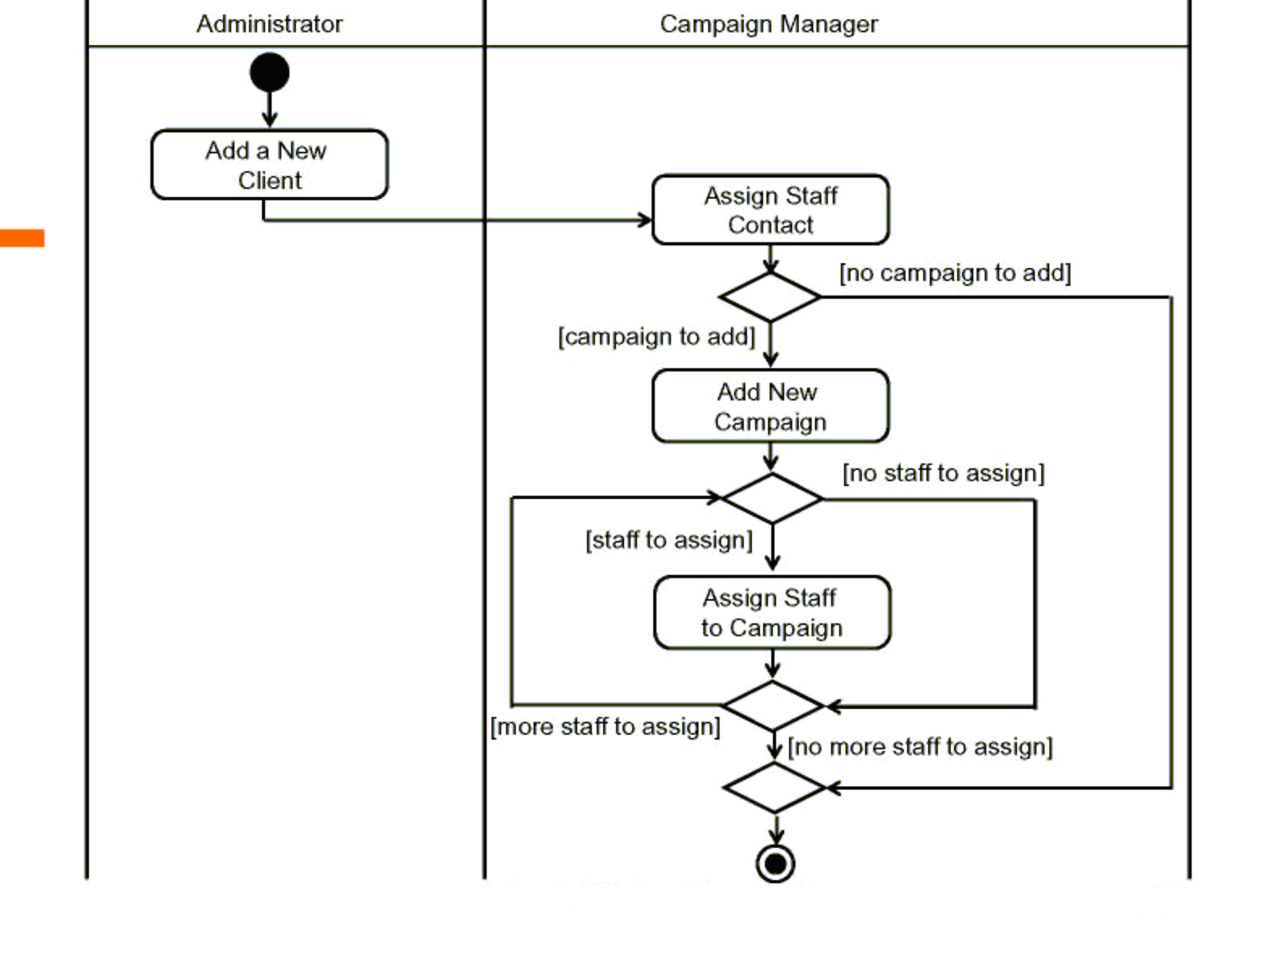
Drawing Activity Diagrams

Slide 18
Drawing Activity Diagrams
Are there any object flows and objects to show?
  these can be documents that are created or updated in a business activity diagram
  these can be object instances that change state in an operation or a use case
Add the object flows and objects

Slide 19
Administrator
Campaign Manager
Add a New
Client
:Client
[New]
Assign Staff
Contact
[no campaign to add]
[campaign to add]
:Campaign
Add New
Campaign
[no staff to assign]
[Commissioned]
[staff to assign]
Assign Staff
to Campaign

