Slide 1
Chapter 7: Requirements Analysis
Chapter 8: Refining the Requirements Model
The Class Diagram (Relative stability of classes & instances) {7.4.1 Pg 168}
Analysis Class Stereotypes {7.3.2 Pg 165-167}
Attributes {7.4.2 Pg 168,169}
Adding and Locating Attributes {7.5.4 Pg 187}
Link and Association, Significance of Associations {7.4.4,7.4.5 Pg 170,171}
Adding Associations {7.5.6 Pg 189}
Generalization, Adding Further Structures {Pg 212, 8.3 Pg 214-220}
Composition, Composition in UML {Pg 213, 8.2.3 Pg 213,214}
Combining Generalization with Composition or Aggregation {8.3.2 Pg 220,221}
Multiplicity {7.4.7 Pg 172-174}
Determining Multiplicity {7.5.7 Pg 189}
Operations {7.4.8 Pg 174-176}
Finding Operations, Preliminary Allocation of Operations {7.5.8,7.5.9 Pg 190}
Other Approaches to finding Objects and Classes {7.5.3 Pg 183-187}
Assembling the Analysis Class Diagram {7.7, A3 Pg 194,200-207}

Slide 2
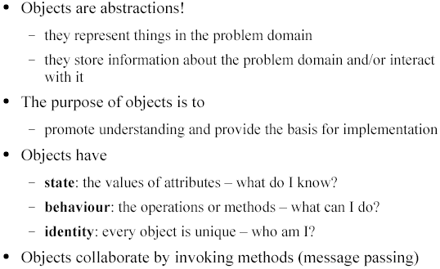
Objects

Slide 3
Object Diagram
The notation for object diagrams (aka instance diagrams) is derived from class diagrams.
Object diagrams are used to show an instance of classes and their relationships at a point in time
Useful for illustrating complex behaviors and data structures

Slide 4
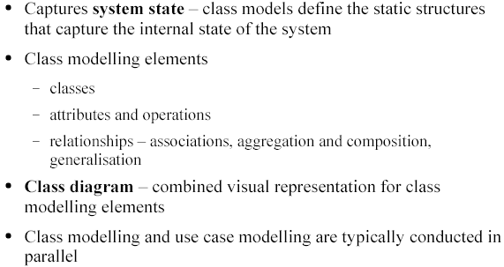
The Class Modelling

Slide 5
Class Diagram
Models the static structural design view of a system
Typically used to express association, generalization (is-a) and aggregation (has-a) relationships between objects

Slide 6
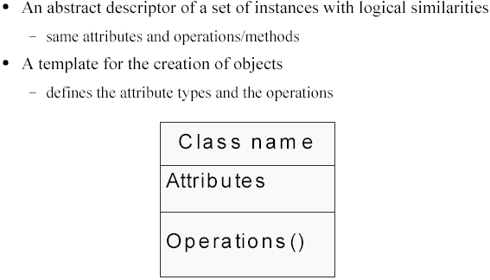
Classes

Slide 7
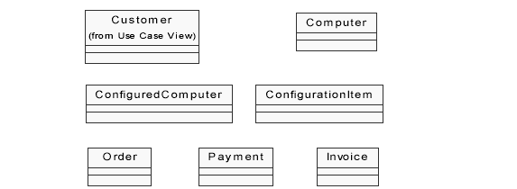
Classes - Example

Slide 8
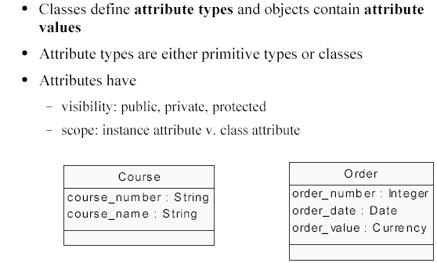
Attributes

Slide 9
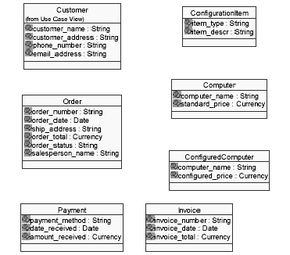
Classes and Attributes

Slide 10
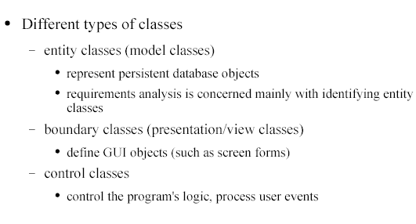
Types of Analysis Class Diagram

Slide 11
Boundary class Stereotype
<<boundary>>
User Interface::AddAdvertUI
User Interface::withdrawUI
startInterface( )
startInterface( )
User Interface::withdrawUI
selectAccount( )
selectClient( )
getAmount( )
selectCampaign( )

Slide 12
Entity class Stereotype
<<entity>>
Card
Card
CardNo
CardNo
PIN
PIN
status
status
Card
changePIN()
changePIN()
checkPIN( )
checkPIN( )

Slide 13
Control class Stereotype
<<control>>
Control::withdrawCtrl
Control::withdrawCtrl
withdraw( )
withdraw( )
withdrawCtrl

Slide 14
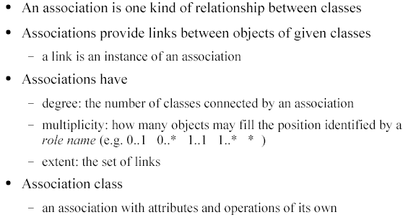
Associations

Slide 15
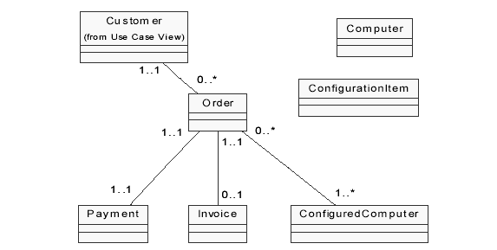
Associations

Slide 16
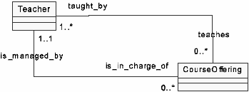
Association Multiplicity (Cardinality) Constrain
Constrain specifies the range of allowable objects that can be linked with an object of other class under that association (or on that role).
The format is, Lowerbound .. Upperbound
Role names - may be used with association at both ends or at one of the ends to increase clarity.

Slide 17
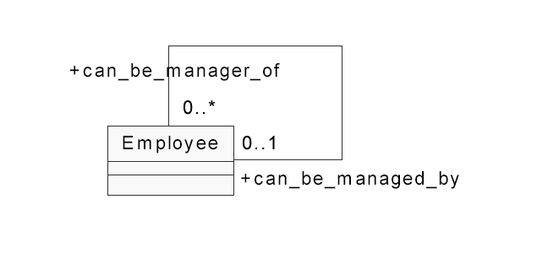
Association Degree (Unary Association)

Slide 18
Other Constraints
Ordered
Holds must be in some
order
1
placeOn
0..*
book
hold
{ordered}
1
employee
Subset
Manager must be an
employee
*
company
{subset}
person
1
manager
*
XOR
Prevents artificial
subclasses
*
perOwner
account
Person
*
{exclusive or}
Account
1
orgOwner
account
Organisa
*

Slide 19
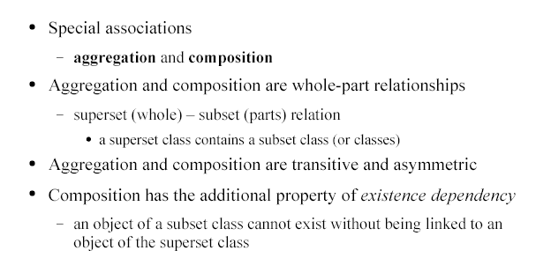
Aggregation and Composition

Slide 20
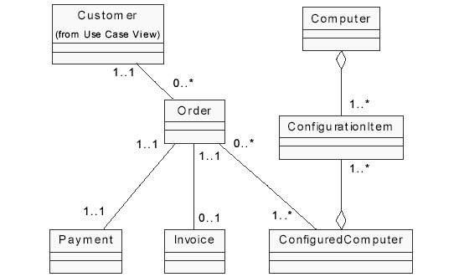
Aggregation

Slide 21
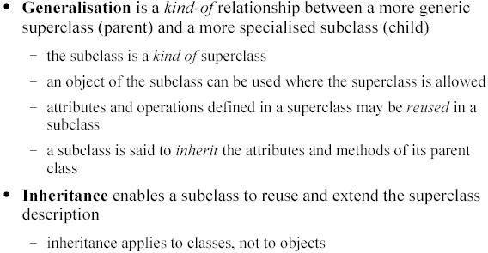
Inheritance, Generalization & Specialization

Slide 22
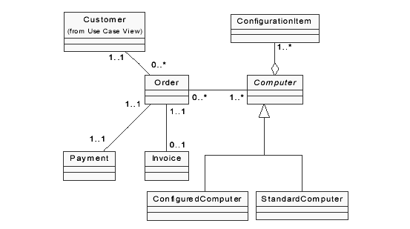
Generalization

Slide 23
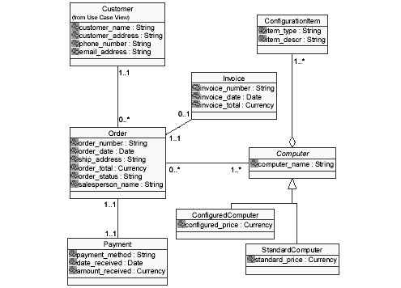
Class Diagram

Slide 24
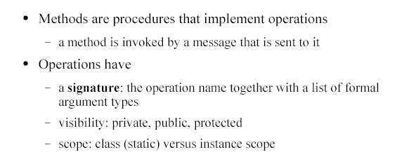
Class Operations

Slide 25
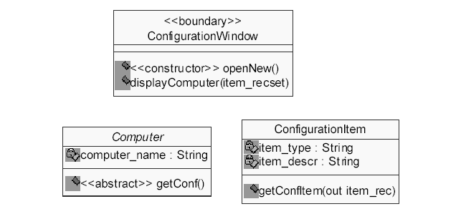
Class Operations

Slide 26
Visibility (of class members)
Visibility affects the accessibility of a class member outside its boundary
If a member is to be used in any of its subclasses directly, define it as ‘Protected’.
Account
3 types
Public (+)
Protected (#)
Private (-).
- nextAno
- aNo
# balance
+ balance( )
+ withdraw( )

Slide 27
Binding
The process of determining which process to be invoked for a certain message call
  Static binding → Determined at compile time
  Dynamic binding → Determined later at run time
Dynamic binding gives flexibility.
Allows the invocation decision to be postponed until additional information is known.

