Slide 1
Chapter 9: Object Interaction
Interaction Sequence Diagram
Introduction {9.1,9.2 Pg 231-234}
Interaction Sequence Diagrams {9.3 Pg 234-244}
Definition {9.3 Pg 234}
Basic Concepts and Notation {9.3.1 Pg 235-240}
  Lifeline
  Message
  Stimulus
  Reflexive relationships
Time Constraints {9.3.2 Pg 241}
Branching {9.3.3 Pg 241,242}
Managing Sequence Diagrams {9.3.4 Pg 242-244}
Modeling Real Time Systems and Concurrency {9.3.5 Pg 244}

Slide 2
Object Interaction
How to develop object collaboration from use cases
How to model object collaboration using an interaction sequence diagram
How to model object collaboration using an interaction collaboration diagram
How to cross-check between interaction diagrams and a class diagram

Slide 3
Object Messaging
Objects communicate by sending messages
Sending the message getFineDue() to a Student object, might use the following syntax
fine = sam.getFineDue()
UML :Book
sam:Student
getFineDue( )

Slide 4
Sequence Diagrams
Sequence diagrams display interactions between system objects over time
Created from use case analysis
Used to derive interactions, relationships, and methods of objects in the system
Show an interaction between objects arranged in a time sequence
Can be drawn at different levels of detail and to meet different purposes at several stages in the development life cycle
Typically used to represent the detailed object interaction that occurs for one use case or for one operation

Slide 5
Sequence Diagram - Example
:AdvertController
:CampaignModel
:AdvertView
changeAdvert()
modifyAdvert()
notify()
update()
displayAdvert()
getAdvertData()
update()
getAdvertData()

Slide 6
Sequence Diagrams
Vertical dimension shows time
Objects involved in interaction appear horizontally across the page and represented by lifelines
Messages are shown by a solid horizontal arrow
The execution of an operation is shown by an activation

Slide 7
Sequence Diagram - with entity objects only
Campaign
Manager
:Client
:Campaign
:Advert
getName()
listCampaigns()
*getCampaign
Details()
listAdverts()
*getAdvert
Details()
addNewAdvert()
Advert()
newAd:Advert
Activation
Object lifeline
Object creation

Slide 8
Sequence Diagram - Boundary & Control Classes
Most use cases imply at least one boundary object that manages the dialogue between the actor and the system.
e.g :withdrawUI, AddAdvertUI
The control object manages the overall object communication.
e.g. :withdrawCtrl, AddAdvert

Slide 9
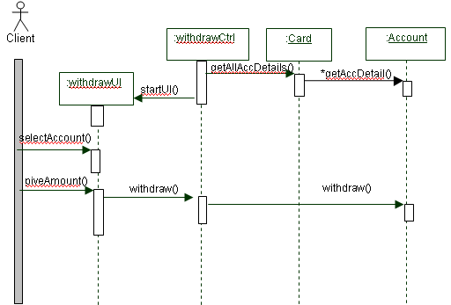
Sequence Diagram - Boundary & Control Classes
Use Case: withdraw

Slide 10
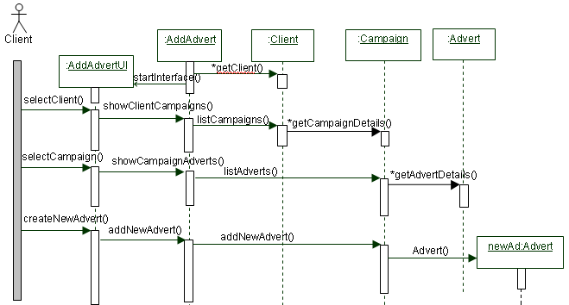
Sequence Diagram - Boundary & Control Classes
Use Case: Add a new advert to a campaign

Slide 11
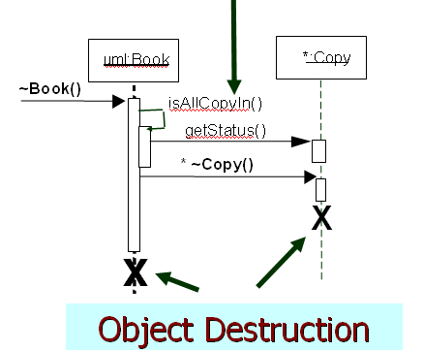
Reflexive Massage

Slide 12
Message Types
A synchronous message or procedural call, shown with a full arrowhead, causes the invoking operation to suspend execution until the focus of control has been returned to it
An asynchronous message, drawn with an open arrowhead, does not cause the invoking operation to halt execution while it awaits a return

Slide 13
Further Notation
:ClassA
:ClassB
Synchronous (blocking) message
An active object
a
Asynchronous message
{b.sendtime –
a.sendtime < 3 sec}
b
Construction marks to show time constrained interval
< 5 sec.
c
{d.receivetime –
d.sendtime < 1.5 sec}
d
Callback
{e.sendtime -d.receivetime
< 6 sec}
Here e is used as shorthand for e.sendtime and
e’ represents e.receivetime
e
Time
constraints
{e’ – e < 6 sec}

Slide 14
Object Grouping
A group of objects
can be represented
by a single lifeline,
and interaction
among these objects
is shown on a
different diagram
:Client
CampaignAdverts
Campaign
Lifeline representing a set of objects
Manager
getName()
listCampaigns()
checkCampaignBudget()

