Slide 1
Chapter 7: Requirements Analysis
Chapter 8: Refining the Requirements Model
The Class Diagram (Relative stability of classes & instances) {7.4.1 Pg 168}
Analysis Class Stereotypes {7.3.2 Pg 165-167}
Attributes {7.4.2 Pg 168,169}
Adding and Locating Attributes {7.5.4 Pg 187}
Link and Association, Significance of Associations {7.4.4,7.4.5 Pg 170,171}
Adding Associations {7.5.6 Pg 189}
Generalization, Adding Further Structures {Pg 212, 8.3 Pg 214-220}
Composition, Composition in UML {Pg 213, 8.2.3 Pg 213,214}
Combining Generalization with Composition or Aggregation {8.3.2 Pg 220,221}
Multiplicity {7.4.7 Pg 172-174}
Determining Multiplicity {7.5.7 Pg 189}
Operations {7.4.8 Pg 174-176}
Finding Operations, Preliminary Allocation of Operations {7.5.8,7.5.9 Pg 190}
Other Approaches to finding Objects and Classes {7.5.3 Pg 183-187}
Assembling the Analysis Class Diagram {7.7, A3 Pg 194,200-207}

Slide 2
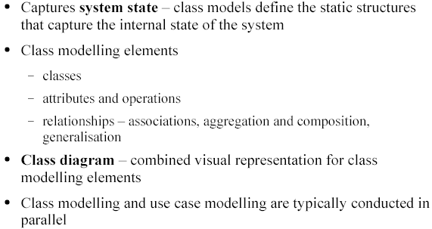
The Class Modelling

Slide 3
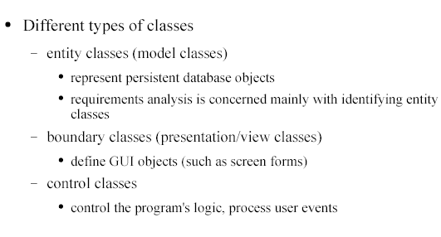
Classes
Ю
O
O

Slide 4
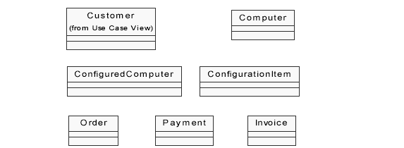
Classes

Slide 5
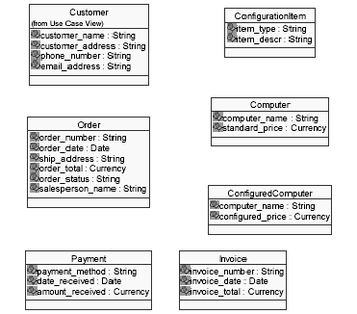
Classes and Attributes

Slide 6
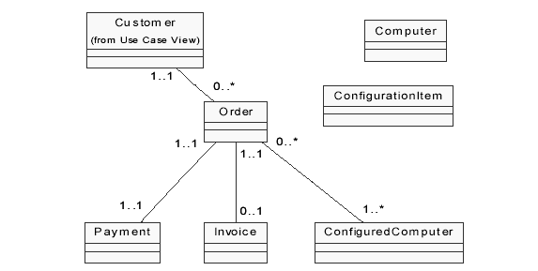
Associations

Slide 7
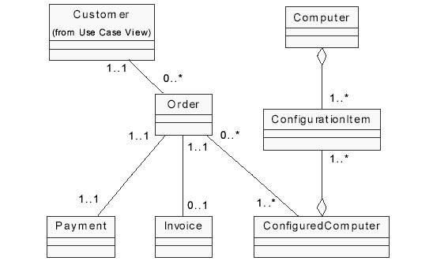
Aggregation

Slide 8
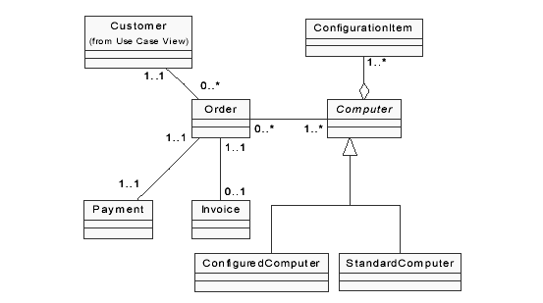
Generalization

Slide 9
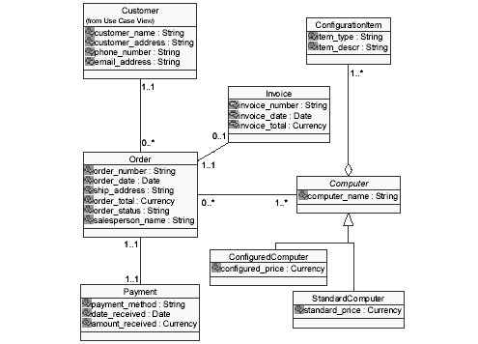
Class Diagram

Slide 10
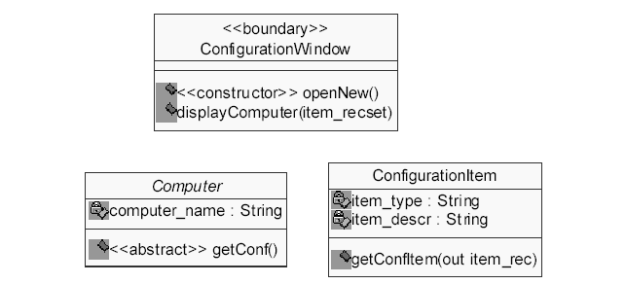
Class Operations

