Slide 1
Use Case Diagram - Example
lend to staff
lend
lend to member
Return for member
Calculate Fine
Search by
Title
Search by
VideoNo
Search by
Title
Pay Fine

Slide 2
Usecase Description Return
Precondition: Return option is available
Main Flows
Step-0 : Clerk selects ‘Return’
Step-1 : Clerk Enter the video ID
Step-2 : System displays all the copy ID’s that are on loan
Step-3 : Clerk selects the copy ID
Step-4 : Sytem checks duedate
Step-5: Sytem update records and prompts ‘return is success’
Step-6: Clerk confirms and usecase ends
Alternate Flows
Step-2,3: Only one copy is on loan, system selects it
Step-5 : Sytem calculate fine, displays, and updates the record
Error
Step-1 : A wrong number is entered

Slide 3
Sequence Diagram (Happy Day )
Clerk
ctrli:RetCtrl
:Video
:Copy
ruiI:RetUI
startInterface()
selectVideo()
getVideoInfo()
getTitle()
getLendCopies()
*getStatus()
*getCopyID()
selectCopy()
return()
checkDuedate()
setStatus()

Slide 4
Alternative Scenarios (Bad Day )
Consider Alternative Scenarios
  Here, return passed due date (Bad day)
  What are the new functionalities?
    Video ID is given, get the Title of the video
    Get all the Copy IDs of that video
    Copy ID is given, check the due date
    Duedate passed, calculate the fine
      Which knows the fine/day? Is it accessible now?
    Record the fine
      Where to record? Which can do that easily?

Slide 5
Usecase Description Return (Bad Day )
Clerk
ctrli:RetCtrl
:Video
:Copy
:Band
:Member
ruiI:RetUI
startInterface()
selectVideo()
getVideoInfo()
getTitle()
getLendCopies()
*getStatus()
*getCopyID()
selectCopy()
return()
return()
checkDueDate()
getBand()
calcFine()
updateDue()

Slide 6
Class Diagram
has
*
0..1
User
Copy
Video
0..*
copyID
status
name
phone
dofBirth
email
vId
title
certificate
firstHolderID
1
Lend
getStatus()
setStatus()
lendNo
dueDate
age()
checkLimit()
getTitle()
getCertificate()
getLendCopies()
getBand()
checkDueDate()
0..*
Band
1
Member
Staff
bandNo
charge
fine
is-assigned
memNo
due
limit
staNo
grade
limit
calculateFine()
updateDues()
checkLimit()
checkLimit()

Slide 7
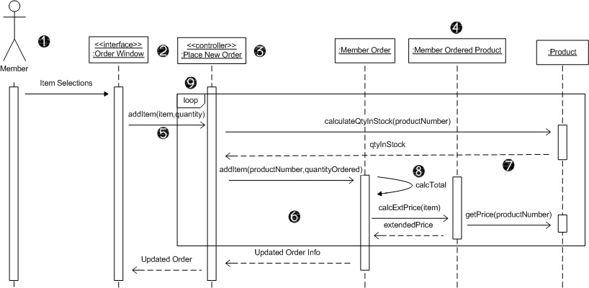
Sequence Diagram
Actor
Interface class
Controller class
Entity classes
Messages
Activation bars
Return messages
Self-call
Frame

