Slide 1


Allin Setiawan
HOUSE PRICING PREDICTION
99 GROUP
Telephone
Email Address
October 2024
+62 8788 3393 427
allin.setiawan@binus.ac.id

Slide 2
TABLE OF CONTENT
HOUSE PRICING PREDICTION
01
04
About Dataset
Weird Values
02
05
Statistical Description
Summary
03
Missing Value

Slide 3
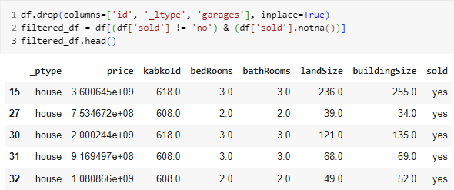
ABOUT DATASET
LISTINGS DATASET
The Listings dataset is used to predict house prices with various features such as property_type(_ptype), listings type(_ltype), kabkoId, bedRooms, bathRooms, landSize, buildingSize, garage, sold. which is suitable for predicting for price. In this case, there are some columns that need to be omitted because there is no need for "id, _ltype, garages" and only take the "yes" value in the sold column
NEXT

Slide 4
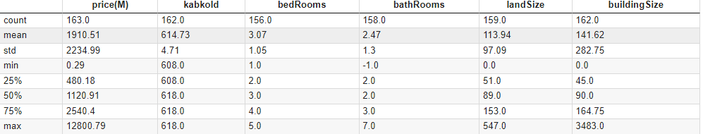
STATISTICAL DESCRIPTION
The table above is the result of a statistical summary on numerical type data. From summary statistical, we can get some observation such as count, mean, standard deviation, mininum value, quartile(25%, 50%, 75%), maximum from each column of the dataset. To make it easier to be seen, the price data units is converted to millions and for the summarization of the data are rounded into 2 digit behind the comma.

Slide 5
Allin Setiawan
THANK YOU
FOR YOUR NICE ATTENTION
Telephone
Email Address
October 2024
+62 8788 3393 427
allin.setiawan@binus.ac.id

Slide 6
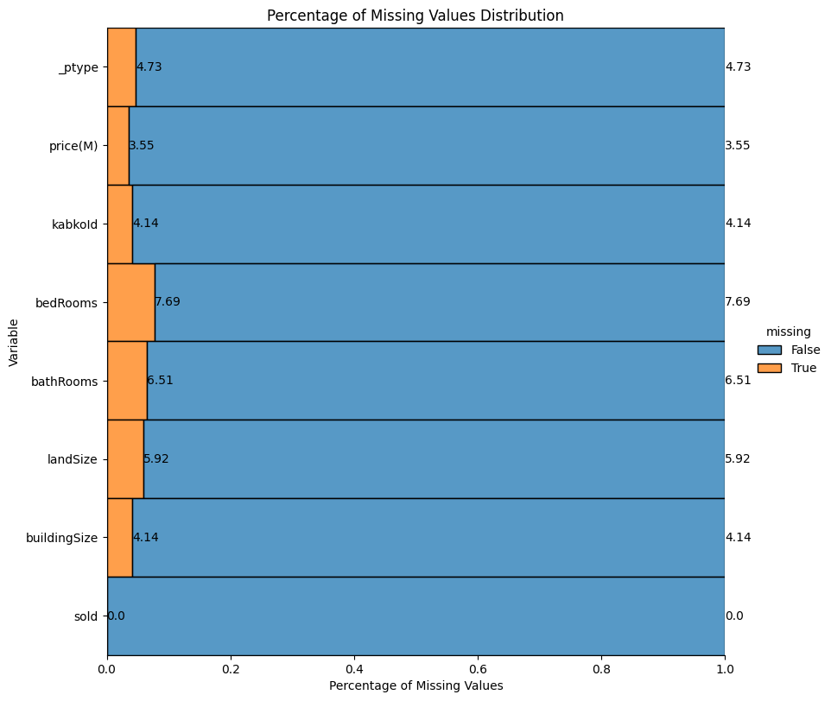
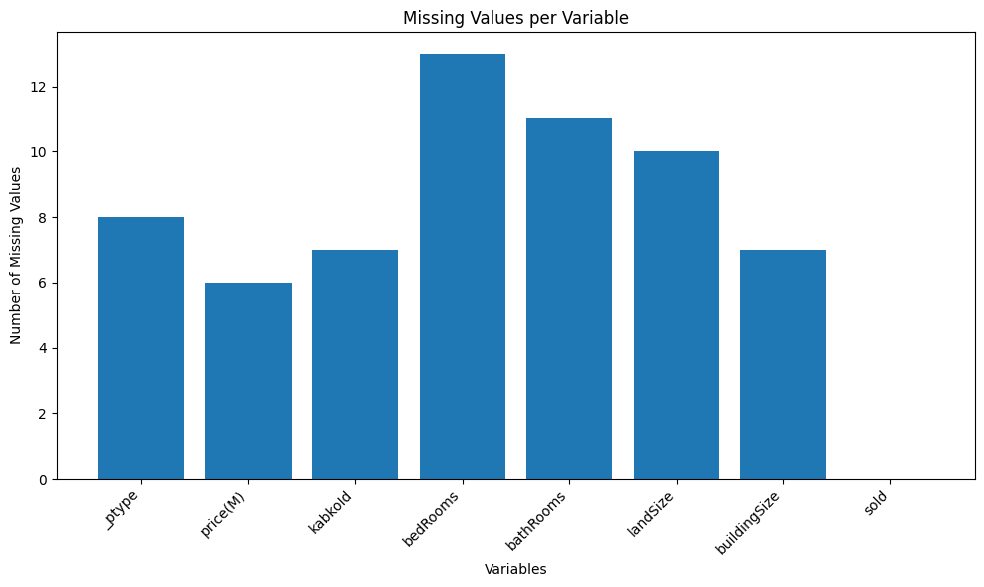

MISSING VALUES
In this data, there is a missing value in each variable. The most missing values were produced in bedRooms as many as 13 and bathRooms as many as 11. while in the sold variable there is no missing value
Since the missing value is less than 10% of each column, we can use impute by using the mean from the dataset

Slide 7
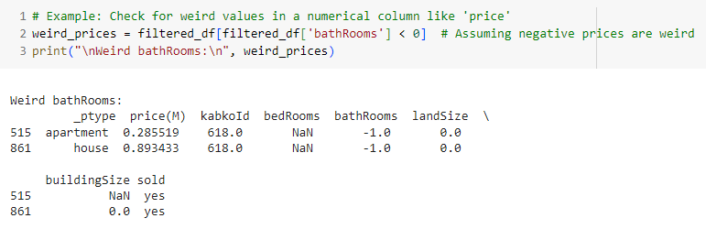

Weird Values and Duplicate Values
Weird Values
Variable bathRooms should’t be -1.0 because variable bathRooms is the number of bathroom in the unit. In this case, we make a filter so that the lowes data in the bathRooms column is 0
Duplicate Values
In this dataset, there is no duplicate values detected

Slide 8
SUMMARY
Drop the column are not requested by project team, such as ‘Id, _ltypes, garages’ and eliminate every data property data that are not sold
Find the missing values and impute them with the mean of dataset
Check weird values and make a filter the values
1
2
3

