Slide 1

Similarity-Based Duplicate Record Detection System
DATA SCIENCE (24AD3107) Project Review-1
16 September 2026
 | Under the Guidance of Ms. Bonagani Prathusha Assistant Professor, Department of Computer Science and Engineering, KLH CSE Bowrampet Campus
Team Members Allipuram Akhil – 2420030540 P. Ruthvik Reddy – 2420030546 Surya – 2420030440

Slide 2
Outline of Project Work
Focus
Introduction
Literature Survey
Challenges
Research Objectives
Conclusion & Future Work
References
Publications Details

Slide 3
Problem Statement
Organizations collect customer and record data from multiple sources (web forms, system migrations, merges), which introduces exact and near-duplicate records that differ due to typos, formatting, or missing fields.
Manual identification of duplicate records is time-consuming, error-prone, and does not scale to large datasets.
Naively comparing every record against every other record is computationally expensive — an O(n²) operation — and becomes impractical as data volume grows.
There is a need for an automated system that detects both exact and near-duplicate records using similarity measures and machine learning, and produces a clean, deduplicated dataset.

Slide 4
Objectives
Design a pipeline that pre-processes and standardizes raw record data — names, emails, phone numbers, and addresses.
Implement an efficient blocking strategy that reduces the candidate-pair search space instead of comparing every record pair.
Compute complementary similarity measures — string-based (Levenshtein ratio, Jaro-Winkler) and vector-based (TF-IDF, Cosine, Jaccard) — and combine them into a weighted similarity score.
Train and compare supervised ML classifiers (Logistic Regression, Random Forest, XGBoost) for duplicate / non-duplicate classification, with grid-search hyperparameter tuning.
Evaluate models using accuracy, precision, recall, and F1-score, and generate a cleaned, deduplicated output dataset.
Provide an interactive web interface for running detection, inspecting flagged pairs, and visualizing results.

Slide 5
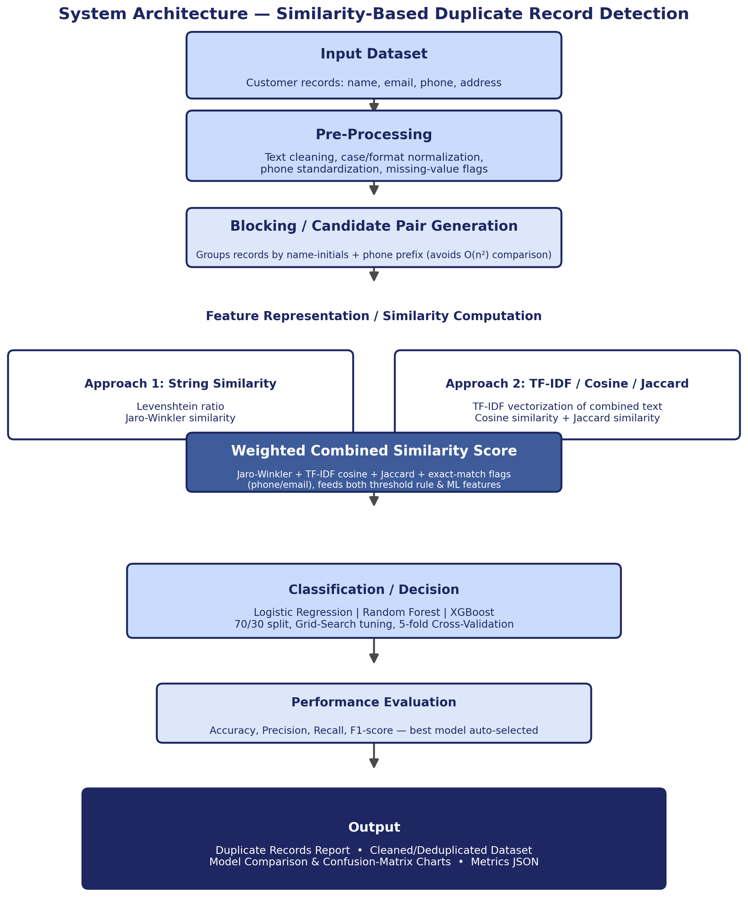
Proposed System Architecture

Slide 6
Literature Survey
Authors | Title of the Paper | Methodology | Inferences | Limitation/Future work
Elmagarmid, Ipeirotis & Verykios [1] | Duplicate Record Detection: A Survey, IEEE TKDE, 2007 | Comparative survey of field-matching, string-similarity, rule-based, and blocking techniques for duplicate detection | Establishes the blocking + similarity + classification taxonomy that most modern pipelines, including this one, still follow | Survey pre-dates deep-learning approaches; does not benchmark ML classifiers on large modern datasets
Ebraheem et al. [2] | DeepER – Deep Entity Resolution (DeepER), arXiv, 2017 | Distributed tuple representations via word embeddings, similarity scoring, and a classifier for entity resolution | Deep representation learning reduces manual feature engineering compared to hand-crafted similarity features | High computational cost and needs large labelled training data; less interpretable than similarity-based scoring
Ravikanth, Korra & Mamidisetti [3] | An Efficient Learning-Based Approach for Automatic Record Deduplication with Benchmark Datasets, Scientific Reports, 2024 | LSTM classifier combined with attribute-level similarity metrics, handling missing/null values across records | Attribute-level weighting with a hybrid similarity + deep-learning classifier improves precision/recall over rule-based baselines | Higher computational overhead; accuracy can degrade on highly noisy or partially missing records

Slide 7
Problem Gap Identification
Traditional duplicate detection relies on exact matching or simple rule-based string comparison, which misses near-duplicates caused by typos, reordering, or missing fields.
Pure similarity-threshold approaches lack the discriminative power of a trained classifier and require manual threshold tuning for every new dataset.
Many existing systems compare record pairs exhaustively, which does not scale to large, real-world datasets.
Few systems combine blocking, multiple similarity approaches, and ML classification together with an interactive, explainable interface for verifying flagged pairs — this is the gap this project addresses.

Slide 8
Innovation, Creativity, and Novelty
Combines two complementary similarity approaches — string similarity (Levenshtein / Jaro-Winkler) and vector-based similarity (TF-IDF / Cosine / Jaccard) — into one weighted combined score, rather than relying on a single measure.
Uses a blocking step (name-initial + phone-prefix key) so the pipeline scales to large datasets, mirroring standard practice in real-world entity resolution.
Learns the decision boundary with ML classifiers, grid-search tuning, and 5-fold cross-validation, instead of a manually fixed similarity threshold.
Applies union-find based cleaning to keep the most complete record from each duplicate cluster while producing a clean, deduplicated dataset.
Ships as an interactive Flask web application with side-by-side pair comparison, live progress tracking, and downloadable reports — not just a command-line script.

Slide 9
Feasibility and Project Plan
The project is executed across six phases over the semester, from requirement study through final testing and documentation.
Phase 1 (Weeks 1–2): Requirement study, literature survey, and dataset design.
Phase 2 (Weeks 3–4): Pre-processing and blocking implementation.
Phase 3 (Weeks 5–6): Feature engineering — string similarity, TF-IDF/Cosine/Jaccard, and the combined score.
Phase 4 (Weeks 7–8): ML model training, hyperparameter tuning, and evaluation.
Phase 5 (Weeks 9–10): Web interface development and pipeline integration.
Phase 6 (Weeks 11–12): Testing, documentation, and final report / viva preparation.

