Slide 1
COMPLIANCE AGENTIC AI
Vendor Due-Diligence Gate
A deterministic compliance engine that gates vendor spend before the money moves — explainable, auditable, and human-accountable.
8 compliance controls
Full audit trail
Deploys unchanged to AWS

Slide 2




THE PROBLEM
Vendor spend gets approved by habit and memory — not by policy
No on-file sign-off
Screening gets skipped
Invoices above the approval threshold go out because nobody is tracking thresholds transaction-by-transaction.
A new vendor gets paid before anyone checks a sanctions list — screening is a step someone has to remember.
Unverified bank changes
Conflicts surface too late
A vendor "updates" payment details by email and it's applied unconfirmed — the classic business-email-compromise fraud vector.
An undisclosed relationship between requestor and vendor only comes out after the money has already moved.
Vendor Due-Diligence Gate

Slide 3





THE SOLUTION
A deterministic gate stands between a transaction and the money moving
Evaluate
Decide
Route
Record
Every transaction is checked against a versioned, cited rule catalog.
A clear decision: approved, blocked, needs evidence, or needs a human.
Procurement, Legal, or Finance is notified automatically, by risk.
An append-only audit trail: what was decided, by what rule, and why.
Evidence-first
Explainable outcomes
Risk-based routing
Audit by default
Vendor Due-Diligence Gate

Slide 4
COVERAGE
Eight controls, one gate
Control | What it checks
Spend Approval | Approval thresholds; dual sign-off above a higher threshold
Vendor Due Diligence | Sanctions / watchlist screening for new or high-risk vendors
Jurisdiction Risk | Enhanced due diligence for vendors in high-risk jurisdictions
Conflict of Interest | Disclosure and compliance clearance before spend proceeds
Expense Receipts | Itemized documentation and amount reconciliation
Worker Classification | Misclassification risk for part-time / temporary engagements
Gifts & Hospitality | Anti-bribery pre-approval — zero threshold for government officials
Payment-Change Verification | Independent verification of vendor banking-detail changes
Every control cites the regulation or internal policy it enforces.
Vendor Due-Diligence Gate

Slide 5


HOW IT WORKS
How a transaction moves through the gate
1
2
3
4
5
Submit
Evaluate
Score
Decide & route
Audit
A purchase order or vendor transaction is submitted
Checked against the versioned rule catalog for that control
A risk band is assigned: low, medium, high, or critical
Approved, blocked, or sent to the right reviewer
Every step is logged, immutably, for later reconstruction
The same code runs locally today (SQLite) and is built to deploy unchanged to AWS (DynamoDB, Lambda, Cognito) via CDK — no rewrite required to go live.
Vendor Due-Diligence Gate

Slide 6
SEE IT WORK
From rule to decision, in one call
PROC-VENDOR-PAYMENT-CHANGE-001 — the same control guarding against business-email-compromise fraud
RULE
TRANSACTION
DECISION
{
{
{
"control_id":
"case_id": "CASE-2029",
"decision": "blocked",
"PROC-VENDOR-PAYMENT-CHANGE-001",
"vendor_name": "Meridian Consulting Group",
"risk_band": "critical",
"required_evidence": [
"recommended_action": "Block the payment. Escalate to Finance and Legal immediately as a suspected fraud incident.",
"payment_change_verification_record"
"vendor_payment_details_changed": true,
],
"payment_change_verification_record": {
"elevated_scrutiny_
"verified": false
"escalation_recipients": ["procurement", "finance", "legal"]
above_amount": 5000
}
}
}
}
CASE-2029 from the seeded demo data, citing Barbados's Computer Misuse Act, Chapter 124B — every field name and value above is the engine's real output for this case.
Vendor Due-Diligence Gate

Slide 7
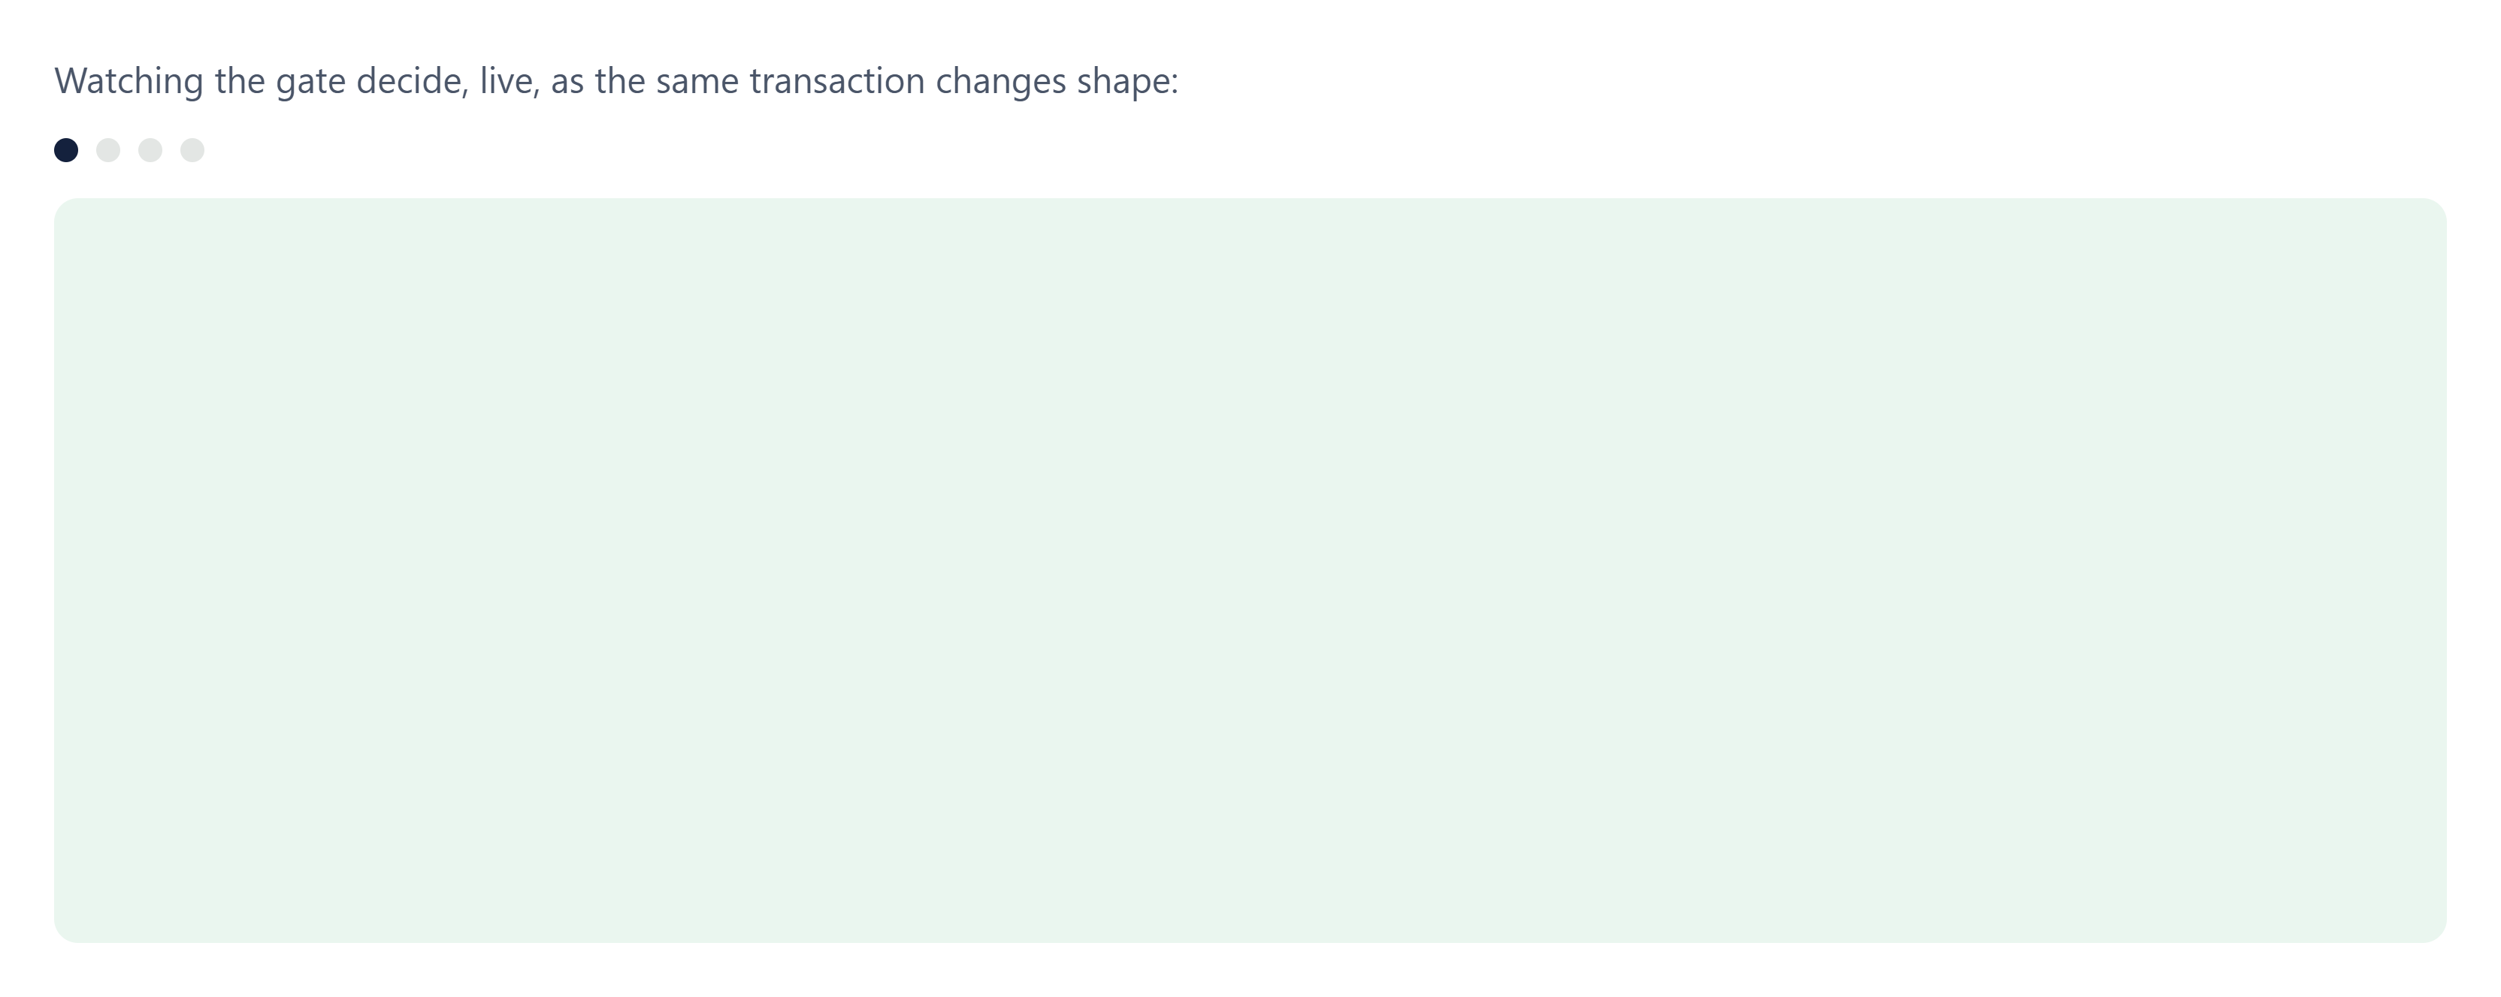
SEE IT LIVE
Same control, four scenarios
Vendor Due-Diligence Gate — live simulation, mirrors the real evaluator's logic

Slide 8
OUTCOMES
Four decisions, always explainable
APPROVED
BLOCKED
INSUFFICIENT EVIDENCE
HUMAN REVIEW
Meets every rule — proceeds without delay
Fails a control outright — spend stops here
Missing documentation — more evidence required
Ambiguous or high-risk — a person makes the call
Human oversight on every review
A manager assigns a reviewer, who starts and submits the decision with mandatory notes. Identity is checked at every step, and any completed review can be reopened with a documented reason. Four roles — employee, compliance analyst, compliance manager, auditor — govern who can do what.
Vendor Due-Diligence Gate

Slide 9




GOVERNANCE
Built for audit from day one
Policy traceability
Escalation routing
Every control cites the exact regulation or internal policy it enforces.
Every decision computes who should be notified — Procurement, Legal, Finance — by risk band.
Governance dashboard
Append-only audit trail
Per-control decisions, risk-signal frequency, and pending notifications in a single view.
Every decision and review action is logged immutably, with actor and timestamp.
Vendor Due-Diligence Gate

Slide 10
WHY IT MATTERS
The cost of unmanaged vendor risk is real — and avoidable
Stops fraud before it pays out
Reduces real legal exposure
Gated before the money moves, not reviewed after — including the business-email-compromise pattern behind most payment fraud.
Anti-bribery breaches alone carry penalties up to BBD $1.5M or 15 years imprisonment under Barbados law.
Always audit-ready
Scales without headcount
Any decision can be reconstructed — what rule, what evidence, what outcome — on demand.
One rule catalog, eight controls — consistent enforcement as vendor volume grows.
Vendor Due-Diligence Gate

Slide 11
UNDER THE HOOD
Same code, either environment
Client — Swagger UI / curl / LLM agent
JWT: HS256 (local) or RS256 via Cognito JWKS (AWS)
Local
AWS
uvicorn — dev_server.py / run_demo.py
API Gateway (HTTP API) → Lambda
Optional: LLM triage agent
FastAPI app + deterministic rule engine
Extracts fields from plain English — never decides risk itself
8 versioned rule catalogs, each citing real regulation
→ decision, risk band, escalation recipients — no LLM in this path
SQLite (local)
DynamoDB (AWS)
decisions, reviews + audit history
4 tables, streamed for export
Audit export → S3
immutable archive (RemovalPolicy.RETAIN)
CI/CD: GitHub Actions + OIDC — no stored AWS keys
Governed: CloudWatch alarms + $25/mo AWS Budget
Measured: p50 11.4ms / p95 12.7ms per decision
Vendor Due-Diligence Gate

Slide 12
SEE IT RUN
What actually happened when we ran it
12 seeded transactions, evaluated locally against the real engine — this is /dashboard/summary's live response, not a mockup.
GET localhost:8000/dashboard/summary
200 OK
12
2
2
8
Transactions evaluated
Blocked outright
Insufficient evidence
Controls touched
Escalations queued, by team
Procurement: 11
Legal: 8
Finance: 6
Vendor Due-Diligence Gate — real output from this run, not illustrative

Slide 13

WHAT'S NEXT
From working system to production rollout
Deploy to a live AWS account and provision the first compliance manager
Wire escalation routing to a real channel — email or Slack
Confirm remaining regulatory questions and extend coverage beyond Barbados/Caribbean
Deterministic rules where rules are enough. Human judgment where they aren't. A permanent record either way.

