Slide 1
Investigating Customer Churn Rates of Telecom Providers
Zhihan Xiong

Slide 2
Task Summary
Telephone services are widely used
Classification Problem
Hence, it is important for telecom companies to understand what predicts customer churn rates, and crucially, whether customers choose to switch to a different service.
Attracting new customers is expensive
The telephone service market
Notes:
The background and motivation for our project is…
Telephone services are widely used in our daily lives, and various factors can lead us to switch to different telecommunication (telecom) providers.
From the viewpoint of telecom providers, it is crucial to retain old customers, as attracting new customers could be more costly and arduous.
Advertisements are obviously...expensive. Better to keep old customers.
The telephone service market is a market where the total number users is basically set and would not change significantly over time (there’s a specific term for this but idk what it is exactly; refer to pt.1). In these markets, competitors must compete for larger market shares to win over their counterparts.
Churn rate: customer attrition rate, or when customers switch to a different service

Slide 3
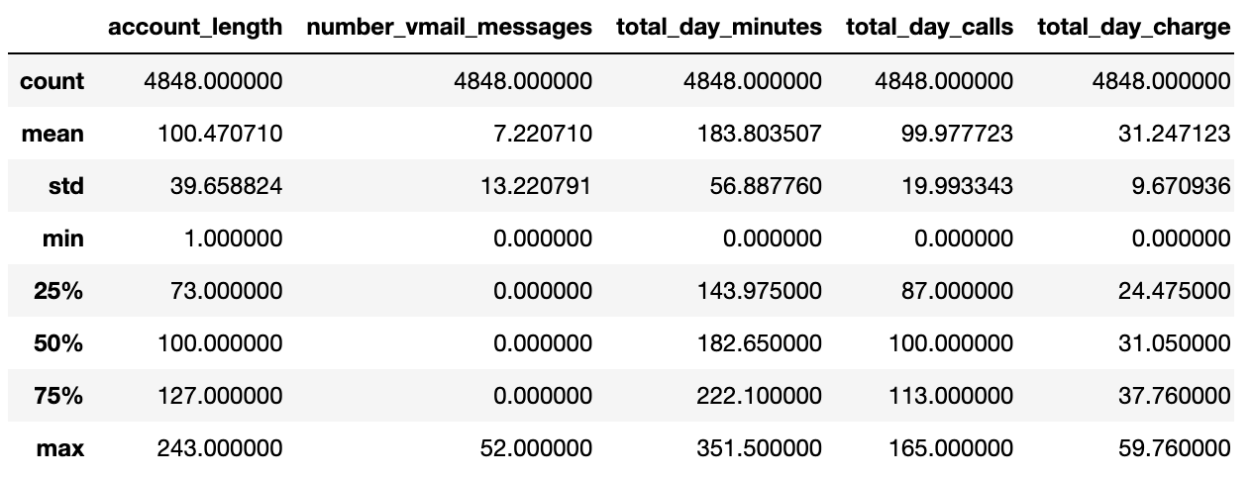
Dataset & Features
Data shape: 4848*19 (30% test data)
Classes: Churn
Yes: 1196
No: 3652
HI
Categorical variables: international_plan, voice_mail_plan
HI
Numerical variables:
number_vmail_messages total_day_minutes total_day_calls
total_day_charge total_eve_minutes total_eve_calls
total_eve_charge total_night_minutes total_night_calls
total_night_charge total_intl_minutes total_intl_calls
total_intl_charge number_customer_service_calls
Data source: https://www.kaggle.com/c/customer-churn-prediction-2020/overview
Notes:
Our data comes from kaggle with more than 4 thousand rows and 20 columns
Since we are going to use two different types of models to address our question, we will look at
customer churn, a binary variable, for our logistic regression and mixed effect logistic regression
And account length and customer churn for our survival analysis
For our exploratory variables
There are three categorical variables: international plan, voice mail plan, and state.
((Currently, we plan to cluster our mixed effect logistic regression model on state, but we might also consider alternative options.这个留到后面glmm再说吧))
Following categorical variables are the 14 numerical variables that will be our predictor variables (停几秒钟让大家看到是什么）

Slide 4
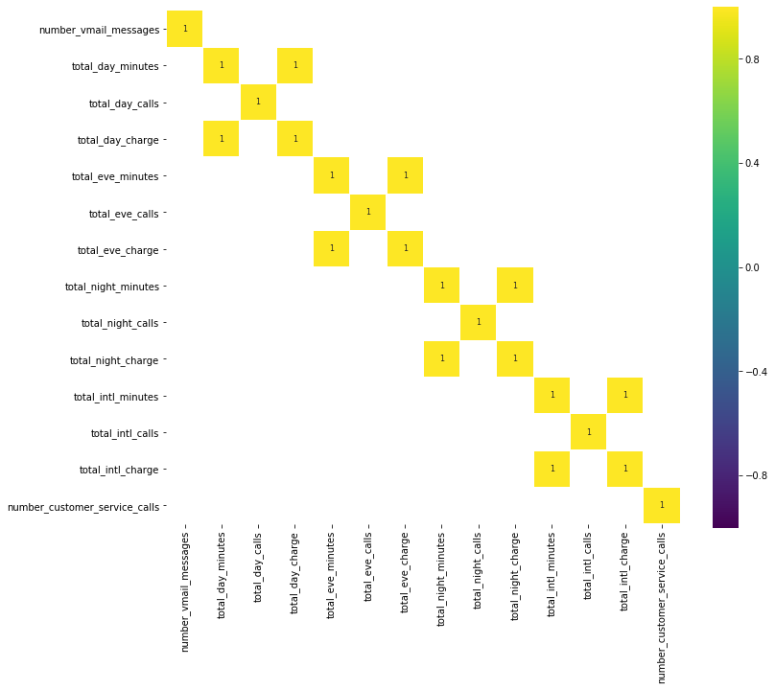
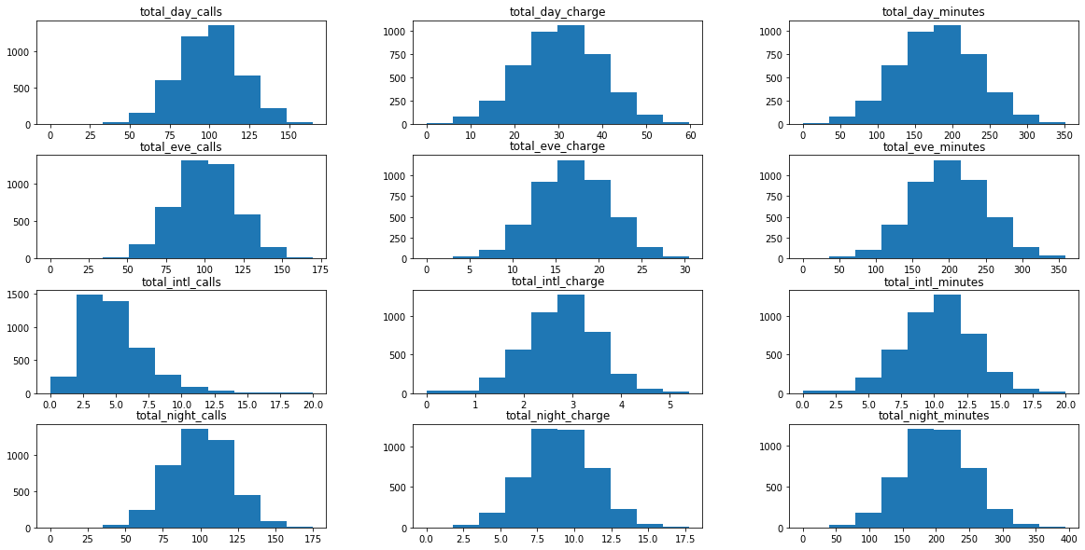
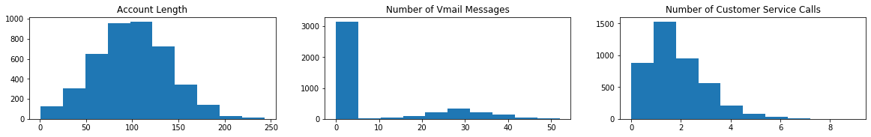
Exploratory Analysis
Data Preprocessing:
Feature selection
Standardization
Transformation of categorical variables
Churn: 14.07% International Plan: 9.31% Voice Email: 26.16%
Notes:
Plots of numerical variables’ distribution : 124 similar distribution and mean; international calls right skewed
No strong (>.5) correlation between variables, except for (minuts, charge) pairs
Indicates redundancy: eliminate some variables
12 features left

Slide 5
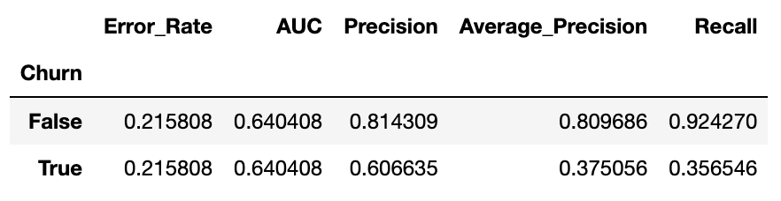
Logistic regression
Models
Score: 0.7842
Top features: int_plan, v_mail_plan,
custermer_service_call, total_day_minutes
Notes:
0.7842
False positive higher than true positive

Slide 6
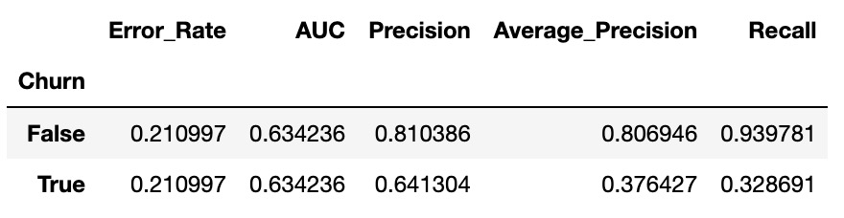
2. Support Vector Machine
Score: 0.789
Top features: int_plan, v_mail_plan,
total_day_minutes, custermer_service_call
Notes:
0.789
Analogizes
Better for negative instances; worse
False positive higher than true positive

Slide 7
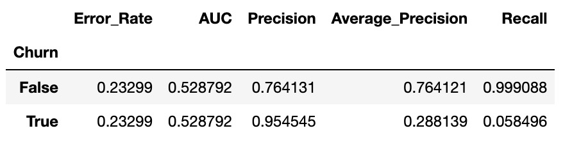
3. Random Forest
Score: 0.767
Notes:
Strategy: numbly classify everything as negative

Slide 8
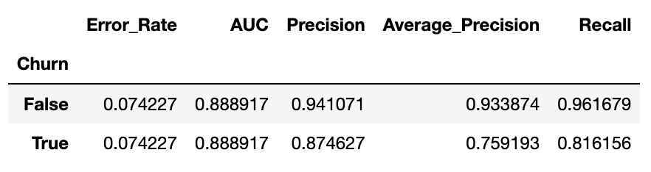
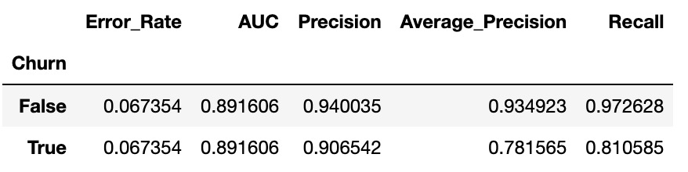
4. K Nearest Neighbors
Score: 0.9258 -> 0.9326
Best k: {'n_neighbors': 9, 'weights': 'distance'}
Notes:
Clustered?
False positive lower than true positive
Best parameters
Weights: higher weights for closer neighbors

Slide 9
Model comparison
LR
SVM
RF
KNN
Recall Score: 0.357
Score: 0.329
Score: 0.058
Score: 0.811
Possible improvement: Boosting algorithms; More hyperparameter tuning; Balancing Data
Notes:
Recall of positive instances: what we actually care about
3 times of negative data

