Slide 1

ANALYSIS OF THE IMPACT OF
COVID19 OUTBREAK ON THE
INDIAN BANKING SYSTEM
By- Krishnakanta Maity
Under Supervision of
Dr. Prasenjit Chakrabarti
Dept. of Accounting and Finance, IIM Ranchi
Guide: Br. Mrinmay

Slide 2
Motivation
India, which has a mix of state-owned banks and private sector banks, provides an ideal setting to explore the impact of COVID19 crisis.
In general most of the people’s perception during crisis is withdraw money from private sector and deposit into public sector.

Slide 3
Aims and Objectives
Which banks are more vulnerable during COVID?
Checking whether crash risk of firms taking loans from vulnerable bank is high or not compared to non-vulnerable bank.

Slide 4
Data Description
Stock market data of Nifty50 index and considered all private and public Indian bank is collected from the National Stock Exchange (NSE) and the Bombay Stock Exchange (BSE) through Yahoo Finance API.
Listed companies/firms stocks data is given by supervisor.
Number of Bank:
12 Public Bank
17 Private Bank
Considered time period:
Before COVID: July 2019 to December 2019
During COVID: January 2020 to June 2020

Slide 5
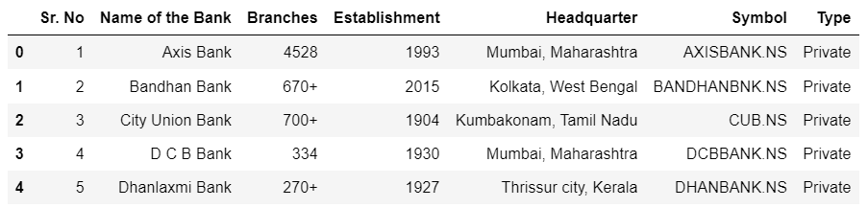
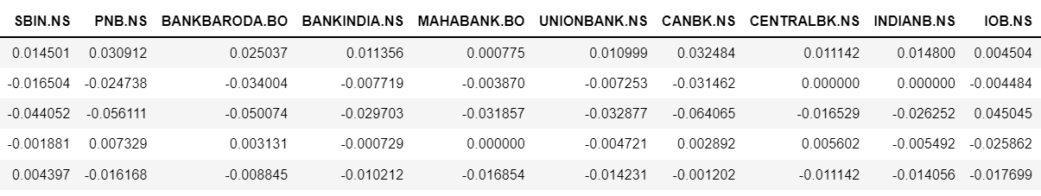
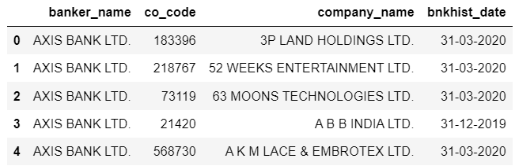
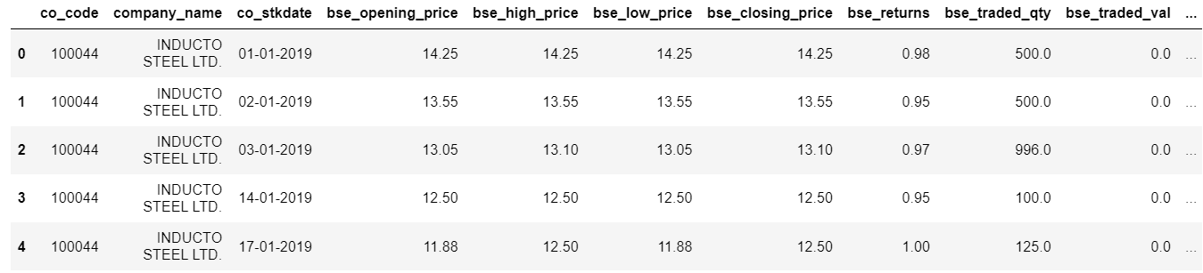
Snapshot of Data
RBI
Yahoo Finance
Private

Slide 6
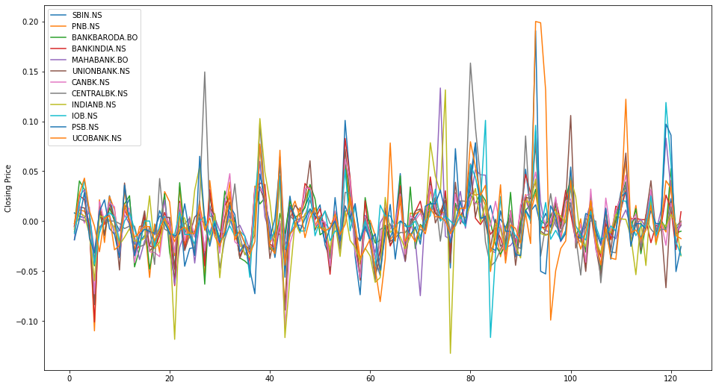
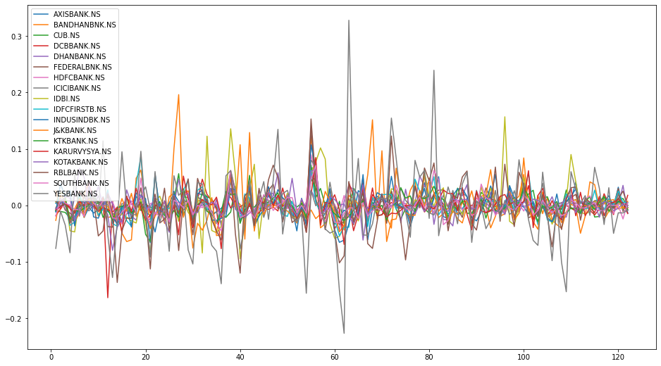
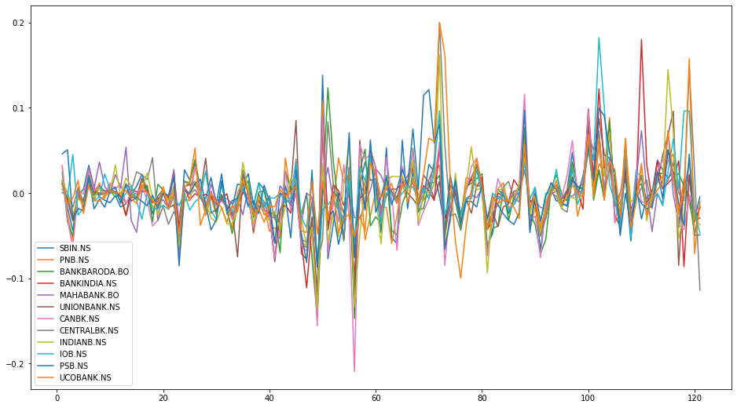
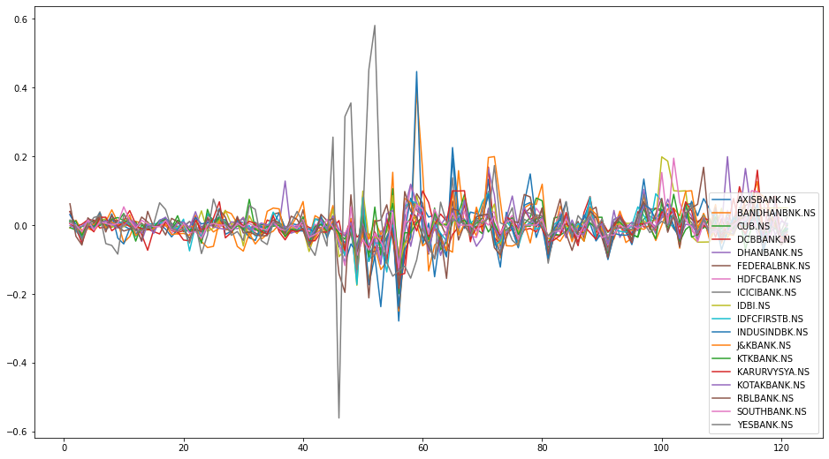
Exploratory Data Analysis
PUBLIC BANK
PRIVATE BANK
BEFORE
AFTER

Slide 7
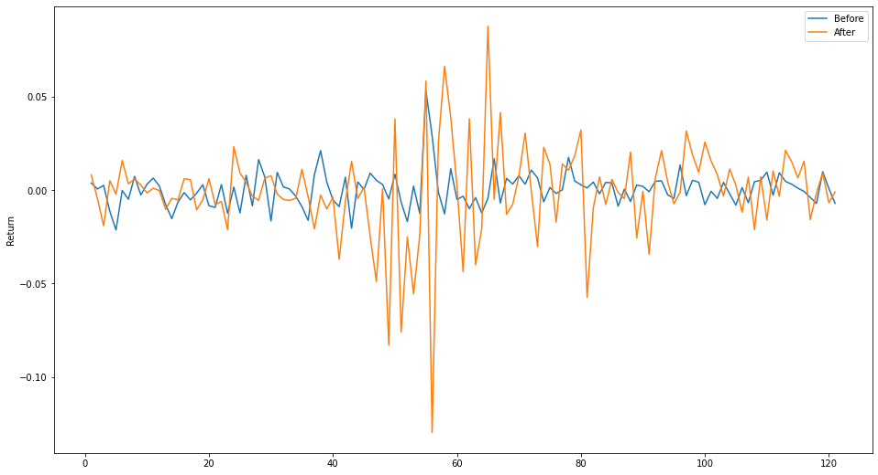
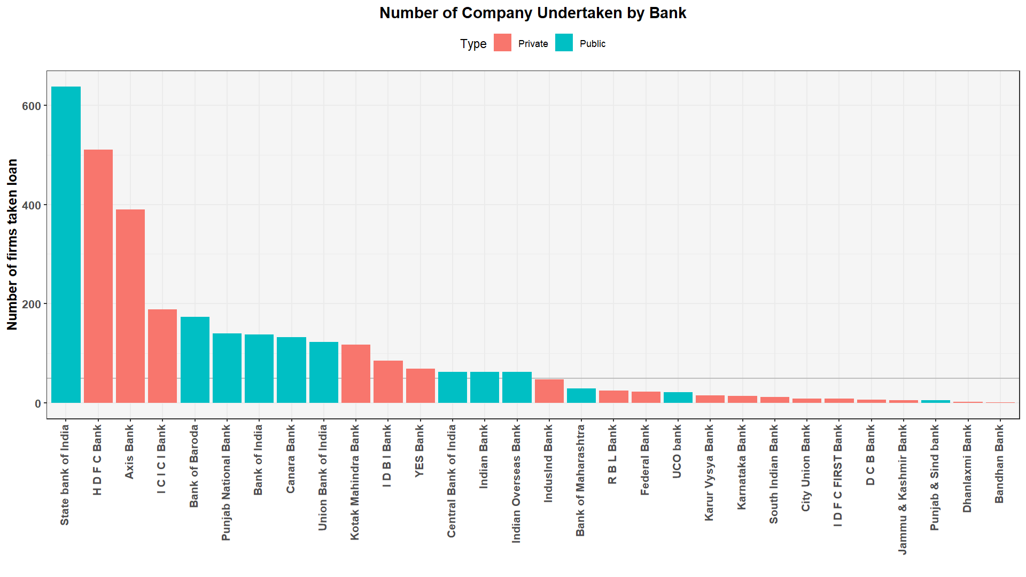
Exploratory Data Analysis
Market return before and after COVID19
Number of firms taken loan from public and private banks

Slide 8
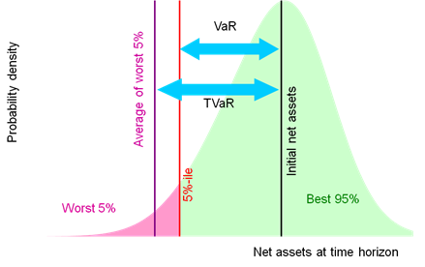

Methodology-I
Calculating Beta and Marginal Expected Shortfall
Beta: Risk-reward measure.
MES: Measure of expected equity loss.
Making a threshold to measure vulnerability
$$y=α+βx$$
During time period, y is the Nifty50 daily return and x is individual bank’s daily return
$$MES_{i,t}=E_{t}(r_{i,t+1}|r_{m,t+1}<q_{α,t}\left(r_{t+1}\right)=C)$$
Where C is a constant defined as tail risk in the market
(Source)

Slide 9
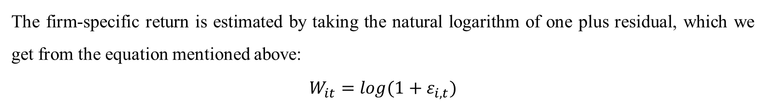
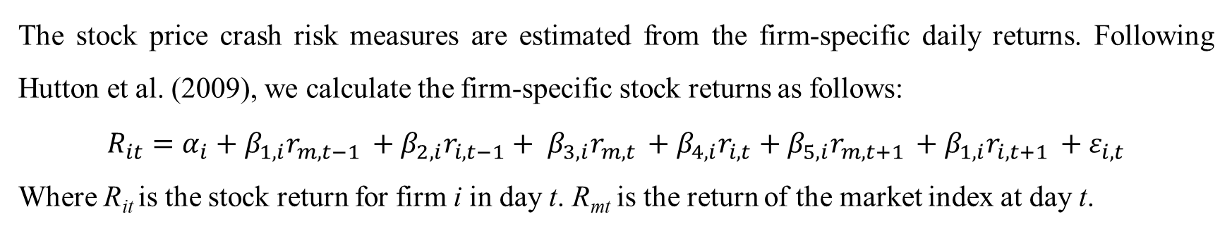
Methodology-II
Crash risk
The stock price crash risk measures are estimated from the firm-specific daily returns. Following Hutton et al. (2009), we calculate the firm-specific stock returns as follows:
$$R_{it}=α_{i}+β_{1,i}r_{m,t−1 }+β_{2,i}r_{i,t−1}+ β_{3,i}r_{m,t }+β_{4,i}r_{i,t}+β_{5,i}r_{m,t+1 }+β_{1,i}r_{i,t+1 }+ε_{i,t}$$
Where R_{it} is the stock return for firm i in day t. R_{mt} is the return of the market index at day t.
The firm-specific return is estimated by taking the natural logarithm of one plus residual, which we get from the equation mentioned above:
$$W_{it}=log(1+ε_{i,t})$$

Slide 10
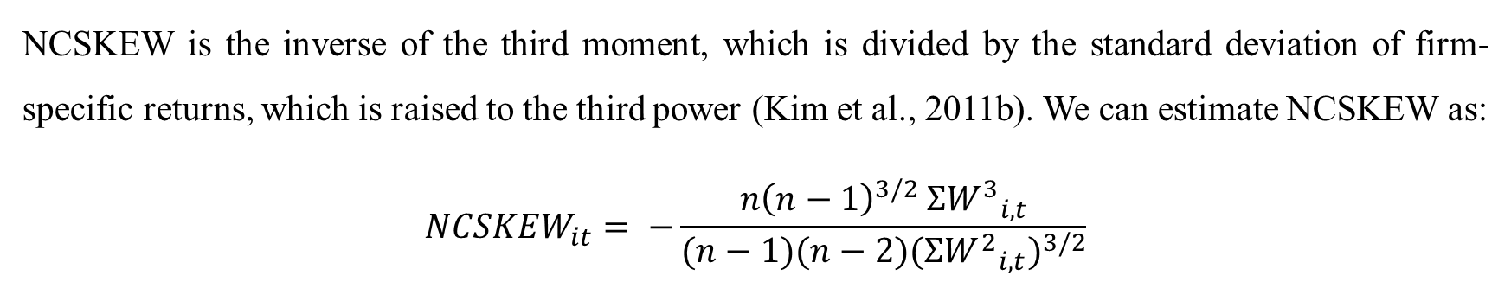
Methodology-III
NCSKEW
NCSKEW is the inverse of the third moment, which is divided by the standard deviation of firm-specific returns, which is raised to the third power (Kim et al., 2011b). We can estimate NCSKEW as:
$$NCSKEW_{it}= −\frac{{n\left(n−1\right)}^{3/2 }{{ΣW}^{3}}_{i,t}}{(n−1)(n−2){({{ΣW}^{2}}_{i,t})}^{3/2}}$$
Where W_{i,t} is the firm-specific return is estimated by taking the natural logarithm of one plus residual. n is the number of daily observations.

Slide 11
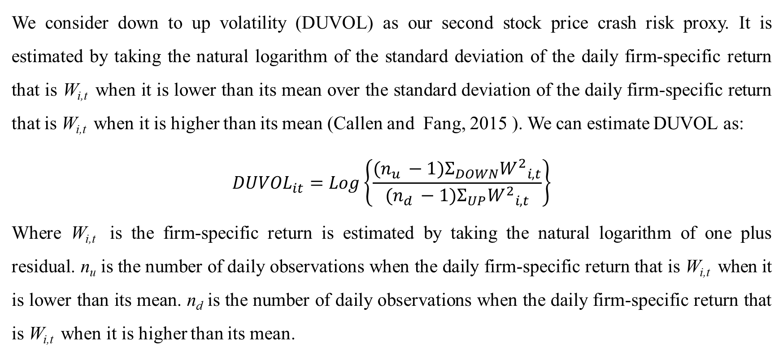
Methodology-III
DUVOL
We consider down to up volatility (DUVOL) as our second stock price crash risk proxy. It is estimated by taking the natural logarithm of the standard deviation of the daily firm-specific return that is W_{i,t} when it is lower than its mean over the standard deviation of the daily firm-specific return that is W_{i,t} when it is higher than its mean (Callen and Fang, 2015 ). We can estimate DUVOL as:
$$DUVOL_{it}=Log\left\{\frac{(n_{u }−1)Σ_{DOWN}{W^{2}}_{i,t}}{(n_{d }−1)Σ_{UP}{W^{2}}_{i,t}}\right\}$$
Where W_{i,t} is the firm-specific return is estimated by taking the natural logarithm of one plus residual. n_{u} is the number of daily observations when the daily firm-specific return that is W_{i,t} when it is lower than its mean. n_{d} is the number of daily observations when the daily firm-specific return that is W_{i,t} when it is higher than its mean.

Slide 12
Model
Bank-level analysis
Difference in difference regression
Panel data regression

Slide 13
Thank You

