Slide 1
Oil Price and the Stock Market: A Structural VAR Model Identified with an External Instrument
Author: Tomas Perez
Adviser: Nam Vu

Slide 2
Motivation
The relatively new identification method, SVAR-IV
Novel method for dealing with endogeneity issues within a system
Lack of empirical work
Recent changes impacting the U.S. energy market over the past decade
Innovations in U.S. oil production
Notes:
Touch on US oil market in a later slide
Renewables surpassed coal consumption for the first time in 130 years in 2019
In 2019, renewables accounted for 11% of total US energy consumption and 17% of electricity generation. It is the fastest growing energy source in the US. Renewable generation doubled in the past decade alone.

Slide 3
Literature Review
Oil Markets and the Economy
J.D. Hamilton (1983), “Oil and the Macroeconomy Since World War II”
M. Keane and E. Prasad (1996), “The Employment and Wage Effects of Oil Price Changes: A Sectoral Analysis”
L. Kilian (2009), “Not All Oil Shocks are Alike: Disentangling Demand and Supply Shocks in the Crude Oil Market”
J.D. Hamilton (2019), “Structural Interpretation of Vector Autoregressions with Incomplete Identification: Revisiting the Role of Oil Supply and Demand Shocks”
Oil Markets and the Stock Market
L. Killian and C. Park (2009, 2014), “The Impact of Oil Price Shocks on the U.S. Stock Market”
P. Sadorsky (1999), “Oil Price Shocks and Stock Market Activity”
C. Ciner (2001), “Energy Shocks and Financial Markets: Nonlinear Linkages”
Notes:
Hamilton finds that all but one US recession since WWII (1948-1972) have been preceded by dramatic increase in the price of crude oil. By extension, energy price increases may account for much of post-OPEC macroeconomic performance.
Keane and Prasad us panal data techniques and an instrument variable to look at the microeconomic impacts of oil price changes. Finds that substantial changes in employment and relative wages across industries.
Kilian differentiates between supply and demand shocks for oil and finds that supply shocks have a larger effect than demand shocks.
Kilian and Park later investigate the impact of oil supply and demand shocks on the US stock market. They find similar results. A reevaluation of the study in 2014 by Kang, Ratti, and Vespignani find further reduced effects.
Hamilton uses SVAR analysis and finds that oil supply shocks lead to reductions in global economic activity, whereas oil demand shocks do not.
Ciner investigates the claims that the linear specification misrepresents the true relationship. This paper is key to this study as it provided the instrument variable used.

Slide 4
Literature Review (Cont.)
Oil markets over time
O. Blanchard and J. Gali (2009), “The Macroeconomic Effects of Oil Price Shocks: Why are the 2000s so Different from the 1970s?”
O. Blanchard and M. Riggi (2013), “Why are the 2000s so different from the 1970s? A Structural Interpretation of Changes in the Macroeconomic Effects of Oil Prices”
M.A. Hooker, “What happened to the Oil Price-Macroeconomy Relationship?”
L. Kilian and R. Barsky (2004), “Oil and the Macroeconomy Since the 1970s”
Structural VAR with External Instruments
C. Romer and D. Romer (1989), “Does Monetary Policy Matter? A New Test in the Spirit of Friedman and Schwartz”
J. Hamilton (2003), “What is an Oil Shock?”
J. Stock, J. Olea, and M. Watson (2018), “Inference in Structural Vector Autoregression Identified with an External Instrument”
J. Stock (2008), “What is new in econometrics: Time Series”
K. Mertens and M. Ravn (2013), “The Dynamic Effects of Personal and Corporate Income Tax Changes in the United States.”
Notes:
O. Blanchard has heavily studied the changing effects of oil shocks. Consistently finds that the impacts have diminished over time.
Others have found similar results. Kilian iterates on Hamilton’s paper, but with a new time frame. He argues that prior studies on the importance of oil price shocks is mistaken and oil prices movements are not exogenous with respect to the US macroeconomy.
Romer and Romer established the “narrative approach” it identify exogenous shocks but suffers from measurement error concerns. Acted as the inspiration for proxy-SVAR approach.
Although Romer and Romer are credited, Hamilton (1985) is also noted as using the narrative approach in historical causes of postwar oil shocks and recessions
Hamilton used an external instrument (exogenous disruptions in oil supply) in a single-equation distributed-lag model to identify shocks that effect GDP growth.
Mertens and Ravn use the narrative shocks developed by Romer and Romer, and implement it in the SVAR-IV methodology
Stock introduced the idea of using instrument variables to identify structural shocks in impulse responses. He and his collaborators have developed the methodology.

Slide 5
Oil Demand and Stock Markets
In studies leading up to 2008, it is generally found that oil price changes have negative relationship with stock markets
Magnitudes and the significance of the effects are often disputed
The relationship between oil prices and the macroeconomy has weakened over time
Incorrect model specification
More flexible labor markets
Changes in monetary policy
Changes in oil production
Oil prices becoming endogenous
Oil Prices cannot be taken as strictly exogenous
Since 2008, studies find small or no significant impact on stock markets
Oil demand and supply shocks jointly do significantly impact U.S. stock returns
Notes:
Huang (1996) finds that oil price returns have a small impact on the US market but have large impacts on specific industries and firms related to energy.
Kual and Jones (1996) find that oil prices do have large impacts on the US, Canada, and Japan. Most studies align with the findings of Kual and Jones.
A common issue that arises is that oil prices can no longer (since 1980) be seen as strictly exogenous since stock market returns also impact oil futures (Ciner, Kilian)

Slide 6
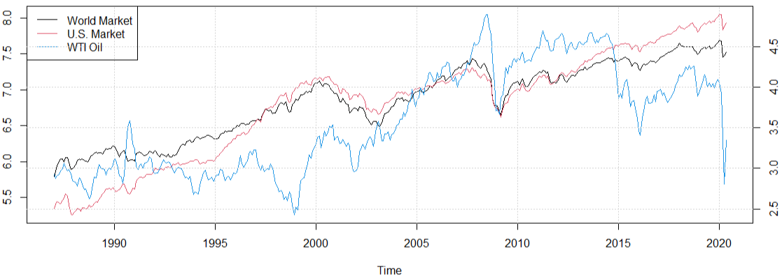
Market Indexes and WTI Oil Price
Log-market indexes (left axis) and log-WTI oil prices (right axis)
Notes:
World and U.S. market indexes are

Slide 7
Structural VAR with External Instruments
Identification in standard VAR models can be classified as internal – the variables used for identification are internal to the system
The goal of the external instrument approach is to find a variable(s) external to the system in order to capture exogenous variation in the shock of interest
The approach takes advantage of information developed outside the VAR, such as a series based on narrative evidence
Commonly referred to as Proxy-SVAR or SVAR-IV
Notes:
The narrative approach involves constructing a series of historical “events” to identify the reason/quantities associated with a particular change in a variable.
Hamilton isolated political events that led to disruptions in world oil markets.
These series were either used as exogenous shocks in sets of dynamic single equation regressions or ordered first in a Cholesky decomposition.
Follow-up literature has operated on the assumption that the narrative alone provides exogeneity. This is not necessarily true and recent innovations have led to improved methods for incorporating these series.
Structural VAR models are used to estimate the dynamic causal effects of structural shocks through a system of simultaneous equations, allowing variables to have a contemporaneous effect on other variables in the system.
Modern microeconomics have developed techniques to use external sources of variation to identify causal effects.

Slide 8



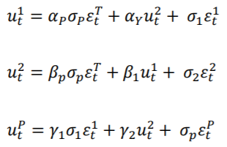
SVAR-IV Example
Consider a 3-variable model where are three endogenous variables. We want to identify shocks to the variable indicated by P. The reduced-form VAR is
The reduced-form residuals are related to the structural shocks as follows:
Notes:
This example comes from Valerie Ramey (2016), “Macroeconomic Shocks and Their Propagation”
Dt represents a constant and other deterministic terms, A(L) is our lag operator, and ut is our reduced-form residuals
B is a nonsingular matrix of coefficients, and episilon is underlying structural shocks
Following Mertens and Ravn (2013):
3rd Row: gamma1 and gamma2 represent the endogenous response of Xp to X1 and X2
1st and 2nd Row: alpha(p) and beta(p) represent the contemporaneous effect of X1 and X2 to Xp
All: sigmas represent the standard deviations of the structural shocks

Slide 9

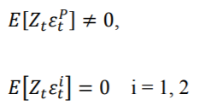
External Instrument Conditions
Let represent the external instrument that we will use to identify the shock . is considered valid if the following two conditions are met:
The first condition is the relevance condition: The instrument is contemporaneously correlated with the structural shock of interest.
The second condition is the exogeneity condition: The instrument must be contemporaneously uncorrelated with the other structural shocks in the system.
Notes:
The first condition is our relevance condition. The instrument is contemporaneously correlated with the structural shock of interest.
The second condition is our exogeneity condition. The instrument must be contemporaneously uncorrelated with the other structural shocks in the system.
There is a third condition that can be relaxed that we will touch on later.

Slide 10
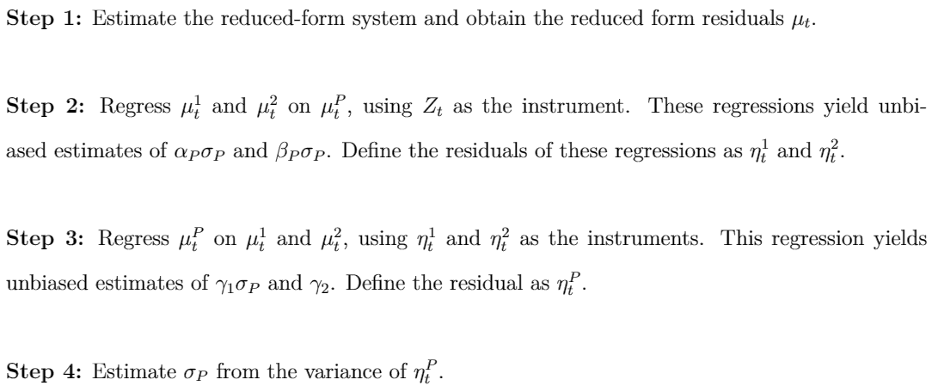
SVAR-IV Steps
The SVAR-IV procedure is as follows:

Slide 11
This Study
The goal is to estimate the dynamic causal effects of oil price fluctuations on stock market returns using SVAR-IV
Compare results between SVAR-IV model and a Cholesky-Identified SVAR model
Investigate how responses to oil demand shocks have changed over time
Notes:
We will treat other variables in the system purely as controls, and not concern ourselves with

Slide 12
Data
Total U.S. Market
Consumer Discretionary
Consumer Staples
Energy
Financials
Utilities
Healthcare
Information Technology
Real Estate
Industrials
Materials
Telecommunications
Sample includes monthly data that spans from January 1987 to May 2020
The variable of interest is monthly average returns of the U.S. stock market disaggregated at two levels:
Total U.S. market index and sector-level indexes.
Sector indexes include the 11 GICS identified sectors
Notes:
January 1987 is the earliest date where I could get a complete dataset without missing data.
Timeframe was expanded to May 2020 in an effort to account for recent disruptions caused by the COVID-19 pandemic.
Thomson Reuters Datastream indexes
Sectors are generally a broad classification composed of sub-sectors and industries and not easily delineated.
The Global Industry Classification Standard was developed by MSCI and Standard and Poors. We include the 11 broad GICS sectors commonly used for sectoral breakdown reporting.
Consumer Discretionary is composed of goods considered non-essential, but desirable. Durable goods, high-end, entertainment and leisure, etc.
Consumer Staples is composed of goods considered essential.
Utilities are composed of basic amenities like water, sewage, electricity, and natural gas (power generation).
Energy is composed of energy production and supply. Oil or gas reserves, drilling, refining. The energy sector does include integrated power utility companies.

Slide 13
Data (Cont.)
WTI Oil price return is the regressor of interest
Control variables included to account for systematic risk:
World total-market index
U.S. industrial production
Inflation rate
10-year treasury rate
No.2 Heating Oil is the chosen external instrument
Notes:
When investigating stock returns, it’s important to distinguish between idiosyncratic and systematic risk.
Idiosyncratic risk is generally referred to as the inherent risk in an asset, typically mitigated by diversification in a portfolio and therefore uncorrelated with aggregate market returns. Using market indexes we don’t have to concern ourselves with idiosyncratic risk.
Systematic risks are broader trends that affect the market as a whole and are not so easily mitigated. Its important to include systematic variables as controls in this study.
Note: All variables are computed as the first log-difference (monthly percentage change).
Inflation rate is included as a proxy for the Effective Federal Funds Rate. The Effective Funds Rate doesn’t change month-to-month, so inflation rate was chosen over it to gain meaningful variation.
Still wanted a variable to account more strongly for monetary policy changes, so the 10-year treasury rate was included. Changes regularly, giving sufficient variation.

Slide 14
Choice of External Instrument
Heating oil is used as fuel for furnaces and boilers in buildings, primarily in the Northeast region of the United States.
From one 42-gallon barrel of crude oil, approximately 11-12 gallons of distillate fuel is refined.
Distillate fuel is then sold as diesel fuel and heating oil
Ciner (2001) finds that crude oil futures influence the U.S. stock market, but heating oil futures do not.
Notes:
Theoretically, the price of heating oil act as a strong instrument. It is highly correlated with crude oil prices and uncorrelated with stock market returns, thus satisfying the two conditions for a suitable instrument.
First-Stage F-Stat = 193.86 >10

Slide 15
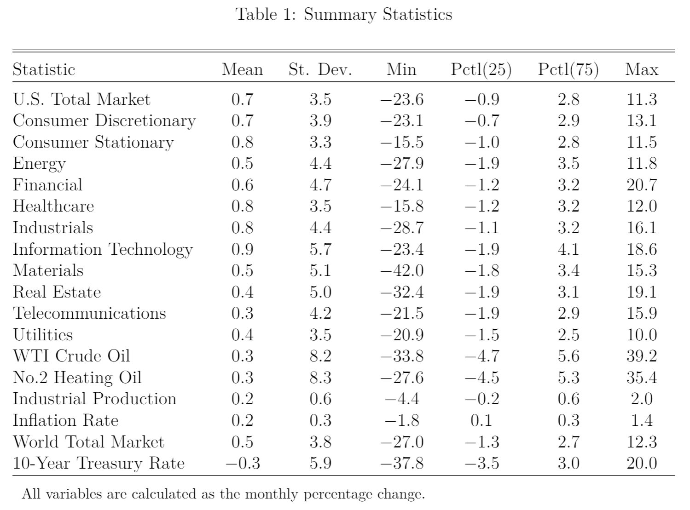
Notes:
We are dealing with monthly average percentage changes typically less than 1%

Slide 16
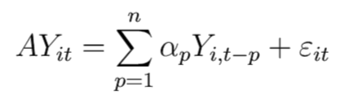




Model and Identification
Consider the structural VAR model:
Since , an estimate of the covariance matrix of the reduced-form errors provides j ( j – 1 )/2 = 30 identifying restrictions. However, we require additional identifying assumptions for the elements of at least the last column of B.
Notes:
A is a 6x6 matrix of contemporaneous coefficients. The reduced-form VAR model is obtained by multiplying both sides of the equation by the inverse of A.
Y is 6 variable vector of endogenous variables (i = 1,…,12). We run a model for each variable of interest, so 12 runs
Where epsilon is a vector of serially and mutually uncorrelated structural disturbances.
The reduced-form errors can be expressed as eta, let B represent the inverse of A.
The latent variables of epsilon are estimated on the basis of the prediction errors of Y (the vector of endogenous variables), conditional on the information contained in the vector of lagged dependent variables X

Slide 17

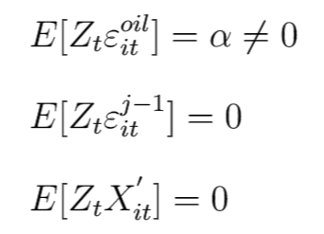

Model and Identification (Cont.)
Consider the following partition:
The third condition requires that the instrument is orthogonal to the history of the variables in the endogenous vector
Notes:
Epsilon(oil) is the shock of interest, and epsilon(j-1) is a (j – 1)x1 vector containing all other shocks in the system.
We have our relevance condition, our exclusion restriction.
The third condition can be relaxed, because when the instrument is correlated with the lagged dependent variables, then Z becomes the projection error on X.
As long as the instrument is orthogonal to other shocks (condition 2) then they contain information that can be exploited for identification.

Slide 18
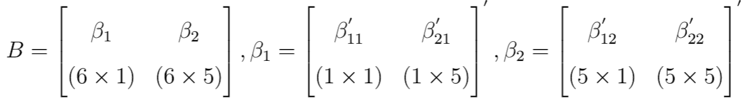

Model and Identification (Cont.)
Consider the partition of B for a single VAR(p) system (i.e. for one of the variables of interest):
The instrument conditions imply,
Notes:
Beta1 is the column of the B matrix that requires further restrictions for identification
Alpha times the transpose of the first column of B is equivalent to the expected value of instrument on the reduced-form errors. Provides additional identifying restrictions, but we do not want to make assumptions on theta.

Slide 19
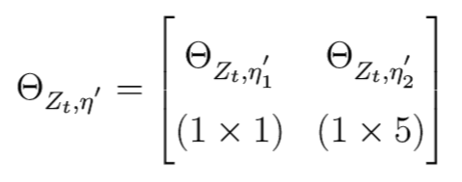

Model and Identification (Cont.)
Further partitioning of Theta gives the following:
Notes:
Since this is estimable, this constitutes a set of covariance restrictions necessary for identification.

Slide 20
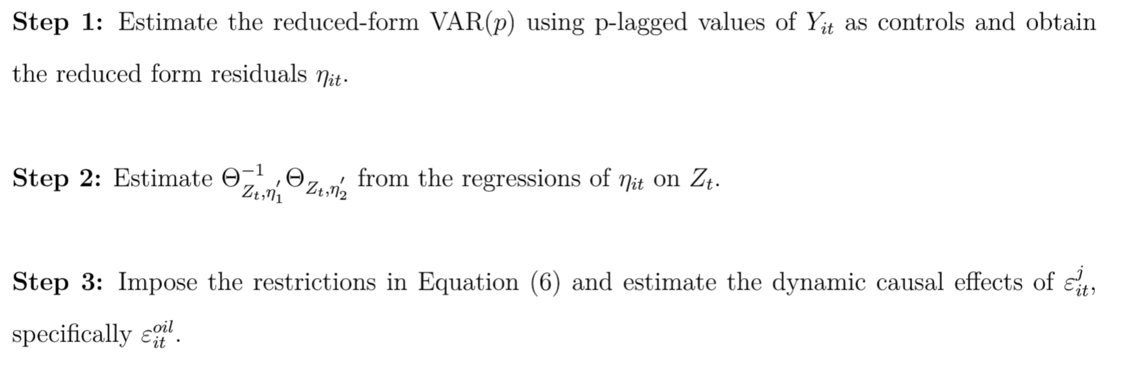
In Practice

Slide 21
Impulse Response Functions
SVAR-IV (Full-sample) 1987:01 – 2020:05
Standard SVAR (Full-sample) 1987:01 – 2020:05
SVAR-IV Cumulative IRF Rolling Window 1995:01 – 2020:05
SVAR-IV (Prior to Great Recession) 1987:01 – 2007:12
SVAR-IV (Prior to COVID-19 pandemic) 1987:01 – 2019:12
Notes:
Impulse responses are estimated over a horizon of 12 months.
Following the advice of Kilian and Ivanov (2005) that AIC produces the most accurate impulse responses for monthly structural models, AIC is used to determine the lag order selection of p=1 lag.
Its worth noting that SBC/SIC also suggests the use of p=1 lags.
For comparison we maintain 1 lag for all sets of impulse responses.
Bootstrapped 95% confidence intervals over 100 runs are included. 100 runs was chosen, because the code took upwards of 30 minutes to run for one system (reminder that we have 12 systems total).

Slide 22
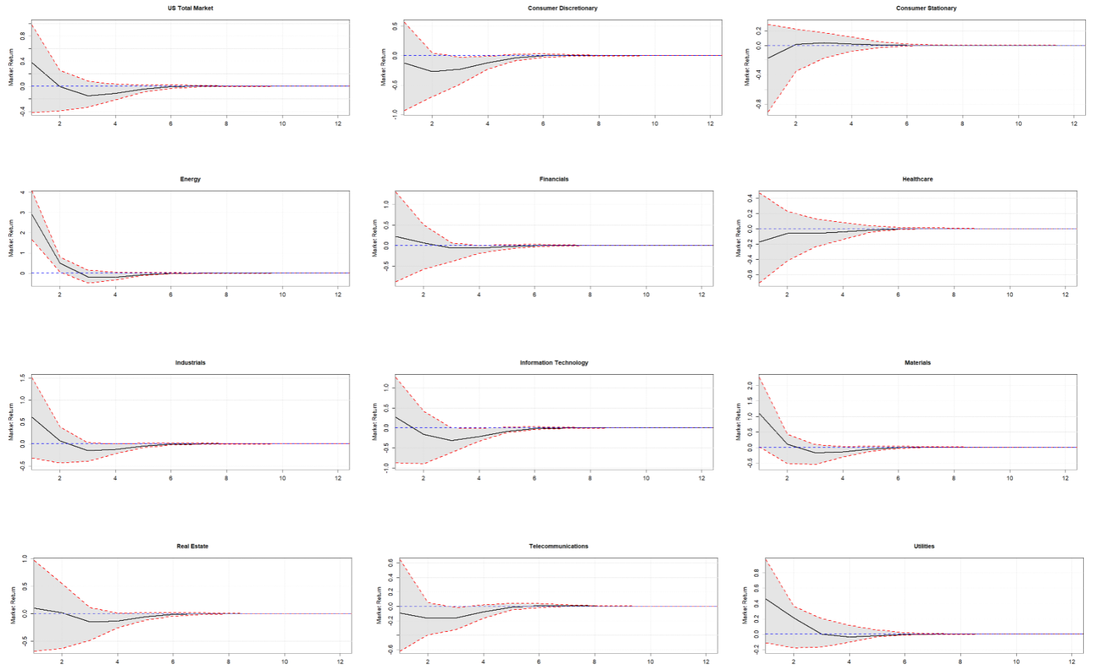
Impulse Responses to Oil Price Shock (SVAR-IV) 1987:01 – 2020:05
Notes:
Overall the responses to an unexpected oil demand shock are small in magnitude and mostly insignificant. Only the Energy and Materials sectors see returns greater than 1% in absolute terms.
A negative response in the first month following the shock is only found in 4 of the 11 sectors and not in the total market index. The sectors that do have a negative response in the first month are all near zero.
This contradicts most prior studies that state that positive oil price shocks are generally associated with negative stock market responses.
However, by the third month 10 of 11 sectors and the total market see a negative impact.
This gives me the idea that potentially 3 lags should be used in the models, and sure enough, if you restrict the model to 2019, AIC suggests 3 lags. This is worth investigating in a follow-up.
Responses stabilize around the sixth month following a shock, and are virtually gone by the eighth month.
The results are semi-consistent with prior studies. Again, most studies show mostly negative responses in reaction to an oil price shock, even if it is small in magnitude.
Something worth noting for all graphs in this study: pay close attention to the y-axis. They are not consistent across graphs.

Slide 23
Differentiating Factors in This Study
This study finds a more positive stock market response to an oil price shock, albeit small, compared to prior studies
The discrepancies can be attributed to two factors:
The use of an external instrument in identification
The sample period 1987:01 – 2020:05
SVAR-IV estimates will differ from Cholesky-identified estimates
Recent events and innovations in the past ten years have changed market dynamics

Slide 24
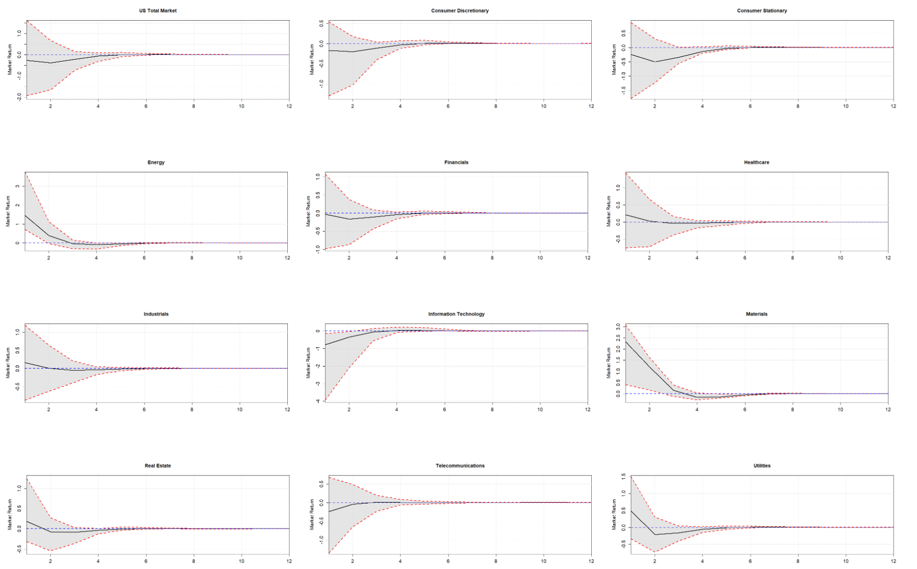
Impulse Responses to Oil Price Shock (SVAR) 1987:01 – 2020:05
Notes:
The standard SVAR estimation remains the same as for the SVAR-IV estimation
The results are similarly small in magnitude
Now 5 of 11 sectors and the total market see negative returns in the month following an oil price shock.
Overall the results are more depressed compared to the SVAR-IV model, with the exception of the Materials and, barely, the Utilities sectors
This is consistent with Stock’s 2018 reevaluation of Kilian (2009) study on oil shocks. Kilian used a 3 variable model (oil price, oil production, and global activity index)
Stock, Watson, and Olea find that the SVAR-IV estimates are generally larger than Cholesky-identified estimates.
So the SVAR-IV results are more pronounced.
Why? We are now controlling for endogeneity

Slide 25
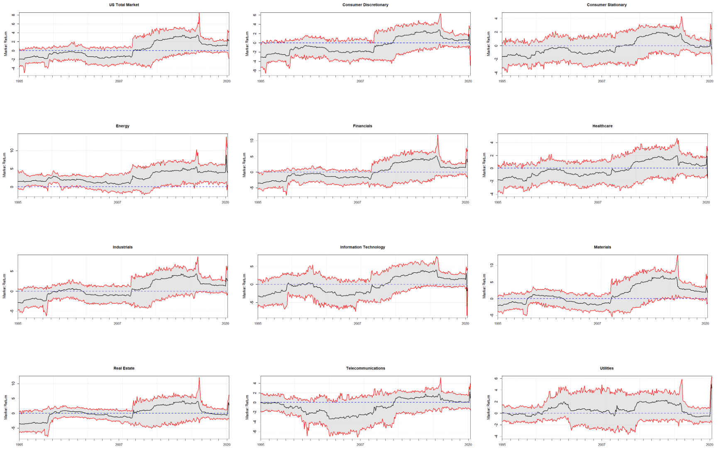
Cumulative Impulse Responses to Oil Price Shock, 8-Year Rolling Window (SVAR-IV)
Notes:
Now we look at how oil price shocks have impacted stock returns over time.
We use an 8-year rolling window analysis of cumulative impulse responses. The first period you’ll see is January 1995.
Several things to note: 1) 1998 responses jumped to be closer to zero
2) mostly negative responses leading up to 2008-2010. However, Energy and Utilities were generally positive.
3) Around the time of the Great Recession, market responses to an oil price shock changed from negative to positive and have stayed positive
4) We have a large shock in 2020

Slide 26
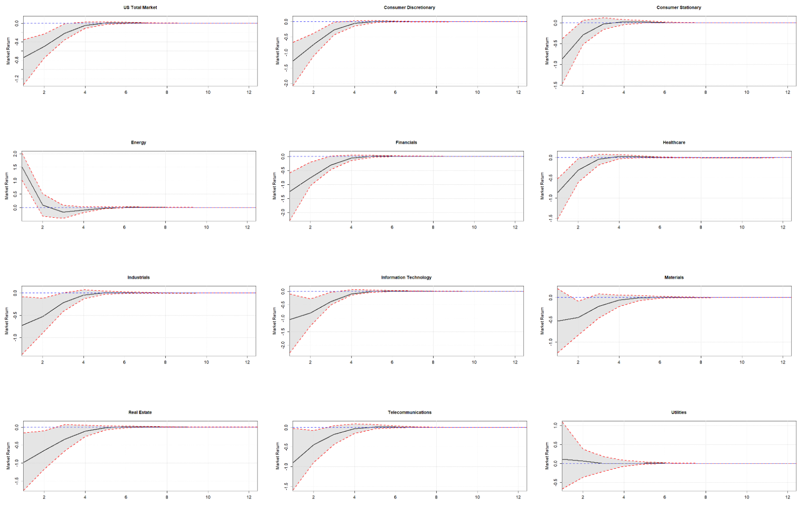
Impulse Responses to Oil Price Shock (SVAR-IV) 1987:01 – 2007:12
Notes:
Results are much larger in magnitude, and stock returns more consistently respond negatively to a positive oil price shock with the exception of Energy and Utilities
These results are more in-line with the findings of prior studies.
December of 2007 is considered the start of the Great Recession by the National Bureau of Economic Research

Slide 27
U.S. Oil Production
U.S. oil production peaked at 10 million barrels per day in 1970
Steadily declined to approximately 4 million barrels per day in 2008
Recent innovations in the extraction of crude oil have resulted in substantial growth in U.S. oil production
In 2018, U.S. oil production surpassed the 1970 peak
In 2019, the U.S. produced approximately 12 million barrels per day and exported more oil than imported for the first time in 75 years
The EIA projects the U.S. will remain a net oil exporter until at least 2050
In March 2020, oil production reached 13 million barrels per day
Currently, oil production fell to 11 million barrels per day
Notes:
Oil production more than doubled in 2019 from 10 years prior.
The increase in U.S. oil production is driven mostly by fracking and production from tight rock formations in states like Texas, North Dakota, New Mexico, and Colorado.
5th bullet

Slide 28
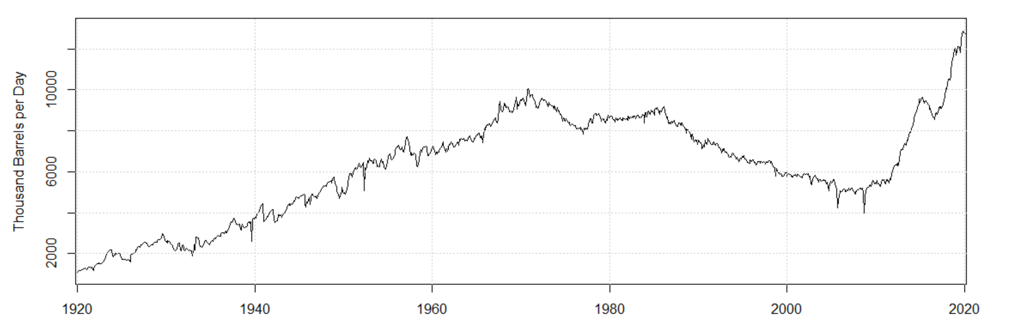
U.S. Oil Production (Cont.)

Slide 29
The COVID-19 Pandemic
December 2019
The coronavirus disease 2019 (COVID-19) pandemic is an ongoing global pandemic that was first identified in Wuhan
January 2020
WHO declares the coronavirus an international public emergency
March 2020
WHO declares the coronavirus a global pandemic
April 2020
U.S. GDP falls to 4.8% in Q1 2020
Unemployment reached 14.7%
U.S. oil turns negative for the first time in history at -$36.96 per barrel
As of July 18, 2020
There are approximately 14.5 million cases and over 600,000 deaths
The U.S. accounts for approximately 3.8 million cases and over 142,000 deaths
Notes:
The original sample period for this paper was supposed to end in December 2019 but was extended to May 2020 in an effort to look at recent disturbances from the COVID-19 pandemic.
Cases continue to rise, and July 16 saw a peak of 250,000 daily cases worldwide
The US has been hit particularly hard
As of July 16, the US saw 75,000 daily cases
Some states have managed the virus better than others. While New York and New Jersey have seen a large number of cases and more deaths than any other state, they are currently seeing decreased number of cases.
States like Florida, California, Texas, and Georgia have seen significant increases in covid cases.
The draft of the paper that was sent, was updated one week ago. I urge you to look at the paper and compare what was written to what is happening now.
In that one week, the US has seen nearly 1 million new cases, and over 10,000 more deaths.
U.S GDP fell nearly 5% in Q1 2020, putting an end to the longest period of expansion in U.S. history
Unemployment rate reached an all time14.7%, nearly 5% higher than the highest unemployment rate during the Great Recession

Slide 30
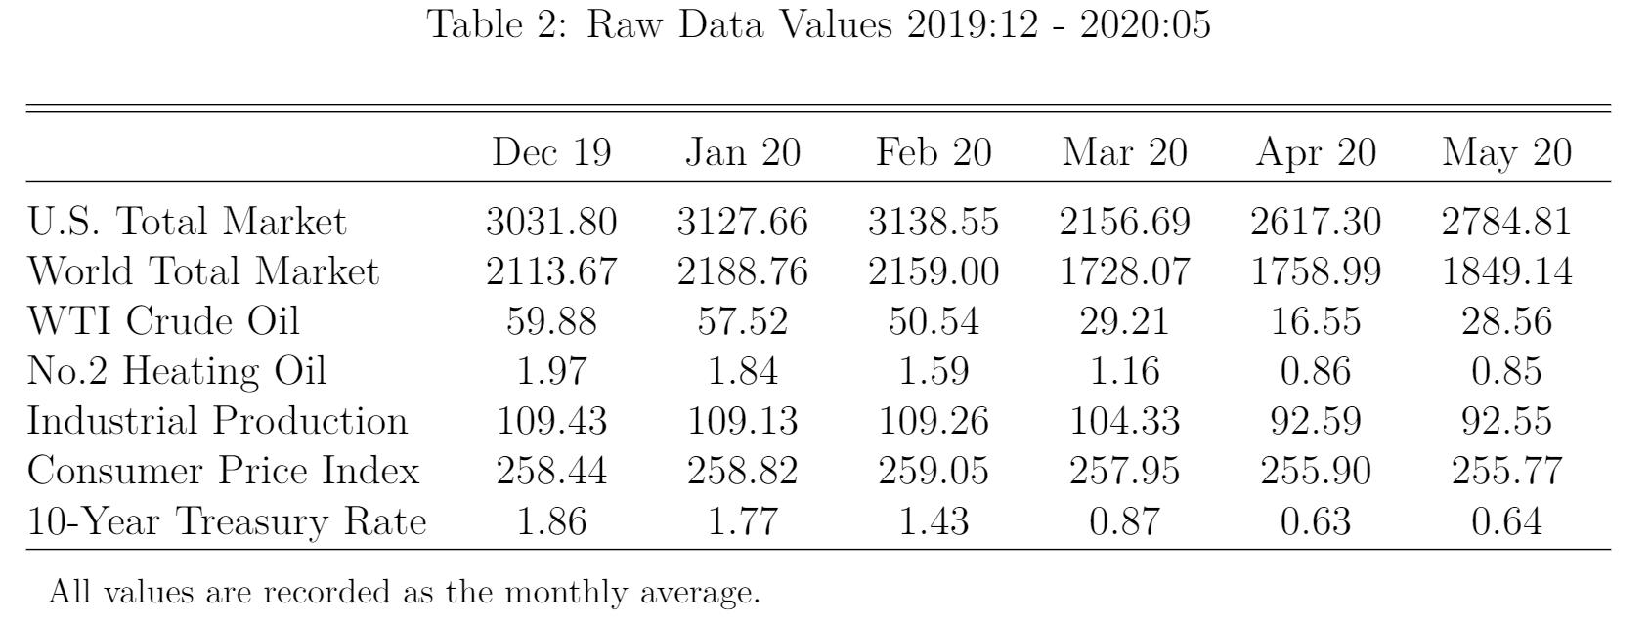

Slide 31
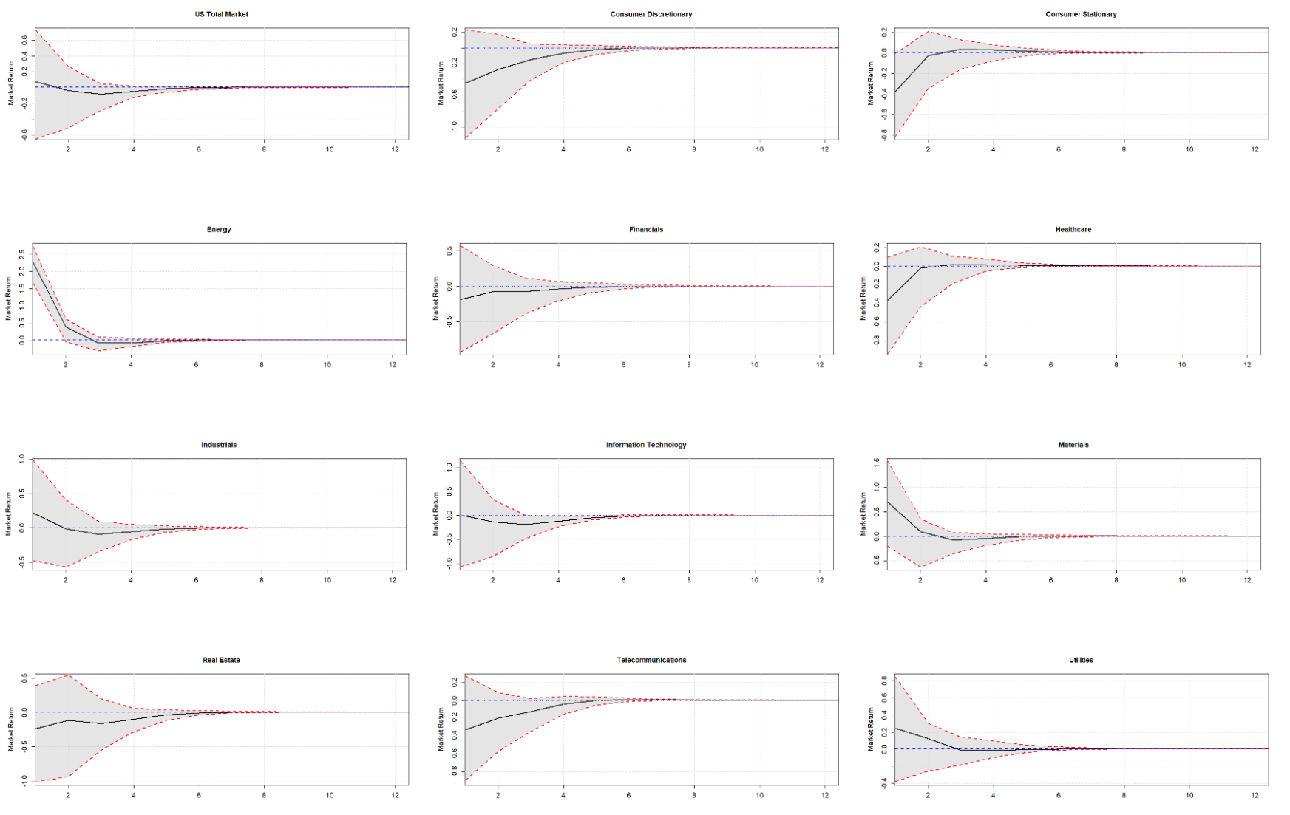
Impulse Responses to Oil Price Shock (SVAR-IV) 1987:01 – 2019:12
Notes:
Here we see that 6 of 11 sectors see initial negative returns in response an oil price shock. The responses are smaller in magnitude than the results from the model including the COVID-19 pandemic.

Slide 32
Conclusion
Generally, U.S. stock returns do not respond in a large way to oil price shocks
The Energy and Materials sectors be exceptions
Though small in magnitude, more sectors are beginning to see a positive response to a positive oil price shock
SVAR-IV estimates tend to be larger in magnitude than Cholesky-identified estimates
Following 2008, the U.S. oil market changed dramatically, causing stocks to react in different manner found in prior studies
The COVID-19 pandemic has further shifted responses upwards

