Slide 1




  Alloy Analyzer 4 Tutorial
  Session 1: Intro and Logic
  Greg Dennis and Rob Seater
  Software Design Group, MIT

Slide 2

agenda
Session 1: Intro & Logic
  break
Session 2: Language & Analysis
  lunch
Session 3: Static Modeling
  break
Session 4: Dynamic Modeling
M.C. Escher

Slide 3
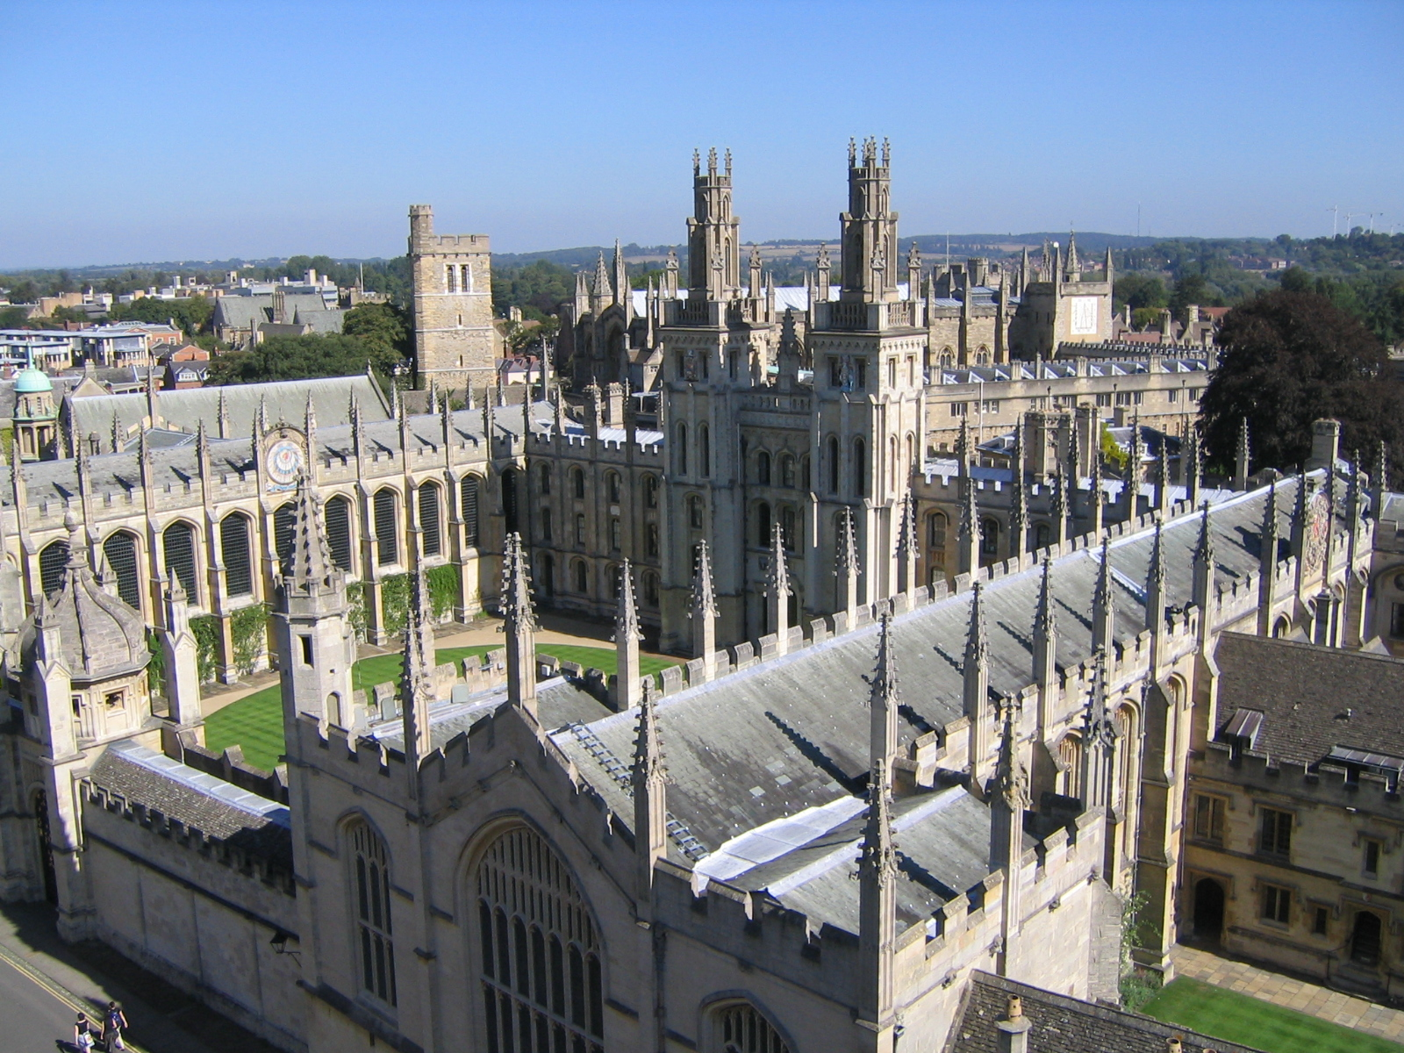

trans-atlantic analysis
notation inspired by Z
  sets and relations
  uniformity
  but not easily analyzed
analysis inspired by SMV
  billions of cases in seconds
  counterexamples not proofs
  but not declarative
Oxford, home of Z
Pittsburgh, home of SMV

Slide 4
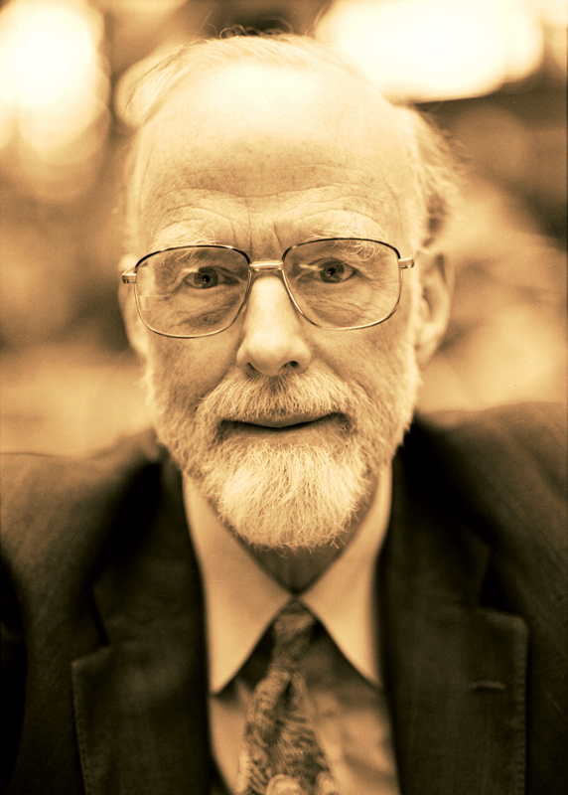
why declarative design?
I conclude there are two ways of constructing a software design.
One way is to make it so simple there are obviously no deficiencies, and the other way is to make it so complicated that there are no obvious deficiencies.
– Tony Hoare [Turing Award Lecture, 1980]

Slide 5

why automated analysis?
The first principle is that you must not fool yourself, and you are the easiest person to fool.
– Richard P. Feynman

Slide 6

alloy case studies
Multilevel security (Bolton)
Multicast key management (Taghdiri)
Rendezvous (Jazayeri)
Firewire (Jackson)
Intentional naming (Khurshid)
Java views (Waingold)
Access control (Zao)
Proton therapy (Seater, Dennis)
Chord peer-to-peer (Kaashoek)
Unison file sync (Pierce)
Telephone switching (Zave)

Slide 7
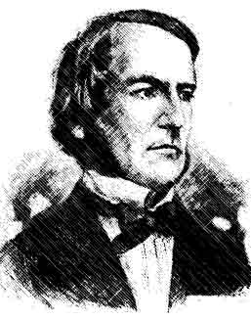
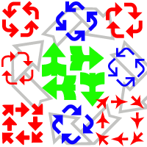


four key ideas . . .
everything is a relation
non-specialized logic
counterexamples & scope
analysis by SAT

Slide 8
1) everything's a relation
Alloy uses relations for
  all data types – even sets, scalars, tuples
  structures in space and time
key operator is dot join
  relational join
  field navigation
  function application
s1

Slide 9
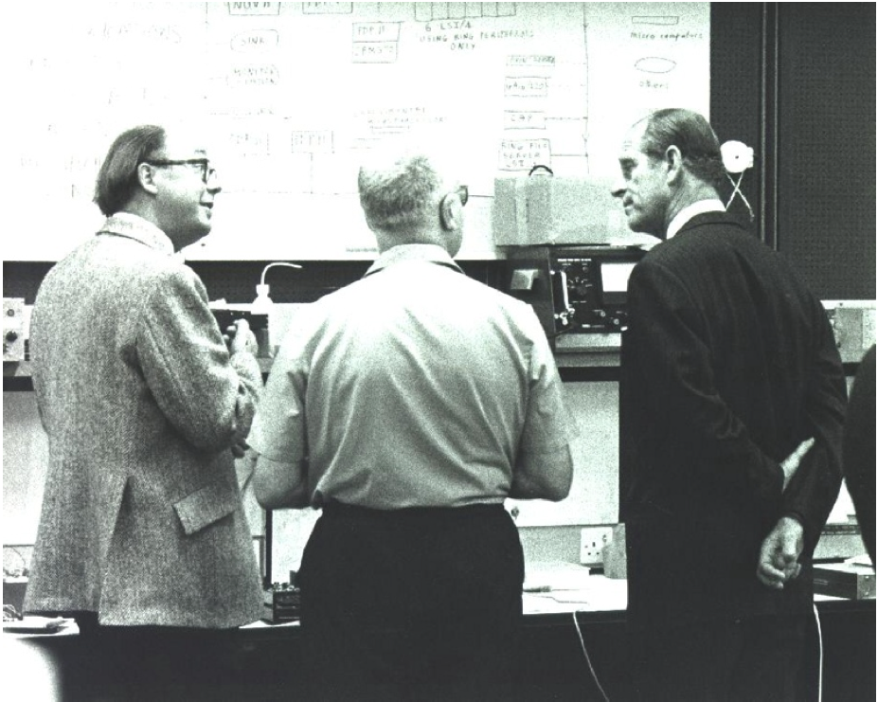
why relations?
easy to understand
  binary relation is a graph or mapping
easy to analyze
  first order (tractable)
uniform
There is no problem in computer science that cannot be solved by an extra level of indirection.
– David Wheeler
Wheeler

Slide 10
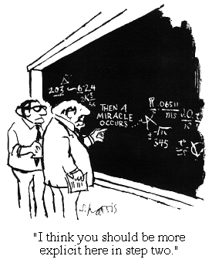
2) non-specialized logic
No special constructs for state machines, traces, synchronization, concurrency . . .

Slide 11
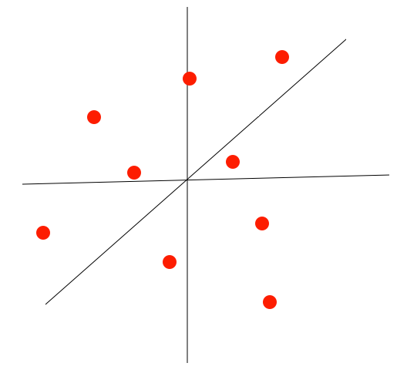
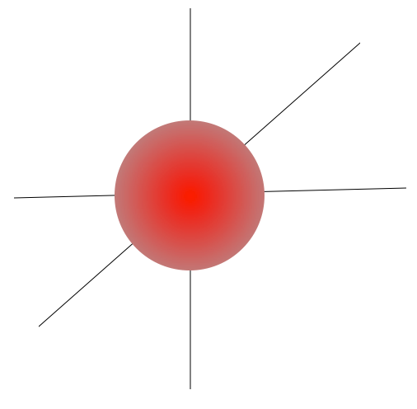
3) counterexamples & scope
observations about design analysis:
  most assertions are wrong
  most flaws have small counterexamples
testing:
a few cases of arbitrary size
scope-complete:
all cases within a small bound

Slide 12

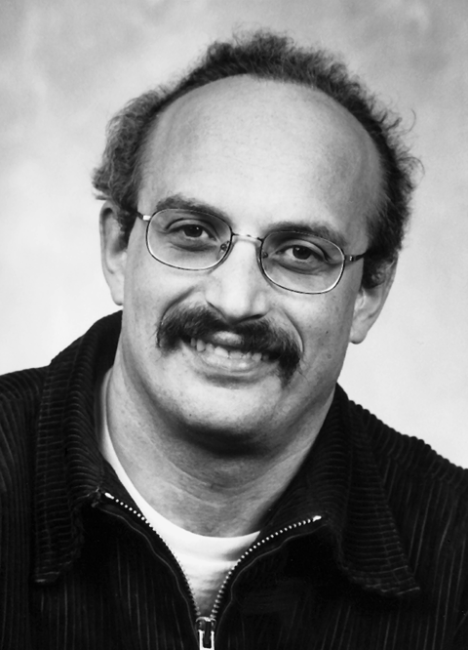



4) analysis by SAT
SAT, the quintessential hard problem (Cook 1971)
  SAT is hard, so reduce SAT to your problem
SAT, the universal constraint solver (Kautz, Selman, ... 1990's)
  SAT is easy, so reduce your problem to SAT
  solvers: Chaff (Malik), Berkmin (Goldberg & Novikov), ...
Stephen Cook
Eugene Goldberg
Henry Kautz
Sharad Malik
Yakov
Novikov

Slide 13
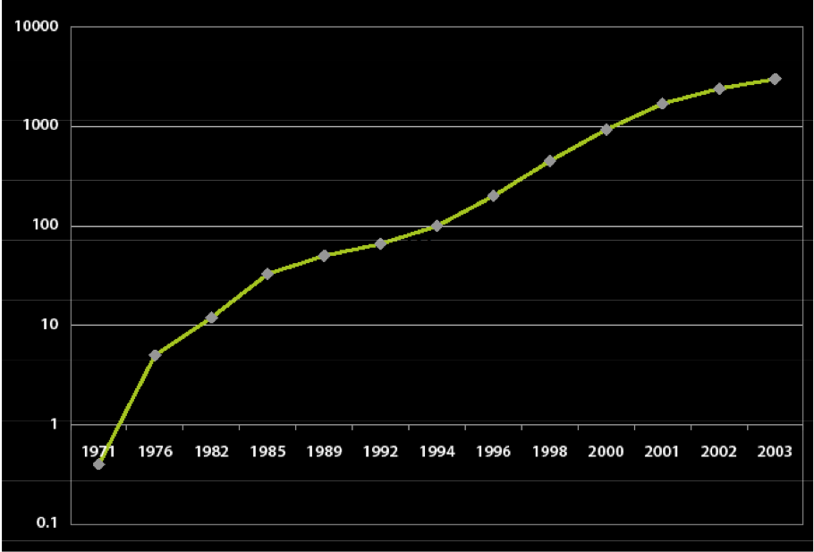
Moore's Law

Slide 14
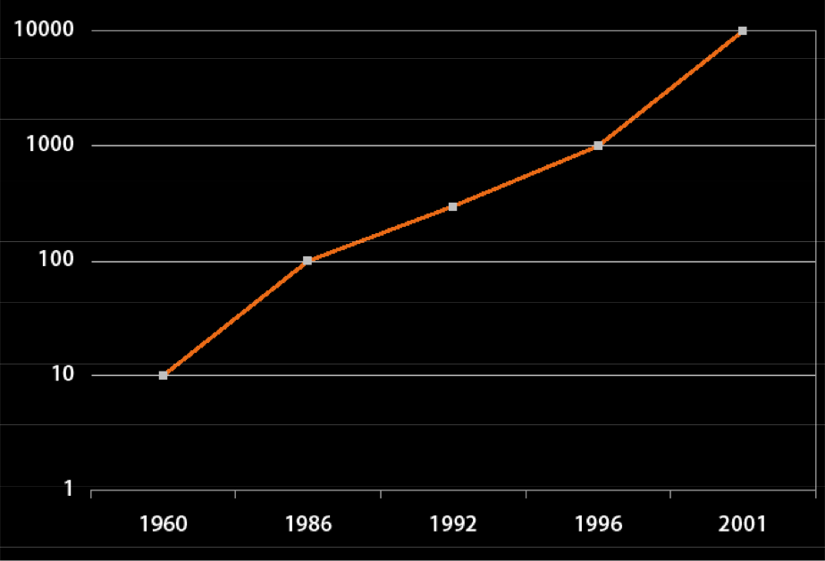
SAT performance

Slide 15
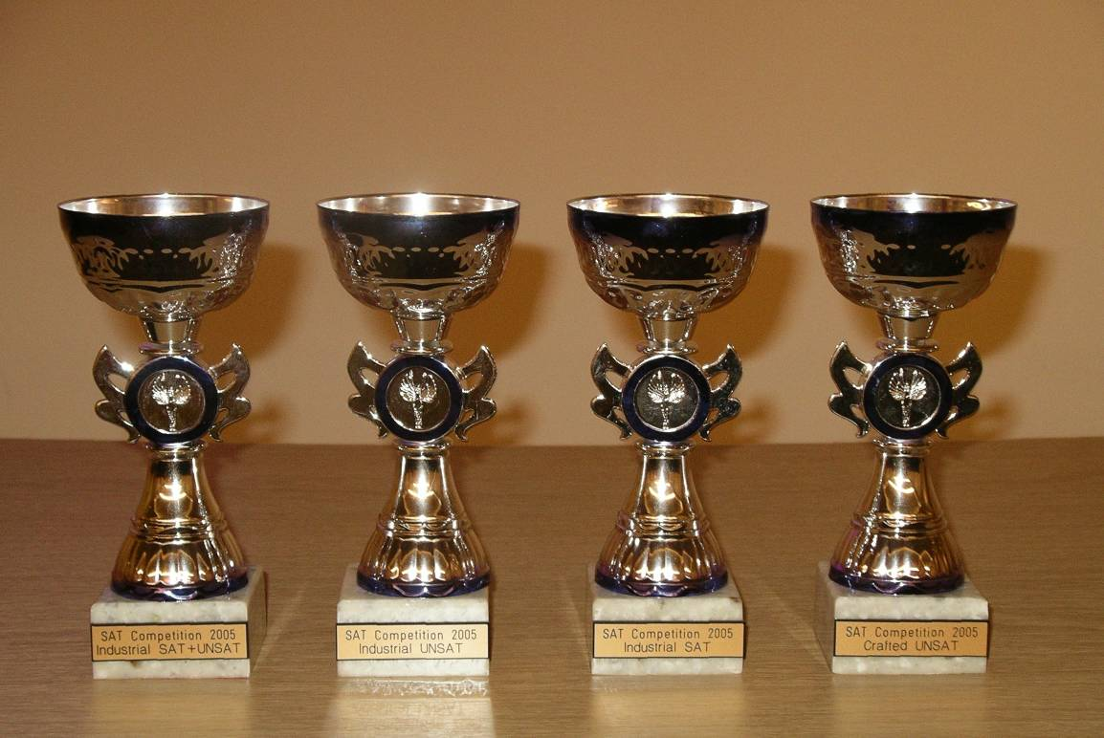
SAT trophies

Slide 16
install the Alloy Analyzer
Requires Java 5 runtime environment
  http://java.sun.com/
download the Alloy Analyzer 4
  http://alloy.mit.edu/alloy4/
run the Analyzer
  double click alloy4.jar or
  execute java -jar alloy4.jar at the command line
this bullet indicates something you should do

Slide 17
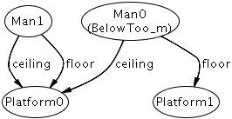
verify the installation
Click the “file” menu, then click “open sample models” to open examples/toys/ceilingsAndFloors.als
click the “Execute” icon
  output shows graphic
need troubleshooting?
  http://alloy.mit.edu/alloy4/

Slide 18
modeling “ceilings and floors”
sig Platform {}
  there are “Platform” things
sig Man {ceiling, floor: Platform}
  each Man has a ceiling and a floor Platform
pred Above [m, n: Man] {m.floor = n.ceiling}
  Man m is “above” Man n if m's floor is n's ceiling
fact {all m: Man | some n: Man | Above[n,m] }
  "One Man's Ceiling Is Another Man's Floor"

Slide 19
checking “ceilings and floors”
assert BelowToo {
all m: Man | some n: Man | Above [m,n]
}
  "One Man's Floor Is Another Man's Ceiling"?
check BelowToo for 2
  check "One Man's Floor Is Another Man's Ceiling"
  counterexample with 2 or less platforms and men?
clicking “Execute” ran this command
  counterexample found, shown in graphic

Slide 20
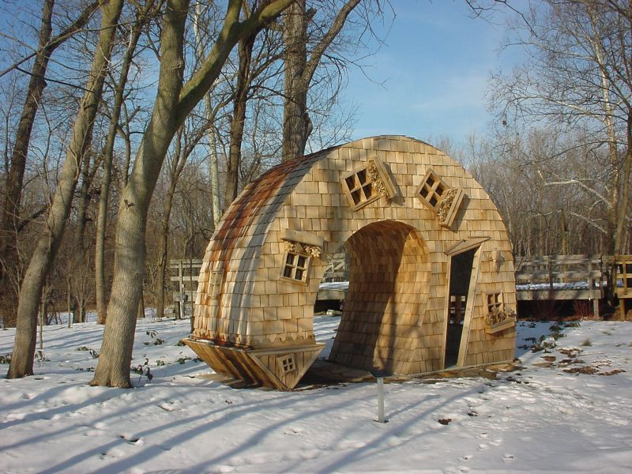
counterexample to “BelowToo”
McNaughton

Slide 21
Alloy = logic + language + analysis
logic
  first order logic + relational calculus
language
  syntax for structuring specifications in the logic
analysis
  bounded exhaustive search for counterexample to a claimed property using SAT

Slide 22
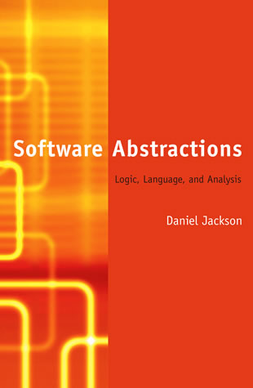
software abstractions

Slide 23
logic: relations of atoms
atoms are Alloy's primitive entities
  indivisible, immutable, uninterpreted
relations associate atoms with one another
  set of tuples, tuples are sequences of atoms
every value in Alloy logic is a relation!
  relations, sets, scalars all the same thing

Slide 24
logic: everything's a relation
sets are unary (1 column) relations
Name = {(N0), Addr = {(A0), Book = {(B0),
(N1), (A1), (B1)}
(N2)} (A2)}
scalars are singleton sets
myName = {(N1)}
yourName = {(N2)}
myBook = {(B0)}
binary relation
names = {(B0, N0),
(B0, N1),
(B1, N2)}
ternary relation
addrs = {(B0, N0, A0),
(B0, N1, A1),
(B1, N1, A2),
(B1, N2, A2)}

Slide 25
logic: relations
addrs = {(B0, N0, A0), (B0, N1, A1),
(B1, N1, A2), (B1, N2, A2)}
rows are unordered
columns are ordered but unnamed
all relations are first-order
  relations cannot contain relations, no sets of sets
B0 N0 A0
B0 N1 A1
B1 N1 A2
B1 N2 A2
size = 4
arity = 3

Slide 26
logic: address book example
Name = {(N0), (N1), (N2)}
Addr = {(A0), (A1), (A2)}
Target = {(N0), (N1), (N2), (A0), (A1), (A2)}
address = {(N0, A1), (N1, N2), (N2, A1), (N2, A0)}
Target
Addr
Name
N0
address
A1
N1
address
A2
address
address
N2
A0

Slide 27
logic: constants
none empty set
univ universal set
iden identity relation
Name = {(N0), (N1), (N2)}
Addr = {(A0), (A1)}
none = {}
univ = {(N0), (N1), (N2), (A0), (A1)}
iden = {(N0, N0), (N1, N1), (N2, N2),
(A0, A0), (A1, A1)}

Slide 28
logic: set operators
+ union
& intersection
- difference
in subset
= equality
Name = {(N0), (N1), (N2)}
Alias = {(N1), (N2)}
Group = {(N0)}
RecentlyUsed = {(N0), (N2)}
Alias + Group = {(N0), (N1), (N2)}
Alias & RecentlyUsed = {(N2)}
Name – RecentlyUsed = {(N1)}
RecentlyUsed in Alias = false
RecentlyUsed in Name = true
Name = Group + Alias = true
greg = {(N0)}
rob = {(N1)}
greg + rob = {(N0), (N1)}
greg = rob = false
rob in none = false
cacheAddr = {(N0, A0), (N1, A1)}
diskAddr = {(N0, A0), (N1, A2)}
cacheAddr + diskAddr = {(N0, A0), (N1, A1), (N1, A2)}
cacheAddr & diskAddr = {(N0, A0)}
cacheAddr = diskAddr = false

Slide 29
logic: product operator
Name = {(N0), (N1)}
Addr = {(A0), (A1)}
Book = {(B0)}
Name->Addr = {(N0, A0), (N0, A1),
(N1, A0), (N1, A1)}
Book->Name->Addr =
{(B0, N0, A0), (B0, N0, A1),
(B0, N1, A0), (B0, N1, A1)}
-> cross product
b = {(B0)}
b' = {(B1)}
address = {(N0, A0), (N1, A1)}
address' = {(N2, A2)}
b->b' = {(B0, B1)}
b->address + b'->address' =
{(B0, N0, A0), (B0, N1, A1), (B1, N2, A2)}

Slide 30
logic: relational join
p q
(a, b)
(a, c)
(b, d)
(a, d, c)
(b, c, c)
(c, c, c)
(b, a, d)
(a, c, c)
(a, a, d)
p.q ≡ · =
x f
x.f ≡ · =
(a)
(c)
(a, b)
(b, d)
(c, a)
(d, a)

Slide 31
logic: join operators
. dot join
[] box join
e1[e2] = e2.e1
a.b.c[d] = d.(a.b.c)
Book = {(B0)}
Name = {(N0), (N1), (N2)}
Addr = {(A0), (A1), (A2)}
Host = {(H0), (H1)}
myName = {(N1)}
myAddr = {(A0)}
address = {(B0, N0, A0), (B0, N1, A0), (B0, N2, A2)}
host = {(A0, H0), (A1, H1), (A2, H1)}
Book.address = {(N0, A0), (N1, A0), (N2, A2)}
Book.address[myName] = {(A0)}
Book.address.myName = {}
host[myAddr] = {(H0)}
address.host = {(B0, N0, H0), (B0, N1, H0), (B0, N2, H1)}

Slide 32
logic: unary operators
~ transpose
^ transitive closure
* reflexive transitive closure
apply only to binary relations
^r = r + r.r + r.r.r + …
*r = iden + ^r
Node = {(N0), (N1), (N2), (N3)}
next = {(N0, N1), (N1, N2), (N2, N3)}
~next = {(N1, N0), (N2, N1), (N3, N2)}
^next = {(N0, N1), (N0, N2), (N0, N3),
(N1, N2), (N1, N3),
(N2, N3)}
*next = {(N0, N0), (N0, N1), (N0, N2), (N0, N3),
(N1, N1), (N1, N2), (N1, N3),
(N2, N2), (N2, N3), (N3, N3)}
first = {(N0)}
rest = {(N1), (N2), (N3)}
first.^next = rest
first.*next = Node

Slide 33
logic: restriction and override
<: domain restriction
:> range restriction
++ override
p ++ q =
p – (domain[q] <: p) + q
Name = {(N0), (N1), (N2)}
Alias = {(N0), (N1)}
Addr = {(A0)}
address = {(N0, N1), (N1, N2), (N2, A0)}
address :> Addr = {(N2, A0)}
Alias <: address = address :> Name = {(N0, N1), (N1, N2)}
address :> Alias = {(N0, N1)}
workAddress = {(N0, N1), (N1, A0)}
address ++ workAddress = {(N0, N1), (N1, A0), (N2, A0)}
m' = m ++ (k -> v)
update map m with key-value pair (k, v)

Slide 34
logic: boolean operators
! not negation
&& and conjunction
|| or disjunction
=> implies implication
else alternative
<=> iff bi-implication
four equivalent constraints:
F => G else H
F implies G else H
(F && G) || ((!F) && H)
(F and G) or ((not F) and H)

Slide 35
logic: quantifiers
all F holds for every x in e
some F holds for at least one x in e
no F holds for no x in e
lone F holds for at most one x in e
one F holds for exactly one x in e
all x: e | F
all x: e1, y: e2 | F
all x, y: e | F
all disj x, y: e | F
some n: Name, a: Address | a in n.address
some name maps to some address — address book not empty
no n: Name | n in n.^address
no name can be reached by lookups from itself — address book acyclic
all n: Name | lone a: Address | a in n.address
every name maps to at most one address — address book is functional
all n: Name | no disj a, a': Address | (a + a') in n.address
no name maps to two or more distinct addresses — same as above

Slide 36
logic: set declarations
x: m e
Q x: m e
set any number
one exactly one
lone zero or one
some one or more
x: e <=> x: one e
RecentlyUsed: set Name
RecentlyUsed is a subset of the set Name
senderAddress: Addr
senderAddress is a singleton subset of Addr
senderName: lone Name
senderName is either empty or a singleton subset of Name
receiverAddresses: some Addr
receiverAddresses is a nonempty subset of Addr

Slide 37
logic: relation declarations
r: A m -> n B
Q r: A m -> n B
r: A -> B <=>
r: A set -> set B
(r: A m -> n B) <=>
((all a: A | n a.r) and (all b: B | m r.b))
workAddress: Name -> lone Addr
each alias refers to at most one work address
homeAddress: Name -> one Addr
each alias refers to exactly one home address
members: Name lone -> some Addr
address belongs to at most one group name
and group contains at least one address
r: A -> (B m -> n C) <=>
all a: A | a.r: B m -> n C
r: (A m -> n B) -> C <=>
all c: C | r.c: A m -> n B

Slide 38
logic: quantified expressions
some e e has at least one tuple
no e e has no tuples
lone e e has at most one tuple
one e e has exactly one tuple
some Name
set of names is not empty
some address
address book is not empty – it has a tuple
no (address.Addr – Name)
nothing is mapped to addresses except names
all n: Name | lone n.address
every name maps to at most one address

Slide 39
logic: comprehensions
{x1: e1, x2: e2, ..., xn: en | F}
{n: Name | no n.^address & Addr}
set of names that don't resolve to any actual addresses
{n: Name, a: Address | n -> a in ^address}
binary relation mapping names to reachable addresses

Slide 40
logic: if and let
f implies e1 else e2
let x = e | formula
let x = e | expression
four equivalent constraints:
all n: Name |
(some n.workAddress
implies n.address = n.workAddress
else n.address = n.homeAddress)
all n: Name |
let w = n.workAddress, a = n.address |
(some w implies a = w else a = n.homeAddress)
all n: Name |
let w = n.workAddress |
n.address = (some w implies w else n.homeAddress)
all n: Name |
n.address = (let w = n.workAddress |
(some w implies w else n.homeAddress))

Slide 41
logic: cardinalities
#r number of tuples in r
0,1,... integer literal
+ plus
- minus
= equals
< less than
> greater than
=< less than or equal to
>= greater than or equal to
sum x: e | ie
sum of integer expression ie for all singletons x drawn from e
all b: Bag | #b.marbles =< 3
all bags have 3 or less marbles
#Marble = sum b: Bag | #b.marbles
the sum of the marbles across all bags
equals the total number of marbles

Slide 42
2 logics in one
“everybody loves a winner”
predicate logic
  ∀w | Winner(w) ⇒ ∀p | Loves(p, w)
relational calculus
  Person × Winner ⊆ loves
Alloy logic – any way you want
  all p: Person, w: Winner | p -> w in loves
  Person -> Winner in loves
  all p: Person | Winner in p.loves

Slide 43
logic exercises: binary relations & join
Download properties.als from the tutorial website
  explores properties of binary relations
Download distribution.als from the tutorial website
  explores the distributivity of the join operator
Follow the instructions in the models
Don't hesitate to ask questions

Slide 44
logic exercise: modeling the tube
Download tube.als from the tutorial website
a simplified portion of the London Underground:
follow the instructions in the model
Jubilee Line
Stanmore
Central Line
Baker Street
Circle Line
Epping

