Slide 1
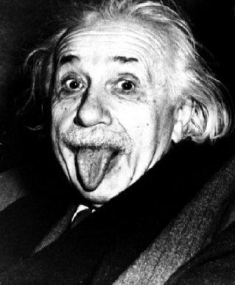
Alloy Analyzer 4 Tutorial
Session 2: Language and Analysis
Greg Dennis and Rob Seater
Software Design Group, MIT

Slide 2

alloy language & analysis
language = syntax for structuring specifications in logic
  shorthands, puns, sugar
analysis = tool for finding solutions to logical formulas
  searches for and visualizes counterexamples

Slide 3

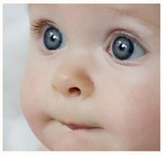
“I'm My Own Grandpa” Song
popular radio skit originally written in the 1930's
expanded into hit song by “Lonzo and Oscar” in 1948

Slide 4
“I'm My Own Grandpa” in Alloy
module grandpa
abstract sig Person {
father: lone Man,
mother: lone Woman
}
sig Man extends Person {
wife: lone Woman
}
sig Woman extends Person {
husband: lone Man
}
fact {
no p: Person |
p in p.^(mother + father)
wife = ~husband
}
assert noSelfFather {
no m: Man | m = m.father
}
check noSelfFather
fun grandpas[p: Person] : set Person {
p.(mother + father).father
}
pred ownGrandpa[p: Person] {
p in grandpas[p]
}
run ownGrandpa for 4 Person

Slide 5
language: module header
first non-comment of an Alloy model
module grandpa

Slide 6
language: signatures
sig A {}
set of atoms A
sig A {}
sig B {}
disjoint sets A and B (no A & B)
sig A, B {}
same as above
sig B extends A {}
set B is a subset of A (B in A)
sig B extends A {}
sig C extends A {}
B and C are disjoint subsets of A
(B in A && C in A && no B & C)
sig B, C extends A {}
same as above
abstract sig A {}
sig B extends A {}
sig C extends A {}
A partitioned by disjoint subsets B and C
(no B & C && A = (B + C))
sig B in A {}
B is a subset of A – not necessarily
disjoint from any other set
sig C in A + B {}
C is a subset of the union of A and B
one sig A {}
lone sig B {}
some sig C {}
A is a singleton set
B is a singleton or empty
C is a non-empty set

Slide 7
grandpa: signatures
all men and women are persons
no person is both a man and a woman
all persons are either men or women
abstract sig Person {
. . .
}
sig Man extends Person {
. . .
}
sig Woman extends Person {
. . .
}

Slide 8
language: fields
sig A {f: e}
f is a binary relation with domain A
and range given by expression e
f is constrained to be a function
(f: A -> one e) or (all a: A | a.f: e)
sig A {
f1: one e1,
f2: lone e2,
f3: some e3,
f4: set e4
}
(all a: A | a.fn : m e)
sig A {f, g: e}
two fields with same constraints
sig A {f: e1 m -> n e2}
(f: A -> (e1 m -> n e2)) or
(all a: A | a.f : e1 m -> n e2)
sig Book {
names: set Name,
addrs: names -> Addr
}
dependent fields
(all b: Book | b.addrs: b.names -> Addr)

Slide 9
grandpa: fields
abstract sig Person {
father: lone Man,
mother: lone Woman
}
sig Man extends Person {
wife: lone Woman
}
sig Woman extends Person {
husband: lone Man
}
fathers are men and everyone has at most one
mothers are women and everyone has at most one
wives are women and every man has at most one
husbands are men and every woman has at most one
Notes:
Doesn't everyone have exactly one father and mother?
Scenarios when model would not be adequate?

Slide 10
language: facts
fact { F }
fact f { F }
sig S { ... }{ F }
facts introduce constraints that
are assumed to always hold
sig Host {}
sig Link {from, to: Host}
fact {all x: Link | x.from != x.to}
no links from a host to itself
fact noSelfLinks {all x: Link | x.from != x.to}
same as above
sig Link {from, to: Host} {from != to}
same as above, with implicit 'this.'

Slide 11
grandpa: fact
no person is his or her own ancestor
a man's wife has that man as a husband
a woman's husband has that woman as a wife
fact {
no p: Person |
p in p.^(mother + father)
wife = ~husband
}

Slide 12
language: functions
fun f[x1: e1, ..., xn: en] : e { E }
functions are named expression with declaration
parameters and a declaration expression as a result
invoked by providing an expression for each parameter
sig Name, Addr {}
sig Book {
addr: Name -> Addr
}
fun lookup[b: Book, n: Name] : set Addr {
b.addr[n]
}
fact everyNameMapped {
all b: Book, n: Name | some lookup[b, n]
}

Slide 13
language: predicates
pred p[x1: e1, ..., xn: en] { F }
named formula with declaration parameters
sig Name, Addr {}
sig Book {
addr: Name -> Addr
}
pred contains[b: Book, n: Name, d: Addr] {
n->d in b.addr
}
fact everyNameMapped {
all b: Book, n: Name |
some d: Addr | contains[b, n, a]
}

Slide 14
grandpa: function and predicate
a person's grandpas are the fathers of one's own mother and father
fun grandpas[p: Person] : set Person {
p.(mother + father).father
}
pred ownGrandpa[p: Person] {
p in grandpas[p]
}

Slide 15
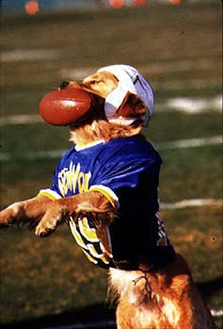
language: “receiver” syntax
fun f[x: X, y: Y, ...] : Z {...x...}
fun X.f[y:Y, ...] : Z {...this...}
f[x, y, ...]
x.f[y, ...]
pred p[x: X, y: Y, ...] {...x...}
pred X.p[y:Y, ...] {...this...}
p[x, y, ...]
x.p[y, ...]
fun Person.grandpas : set Person {
this.(mother + father).father
}
pred Person.ownGrandpa {
this in this.grandpas
}

Slide 16
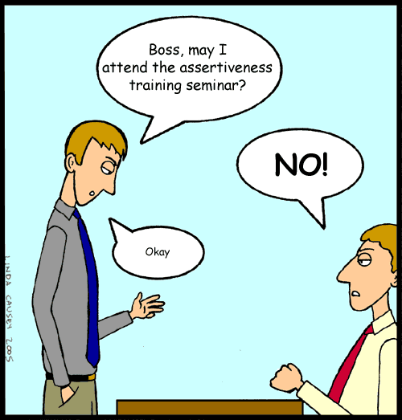
language: assertions
assert a { F }
constraint intended to follow
from facts of the model
sig Node {
children: set Node
}
one sig Root extends Node {}
fact {
Node in Root.*children
}
// invalid assertion:
assert someParent {
all n: Node | some children.n
}
// valid assertion:
assert someParent {
all n: Node – Root | some children.n
}

Slide 17
language: check command
assert a { F }
check a scope
instructs analyzer to search for
counterexample to assertion within scope
if model has facts M
finds solution to M && !F
abstract sig Person {}
sig Man extends Person {}
sig Woman extends Person {}
sig Grandpa extends Man {}
check a
check a for 4
check a for 4 but 3 Woman
check a for 4 but 3 Man, 5 Woman
check a for 4 Person
check a for 4 Person, 3 Woman
check a for 3 Man, 4 Woman
check a for 3 Man, 4 Woman, 2 Grandpa
// invalid:
check a for 3 Man
check a for 5 Woman, 2 Grandpa
check a
top-level sigs bound by 3
check a for default
top-level sigs bound by default
check a for default but list
default overridden by bounds in list
check a for list
sigs bound in list,
invalid if any unbound

Slide 18
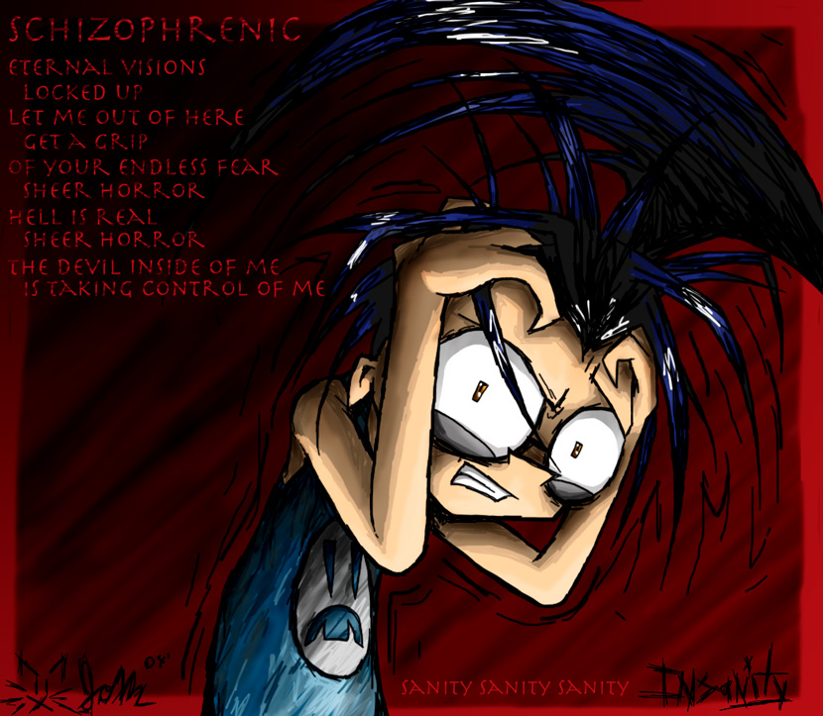
grandpa: assertion check
fact {
no p: Person | p in p.^(mother + father)
wife = ~husband
}
assert noSelfFather {
no m: Man | m = m.father
}
check noSelfFather
sanity check
command instructs analyzer to search for counterexample to noSelfFather within a scope of at most 3 Persons
noSelfFather assertion follows from fact

Slide 19
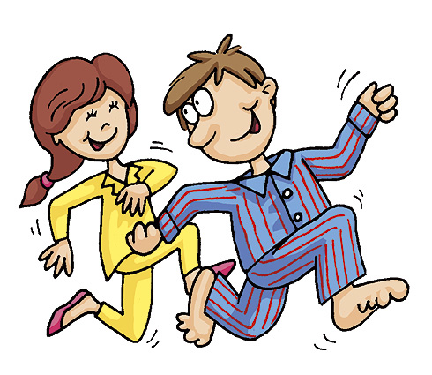
language: run command
pred p[x: X, y: Y, ...] { F }
run p scope
instructs analyzer to search for
instance of predicate within scope
if model has facts M, finds solution to
M && (some x: X, y: Y, ... | F)
fun f[x: X, y: Y, ...] : R { E }
run f scope
instructs analyzer to search for
instance of function within scope
if model has facts M, finds solution to
M && (some x: X, y: Y, ..., result: R | result = E)

Slide 20
grandpa: predicate simulation
command instructs analyzer to search for configuration with at most 4 people in which a man is his own grandfather
fun grandpas[p: Person] : set Person {
p.(mother + father).father
}
pred ownGrandpa[p: Person] {
p in grandpas[p]
}
run ownGrandpa for 4 Person

Slide 21
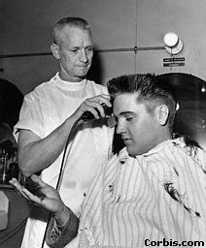
exercise: barber paradox
download barber.als from the tutorial website
follow the instructions
don't hesitate to ask questions
sig Man {shaves: set Man}
one sig Barber extends Man {}
fact {
Barber.shaves = {m: Man | m not in m.shaves}
}

Slide 22
introduction to visualization
Download grandpa.als from the tutorial website
Click “Execute”
Click “Show”
Click “Theme”

Slide 23
superficial
types and sets
  default color → gray
  Apply
  man color → blue
  woman color → red
  Apply
also notice:
  hide unconnected nodes
  orientation
  layout backwards

Slide 24
types & sets
types: from signatures
  person shape → trapezoid
  notice it carries down to man, woman
  woman: align by type
  Apply

Slide 25
types & sets

Slide 26
types & sets
sets: from existentials, runs, checks
  somewhat intelligently named
  $ownGrandpa_m label → self-grandpa
  Apply
  pitfall: don't show vs. don't show as label
  (vs. don't show in customizer...)

Slide 27
relations
relations
  mother: show as attribute → check
  (still shown as arc)
  gray = inherited (vs. overridden)
  Apply

Slide 28
relations
relations
  mother: show as attribute → uncheck
  father, mother, husband, wife: label → “ ”
  father, mother: color → green
  husband, wife: color → yellow
  Apply

Slide 29
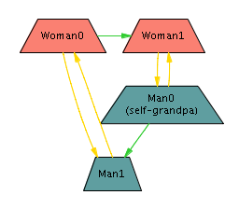
relations

Slide 30
finishing up
save theme
close theme
create your own visualization for the barber exercise!

