Slide 1
Building the Backbone: Database Design for AN Online Learning Platform
From Concept to Database Implementation
By Allswell Sam Obeng

Slide 2

What is the Online Learning Platform?
A platform designed to help students collaborate, share resources, and interact effectively.
This Project is focused on creating a system that supports these functions through a robust database.

Slide 3

Why Focus on the Database?
The strength of any platform lies in its backbone—a robust and well-designed database.
A database ensures:
Seamless organization of users, courses, and resources.
Easy retrieval of information for tasks like collaboration and resource-sharing.
Scalability to support future growth.
This project demonstrated how to translate our platform's functionality into a carefully planned and implemented database.

Slide 4
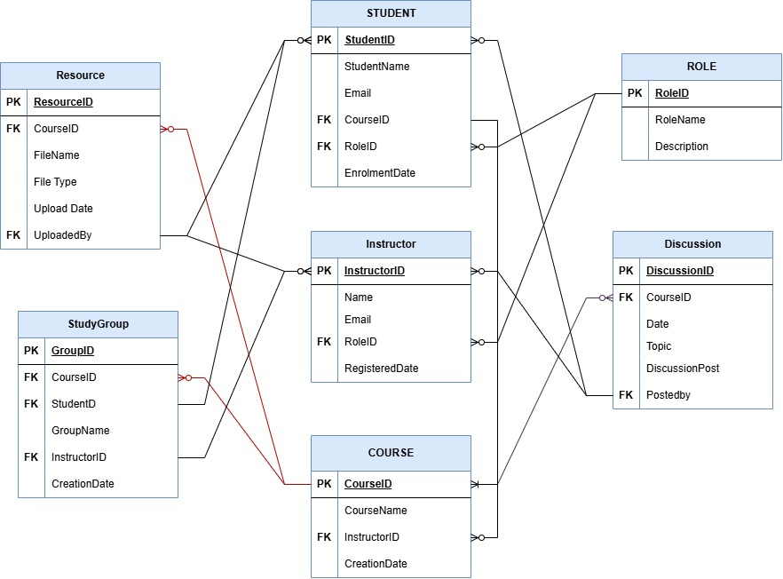
Designing the Database with Draw.io
ENTITY RELATIONSHIP DAIGRAM ( ERD)
In the ER diagram the following major relationships are highlighted:
1. Role → Student/Instructor (One-to-Many): Each role can be linked to multiple user accounts.
2. Instructor → Course (One-to-Many): Each instructor can manage multiple courses.
3. Course → Resource (One-to-Many): Each course can have multiple resources uploaded.
4. Course → Study Group (One-to-Many): Each course can have multiple study groups.
5. Course → Discussion (One-to-Many): Each course can host multiple discussions.

Slide 5
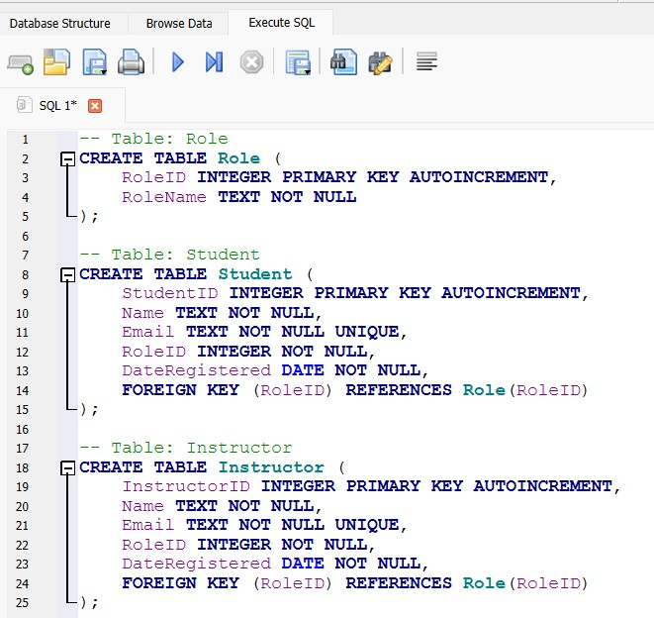
Building the Database Using SQL
The database was built with DB Browser.
DB Browser is used because it is a free open-source platform which helps with prototyping.
Tables for all entities with their relationships were created using SQL commands
Sample Queries is shown in the screenshot

Slide 6
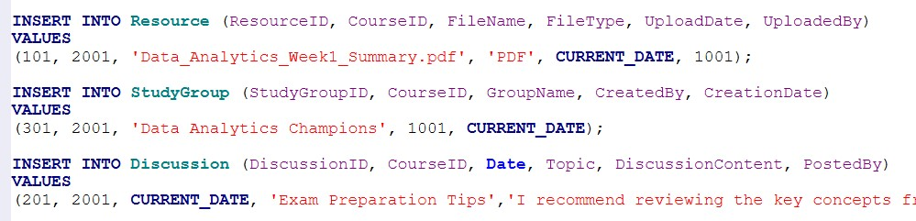
Database Implemenation
User Story: Alex uploads a PDF document titled “Data_Analytics_Week1_Summary.pdf” to the course page. After uploading the resource, Alex notices a discussion thread titled “Exam Preparation Tips”. Curious to see what his classmates are sharing, he decides to join in and contribute. Wanting to strengthen his understanding of the course material, Alex takes the initiative to create a new study group named “Data Analytics Champions” for the Data Analytics course.
The Following Queries Implements Alex's Activities on the Platform:

Slide 7
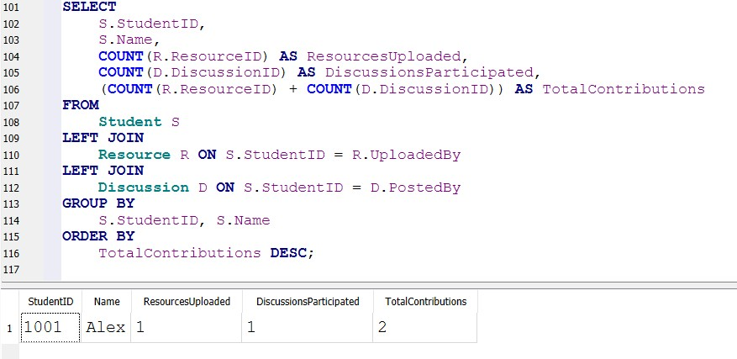
Analysis of the Data SQL for Data Analysis
Determining the Most Active Students on the Platform
This query calculates the number of resources uploaded, discussion posts made by each student, and then their total contributions. Alex is seen to have a total contribution of two. He uploaded one item and participated in only one discussion.

Slide 8
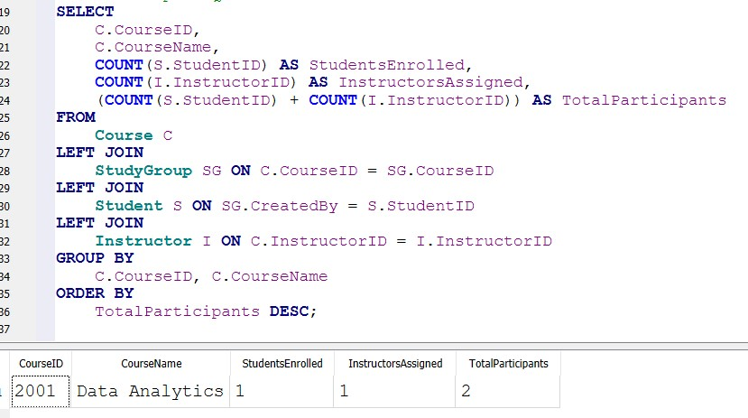
Analysis of the Data SQL for Data Analysis
SQL Query to Identify Popular Courses
This query identifies courses with the most enrollments by Joining tables and counting the total number of students and instructors linked to each course.
From the SQL results, the Data Analytics course has one student enrolled, and one instructor assigned to it

Slide 9

Reflections and Growth from This Project
Enhanced skills in database design and architecture, creating databases using SQL, SQL for Data Analysis, Problem Solving and Critical thinking, and Attention to Detail.
Practical experience in aligning technology with business goals.
Enriched Knowledge and understanding of Database Systems and Applications

Slide 10

THANK YOU

