Slide 1
UNIT V:
RANDOM PROCESSES – SPECTRAL CHARACTERISTICS:
5.1Power Spectrum and its Properties
5.2 Relationship between Power Spectrum and Autocorrelation Function
5.3 Cross-Power Density Spectrum and its Properties
5.4 Relationship between Cross-Power Spectrum and Cross-Correlation Function.
1

Slide 2
Course Objectives
It gives an idea of random process interms of spectrum that is spectral characteristics like power spectrum, auto correlation function. It characterize stochastic processes with an emphasis on power spectrum and its properties
Chapter 7. Random Process - Spectral Characteristics

Slide 3

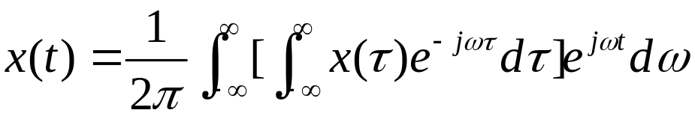
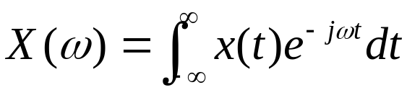

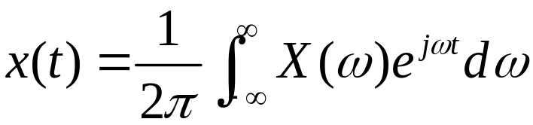

7.1 Power density spectrum and its properties
Chapter 7. Random Process - Spectral Characteristics

Slide 4
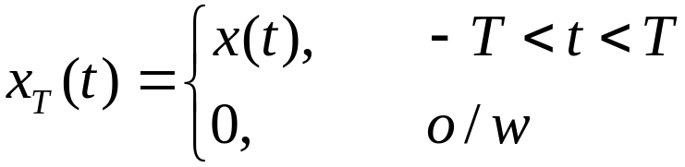

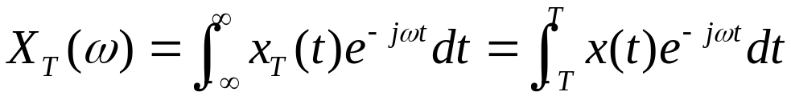
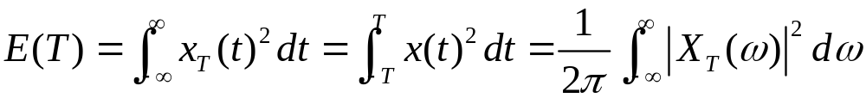
7.1 Power density spectrum and its properties
Chapter 7. Random Process - Spectral Characteristics

Slide 5
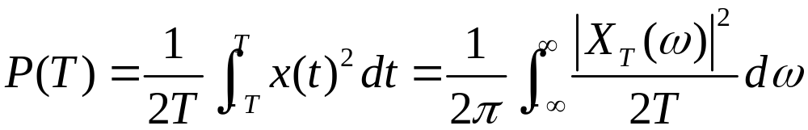

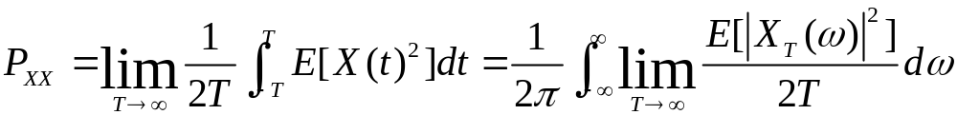
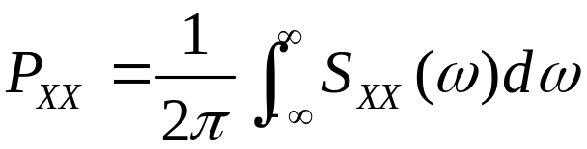

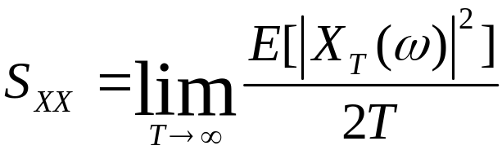

7.1 Power density spectrum and its properties
Chapter 7. Random Process - Spectral Characteristics

Slide 6


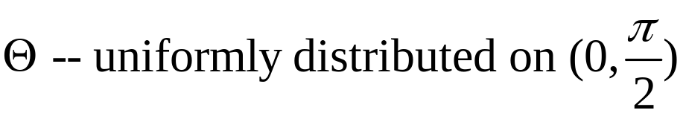

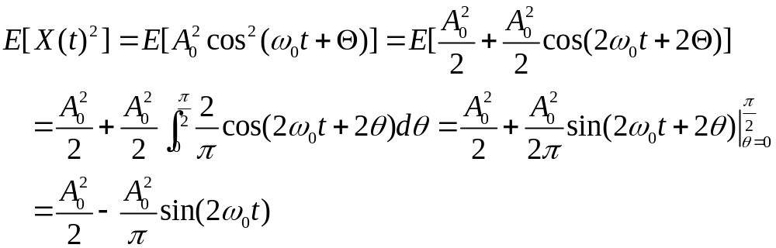
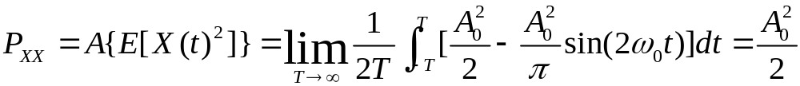
7.1 Power density spectrum and its properties
Chapter 7. Random Process - Spectral Characteristics

Slide 7

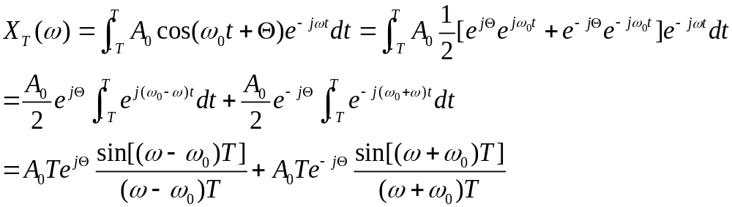
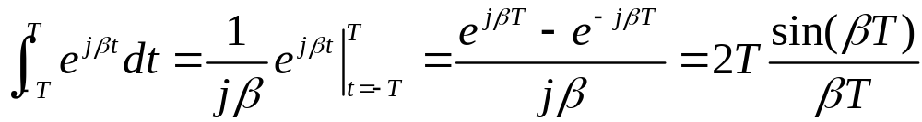
7.1 Power density spectrum and its properties
Chapter 7. Random Process - Spectral Characteristics

Slide 8
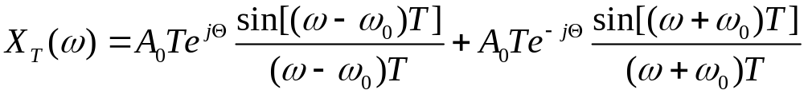
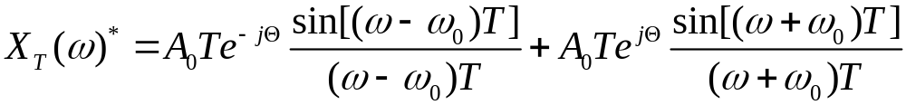
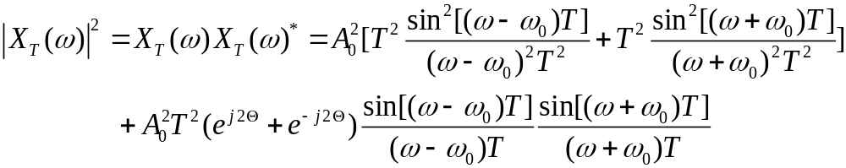
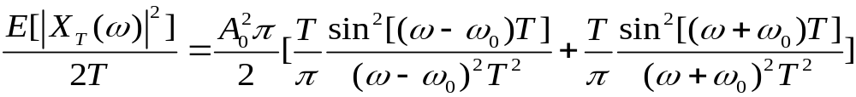
7.1 Power density spectrum and its properties
Chapter 7. Random Process - Spectral Characteristics

Slide 9

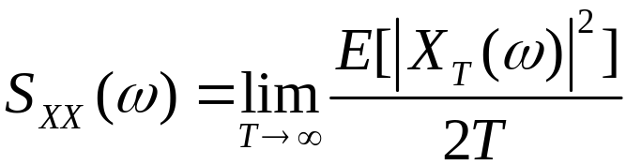

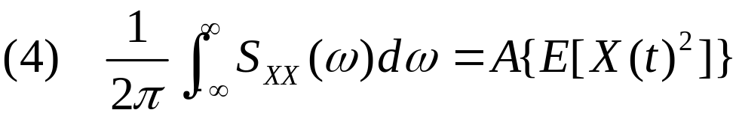

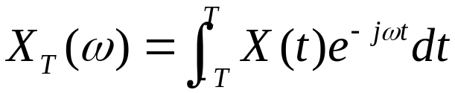
7.1 Power density spectrum and its properties
Chapter 7. Random Process - Spectral Characteristics

Slide 10

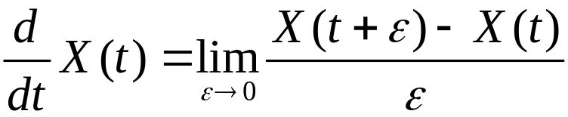

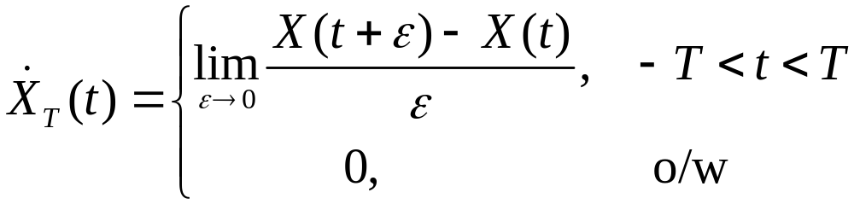

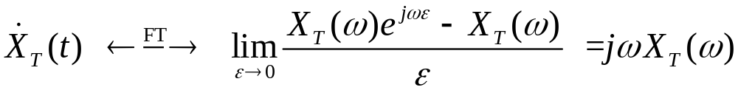
7.1 Power density spectrum and its properties
Chapter 7. Random Process - Spectral Characteristics

Slide 11

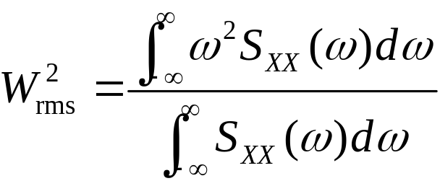

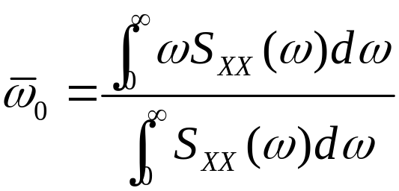


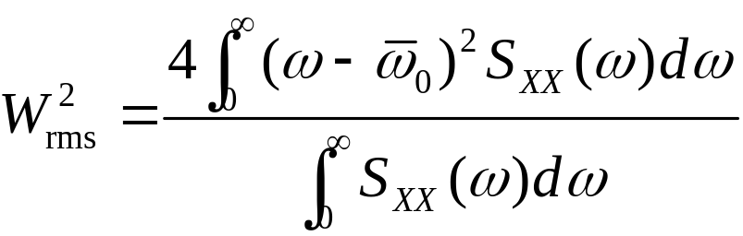

7.1 Power density spectrum and its properties
Chapter 7. Random Process - Spectral Characteristics

Slide 12
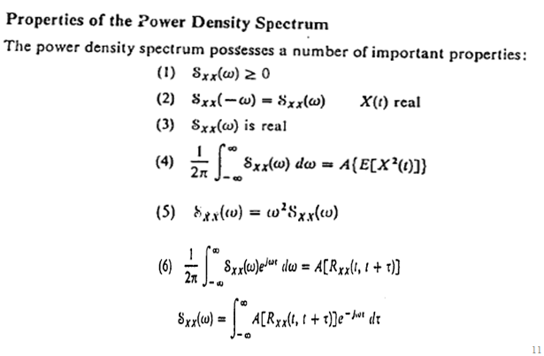
7.1 Power density spectrum and its properties

Slide 13
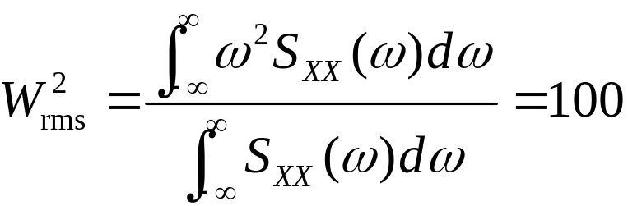

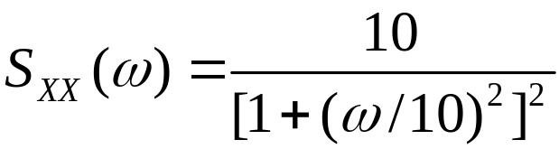
7.1 Power density spectrum and its properties
Chapter 7. Random Process - Spectral Characteristics

Slide 14
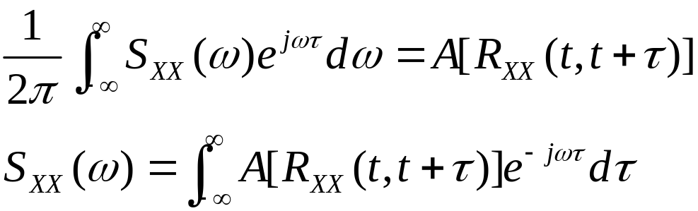

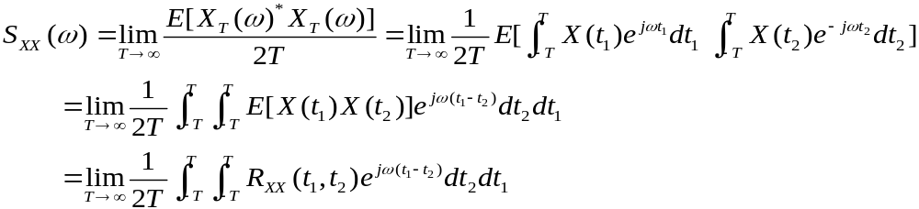
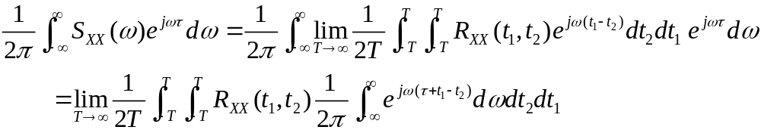
7.2 Relationship between power spectrum and autocorrelation function
Chapter 7. Random Process - Spectral Characteristics

Slide 15
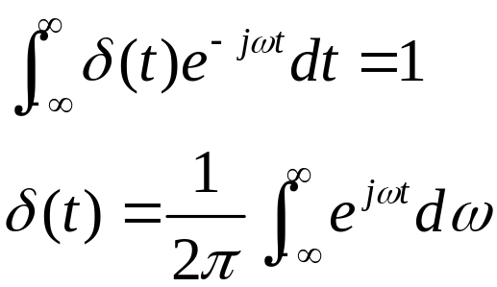

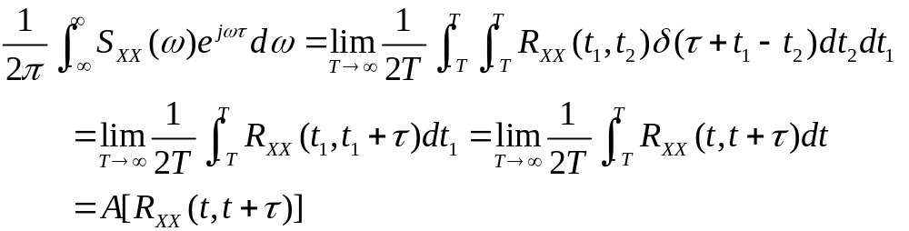

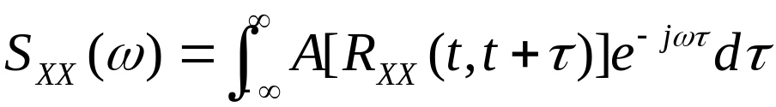
7.2 Relationship between power spectrum and autocorrelation function
Chapter 7. Random Process - Spectral Characteristics

Slide 16

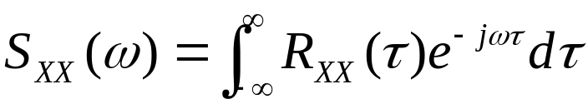
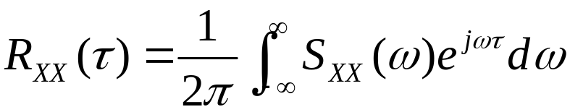
7.2 Relationship between power spectrum and autocorrelation function
Chapter 7. Random Process - Spectral Characteristics

Slide 17


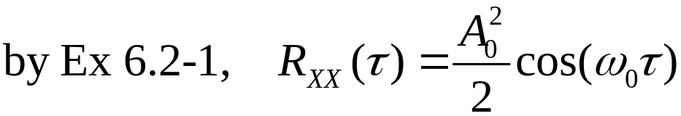
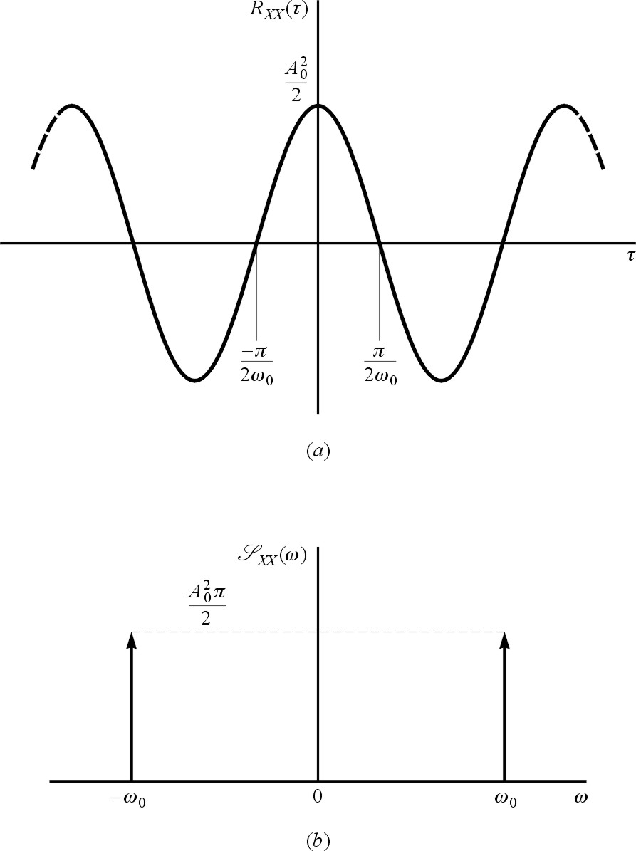
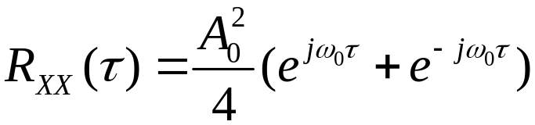


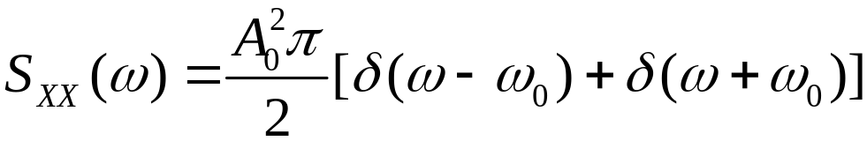
7.2 Relationship between power spectrum and autocorrelation function
Chapter 7. Random Process - Spectral Characteristics

Slide 18


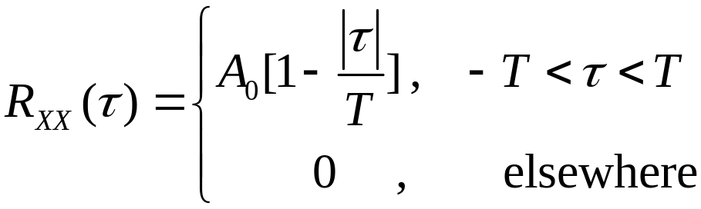
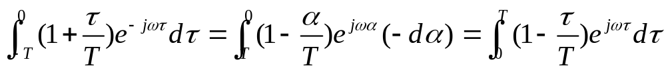
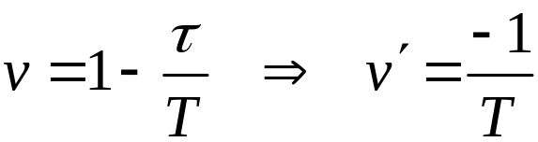
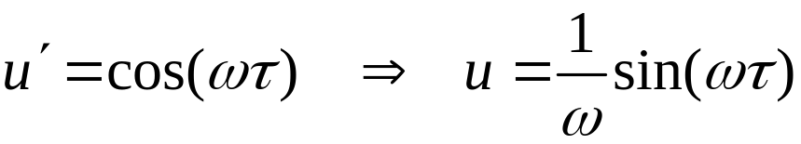
7.2 Relationship between power spectrum and autocorrelation function
Chapter 7. Random Process - Spectral Characteristics

Slide 19
Chapter 7. Random Process - Spectral Characteristics

Slide 20
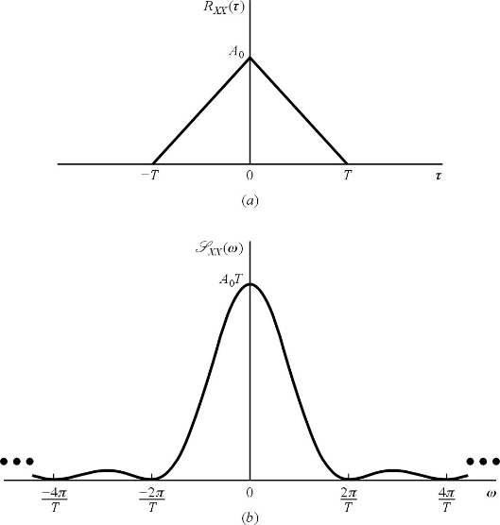
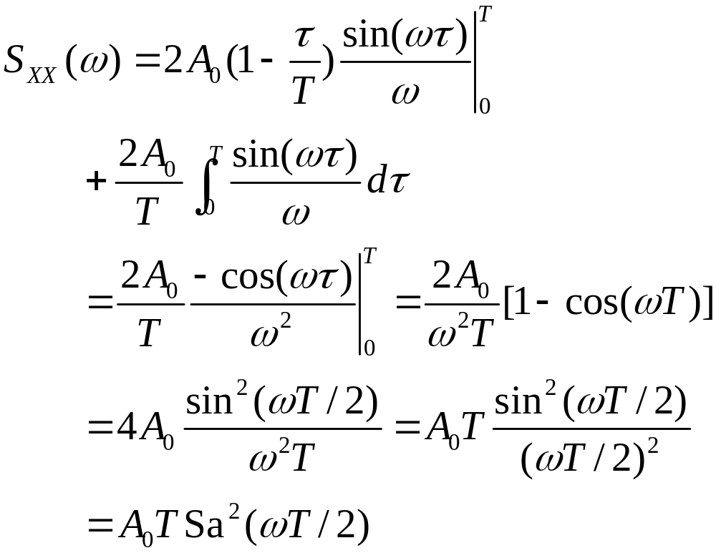
7.2 Relationship between power spectrum and autocorrelation function
Chapter 7. Random Process - Spectral Characteristics

Slide 21

7.3 Cross-power density spectrum and its properties
Chapter 7. Random Process - Spectral Characteristics

Slide 22
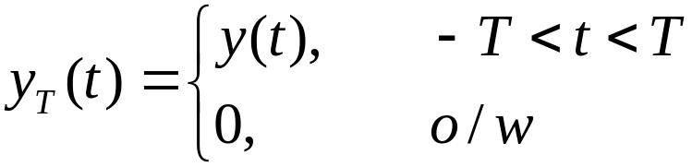



7.3 Cross-power density spectrum and its properties
Chapter 7. Random Process - Spectral Characteristics

Slide 23



7.3 Cross-power density spectrum and its properties
Chapter 7. Random Process - Spectral Characteristics

Slide 24




7.3 Cross-power density spectrum and its properties
Chapter 7. Random Process - Spectral Characteristics

Slide 25

7.3 Cross-power density spectrum and its properties

Slide 26


7.3 Cross-power density spectrum and its properties
Chapter 7. Random Process - Spectral Characteristics

Slide 27


7.3 Cross-power density spectrum and its properties
Chapter 7. Random Process - Spectral Characteristics

Slide 28




7.3 Cross-power density spectrum and its properties
Chapter 7. Random Process - Spectral Characteristics

Slide 29





7.3 Cross-power density spectrum and its properties
Chapter 7. Random Process - Spectral Characteristics

Slide 30



7.4 Relationship between cross-power spectrum and cross-correlation function
Chapter 7. Random Process - Spectral Characteristics

Slide 31



7.4 Relationship between cross-power spectrum and cross-correlation function
Chapter 7. Random Process - Spectral Characteristics

Slide 32



7.4 Relationship between cross-power spectrum and cross-correlation function
Chapter 7. Random Process - Spectral Characteristics

Slide 33
Chapter 7. Random Process - Spectral Characteristics

