Slide 1
Routing Decision in SDN: Performance of Reactive Flow Installation in Max-min Fair Network
EL 7363 Final Project
Kuan-yin Chen, Soheil Abbasloo
Spring 2015
NYU

Slide 2
Today: ECMP Load Balancing
Traditional Load Balancing schemes like ECMP are Local-Aware
No Global Sense of the bottlenecks in the network
Local-awareness makes them sub optimal solutions for Max-Min fairness

Slide 3

Local Load Balance Schemes
Schemes using local knowledge are sub optimal
10 flows
40G
10
40G
40G
40G
20 flows
40G

Slide 4
Local Load Balance Schemes
Schemes using local knowledge are sub optimal
10 flows
40G
10
40G
20
10
40G
40G
20 flows
10
40G

Slide 5
What about a Global-Aware Scheme?

Slide 6
Global-Aware Scheme
Global knowledge leads to better solution!
10 flows
40G
10
So Lets Use Global-Awareness.
But How?
40G
15
5
40G
40G
20 flows
15
40G

Slide 7
Global-Awareness?
Software Defined Network (SDN)
Monitor whole of the Network in a Centralized manner
Control whole of the Network in a Centralized manner
That’s exactly what we want:
SDN will provide us with the global knowledge of the network

Slide 8
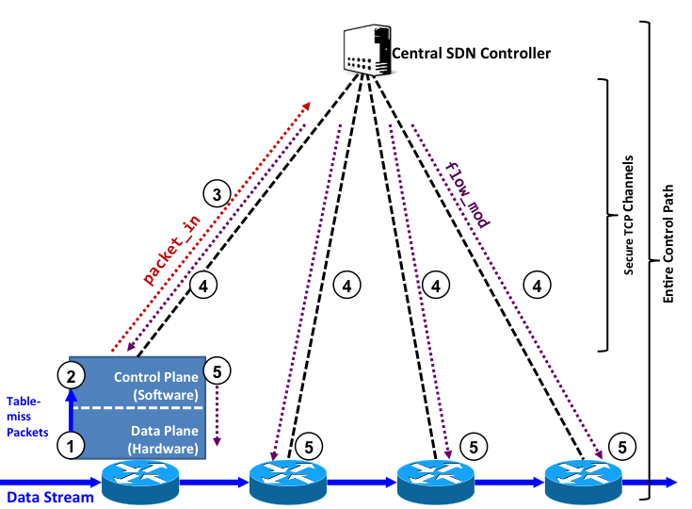
SDN: Overview

Slide 9
Main Design

Slide 10
What are the Design Objectives?
Maximizing the average overall throughput of flows/Minimizing the average flow completion time
Satisfying the Max-Min Fairness
flows’ BW

Slide 11
What are the Constraints?
A SDN based scheme
The granularity is Flow-level not packet-level
Setting flows up should be done in a dynamic/on-demand manner {Reactive Flow Installation }
The number of Demands/Flows is variable during time
For any new flow, we need to identify and set up the best path

Slide 12
Main Design Steps
Path Database Construction
Constructing Pre-Defined paths for each (src, dst) pair
Path Selection
Choosing a path out of the pre-constructed candidate set for any new incoming flow

Slide 13
Path Database Construction
We use two modes of path database construction
Shortest paths
Dijkstra Algorithm
K-Shortest Path
Yen Algorithm

Slide 14
Bandwidth-Aware Path Selection
A Global-Greedy algorithm
Determine all the available paths for the incoming flow
Find the bottleneck link of those paths
After applying max-min fairness, the lowest allocated BW for flows (L-BW) is on the bottleneck link
Pick the path with highest L-BW for the incoming flow

Slide 15
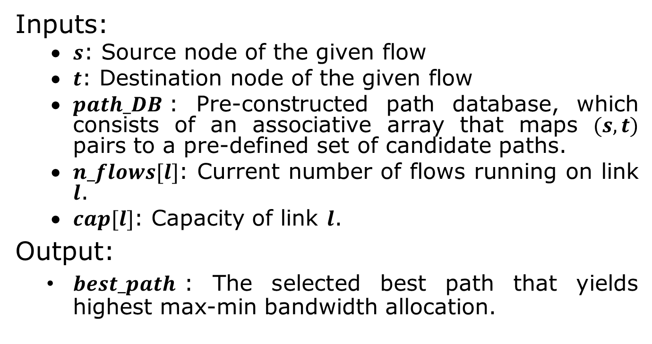
Bandwidth-Aware Path Selection
Inputs:
$s$: Source node of the given flow
$t$: Destination node of the given flow
$path_DB$: Pre-constructed path database, which consists of an associative array that maps $(s,t)$ pairs to a pre-defined set of candidate paths.
$n_flows[l]$: Current number of flows running on link $l$.
$cap[l]$: Capacity of link $l$.
Output:
$best_path$: The selected best path that yields highest max-min bandwidth allocation.

Slide 16
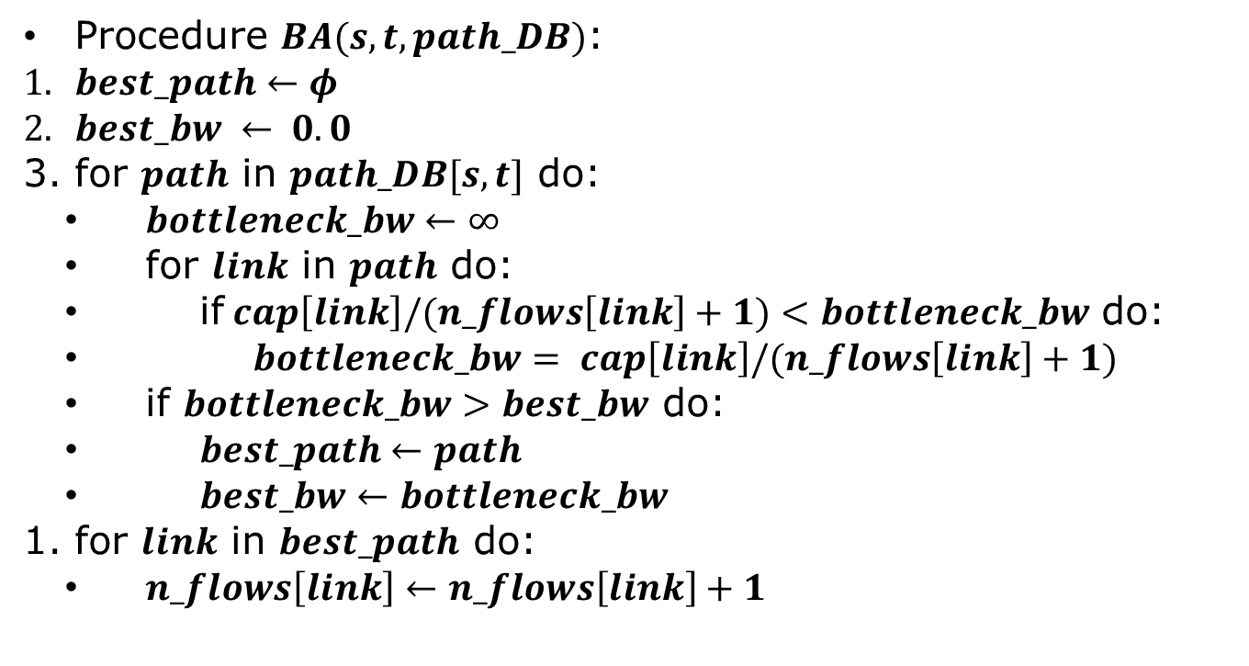
Bandwidth-Aware Path Selection
Procedure $BA(s, t, path_DB)$:
$best_path←φ$
$best_bw ← 0.0$
for $path$ in $path_DB[s,t]$ do:
$bottleneck_bw←∞$
for $link$ in $path$ do:
if$cap\left[link\right]/(n_flows\left[link\right]+1)<bottleneck_bw$ do:
$bottleneck_bw= cap\left[link\right]/(n_flows\left[link\right]+1)$
if $bottleneck_bw>best_bw$ do:
$best_path←path$
$best_bw←bottleneck_bw$
for $link$ in $best_path$ do:
$n_flows\left[link\right]←n_flows\left[link\right]+1$

Slide 17
Simulation Setup
Simulator
NS2, OPNET, and other simulators are packet based
We designed our own flow based simulator
Traffic Models
Three different models:
Gravity
Uniform Random
Anti-Gravity
Flow Size Dist.
lognormal

Slide 18
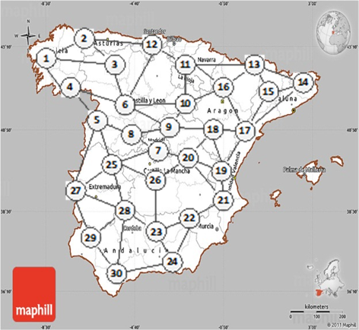
Simulation Setup
Topology
Spanish Backbone Network including 30 nodes

Slide 19
Evaluation Results
Anti-gravity Traffic model

Slide 20
Evaluation Results
Uniform Random Traffic model

Slide 21
Evaluation Results
Gravity Traffic Model

Slide 22
Evaluation Results
Effect of Path Database Construction Alg.

Slide 23
Conclusion
Experiment results show that the proposed bandwidth-aware path selection strategy outperforms ECMP and Uniform Random using different traffic models

