Slide 1


ECE7363 Project Presentation
Panacea: Adaptive Traffic Engineering for Resilient Networks with Reinforcement Learning in SDN
Minghao Ye and Chen-Yu Yen
ECE Department
{my1706, cyy310}@nyu.edu

Slide 2
Outline
Introduction and motivation
Project idea
Methodology
Evaluation Result
Conclusion and Future Works

Slide 3
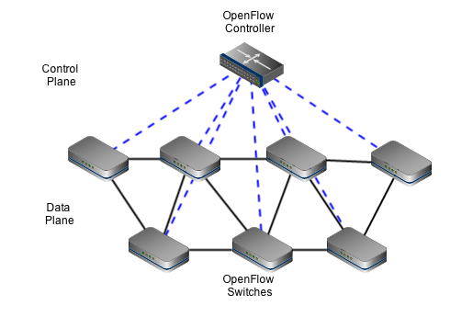
Traffic Engineering (TE) and SDN
Traffic Engineering (TE): An important network operation for Internet Service Providers (ISPs) to optimize their networks
Methodology: controlling traffic distribution and configuring the routing
Goal: network performance (e.g. load balancing) & resource utilization
Metric: The utilization of the most congested link, delay, etc.
Software-Defined Networking (SDN) provides opportunities for fine-grained per-flow routing based on its global view of the network
The control plane can generate and deploy deliberate routing policies for different flows at the SDN switches.

Slide 4
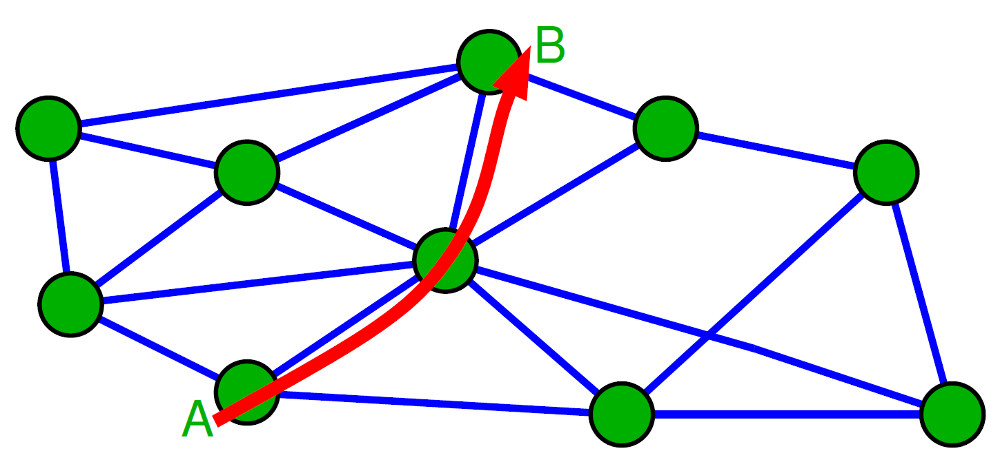
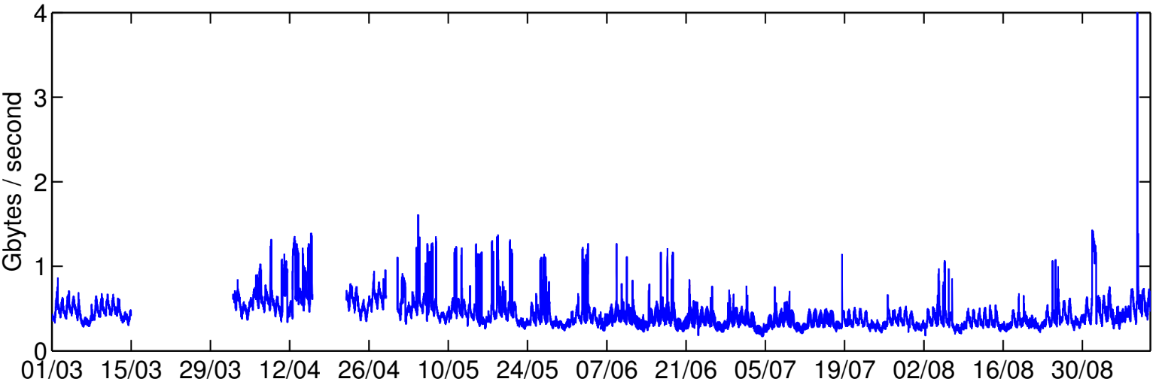
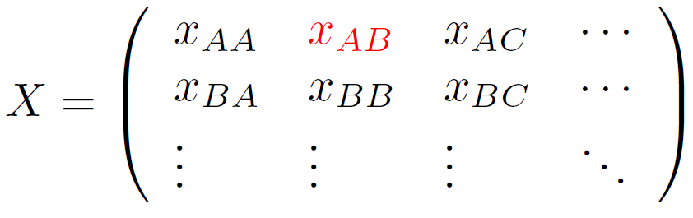
Introduction to TE
TE reroutes flows periodically to achieve load balancing
The traffic demands among the nodes are changing dynamically
The following information is needed for TE optimization
Topology: connectivity & capacity of routers & links
Traffic matrix (TM): traffic demands between nodes in the network
Abilene Network: The variation of total traffic demands
Topology
Traffic Matrix
The variation of traffic demands is much larger in commercial network

Slide 5
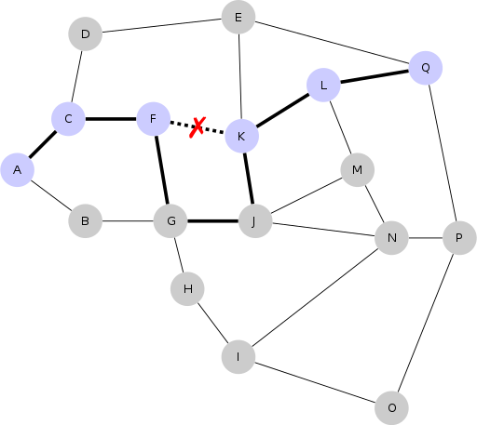
TE for Resilient Networks
Resilience: The capability of a network to recovery from failure
For example, single link failure
Protection vs. Restoration
Protection
Allocates spare resources (such as backup paths)
Fast recovery, but low spare capacity efficiency
Restoration
Computes new network configurations on the fly
Slow recovery, but high resource efficiency
How to handle single link failures?
Reroute the flows on surviving links
Use TE to re-optimize network performance

Slide 6
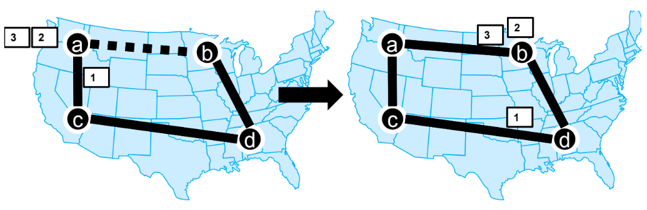
Motivation
Tradition TE solutions often reroute many flows (source-destination flows) to minimize the maximum link utilization (MLU) when network state changes.
Potential problem: significant network disturbance and service disruption.
Changing the path of a source-destination flow could temporarily affect many TCP flows’ normal operation. [1]
Packets out-of-order may trigger duplicate ACKs
Falsely signal network congestion to the senders and reduce sending rate
Increase the flow’s completion time and degrade users’ QoE
How to mitigate the network disturbance with performance guarantee when there is a link failure?
[1] Carpa, Radu, et al. "Evaluating the impact of SDN-induced frequent route changes on TCP flows." 2017 13th International Conference on Network
and Service Management (CNSM).

Slide 7
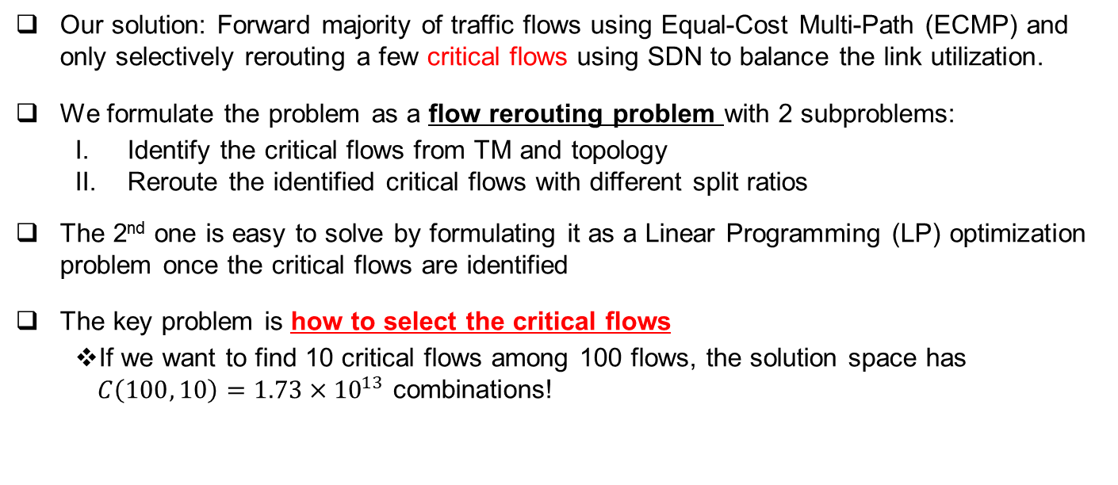
Insight
Our solution: Forward majority of traffic flows using Equal-Cost Multi-Path (ECMP) and only selectively rerouting a few critical flows using SDN to balance the link utilization.
We formulate the problem as a flow rerouting problem with 2 subproblems:
Identify the critical flows from TM and topology
Reroute the identified critical flows with different split ratios
The 2nd one is easy to solve by formulating it as a Linear Programming (LP) optimization problem once the critical flows are identified
The key problem is how to select the critical flows
If we want to find 10 critical flows among 100 flows, the solution space has $C\left(100, 10\right)=1.73×{10}^{13}$ combinations!

Slide 8
Panacea
Therefore, we propose Panacea: a Reinforcement Learning (RL)-based TE solution which can adapt to different failure situations in resilient networks
Take the network topology and TM as an input
Use RL to identify critical flows under different failure situations
Formulate a LP problem to reroute the critical flows with SDN
Panacea can be trained to learn a selection policy over a rich variety of failure situations and historical TMs collected by the SDN controller
The selection policy maps the topology and TM to the critical flow selection
The SDN controller installs and updates flow entries at the SDN switches to reroute the critical flows based on LP solution

Slide 9
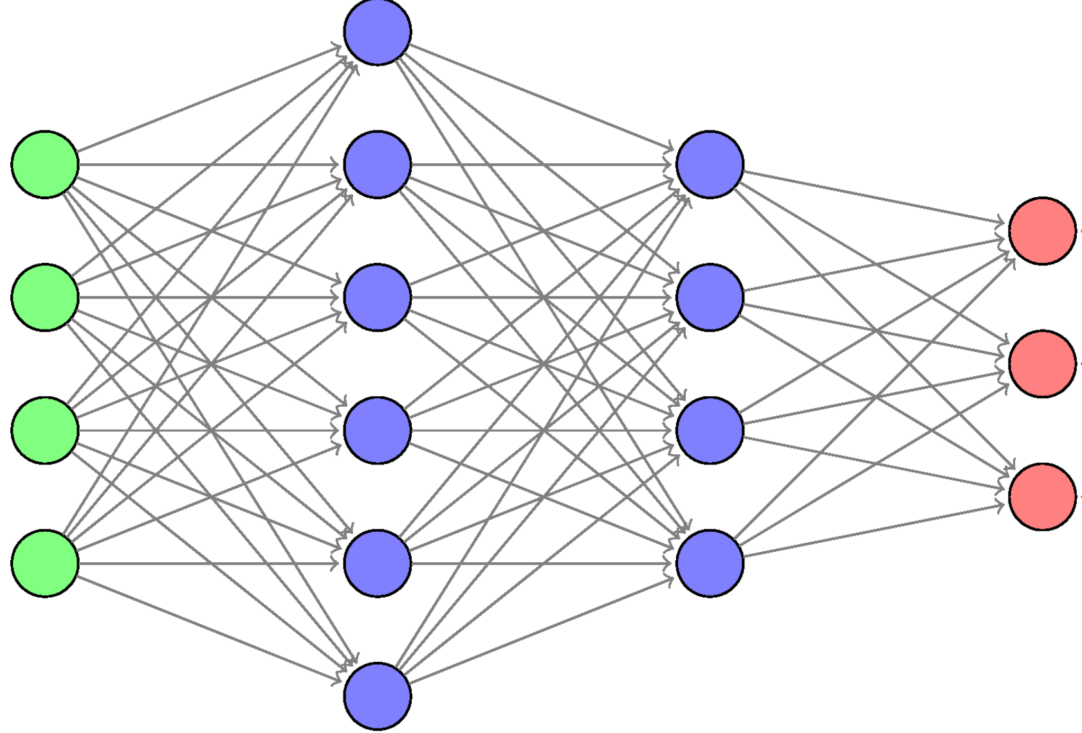
Workflow of Panacea
Panacea
1. Collect TM and current topology
3. LP calculate split ratio
4. Deploy
2. Select Critical Flows

Slide 10
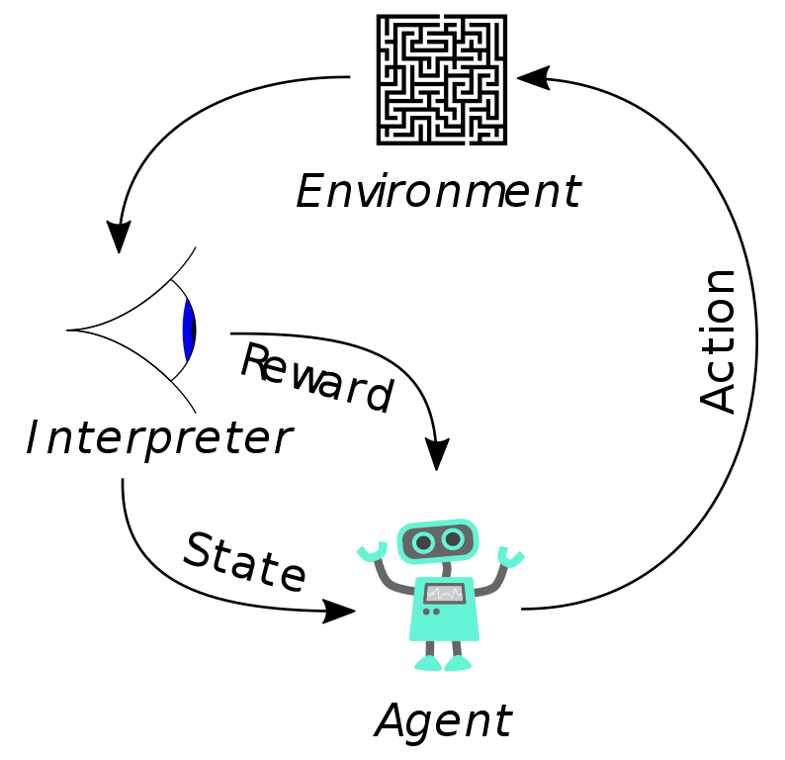
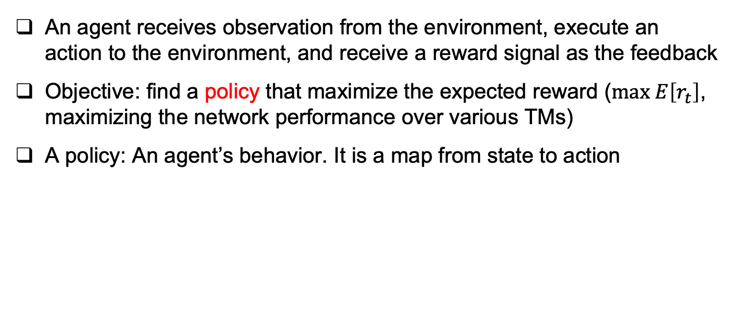
What is reinforcement learning?
An agent receives observation from the environment, execute an action to the environment, and receive a reward signal as the feedback
Objective: find a policy that maximize the expected reward ($max E\left[r_{t}\right]$, maximizing the network performance over various TMs)
A policy: An agent’s behavior. It is a map from state to action

Slide 11
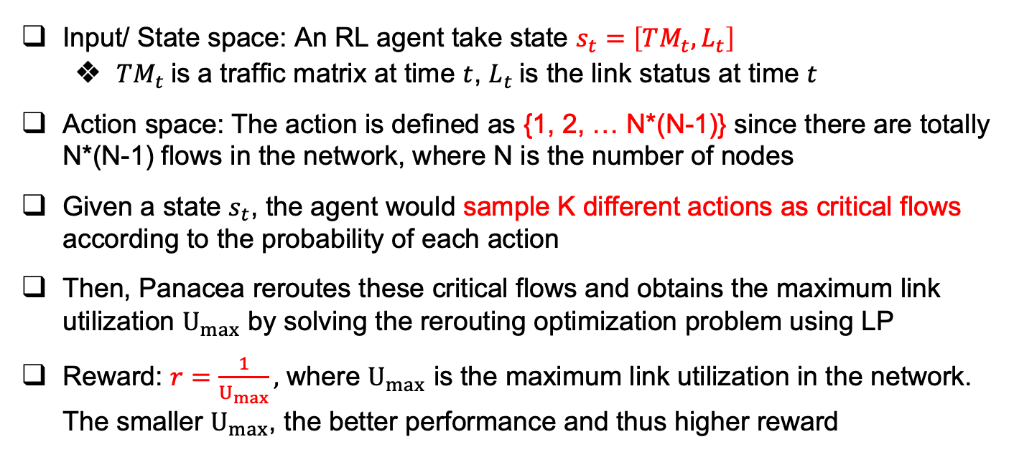
RL Formulation
Input/ State space: An RL agent take state $s_{t}=\left[TM_{t}, L_{t}\right]$
$TM_{t}$is a traffic matrix at time $t$, $L_{t}$is the link status at time $t$
Action space: The action is defined as {1, 2, … N*(N-1)} since there are totally N*(N-1) flows in the network, where N is the number of nodes
Given a state $s_{t}$, the agent would sample K different actions as critical flows according to the probability of each action
Then, Panacea reroutes these critical flows and obtains the maximum link utilization $U_{max}$ by solving the rerouting optimization problem using LP
Reward: $r=\frac{1}{U_{max}},$ where $U_{max}$ is the maximum link utilization in the network. The smaller $U_{max}$, the better performance and thus higher reward

Slide 12
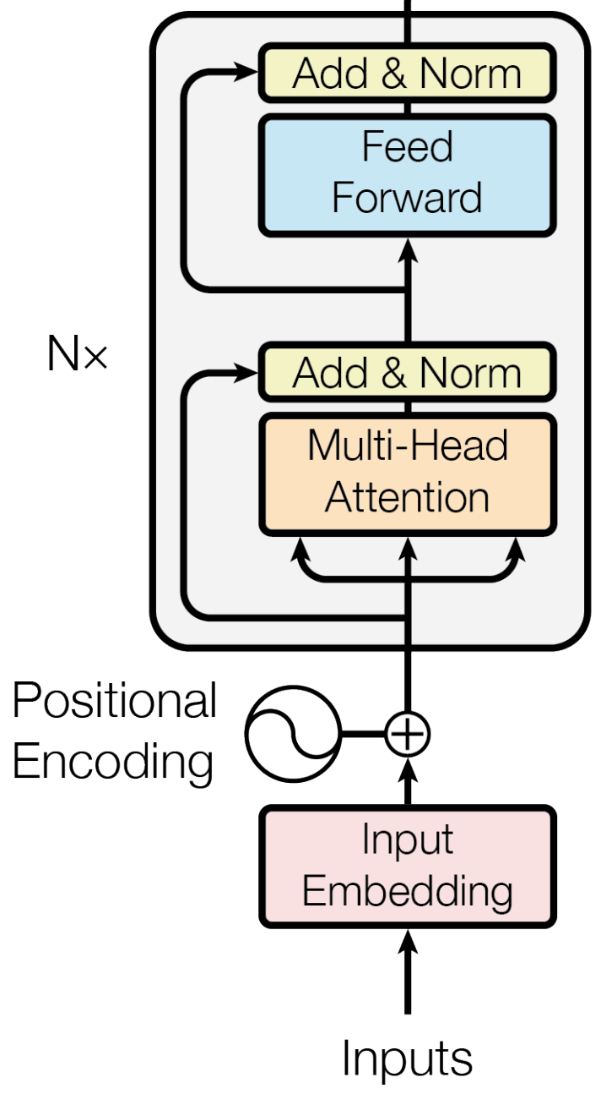
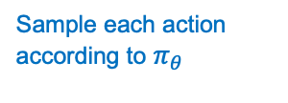

Policy Network Architecture
Sample each action according to $π_{θ}$
0 | 1 | 1
1 | 0 | 1
1 | 0 | 0
Link
Status
Selected flows
Encoder
Softmax $π_{θ}$
0 | 2.2 | 3.6
3.2 | 0 | 6.8
6.3 | 8.9 | 0
Traffic
Matrix
Transformer
MLP
Softmax function for generating the probabilities for all actions
Training: Sample K actions according to the probability of each action
Evaluation (After training is done): Choose K actions with highest probabilities
Learn the feature representations by
self-attention
(Attention is all you need!)
N * (N-1) outputs
Each one corresponds to one of the flows

Slide 13
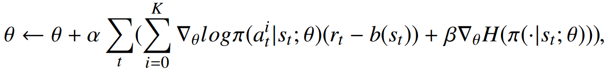
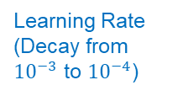
Learn a Critical Flow Selection Algorithm
We train the agent using policy gradient (Actor-Critic method)
Maximize the reward using gradient ascend
Sum over K actions
Entropy factor set to 0.1
H is the entropy (the probability distribution over actions)
Advantage for variance reduction
This term can improve exploration by
discouraging premature convergence to suboptimal deterministic policies

Slide 14

Training Panacea
We spawn 20 actor agents in parallel to speed up the training process
Each actor agent is configured to experience a different set of TMs
The central agent collects the experience tuples (state, action, reward) from actor agents and aggregates them to train the policy neural network
The updated parameters are then sent back to the actor agents
Suppose there are 200 TMs in the training set. Each cycle is one iteration:
Central Agent
Central Agent
Iteration 1, 2, 3…
Send back the updated parameters
Collect the experiences
20 Actor Agents
20 Actor Agents
……
……
Each actor experience a different set of 200/20 = 10 TMs

Slide 15
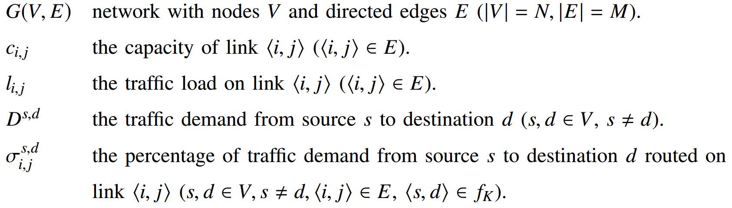
Rerouting Critical Flows
After selecting critical flows, we need to reroute them to achieve load balancing
The optimal multipath routing solution can be derived from LP for all critical flows.
The remaining flows running ECMP are regarded as background traffic.
Here are some notations:

Slide 16
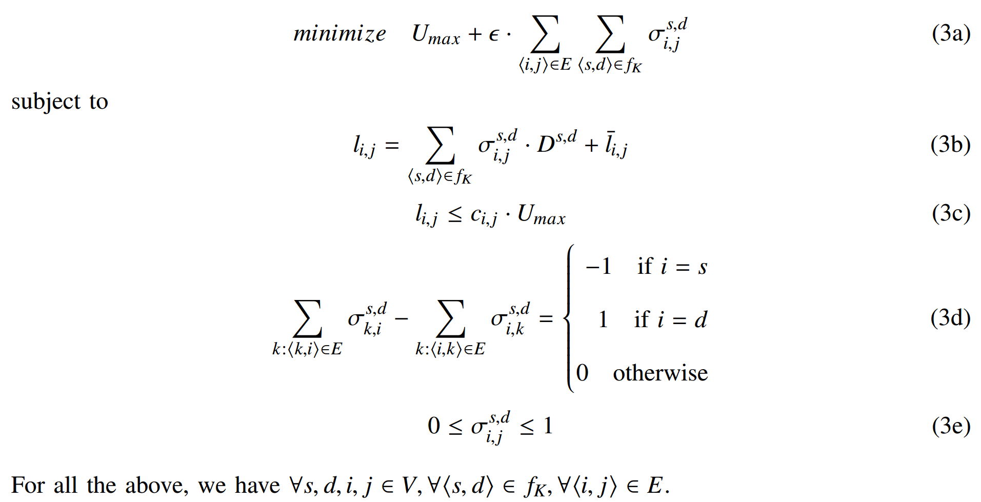
LP Formulation
Avoid unnecessary long paths
Minimize MLU
Link load on link (i, j)
Background traffic
on link (i, j)
link capacity utilization constraint
flow conservation constraint
for critical flows
Split ratio constraint

Slide 17
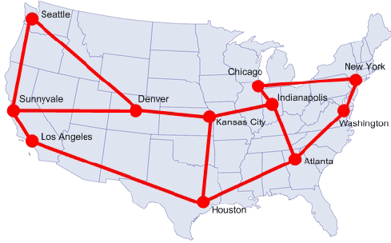
Topologies
Panacea is tested on a real-world network topology
Abilene Network: 12 nodes, 30 directed links, 12 x 11 = 132 flows
The real traces are publicly available
Abilene TMs are measured every 5 minutes
Training set: 288 TMs in Mar. 1st 2004
Testing set: 288 TMs in Mar. 2nd 2004
Note: There are 2 routers in Atlanta

Slide 18
Rule-based Heuristics
2 rule-based heuristics are also evaluated for comparison
Top-K: Selects the K largest flows from a given TM in terms of demand volume.
Assumption: Flows with larger traffic volumes would have a dominate impact to network performance.
Top-K Critical: Selects the K largest flows from the most congested links.
Assumption: Flows traversing the most congested links would have a dominate impact to network performance.

Slide 19
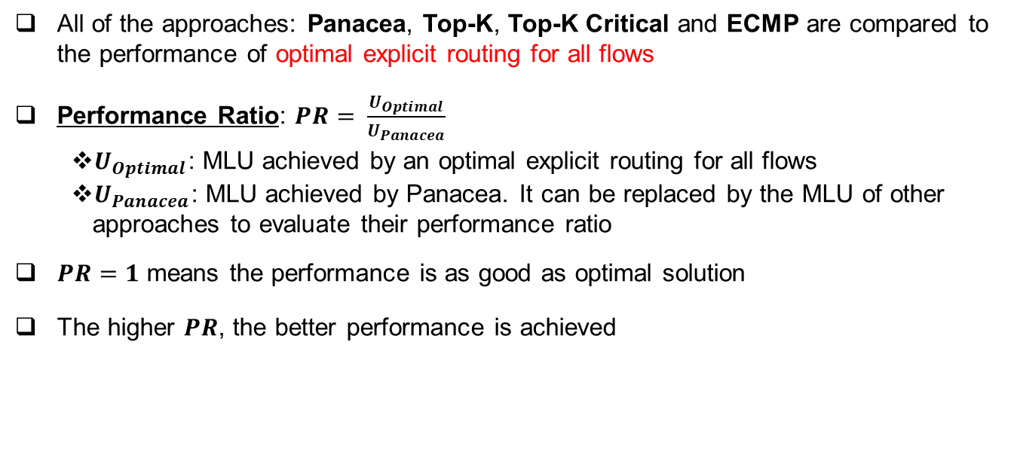
Evaluation Scheme
All of the approaches: Panacea, Top-K, Top-K Critical and ECMP are compared to the performance of optimal explicit routing for all flows
Performance Ratio: $PR= \frac{U_{Optimal}}{U_{Panacea}}$
$U_{Optimal}$: MLU achieved by an optimal explicit routing for all flows
$U_{Panacea}$: MLU achieved by Panacea. It can be replaced by the MLU of other approaches to evaluate their performance ratio
$PR=1$ means the performance is as good as optimal solution
The higher $PR$, the better performance is achieved

Slide 20
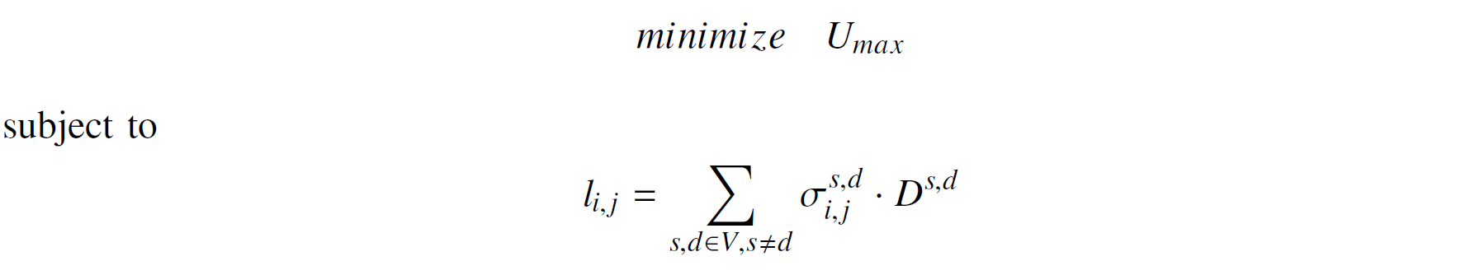
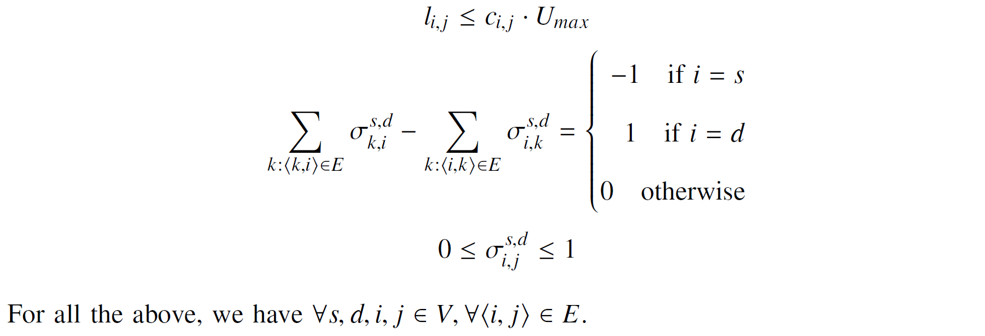

Optimal Explicit Routing for All Flows
Given a network $G(V,E)$ with a traffic demand matrix $D^{s,d}$, the objective is to obtain the best explicit routing ratios $\{σ_{i,j}^{s,d}\}$ to minimize the MLU $U_{max}$ in the network
This routing problem can be formulated as an optimization to obtain $U_{optimal}$:

Slide 21
Evaluation Results
Panacea can achieve near-optimal performance by rerouting only about 10% of all flows
Adapt to different failure situations and outperform the heuristics

Slide 22
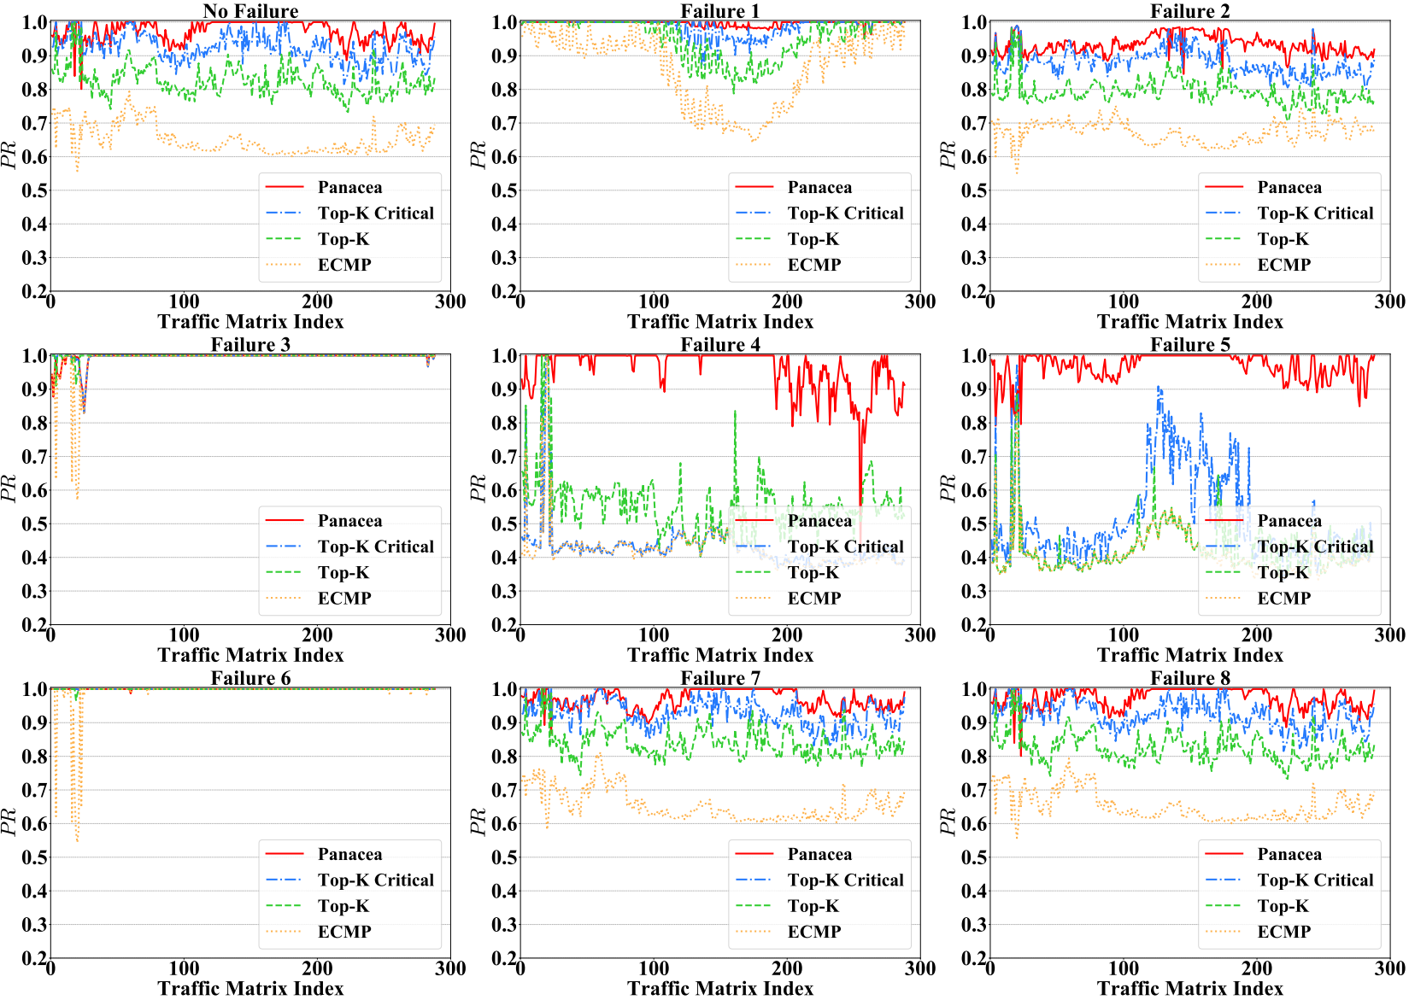
Evaluation Results

Slide 23
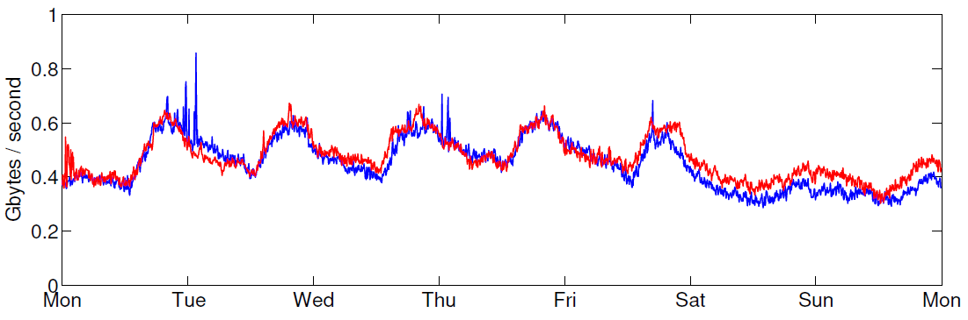
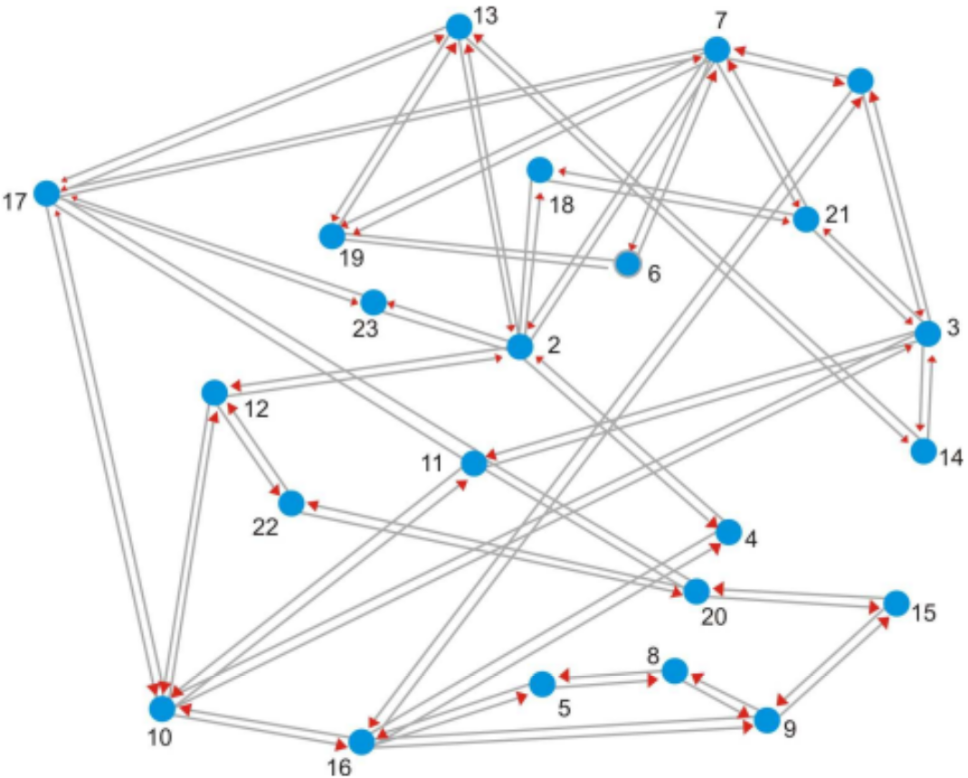
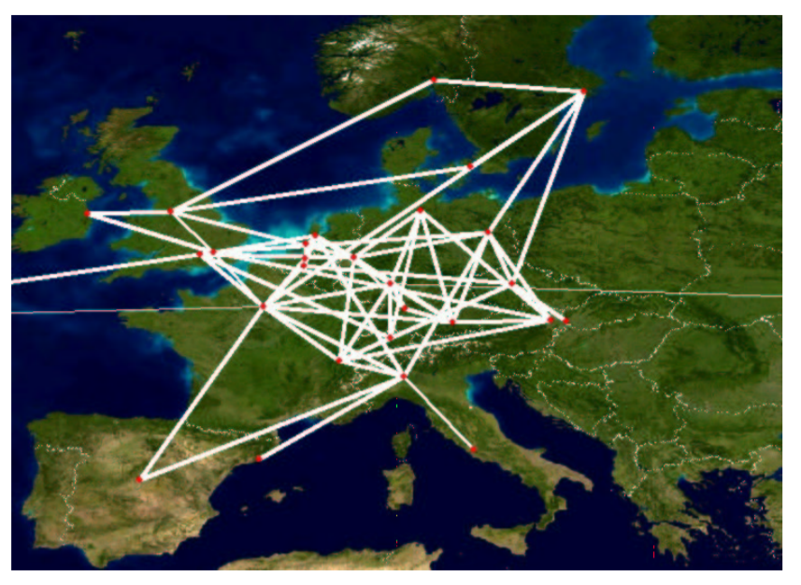
Future Works
Increase the size of training set
For example, use 2016 TMs in one week
Test our scheme on other failure scenarios
Is it possible to extend our solutions to multiple link failures?
Use a larger network to test the scalability
GEANT network (real traces): 23 nodes, 74 links
Other ROCKETFUEL Topologies (synthesized TM): Ebone, Sprintlink, Tiscali…
GEANT
Ebone

Slide 24
Conclusion
With an objective of mitigating network disturbance and improving network performance in resilient networks, we propose Panacea, an RL-based adaptive TE solution.
Panacea selects critical flows for each given traffic matrix under different failure situations and reroutes them to balance link utilization of the network by solving a rerouting optimization problem.
Extensive evaluations show that Panacea works well for different link failures and outperforms the best heuristic scheme by an average of 45.54% in the extreme case.
In addition, Panacea generalizes well to traffic matrices for which it was not explicitly trained.

