Slide 1

Introduction to Movie Recommendation Systems
Movie recommendation systems are intelligent algorithms designed to suggest films that users are likely to enjoy based on their past preferences, behavior, and interactions with the system. These systems play a crucial role in the modern entertainment industry, helping content providers and streaming platforms curate personalized experiences for their audiences. By leveraging advanced data analytics, natural language processing, and machine learning techniques, recommendation engines can identify patterns, extract insights, and make informed predictions to enhance the user experience and drive engagement.

Slide 2
Importance of Sentiment Analysis in Recommendations
1
Enhancing User Experience
2
Improving Recommendation Accuracy
3
Identifying Emerging Trends
Sentiment analysis allows recommendation systems to better understand user preferences and emotions, enabling them to suggest movies that align with the user's mood, taste, and personal interests, leading to a more satisfying and engaging experience.
Sentiment analysis can help identify changing user attitudes and preferences, allowing recommendation systems to adapt and stay relevant, ensuring they continue to provide valuable suggestions as user tastes evolve over time.
By analyzing the sentiment expressed in user reviews, ratings, and social media interactions, recommendation systems can better interpret the underlying reasons behind user preferences, leading to more accurate and personalized movie suggestions.

Slide 3
Data Collection and Preprocessing
Data Sources
Data Preprocessing
Feature Engineering
Recommendation systems rely on a variety of data sources, including user ratings, reviews, watch history, demographic information, and even external data like social media interactions and box office performance.
Before the data can be analyzed, it must undergo thorough preprocessing to handle missing values, remove noise, and transform the data into a format that can be effectively processed by the recommendation algorithms.
Feature engineering is a crucial step in the data preprocessing pipeline, where relevant attributes are extracted from the raw data to enhance the performance of the recommendation models, such as sentiment scores, genre preferences, and user-item interactions.

Slide 4

Sentiment Analysis Techniques
Lexicon-Based Approaches
1
These methods leverage pre-defined sentiment lexicons, which are collections of words or phrases associated with positive or negative sentiment. By matching the text content of reviews or social media posts to the sentiment lexicon, these approaches can determine the overall sentiment expressed.
2
Machine Learning Models
Advanced machine learning techniques, such as supervised learning algorithms (e.g., Naive Bayes, Support Vector Machines, and Logistic Regression) and deep learning models (e.g., Recurrent Neural Networks and Transformers), can be trained on labeled sentiment data to accurately classify the sentiment of text-based movie reviews and comments.
Hybrid Approaches
3
Combining lexicon-based and machine learning-based methods can often result in more robust and accurate sentiment analysis, as the strengths of each approach can complement the weaknesses of the other, leading to more reliable and nuanced sentiment predictions.

Slide 5
Collaborative Filtering Algorithms
User-User Collaboration
Item-Item Collaboration
Matrix Factorization
These algorithms identify users with similar preferences and interests, and then recommend movies that similar users have enjoyed. By leveraging the collective intelligence of the user community, these methods can surface highly personalized and relevant movie suggestions.
Instead of focusing on user similarities, item-based collaborative filtering algorithms analyze the relationships between movies themselves, identifying movies that are frequently co-rated or co-purchased, and then recommending movies that are similar to the ones a user has already enjoyed.
These advanced collaborative filtering techniques leverage matrix decomposition algorithms to uncover latent factors that drive user preferences and item affinities, enabling the system to make highly personalized movie recommendations even for users with sparse rating histories.

Slide 6
Content-Based Filtering Approaches
Genre and Metadata Analysis
Text-Based Analysis
Content-based filtering systems analyze the inherent properties of movies, such as their genre, director, actors, and plot descriptions, to identify movies that are similar to the ones a user has enjoyed in the past. This approach is particularly useful for recommending niche or lesser-known films that may not have extensive user rating histories.
By applying natural language processing techniques to movie synopses, reviews, and other textual data, content-based filtering systems can extract semantic and linguistic features to uncover deeper insights about a user's preferences and recommend movies with similar thematic elements, tones, and narratives.
Multimedia Analysis
Hybrid Approaches
Incorporating visual and auditory analysis of movie trailers, posters, and soundtracks can further enhance content-based recommendations, as these elements can convey important emotional and stylistic cues that resonate with a user's personal tastes and preferences.
Many state-of-the-art recommendation systems employ a combination of collaborative filtering and content-based filtering techniques, known as hybrid approaches, to leverage the strengths of both methods and provide more comprehensive and accurate movie recommendations.

Slide 7
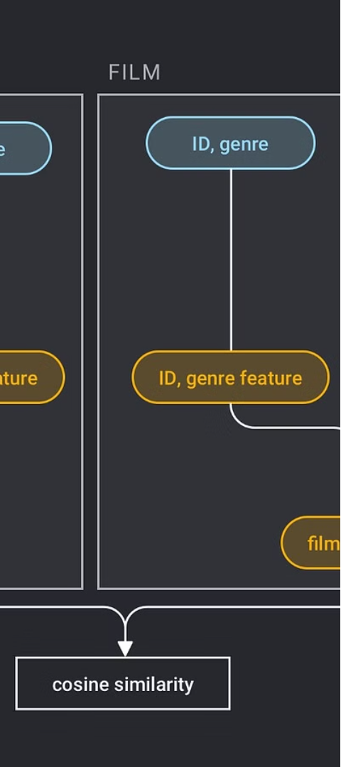



Hybrid Recommendation Strategies
Weighted Hybrid
This approach combines the outputs of collaborative filtering and content-based filtering algorithms, applying weighted scores to each recommendation based on their relative importance or performance in specific use cases.
Switching Hybrid
The system switches between collaborative filtering and content-based filtering recommendations based on factors such as data availability, user preferences, and the overall performance of each approach in different contexts.
Feature Combination
This strategy integrates features from both collaborative and content-based filtering into a single unified model, allowing the system to leverage the complementary strengths of these approaches in a more seamless and effective manner.

Slide 8




Conclusion and Future Directions
Multimodal Integration
Advancements in AI
Improved User Experience
Ethical Considerations
Leveraging a broader range of data sources, including visual, audio, and contextual information, to enhance the accuracy and diversity of movie recommendations.
Continued advancements in artificial intelligence, machine learning, and deep learning techniques to enable more intelligent, adaptive, and personalized movie recommendation systems.
Enhancing the user experience through seamless integration, intuitive interfaces, and providing users with more control and transparency in the recommendation process.
Addressing ethical concerns, such as privacy, fairness, and transparency, to ensure that movie recommendation systems are built with the well-being of users and society in mind.

