Slide 1

ALLURA / TECHNICAL PORTFOLIO
01
AGENTIC AI FRAMEWORK & HARNESS
Evidence-first
enterprise AI systems.
A technical case study of orchestration, governed memory, policy hooks, deterministic evaluation and developer interfaces.
Role-aligned to Principal Engineer, Agentic AI Framework and Harness
Prepared as a portfolio presentation. It does not imply client sponsorship, employment or deployment.
Notes:
[Sources]
- target role posting (accessed 2026-09-01)
- docs/portfolio/allura-bofa-principal-engineer/SOURCES.md
[Presenter notes]
Open with scope and boundary: this shows engineering evidence, not a client claim.

Slide 2
ALLURA MEMORY / PORTFOLIO EVIDENCE
02
What this portfolio demonstrates
The role calls for reusable frameworks, deterministic harnesses, memory, policy hooks and developer interfaces. Each claim below has a repository or CI source.
FRAMEWORK
HARNESS
GOVERNANCE
DEVELOPER EXPERIENCE
Reusable execution path
Deterministic evidence
Controls in the flow
One governed core
Orchestration plus shared interfaces
Scenario, receipt, replay, evaluation
Proof, policy, RLS, durable audit
SDK, API/MCP and CLI
The focus is evidence that a hiring panel can inspect—not a collection of visual claims.
Notes:
[Sources]
- target role posting (accessed 2026-09-01)
- FRAMEWORK.md
[Presenter notes]
Map the job’s themes directly to the following visuals.

Slide 3
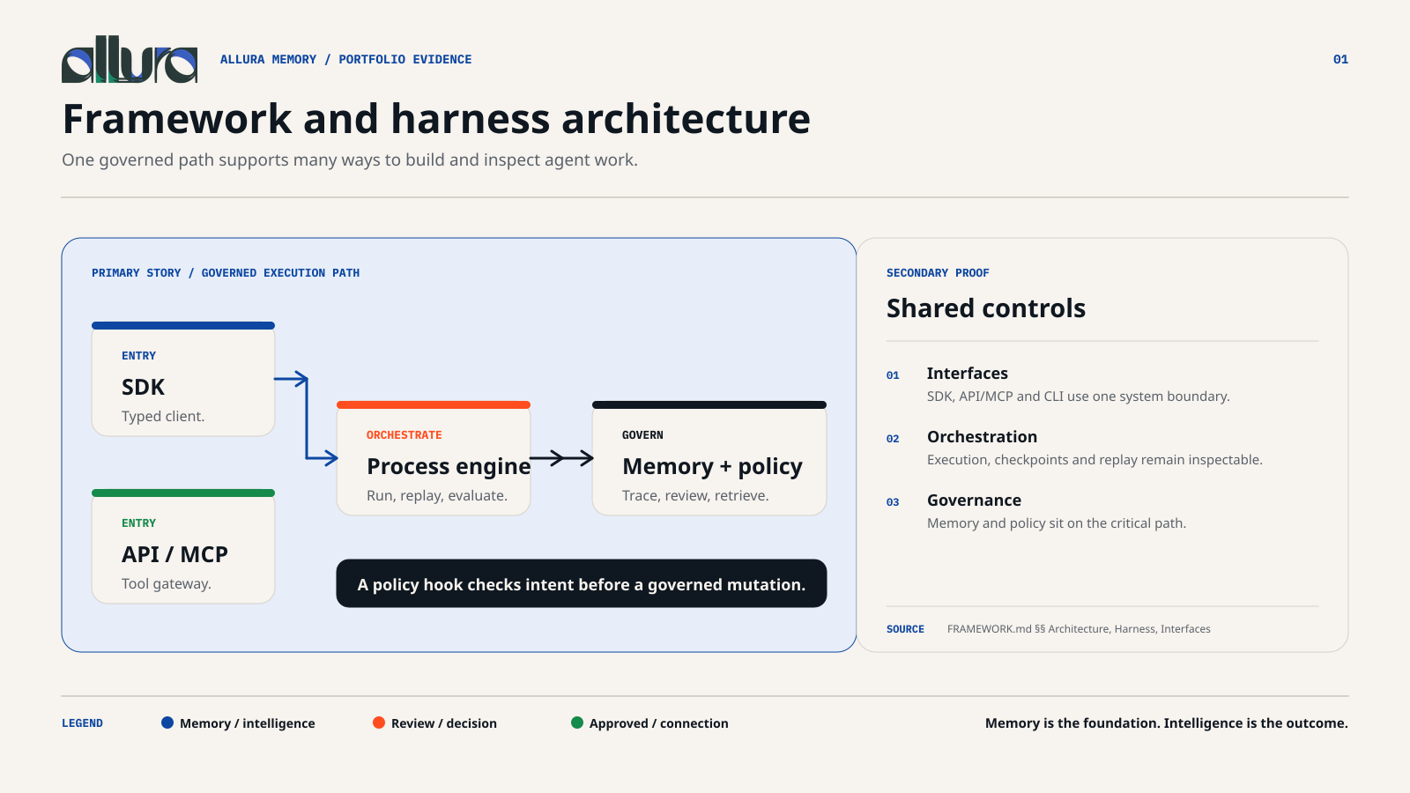
03 / ALLURA TECHNICAL CASE STUDY — ROLE-ALIGNED EVIDENCE; NO EXTERNAL AFFILIATION IMPLIED.
Notes:
[Sources]
- FRAMEWORK.md §§ Architecture, Orchestration, Policy, Harness, Interfaces
[Presenter notes]
Use the graphic to explain the execution boundary and then invite verification through the cited paths.

Slide 4
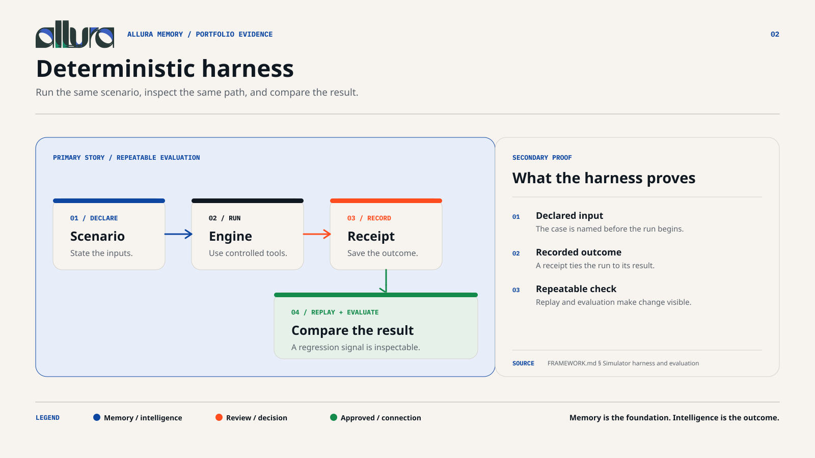
04 / ALLURA TECHNICAL CASE STUDY — ROLE-ALIGNED EVIDENCE; NO EXTERNAL AFFILIATION IMPLIED.
Notes:
[Sources]
- FRAMEWORK.md § Simulator harness and evaluation
- GitHub Actions run 33502490831
[Presenter notes]
Use the graphic to explain the execution boundary and then invite verification through the cited paths.

Slide 5
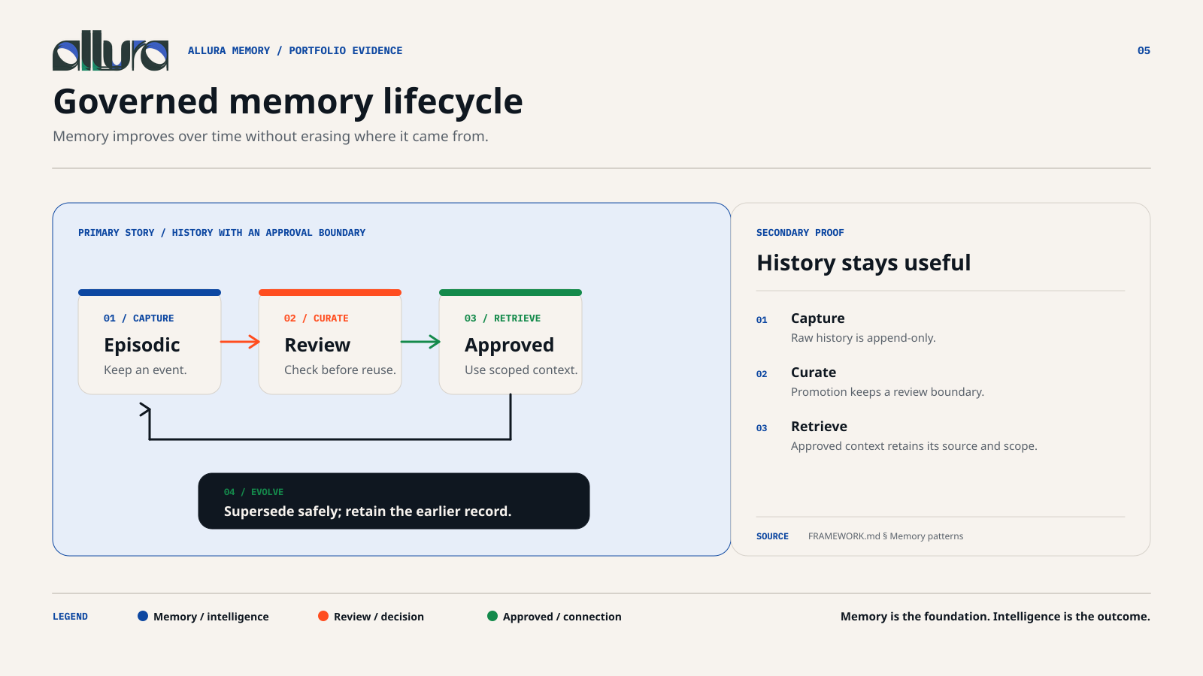
05 / ALLURA TECHNICAL CASE STUDY — ROLE-ALIGNED EVIDENCE; NO EXTERNAL AFFILIATION IMPLIED.
Notes:
[Sources]
- FRAMEWORK.md § Memory patterns
[Presenter notes]
Use the graphic to explain the execution boundary and then invite verification through the cited paths.

Slide 6
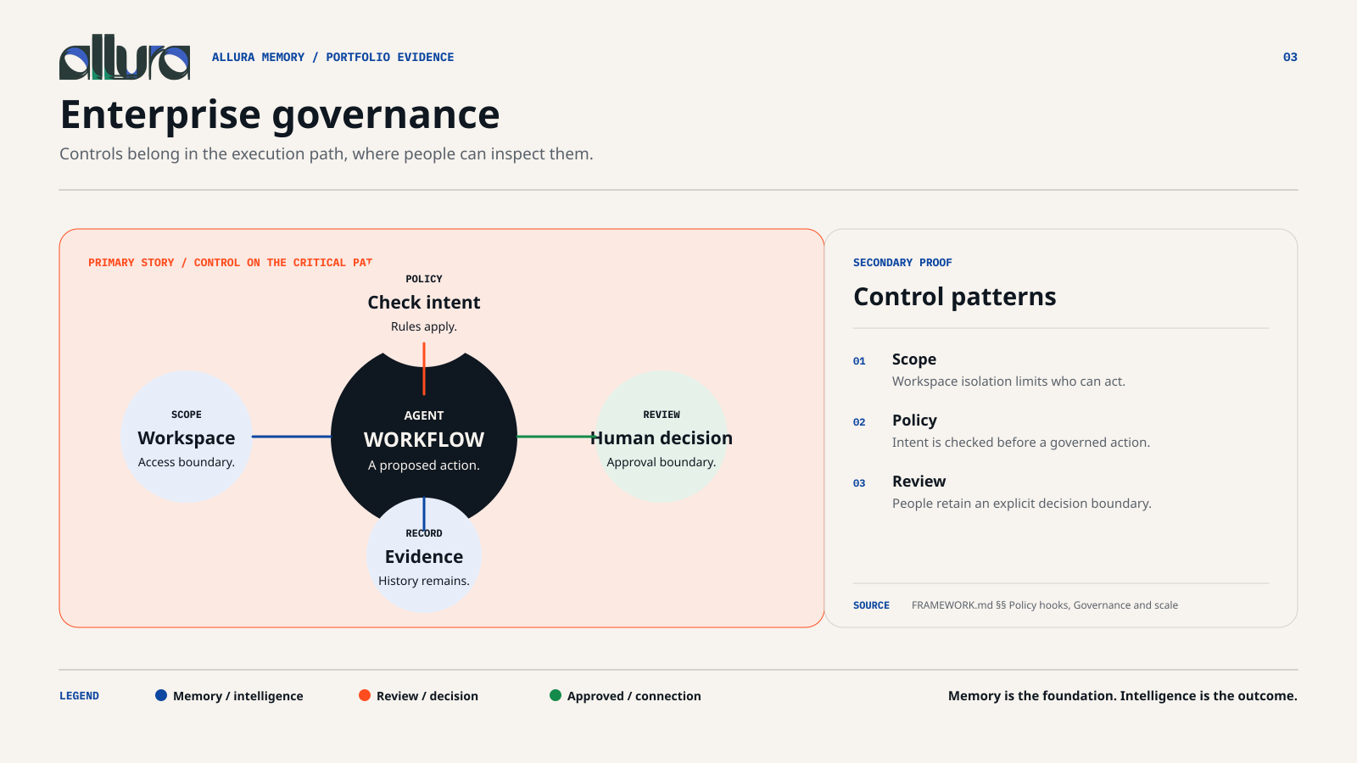
06 / ALLURA TECHNICAL CASE STUDY — ROLE-ALIGNED EVIDENCE; NO EXTERNAL AFFILIATION IMPLIED.
Notes:
[Sources]
- FRAMEWORK.md §§ Policy hooks and tool calling, Governance and scale
[Presenter notes]
Use the graphic to explain the execution boundary and then invite verification through the cited paths.

Slide 7
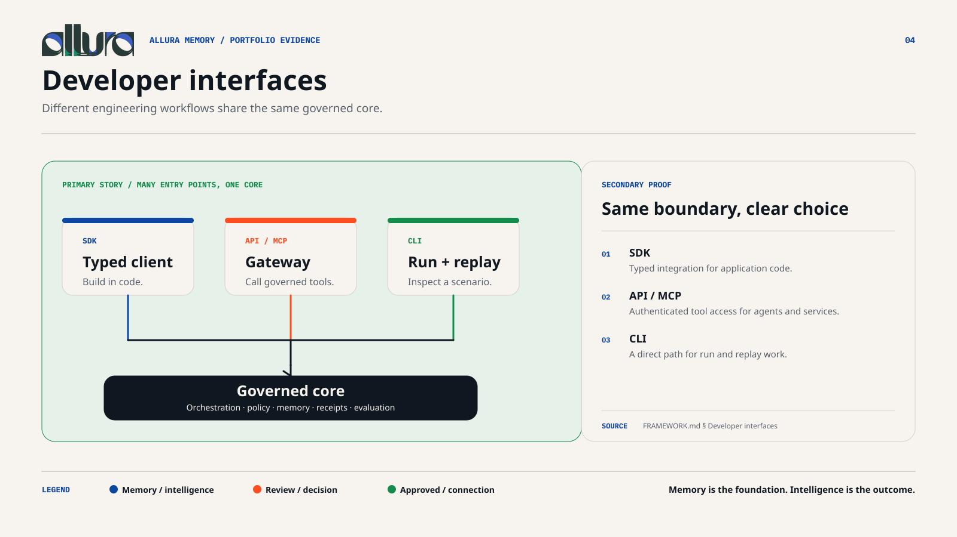
07 / ALLURA TECHNICAL CASE STUDY — ROLE-ALIGNED EVIDENCE; NO EXTERNAL AFFILIATION IMPLIED.
Notes:
[Sources]
- FRAMEWORK.md § Developer interfaces
[Presenter notes]
Use the graphic to explain the execution boundary and then invite verification through the cited paths.

Slide 8
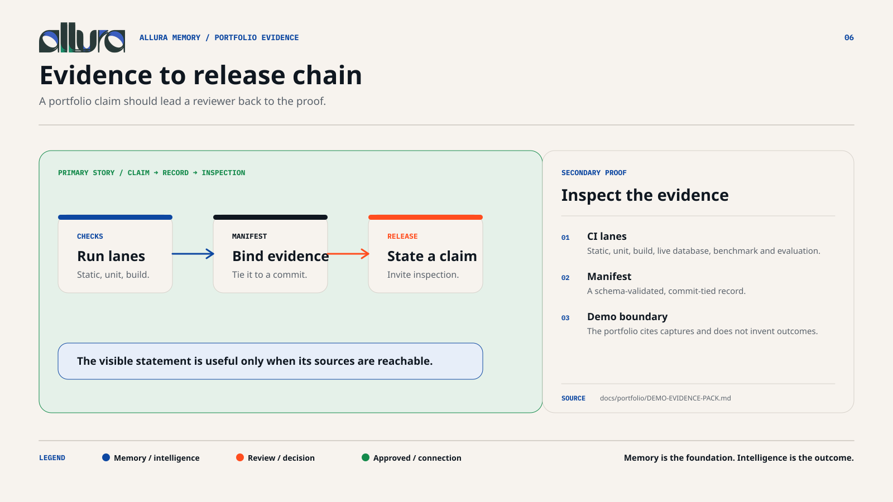
08 / ALLURA TECHNICAL CASE STUDY — ROLE-ALIGNED EVIDENCE; NO EXTERNAL AFFILIATION IMPLIED.
Notes:
[Sources]
- GitHub Actions run 33502490831
- artifacts/dashboard-demo/manifest.json
[Presenter notes]
Use the graphic to explain the execution boundary and then invite verification through the cited paths.

Slide 9
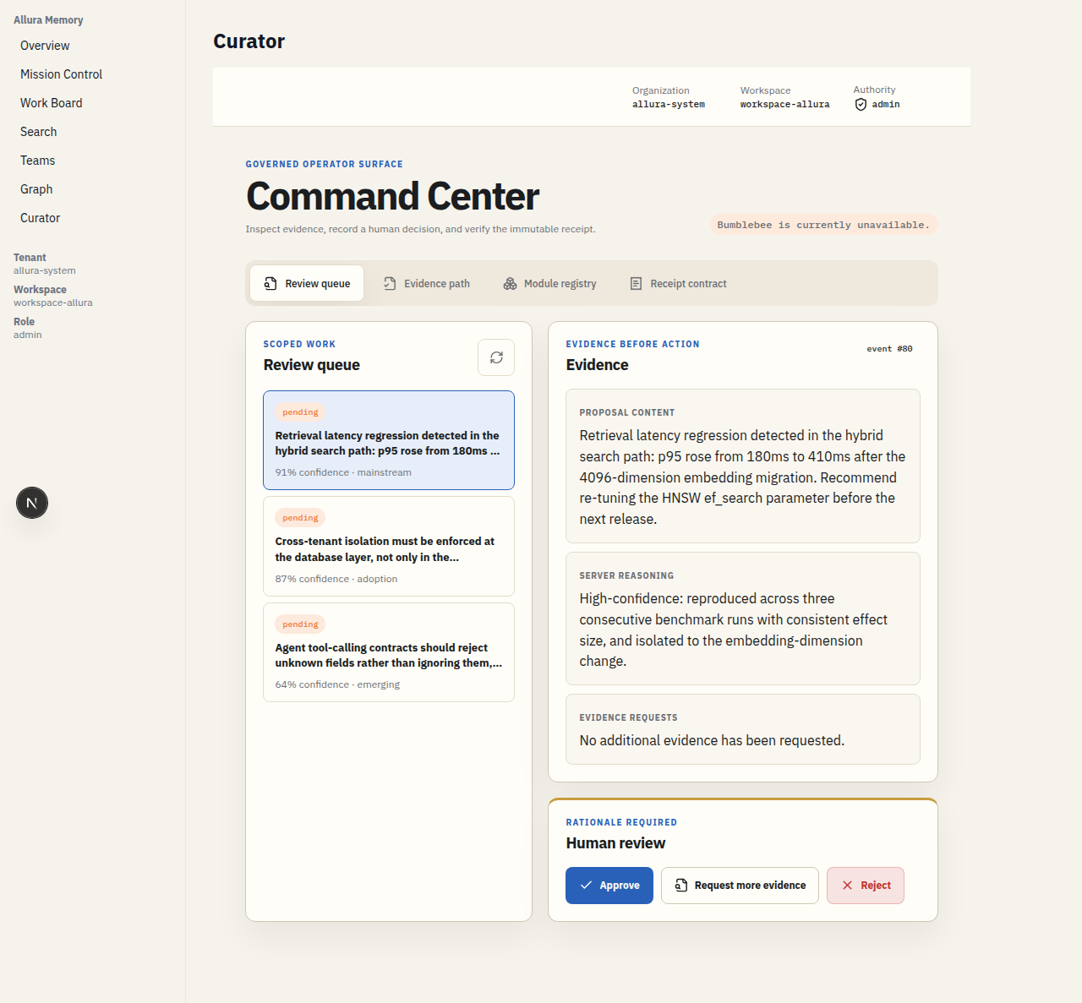
ALLURA MEMORY / PORTFOLIO EVIDENCE
09
Dashboard proof: captured, not invented
The Curator route is a real capture from the active local demonstration. The manifest records seven tested routes, all HTTP 200, without captured console or page errors.
7 / 7
captured routes returned HTTP 200
0
captured redirects
0
captured console or page errors
The screenshot is supporting evidence, not a mockup and not a substitute for the system test record.
Notes:
[Sources]
- artifacts/dashboard-demo/manifest.json
- artifacts/dashboard-demo/curator.png
[Presenter notes]
Explain the capture boundary and point to the machine-readable manifest.

Slide 10
ALLURA MEMORY / PORTFOLIO EVIDENCE
10
How to verify this portfolio
A credible portfolio lets the reviewer separate demonstrated capability from future work.
VERIFY NOW
DEMONSTRATED HERE
NOT CLAIMED
Read FRAMEWORK.md
Framework and harness
External client deployment
Inspect PR #138
Governed memory
client affiliation
Open CI evidence run
Policy and audit path
Production-scale adoption
Review dashboard manifest
Developer interfaces
Unverified performance results
The final deliverable includes editable SVGs, source notes, alt text and a production release gate.
Notes:
[Sources]
- docs/portfolio/allura-bofa-principal-engineer/SOURCES.md
- docs/portfolio/allura-bofa-principal-engineer/qa/BRAND-RELEASE-GATE.md
[Presenter notes]
Close by making verification easy and stating what this case study does not claim.

