Slide 1
Introduction
SALE AND INVENTORY SYSTEM
Nguyễn Dĩ Thái
Lê Châu Hoàng Nhựt
Lý Vĩnh Phú
Date: 22 Month: 08 Year: 2021

Slide 2
Content
Introduction
Actual requirements
Requirements of the project
Deployment diagram
Test result
Conclusion and development
Task list

Slide 3
Introduction - Actual requirements
Trading company need local web application that can connect all information between Sale, Logistics, Accountant department. User can see all information that use to working and they can create or edit or update what they are in charge of.
Example: Sale can see product list with selling price, his/her customer, inventory, all staff, his/her delivery, invoice of sale order. Sale Executive can create new sale order, edit sale order master. Sale Manager can approve new sale order of sale executive and create new sale order.

Slide 4
Introduction - Requirements of the project
Functional
System response about: Business Rules, Transaction corrections, adjustments and cancellations, Administrative functions, Authorization levels, Interfaces, Historical Data.
Non-functional
System owned : Reliability, Maintainability, Security, Usability, Integrity, User Interfaces, Availability,Flexibility, Scalability, Extensibility, Localization.
Notes:
Non-functional (how the system works)
Functional (what the system should do)

Slide 5
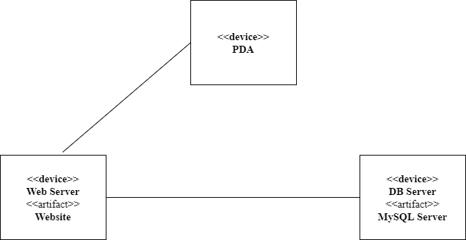
Introduction - Deployment diagram

Slide 6
Conclusion
Project can run stability on any browsers (suggest: Chrome).
System can response enough business owner demanding. ( data integrity, user interface, usability,..)
System is comfortable for user. Easy to learn and expert.
System secure customer, staff, product informations.

Slide 7
Development
In the future, this system will be transfered to PDA devices and Application system.
System will be extended for more part.
Can easy to switch programing language.
Change data management.

Slide 8
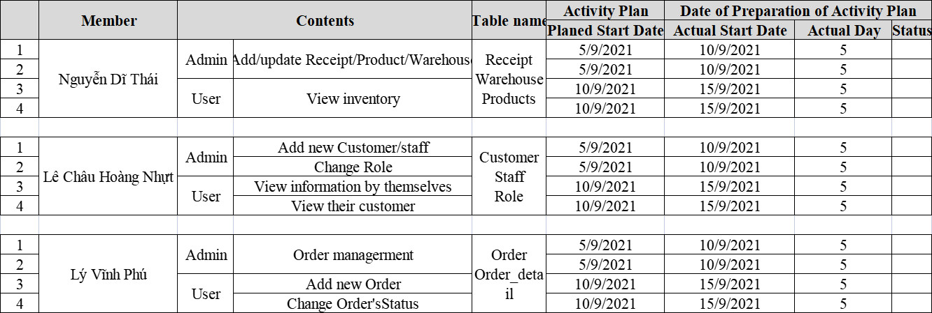
Task List

Slide 9

Thank You

