Slide 1
Maester Documentation Diagrams

Slide 2



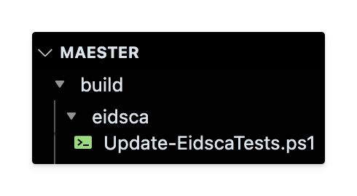


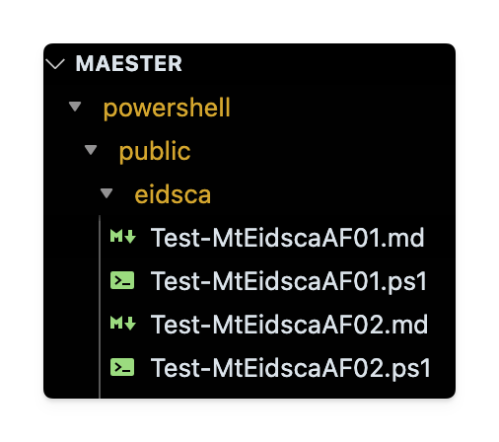
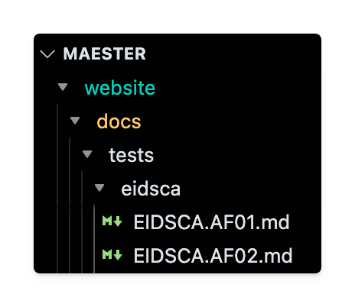
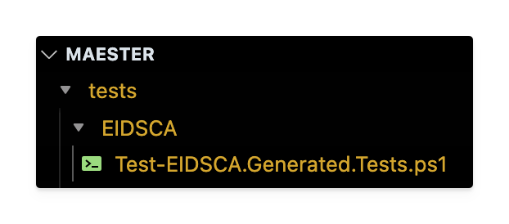
Maester - EIDSCA Integration
EidscaConfig.json
Cloud-Architekt/
AzureAD-Attack-Defense
Run PowerShell script to generate EIDSCA commands, docs & pester tests
Update-EidscaTests.ps1
maester/build/eidsca/
EIDSCA Commands
EIDSCA Docs
EIDSCA Pester Tests

