Slide 1
MINI PROJECT
STEGAPP
Implementing Modified AES(AES+Blowfish) in
Steganography application
Group : 3
Ajay Dileep
Allwin Nebu
Alvin Boby Mathew
Mathew Somy
Guide :
Asst. prof. Devina Vinod

Slide 2
CONTENT
Introduction
Abstract
Literature Review
TimeLine
System Requirement
Proposed Architecture
Algorithm
Flowchart
Working
Why AES Modified?
Why AES+Blowfish?
How is key Exchanged?
Quality Comparison
StegApp vs Other Application
Working/Output
Advantage
Future Enhancement
Target users
Social Relevance
Conclusion
Reference
Live Demonstration
Thank You

Slide 3
INTRODUCTION
Steganography Tool – Hides text, audio, and images inside images.
Encryption Support – Uses AES and Blowfish for secure data hiding.
Data Extraction – Retrieves and decrypts hidden data from stego-images.
GPU Acceleration – Uses CUDA for faster processing if available.
Bitwise Operations – Modifies image pixel bits to store hidden data.
Parallel Processing – Uses multithreading for efficiency.
Audio & Image Support – Can hide and extract WAV, MP3, and images.

Slide 4
ABSTRACT
Secure Steganography – Hides text, audio, and images inside carrier images.
Encryption-Based – Uses AES and Blowfish to encrypt hidden data.
GPU Acceleration – Optimizes processing speed with CUDA (if available).
Bitwise Embedding – Modifies pixel bits to store encrypted information.
Parallel Processing – Uses threading for fast data handling.
Audio & Image Support – Hides and extracts WAV, MP3, and images.
Cybersecurity Application – Useful for secure communication and data protection.

Slide 5
LITERATURE REVIEW
Encryption Algorithm – Sharma modifies AES; this method combines AES, Blowfish, and XOR.
Data Type – Sharma encrypts images; this method encrypts text and audio (image-to-image planned).
Key Generation – Sharma uses dynamic key expansion; this method derives keys from SHA-256 hashing.
Steganography – This method embeds encrypted data in images; Sharma’s method does not include steganography.
GPU Acceleration – This method uses CUDA-based processing for speed; Sharma’s method does not mention GPU usage.

Slide 6
Security Strength – This method adds multi-layer encryption; Sharma’s method relies only on Modified AES.
Error Handling – This method detects incorrect keys to prevent corruption; Sharma’s method does not specify error detection.
Hybrid Cryptography – This method integrates multiple encryption techniques; other studies focus on single encryption methods.
Performance Enhancement – GPU-accelerated steganography improves efficiency, as supported by Lee et al. (2021).
Steganalysis Resistance – Hybrid cryptography and randomized bit embedding improve security, aligning with Tan & Wei (2022).

Slide 7
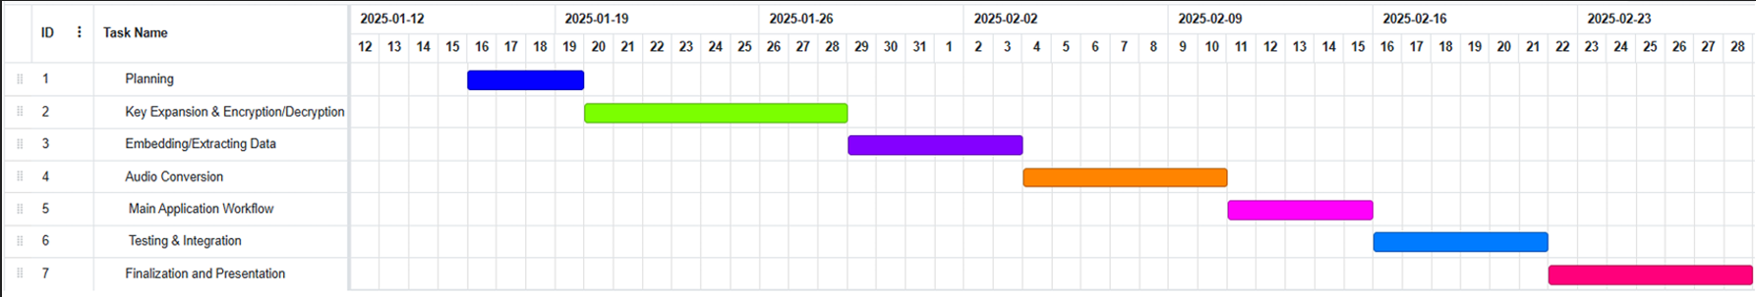
TIMELINE

Slide 8
SYSTEM REQUIREMENT
Hardware Requirements
Processor – Intel i5/AMD Ryzen 5 or higher
RAM – Minimum 4GB (8GB+ recommended)
Storage – At least 100MB free disk space
GPU (Optional) – NVIDIA CUDA-enabled GPU
Display – 1366x768 resolution or higher

Slide 9
Software Requirements
Operating System – Windows, Linux, or macOS
Programming Language – Python 3.x

Slide 10
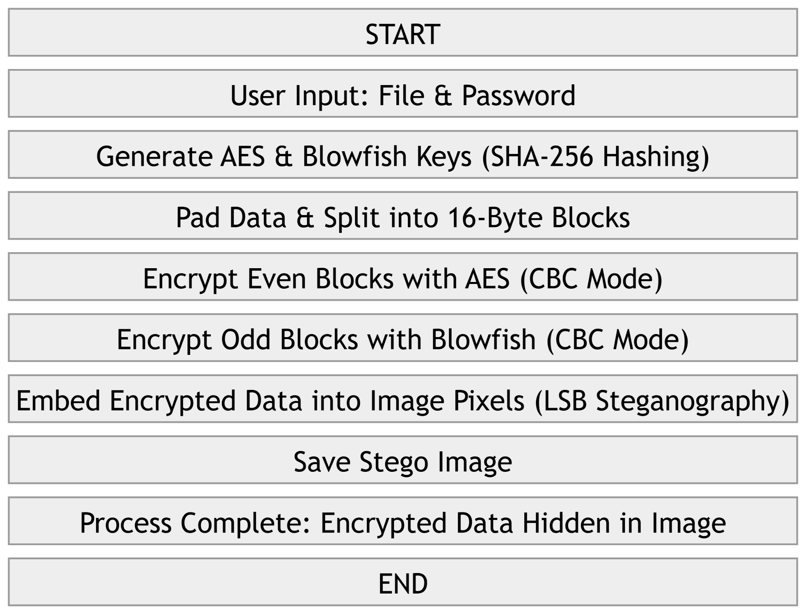
PROPOSED ARCHITECTURE

Slide 11
ALGORITHM
1. Hiding Data
Input: Carrier image, secret data (text/audio/image), encryption key.
Encrypt Data:
Use SHA-256 to derive keys.
Encrypt data using AES and Blowfish.
Embed Data:
Convert encrypted data to binary.
Hide bits in Least Significant Bits (LSB) of image pixels.
Save the modified image as the stego-image.

Slide 12
2. Extracting Data
Input: Stego-image, decryption key.
Extract Data:
Read LSBs of pixels to retrieve binary data.
Decrypt Data:
Use AES and Blowfish with the same key.
Output: Extracted text, audio, or image.

Slide 13
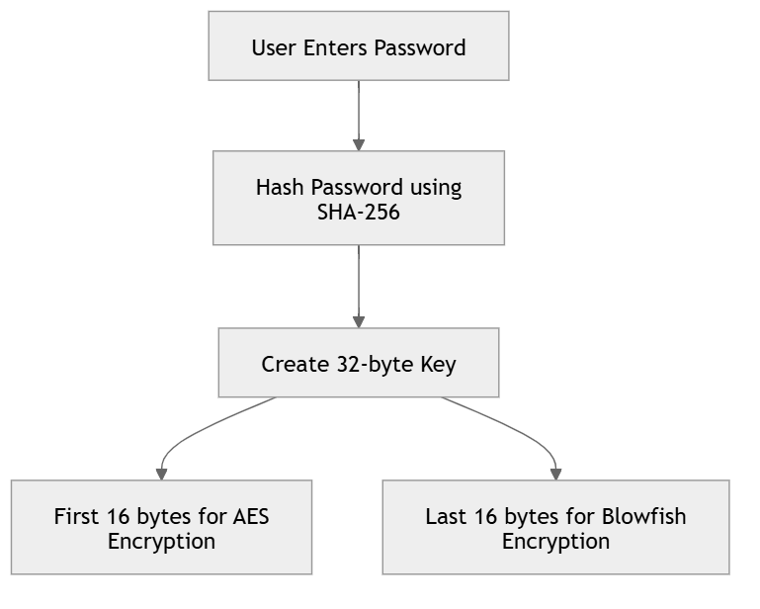
FLOW CHART

Slide 14
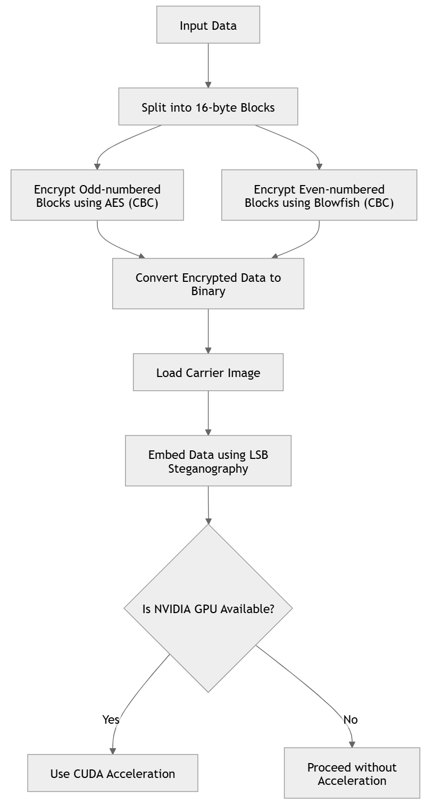

Slide 15
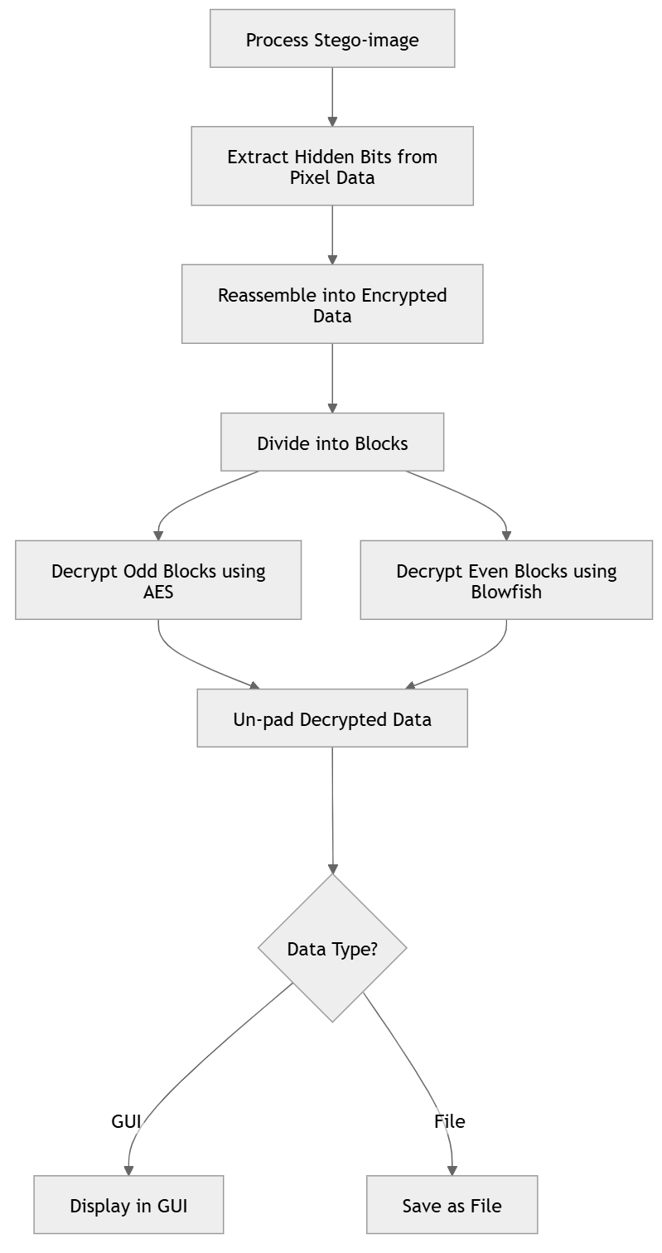

Slide 16
WORKING
1. Key Generation
Input: User provides a shared encryption key.
SHA-256 Hashing: Converts the key into a fixed 32-byte hash.
AES & Blowfish Keys:
First 16 bytes → AES key
Last 16 bytes → Blowfish key

Slide 17
2. Encryption Process
Padding: Ensures data is aligned to 16-byte AES blocks.
AES Encryption: Encrypts data using AES in ECB mode (block-wise encryption).
Blowfish Encryption: Further encrypts AES output using Blowfish.
XOR in GPU: If CUDA is available, XOR operations are applied in the CUDA kernel for additional randomness.
Output: Encrypted data ready for embedding.

Slide 18
3. Decryption Process
Extract Data: Reads the encrypted data from the carrier image.
Blowfish Decryption: First layer of decryption using Blowfish.
AES Decryption: Second layer of decryption using AES.
XOR Reversal: If XOR was applied during encryption, it is reversed in the CUDA kernel.
Unpadding: Removes extra bytes to recover the original data.
Output: Decrypted text or audio.

Slide 19
WHY AES MODIFIED?
Increased Security – AES + Blowfish enhances encryption strength.
Better Randomization – Prevents predictable patterns in encrypted data.
Optimized Performance – Uses GPU acceleration (CUDA) for faster encryption.
Improved Key Handling – Ensures consistent and strong key derivation using SHA-256.
Efficient Small-Block Processing – Encrypts data in smaller chunks for better security.
Error Reduction – 16-byte padding prevents decryption failures and data corruption.

Slide 20
WHY AES+ BLOWFISH ?
Feature | Blowfish+AES | Dynamic S-Box AES | Modified Round AES
Encryption Strength | Very High (AES + Blowfish Hybrid) | High (Custom S-Box resists attacks) | High (Unpredictable rounds prevent attacks)
Key Management | Standard SHA-256 key derivation (easy to implement) | Requires dynamic S-Box key generation (complex) | Uses multiple keys based on rounds (complex)
Error Propagation | Medium (CBC mode only affects adjacent blocks) | Z Low (S-Box encryption localizes errors) | Medium (Varies based on rounds used)

Slide 21
HOW IS KEY EXCHANGED?
User Provides Key – The key is manually entered in the GUI.
No Automatic Exchange – The key is not transmitted over a network.
SHA-256 Hashing – Converts the key into a fixed 32-byte value.
Local Use Only – The key is used for encryption and decryption within the system.
User Must Share Securely – The same key is needed for decryption, requiring manual sharing.

Slide 22
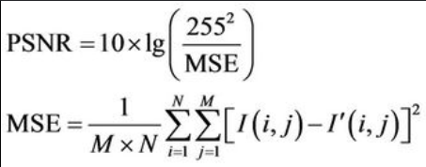
QUALITY COMPARISON
PSNR-it stands for ratio of signal power to noise power.
MSE(mean square error)-it means difference between two given images

Slide 23
SL NO | Image/Audio | MSE | PSNR | Remarks
1. | Original audio-extracted audio | 0 | infinity | MSE less-good steganography Small change(not noticeable)
2. | Original image-stegano image | 9.4483 | 38.38 db | MSE less-good steganography Small change(not noticeable)
3. | Original image-enlarged image | 8.2813 | 38.95 db | MSE less-good steganography Small change(not noticeable)

Slide 24
STEGAPP VS OTHER APPLICATIONS
Feature | StegApp | Other Steganography Apps
Encryption Method | AES + Blowfish + XOR (Strong) | Mostly AES or no encryption
GPU Acceleration | CUDA support for fast processing | Mostly CPU-based, slower performance
Cross-Platform | Works on Windows, Linux, macOS | Often OS-specific
Error Detection | Detects incorrect keys, prevents corruption | May extract corrupted or unreadable data

Slide 25
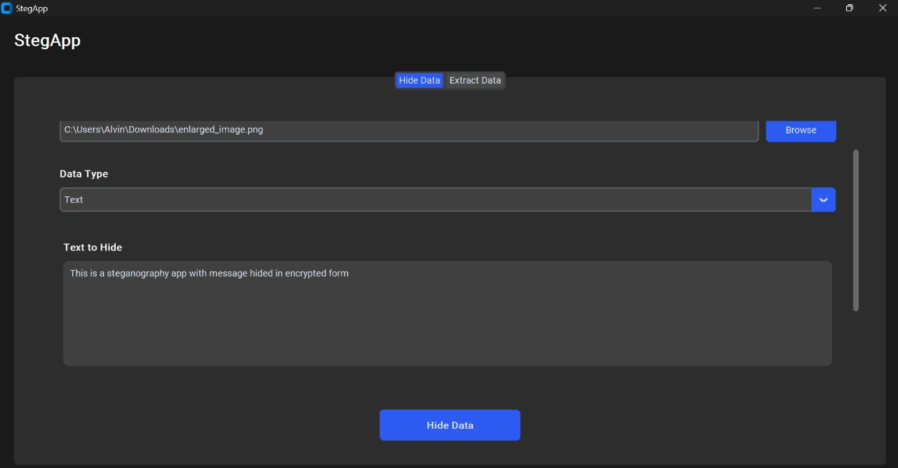
WORKING/OUTPUT

Slide 26
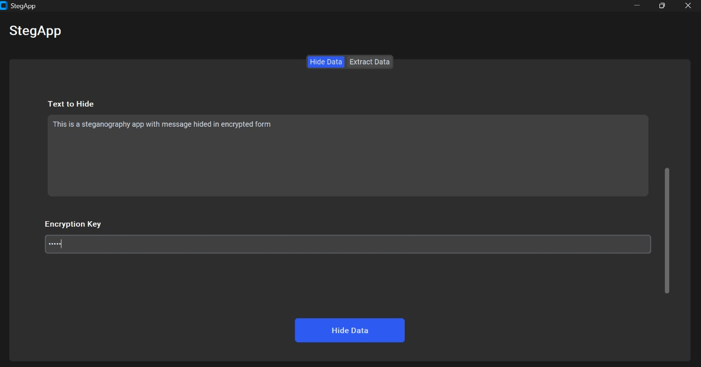

Slide 27
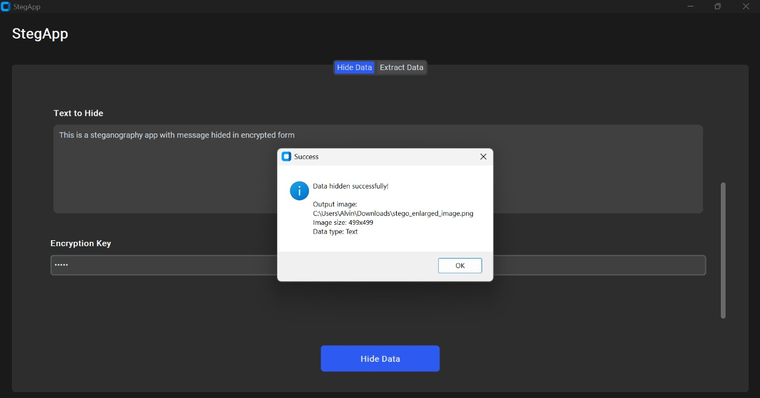

Slide 28
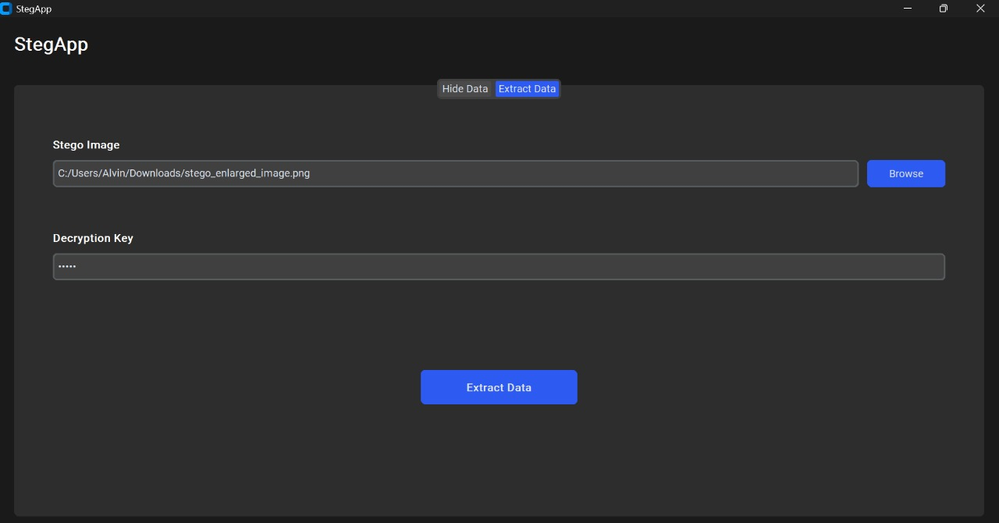

Slide 29
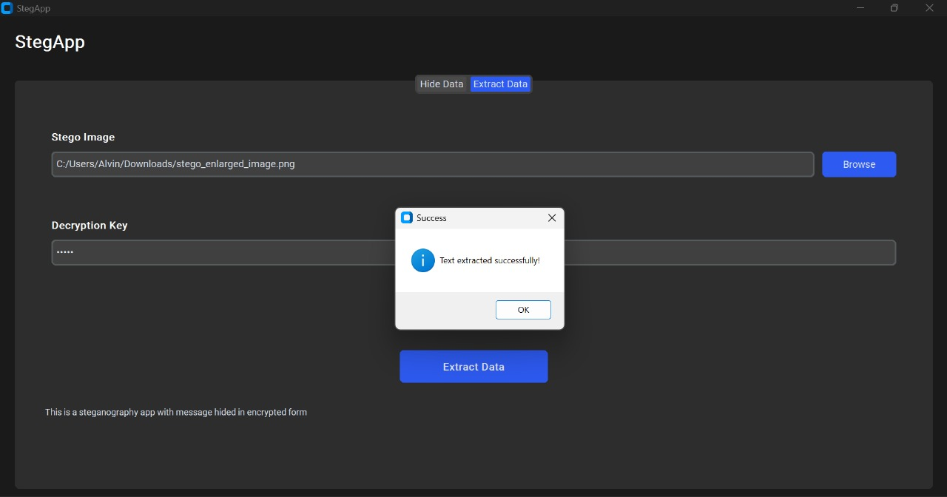

Slide 30
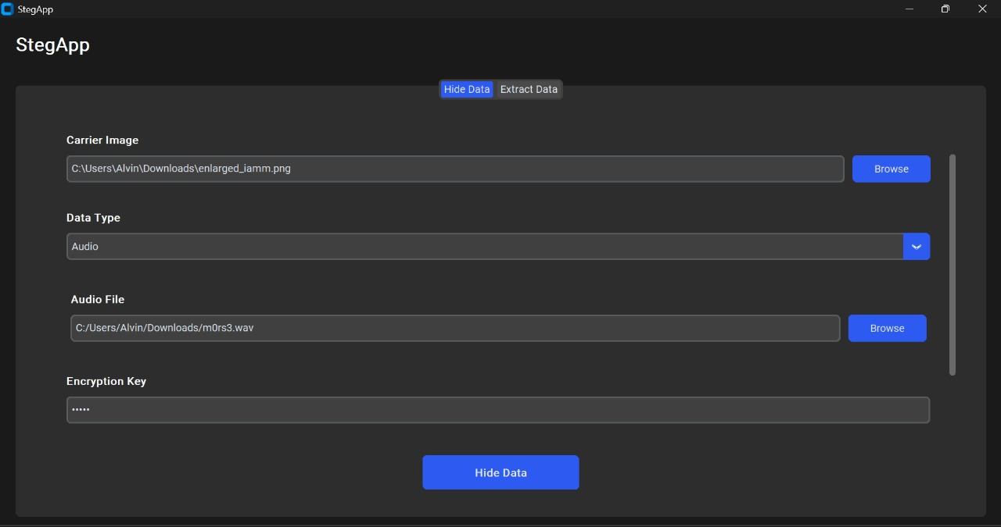

Slide 31
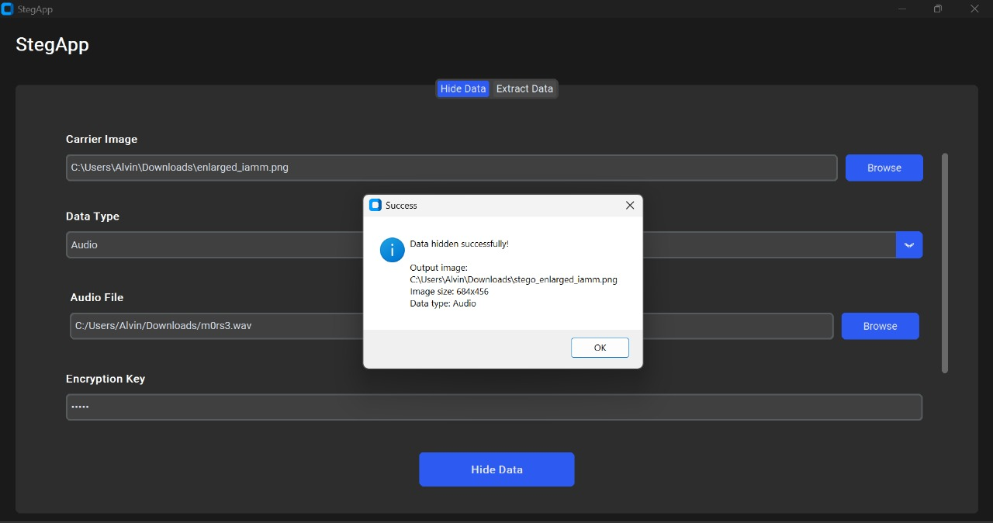

Slide 32
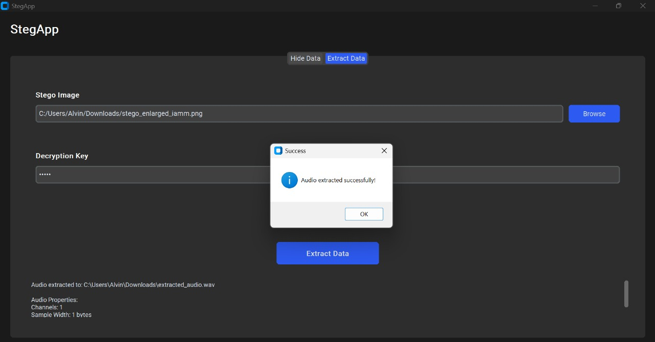

Slide 33
ADVANTAGES
Strong Security – Combines AES + Blowfish for multi-layer encryption.
Improved Key Handling – Uses SHA-256 hashing for strong key derivation.
Fast Performance – GPU acceleration (CUDA) speeds up encryption and decryption.
Optimized Encryption – Encrypts small pixel groups to avoid pattern detection.
Reliable Padding – Ensures 16-byte alignment to prevent decryption errors.
Efficient Processing – Uses multithreading for faster execution.
Flexible Data Support – Can encrypt text and audio securely.

Slide 34
FUTURE ENHANCEMENT
Image-to-Image Steganography – Hides one image inside another securely.
Cross-Platform Desktop Application – Designed to run on all operating systems.

Slide 35
TARGET USERS
Journalists
Cybersecurity Professionals
Intelligence Agencies
Individuals Concerned About Privacy
Researchers
Digital Forensics Experts
Government & Military Organizations

Slide 36
SOCIAL RELEVANCE
Keeps private data safe from hackers.
Hides secret messages using pictures.
Uses both coding and hiding methods.
Stops online threats in chats and emails.
Keeps important info safe and hidden.
Lowers the chance of data leaks.
Helps stop identity theft.
Makes it hard for others to find your data.
Protects against spying.
Helps improve online security tools.

Slide 37
CONCLUSION
Enhanced Security – Combines AES, Blowfish, and XOR for strong encryption.
Fast Performance – GPU acceleration improves processing speed.
Reliable Data Hiding – Supports text, audio, and future image steganography.
Cross-Platform Support – Works on Windows, Linux, and macOS.
User-Friendly & Efficient – Detects errors and prevents data corruption.

Slide 38
REFERENCE
[I] A New Image Encryption using Modified AES Algorithm and its Comparison with AES published at International Journal of Engineering Research Technology 2278-0181 ,http://www.ijert.org, IJERTV91S080083,Published on vol. 9 Issue 08, August-202(). By author:Priyanka Sharma Electronics Communication Engineering Guru Gobind Singh Indraprastha University Delhi, India (last used : 2/2/2025)
[2] S. Kumar and P. Singh, "Efficient Cryptographic Techniques for Secure Data Transmission," 2020. IEEE Transactions on Information Forensics and Security, vol. 15, pp. 1234-1245, doi:
10.1109/TIFs.2020.2975284. (last used : 21/2/2025)
[3]1 Y. Lee, A. Kim, and D. Park, "GPU-Accelerated Steganography: Enhancing Performance," 2021. IEEE Access, vol. 9, pp. 54321- 54335, doi: 10.1109/ACCESS.2021.3057892.(last used: 26/2/2025)
[4] H. Tan and X. Wei, "Steganography and Cryptography: Hybrid Approaches," 2022. Journal of Information Security and Applications, vol. 66, pp. 102-119, doi: 10.1016/j.jisa.2022.102119.(last used : 3/32025)

Slide 39
LIVE DEMONSTRATION

Slide 40
THANK YOU

