Slide 1
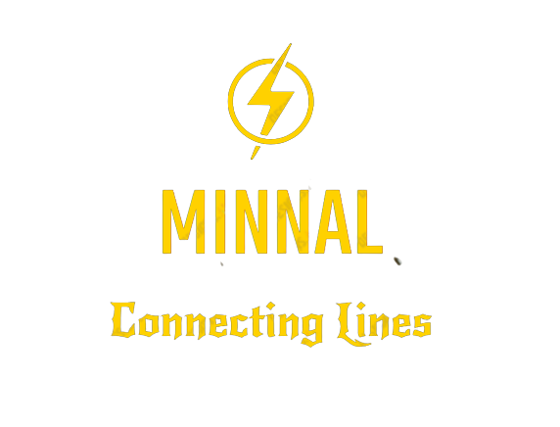

Slide 2
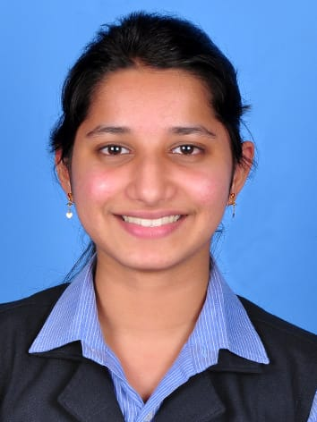
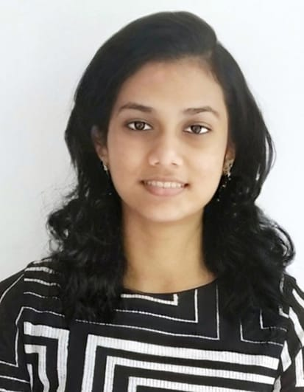
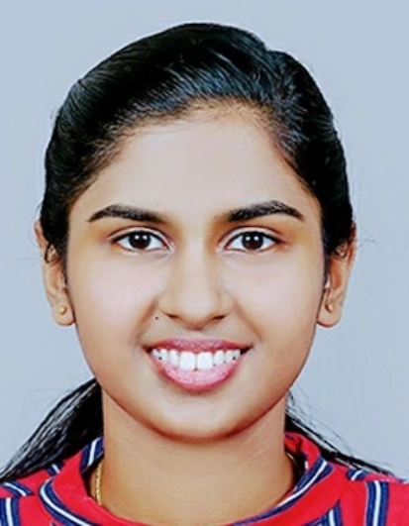
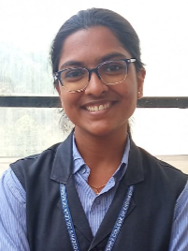
TEAM
Allwina Anna Soy Jose Alphy George Anita Augustine Anitta Siby
S6-CS-B-10 S6-CS-B-11 S6-CS-B-16 S6-CS-B-18
(Team Leader)

Slide 3
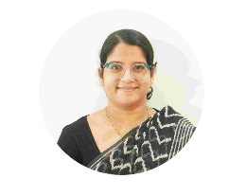
PROJECT GUIDE
Prof. Maria Yesudas
Assistant Professor
Dept. Of Computer Science and Engineering
SJCET,Palai
mariayesudas@sjcetpalai.ac.in

Slide 4
Problem Statement
Inability to connect to the electricity board due to busy network lines.
Make a system where the data about the consumer will be saved only once and a single click can connect them to the electricity board authorities.
The project mainly deals with the servicing requests of transformers as an intermediate in case of any compliant.

Slide 5
Project Scope
“Connecting Lines”
It is a platform through which consumers can easily connect with the authority in case of electricity complaints.
This project makes it easy to connect the board with just a click.
This project makes the consumer to fill in the consumer details only once and it will be saved and used for future reference.
There is no limit of adding consumers to this application. Hence, it is scalable. It will be a better way of organizing and connecting consumers to the board

Slide 6
Requirement Analysis
Data Collection
Functional Requirements
Non Functional Requirements

Slide 7
Data Collection

Slide 8
Functional Requirements
Register and Login
To be able to register a complaint user must have an account and must be logged into it
Report Issues
User can just click on the report button to register the complaint and can provide details
on the issue which will be sent to the KSEB authorities
Receive Notification about Consumer Issues
This feature enables the KSEB authorities to receive notification about issues registered
by the consumer
Send or receive Alert Messages
This KSEB authorities to send alert messages .The consumers can receive these alert messages.
Check Whether the Issue is Resolved
Enables the consumers to check the status of the issues. The authorities can update the
status of the issue.

Slide 9
Non-Functional Requirements
Performance Requirements
The system should respond to user actions within short period of time.
Safety Requirements
The system should prevent unauthorized access to sensitive user and lab data.
Security Requirements
The system should use strong encryption algorithms to protect sensitive user and
lab data during transmission and storage.
Software Quality Attributes
The system should be modular and maintainable, with a clear separation of concerns
and well-defined APIs

Slide 10
Design
Use Case Diagram
Activity Diagram
Consumer
Board
ER Diagram

Slide 11
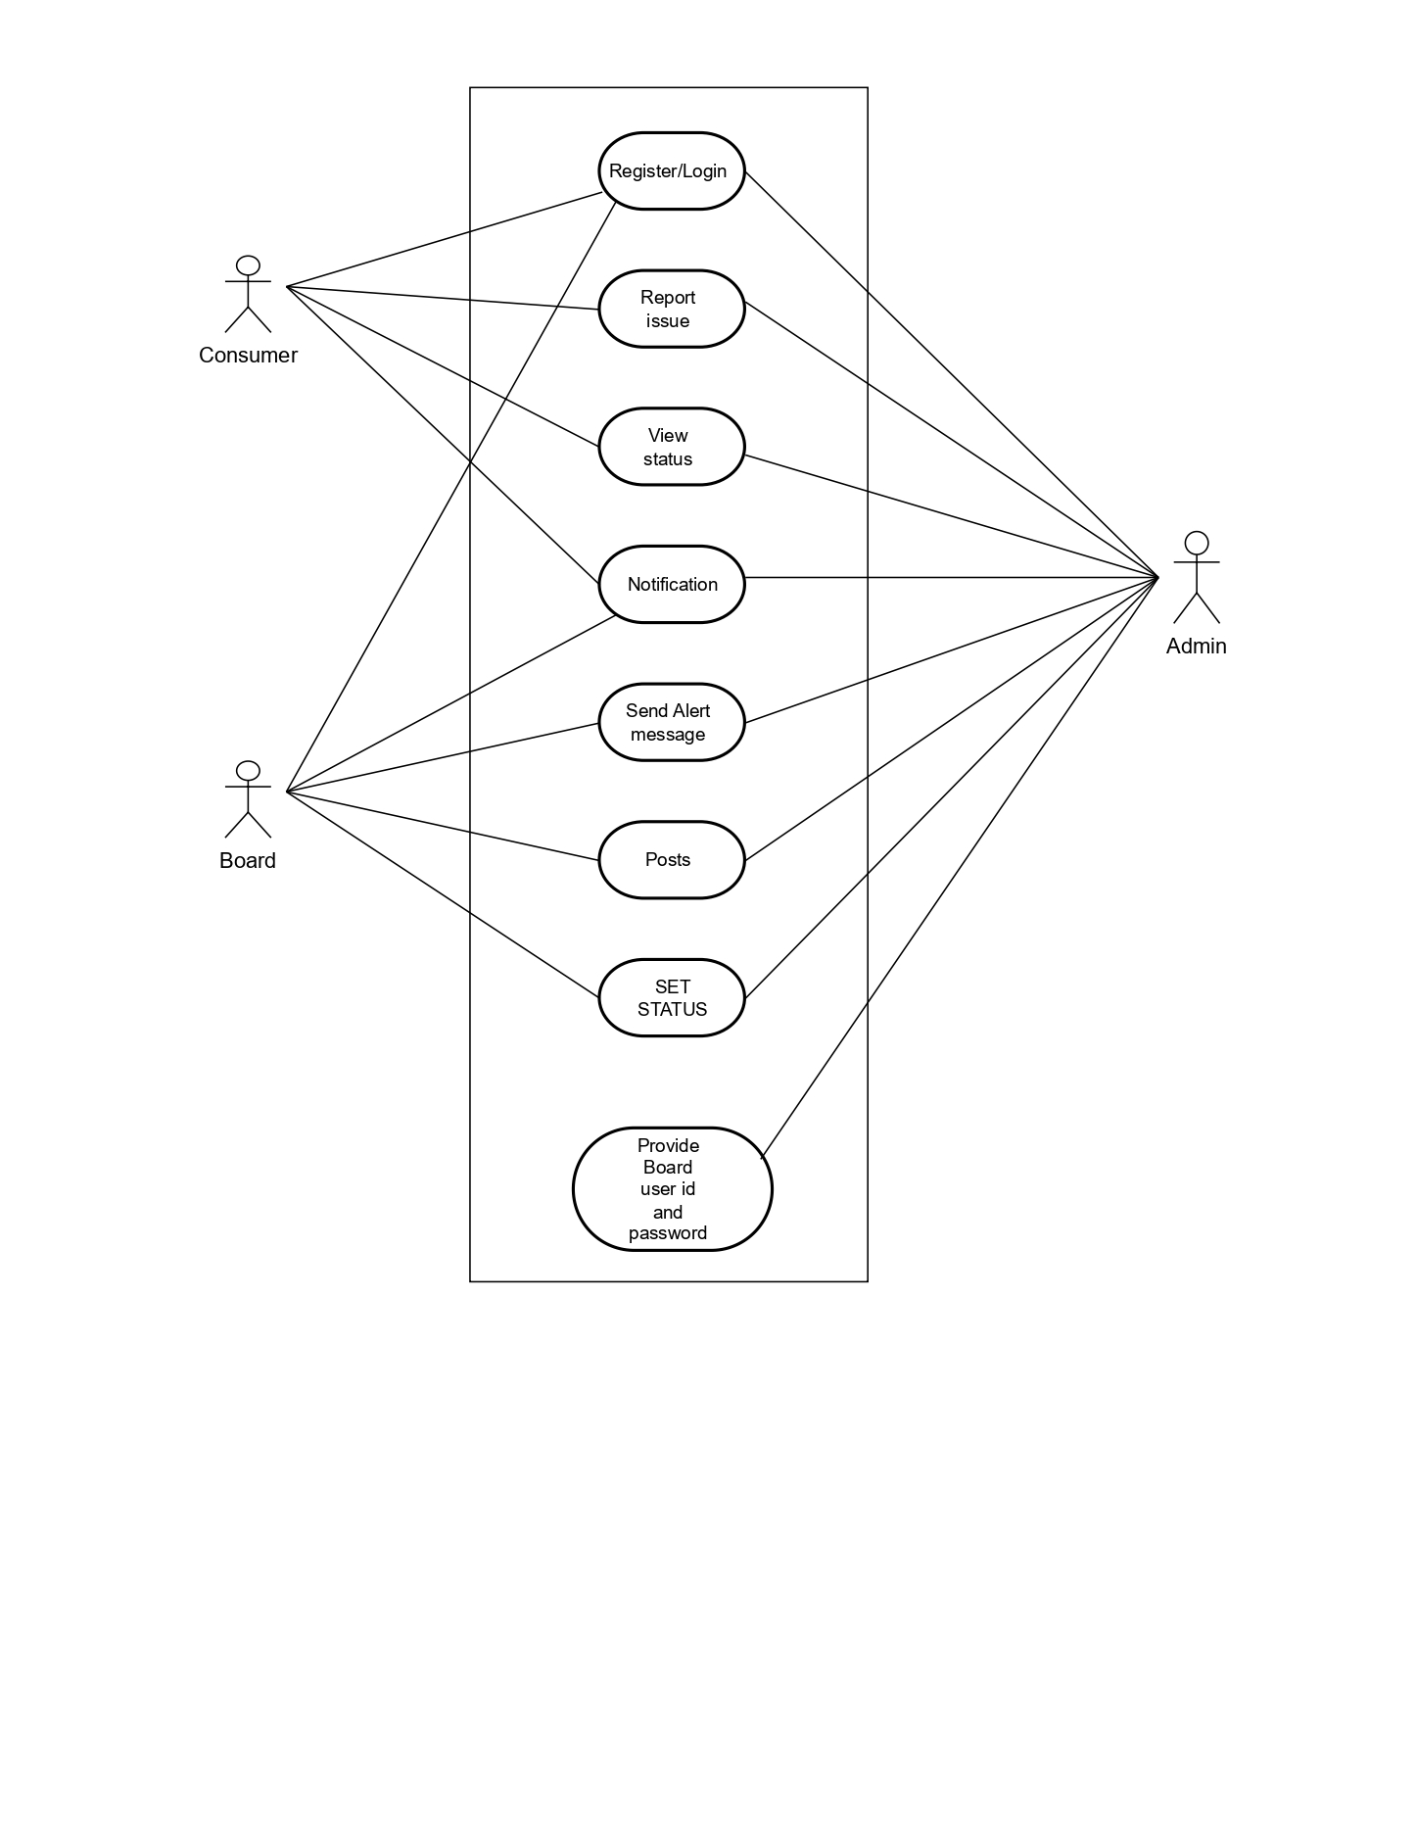
Use Case Diagram

Slide 12
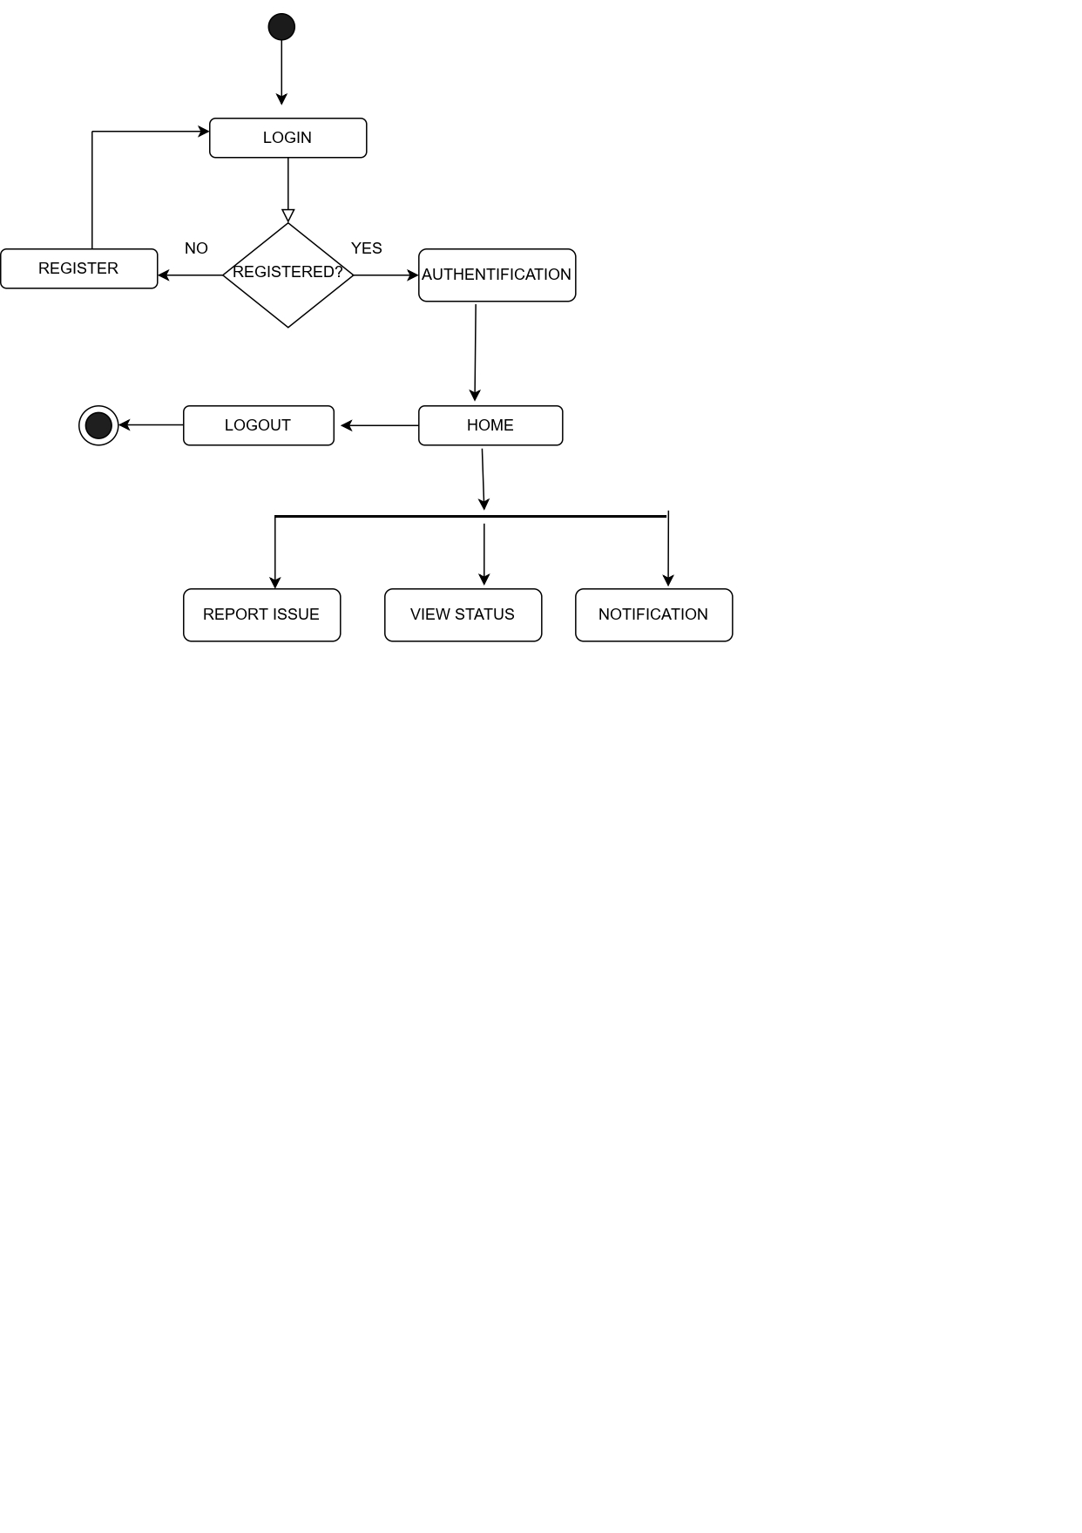
Activity Diagram: Consumer

Slide 13
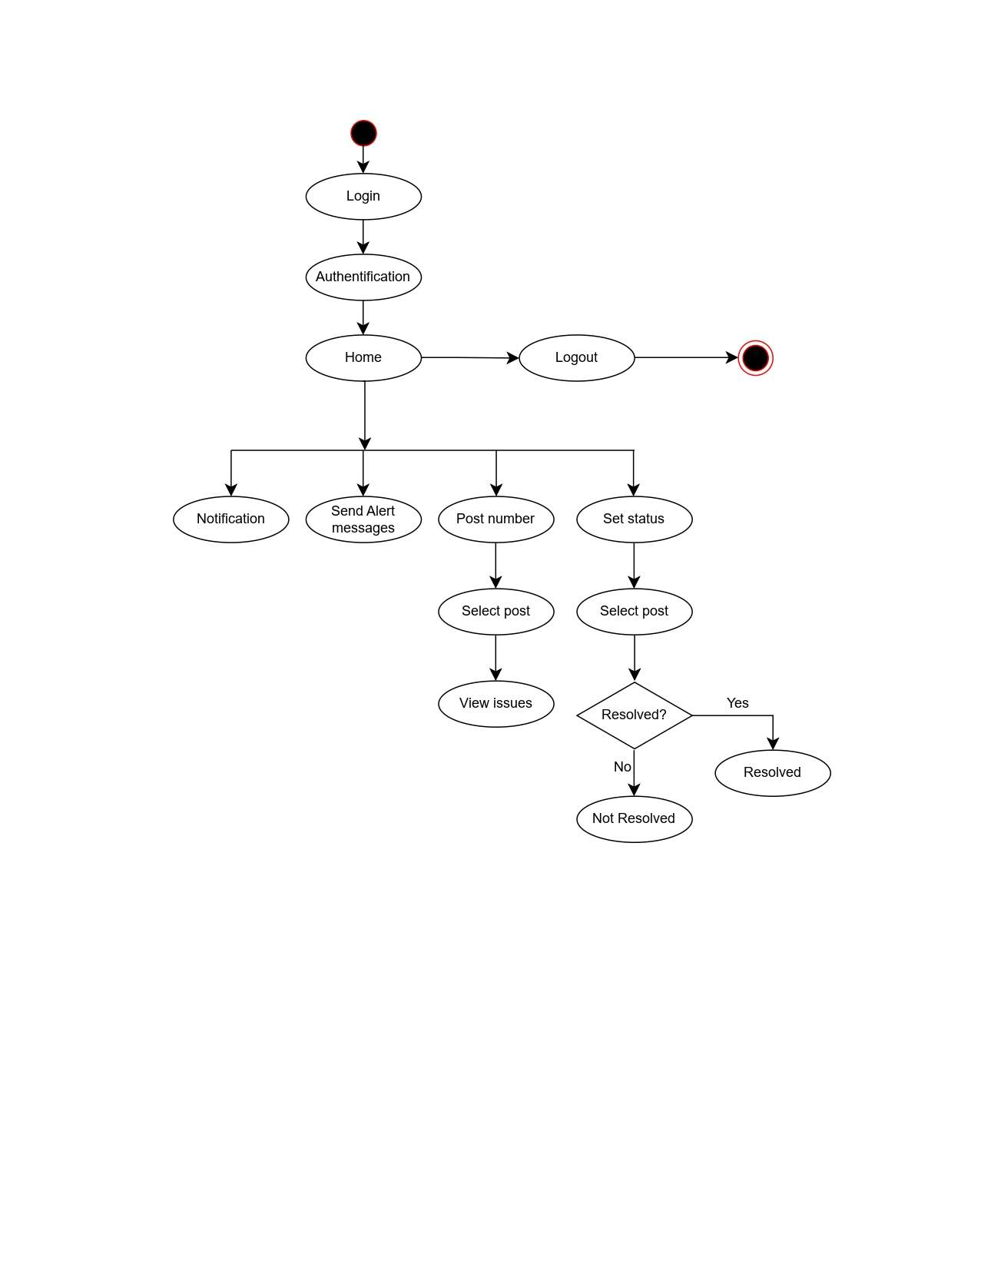
Activity Diagram: Board

Slide 14
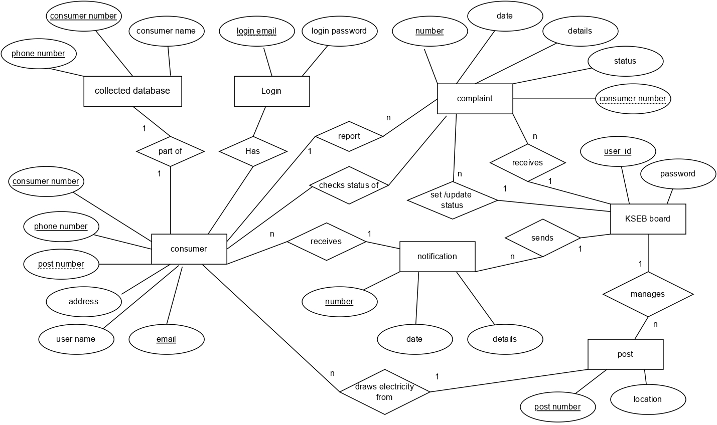
ER Diagram

Slide 15
Module Description
1.Administrator
The administrator is the super user and has complete control over the activities that can be performed. The administrator can remove any user.
Function: provide username and password to electricity board.
2.Consumer:
These are the ordinary people who consume electricity. They are the ones affected in case of power disruption.
Function: Register and login ,Report an issue, View status, Receive notification.
3. Board:
These include the authorities at KSEB who are responsible for supplying electricity. They view the complaints and take necessary action to resolve the issue.
They set the issue ‘resolved ‘once it has been taken care of.
Function: send alert messages and notification, set status of issue.

Slide 16
Technology Stack
Flutter
Flutter is an open-source UI software development kit (SDK) developed by Google for building natively compiled apps for mobile, web, and desktop using a single codebase. It uses the Dart programming language and provides a rich set of pre-built UI widgets and tools.
Firebase
Firebase is a popular backend-as-a-service (BaaS) platform developed by Google. It provides a range of cloud-based services for building mobile and web apps, including authentication, real-time databases, storage, and more.

Slide 17
Gantt Chart

Slide 18
THANK YOU

