Slide 1
Coca-cola advert
By:Suleiman Usama

Slide 2
Table of content
Modeling
UV Texturing
Shading
Animation

Slide 3
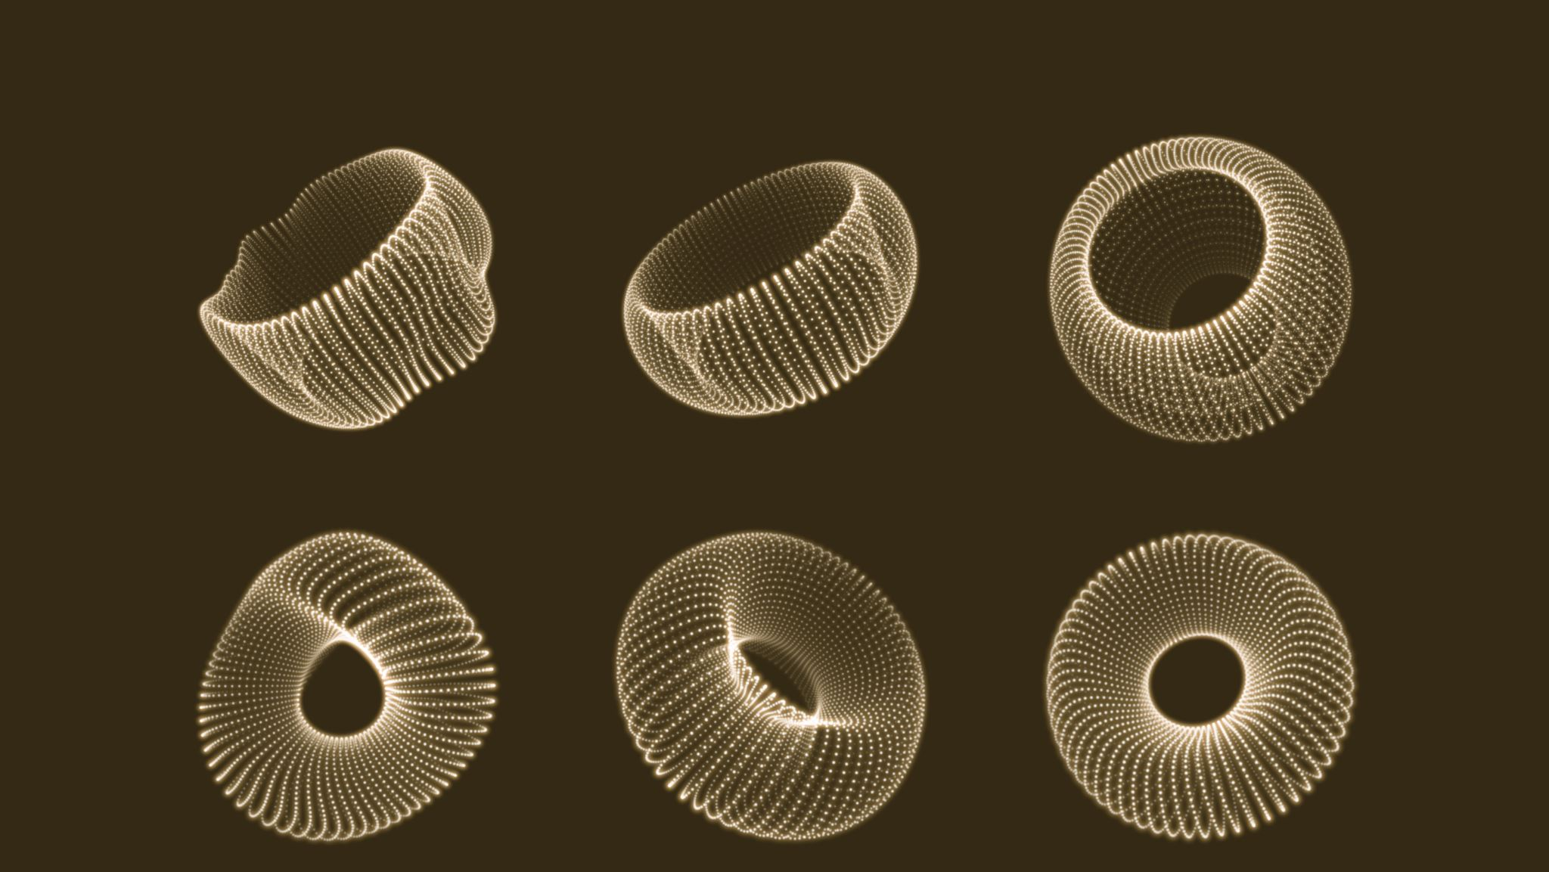
Modeling
I created a cylinder and used an online can image as a reference.
For the bottom part I used extending and bevel for the contours before adding a subdivision modifier.

Slide 4
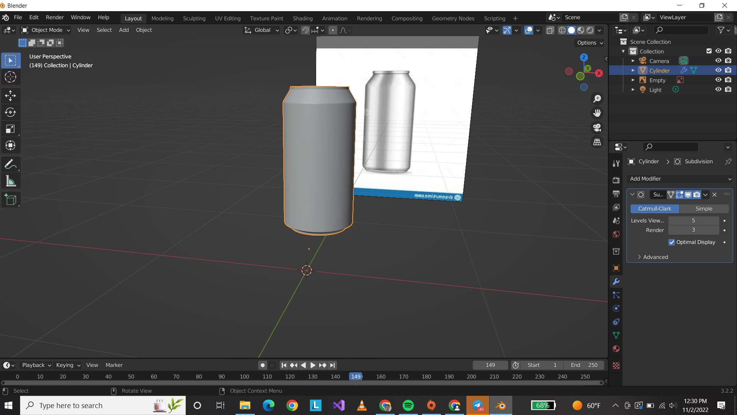

Slide 5
UV texturing
After finishing modeling then marking the seems where the logo will come in.
Then entering UV panel, I brought a texture then unwrapped.

Slide 6
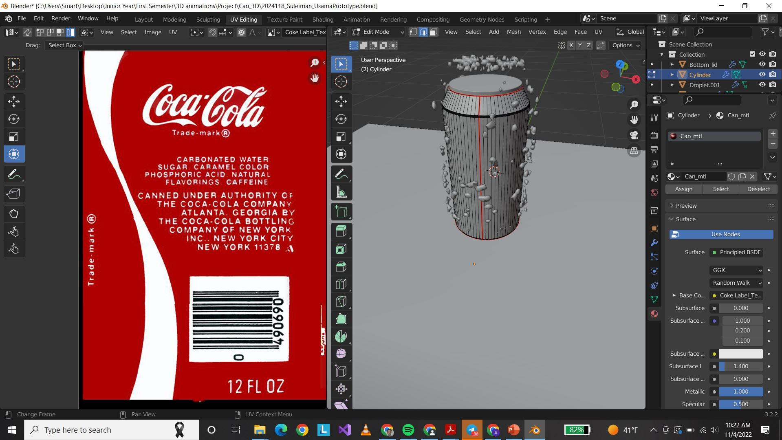

Slide 7
Shading
For shading there were numerous shaders, we used such as:
For the bottom part, top lid and can

Slide 8
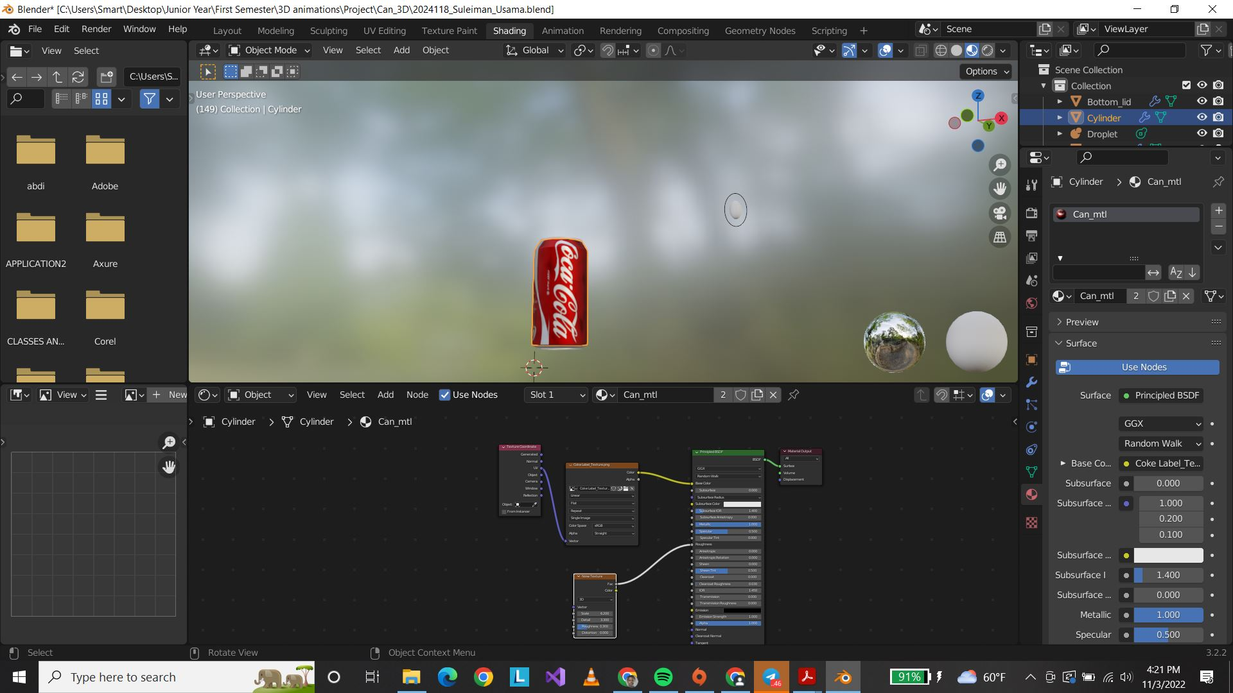

Slide 9
It is used to implement a double-ended priority queue.

Slide 10
Animation

Slide 11
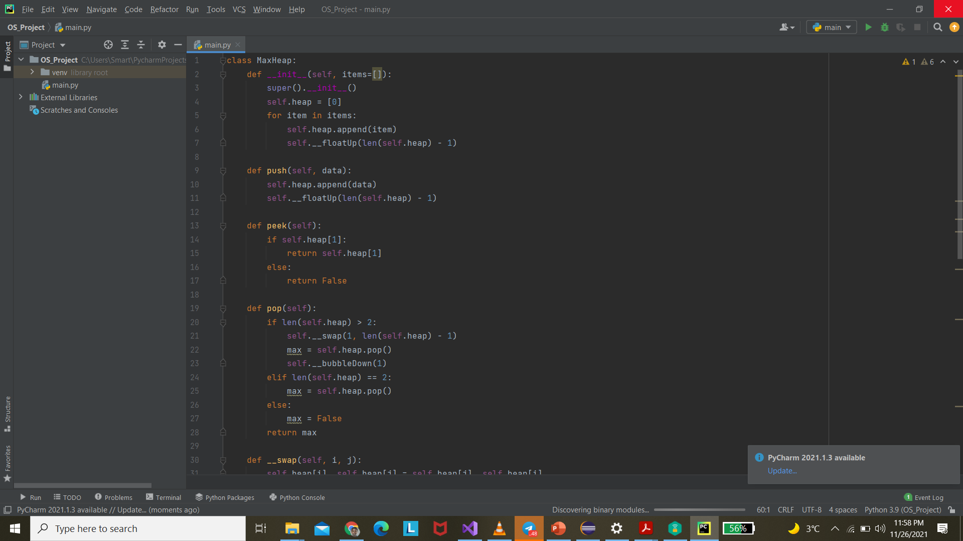
Final Image

Slide 12
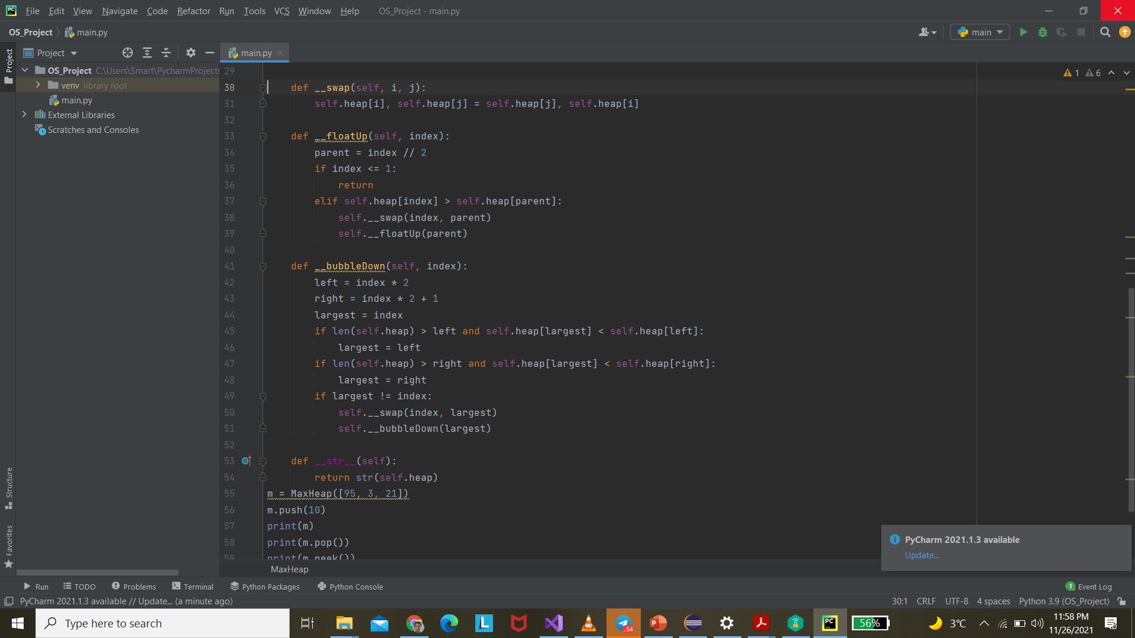

Slide 13
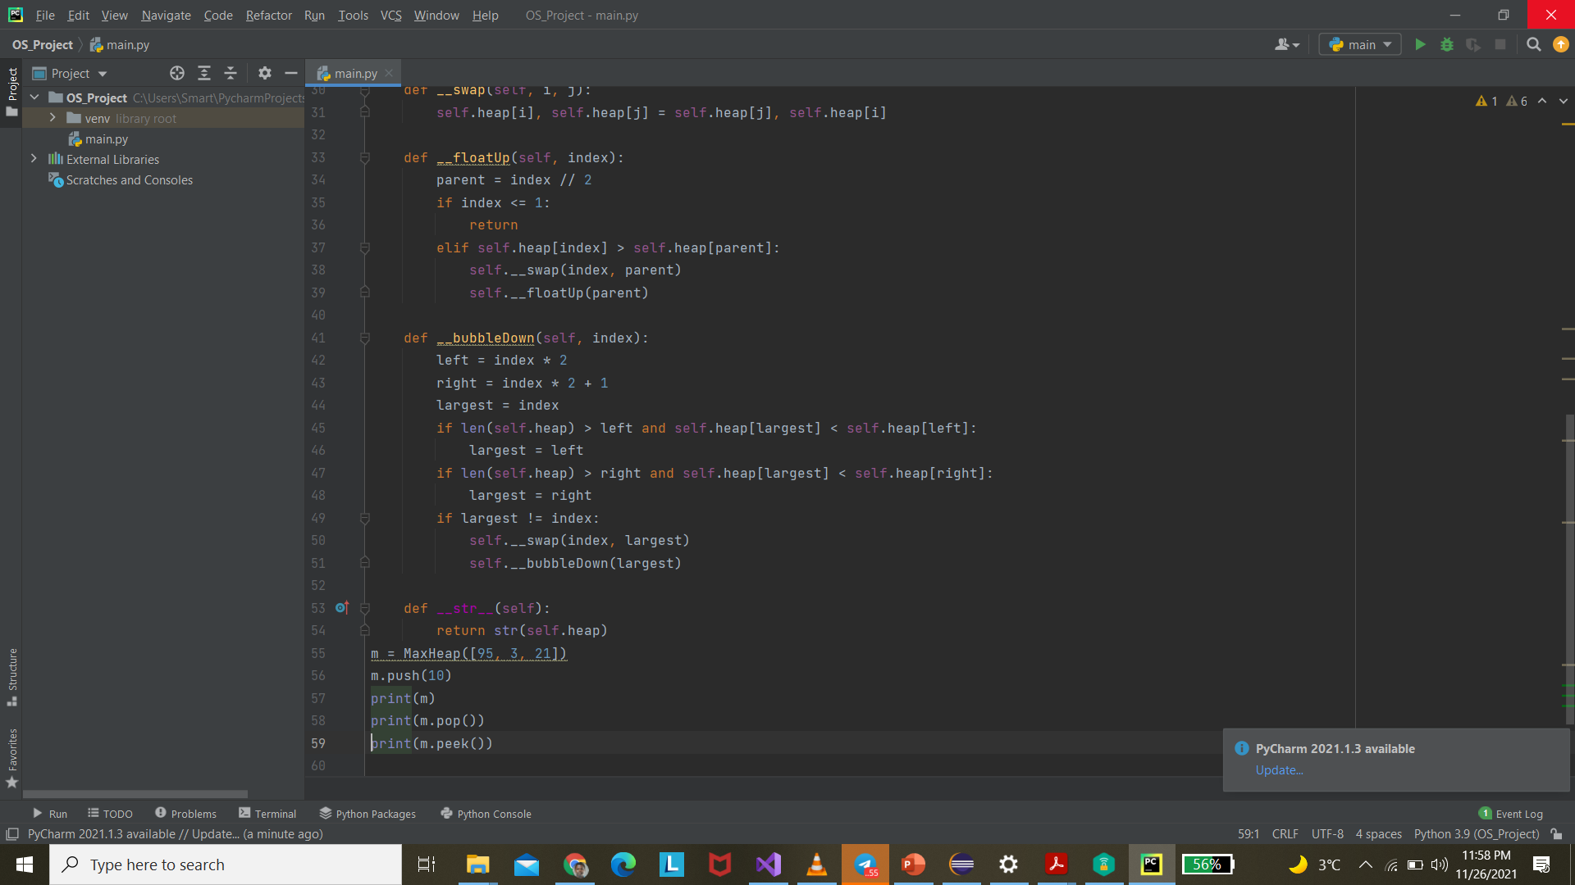

Slide 14
