Slide 1

Android Prescription Management System
Alastair James Campbell Innes – 2317070
Level 4 Individual Project

Slide 2
Contents
1. Background
2. Requirements
3. Design
4. Implementation
5. Evaluation

Slide 3
Background – Medication Adherence
According to the World Health Organisation, medication adherence is a global problem which leads to increased mortality rates.
Studies have shown that there is an inverse relationship between the frequency of medication doses and rates of medication adherence
This puts patients who are suffering from chronic illness to be at increased risk of failing to adhere to their medication

Slide 4
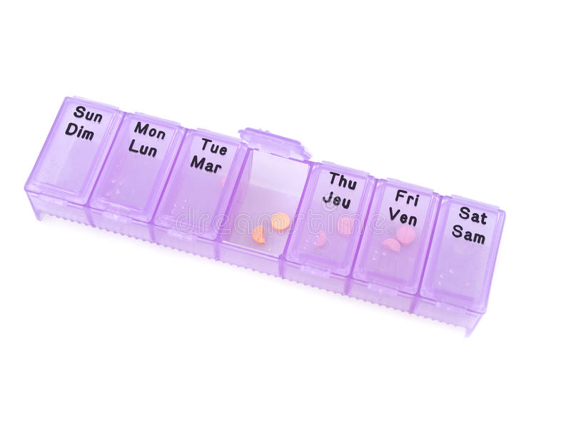
Background – Medication Adherence
Medication nonadherence is usually down to involuntary causes such as simple forgetfulness.
The act of remembering to do tasks in the future is a function of prospective memory, which is an ability that declines with age
A traditional method to circumvent forgetfulness of taking medication is the pillbox

Slide 5
Background – Reminder Apps
A modern method of remembering to perform tasks is the usage of reminder apps on mobile devices, that can send notifications to the user
This can be generalised for a medication reminder system on a user’s mobile device
These have been proven to be more effective in the case of enforcing medication adherence than pillboxes

Slide 6
Background – Google Calendar
Calendars are used to support prospective memory, serving as a tool that people can refer to for future events.
Online calendars have the benefit over physical calendars as they can be accessed across multiple devices.
Google Calendar is one of the most popular online calendar services, with 25% of mobile calendar users using it.
Studies have shown that using Google Calendar helps increase the performance of prospective memory

Slide 7
Idea
A prescription management system on a mobile device that can interface with a user’s Google Calendar can lead to increased performance in prospective memory, and thus lead to greater rates of medication adherence.

Slide 8
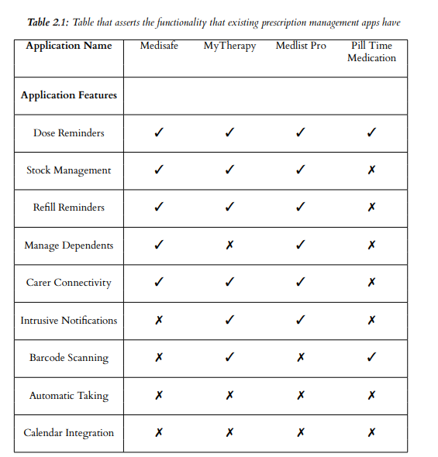
Existing Apps
Four apps were looked at and their features were identified
No app in the Play Store has the functionality to synchronise with an online calendar system

Slide 9
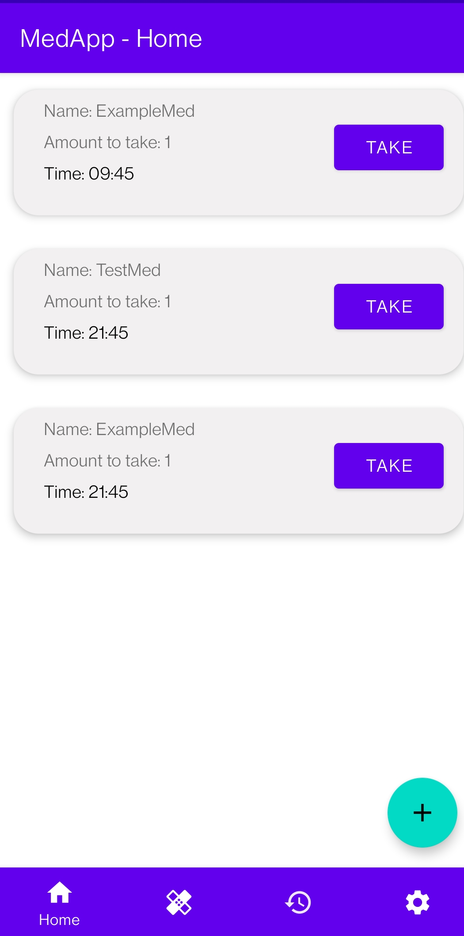
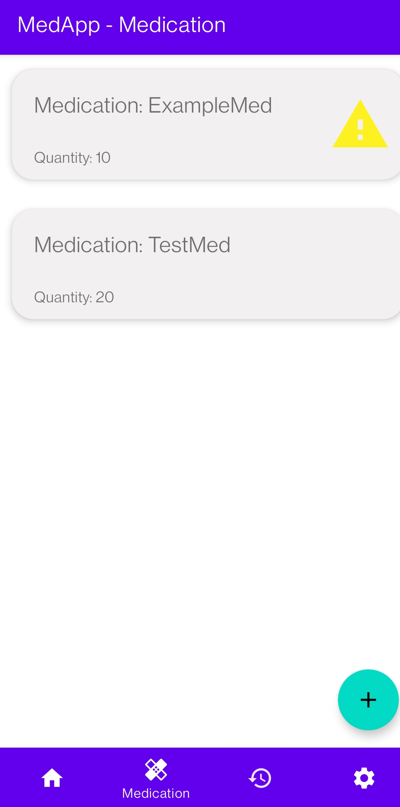
User Interface - Final

Slide 11
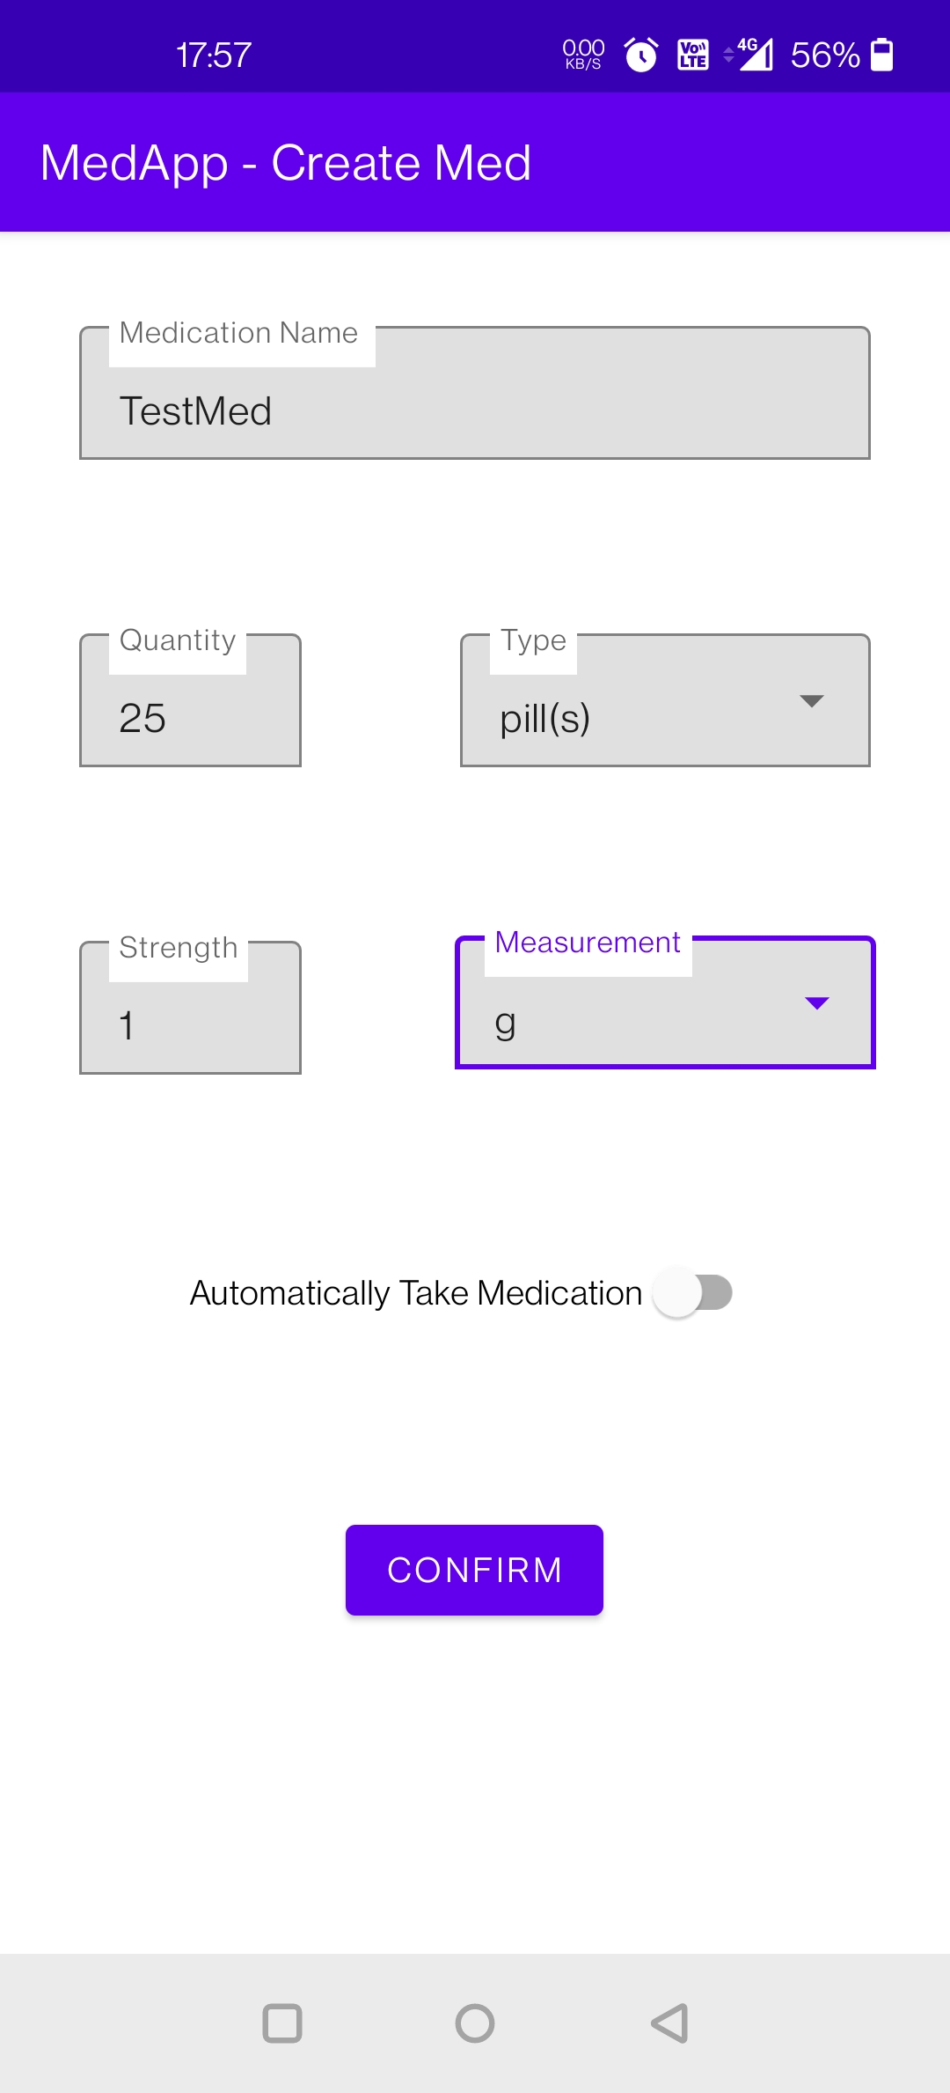
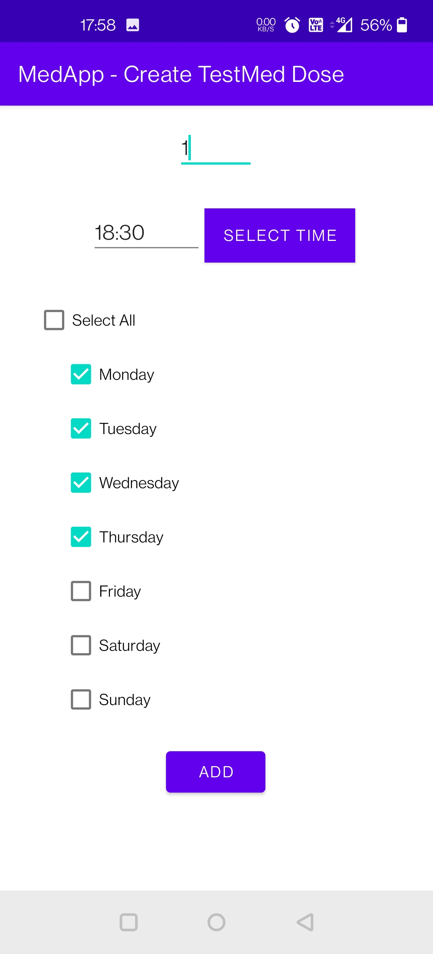
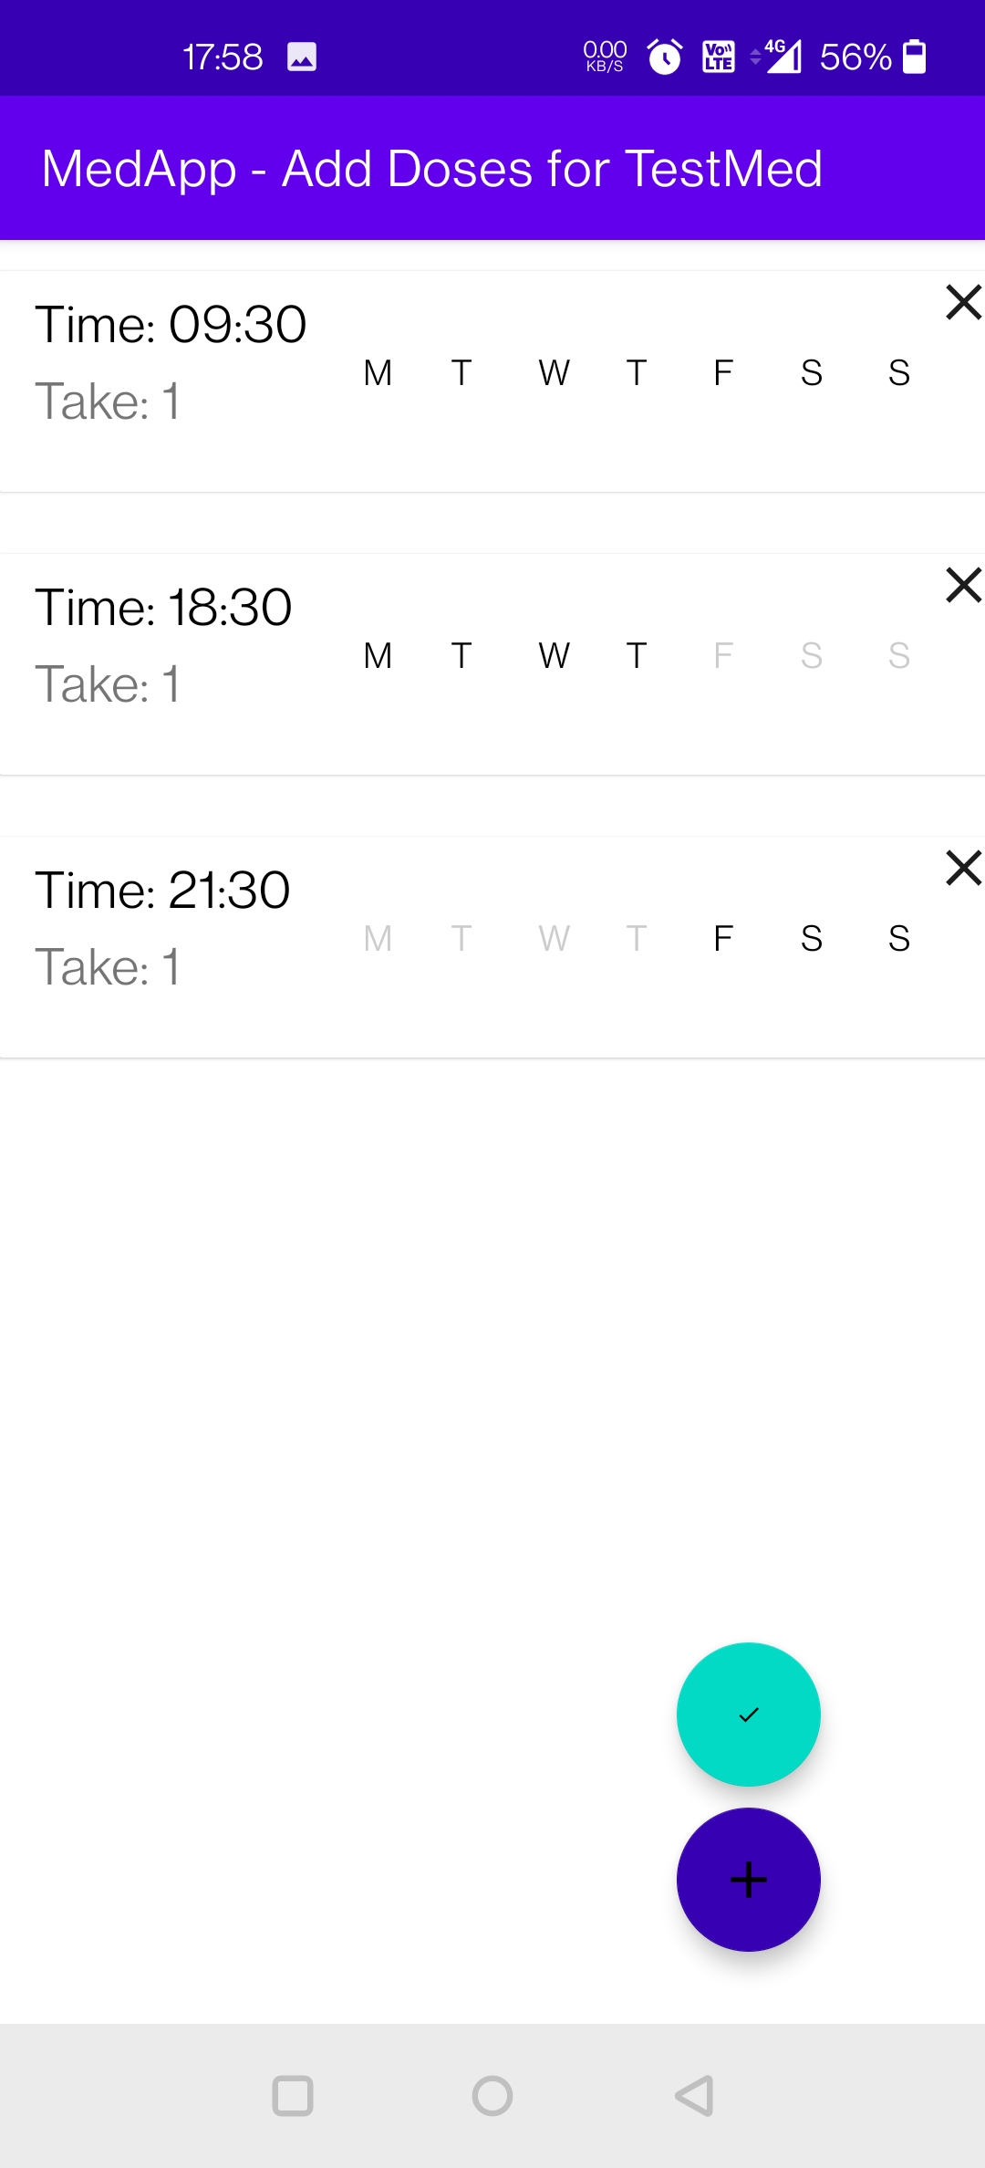
User Interface - Final

Slide 12
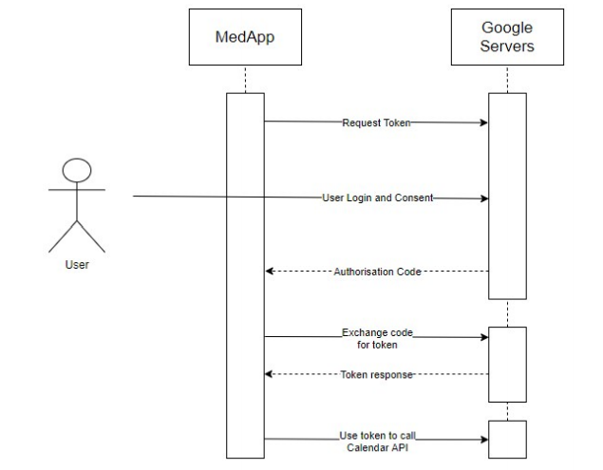
Google Calendar API - Design
To be able to interface with Google Calendar, MedApp must use the Google Calendar API.
This API makes use of the OAuth 2.0 authentication protocol to authenticate and authorise Google users, without the app receiving or knowing any details about who the user is

Slide 13
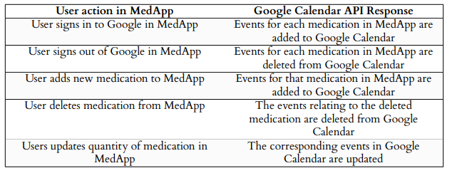
Google Calendar API

Slide 14
Scheduling Events
Events can be scheduled in MedApp by using the system alarm and Android Studio’s BroadcastReceivers
I.e. using AlarmManager to define a certain time to send a message to a receiver to execute code
This is used for:
Daily events in the app (e.g. resetting the “isTaken” field of doses so that they can be taken again
Dose reminders (e.g. alarm set for the time the dose is to be taken so that the notification is sent to the user at this time
Refill reminders (e.g. alarm set on days where the medication is low on stock and needs a refill)

Slide 15
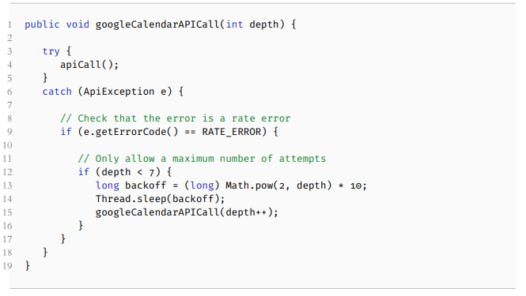
Google Calendar API
When too many requests were happening at once, the API would encounter rate errors and fail to add or delete events accordingly
Exponential backoff algorithm was implemented for API requests in order to resolve this

Slide 16
Thank you for watching!

