Slide 1


Slide 2
Big data Marketing
Group project: Penguin app
Egor Nikishin
Marina Nemtsova
Hossain Md Al Amin

Slide 3

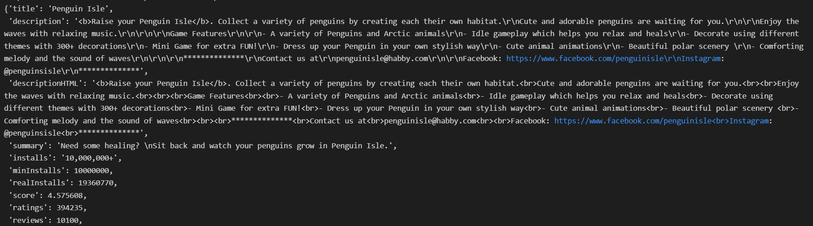
App info
The product we have chosen is the penguin app. We have found out that Bouncemasters: Jumping Games (by Casual Azur Games), Penguin Isle (by Habby) and Super Penguins (by Supersolid) are the most popular penguin apps (in terms of number of downloads). The dataset was parsed from Google Play with the help of google-play-scrape library.

Slide 4

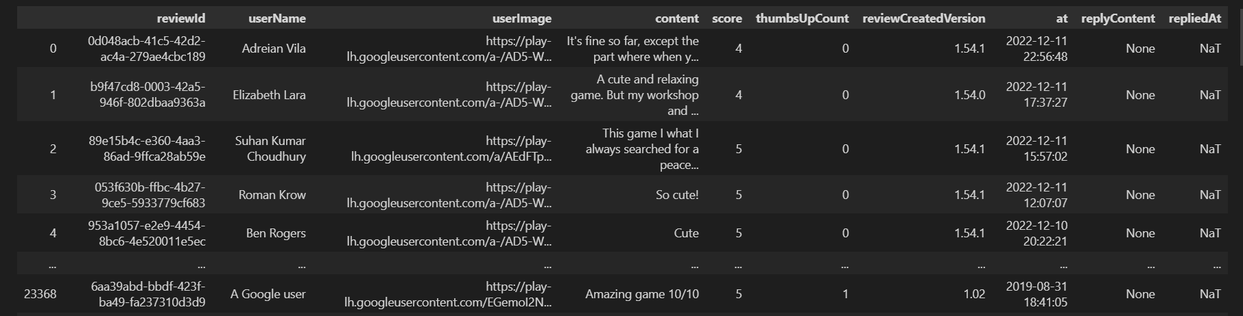
Data parsing
We have received the following parameters of app's reviews:
at - review date
content - review text translated to English
score - review or product rating out of 5
userName - author account name
separate table info - info about the product
23373 entries
10 columns
memory usage: 1.8+ MB
D
Notes:
23373 entries
10 columns
memory usage: 1.8+ MB

Slide 5
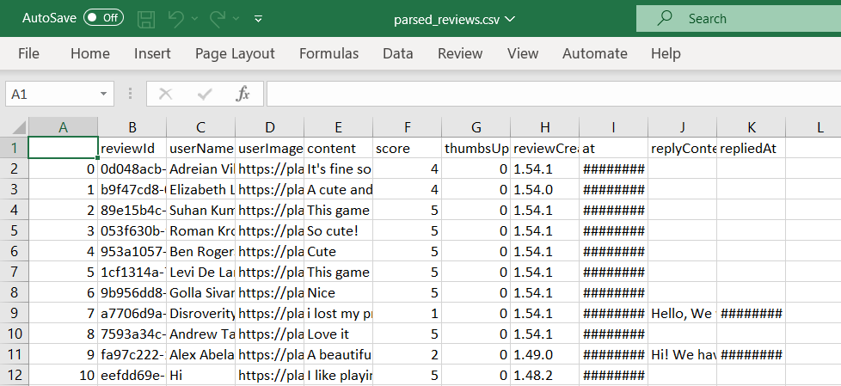
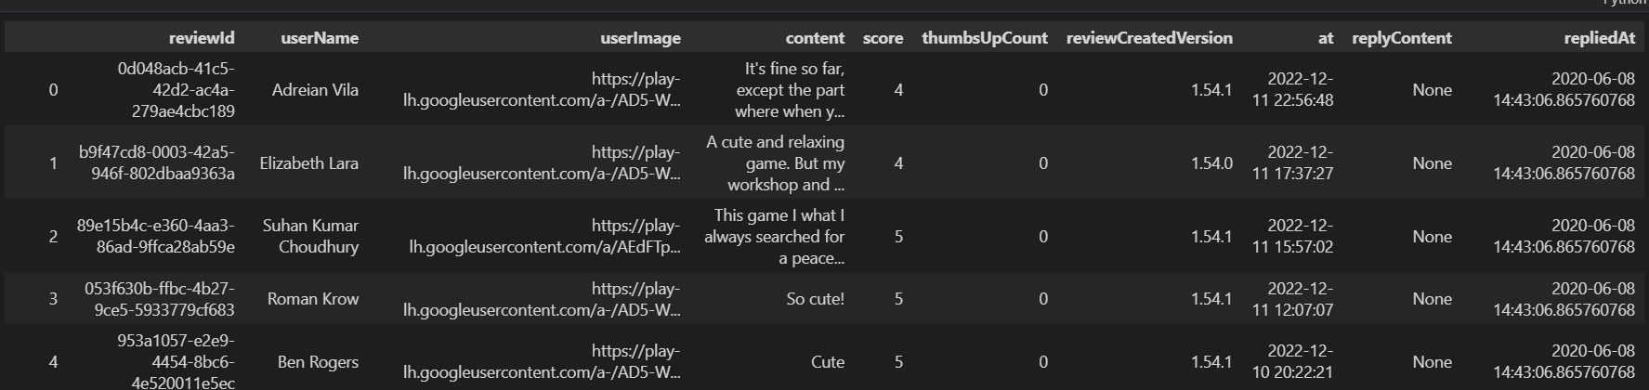
Data preprocessing
Some of the rows didn’t have a date of review (Nan), so we counted the mean of not-null dates and deleted the nulls. Both versions of the dataframe were saved in csv files

Slide 6
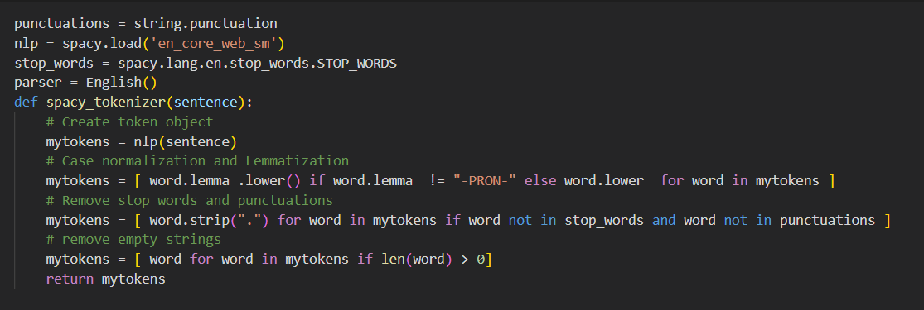
Custom Tokenizer
We wrote our own function to tokenize and clean our dataset appropriately to remove unhelpful noise from our dataset.
This function will:
Tokenize each word.
Lemmatize each token. E.g. going → go, went → go
Convert everything to lowercase
Remove stop words Stop words are extremely common words that are irrelevant for our analysis and can be removed e.g. if, and, but, or

Slide 7
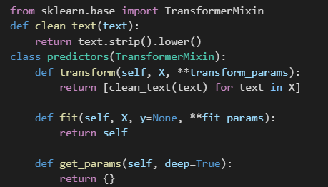
Custom Transformer
We will be using the class TransformerMixIn from sklearn to create our own class transformer.
Our class will override the transform, fit and getparams from the main function and create our own. We will also pass a function called clean_text() that removes the spaces and converts the text into lowercase for an easier analysis.

Slide 8
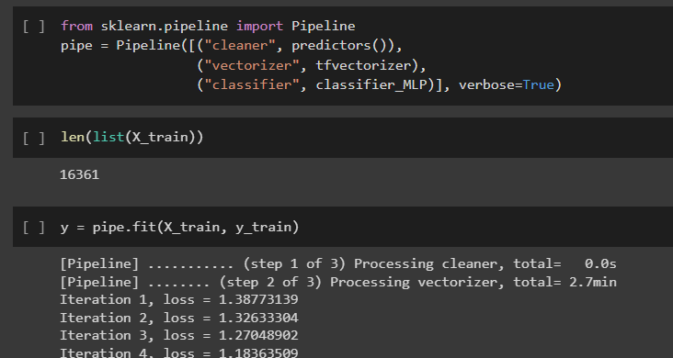
Pipeline
We created a pipeline that cleans data, creates tokens (TfidfVectorizer with our custom tokenizer) and classifies (MLPClassifier with max. 400 iterations) the train data (70%) to make prediction of score (rating out of 5) based on the content of reviews.

Slide 9
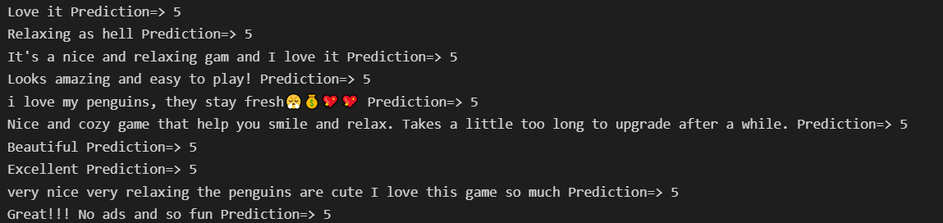
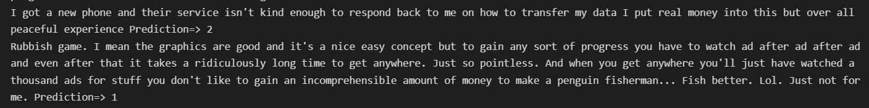
Prediction

Slide 10
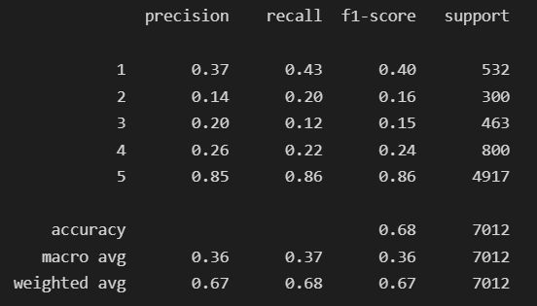

Key metrics

Slide 11
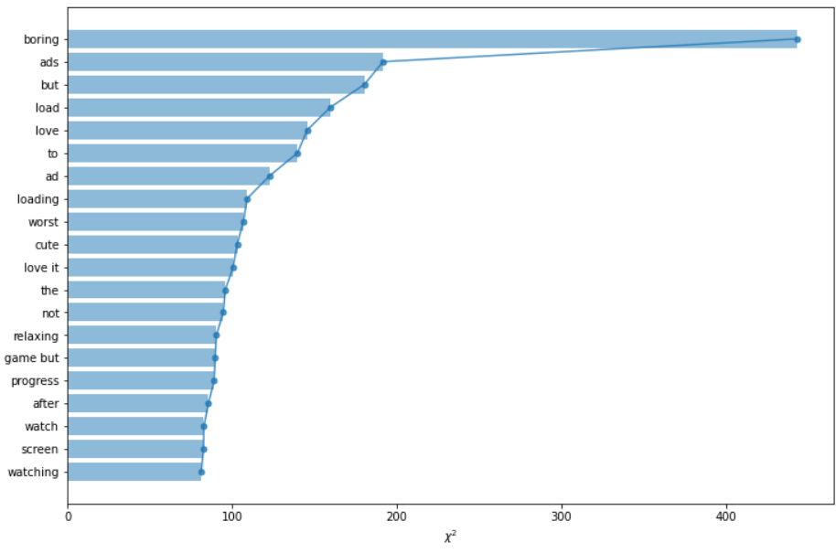
Chi-square scores to identify buzz words
Notes:
We calculated the Chi square scores for all the features and visualized the top 20, here terms or words or N-grams are features, and positive and negative are two classes. given a feature X, we can use Chi square test to evaluate its importance to distinguish the class.

Slide 12
Conclusions
Android app creator Penguin Apps has been working since 2011. There are 12 apps in the portfolio right now. In total, we calculate that Penguin Apps apps have received around 10 million installs, with 2,000 of those installs occurring in the previous 30 days. Baby Phone - Games for Family, one of the top apps in Google Play with more than 5 million downloads, is a very well-liked application.
Tone of voice is how a brand communicates and connects with its audience through messaging and customer interactions. Penguin Apps reply on platforms like Google play.
Bouncemasters app, downloaded by over 100 million users, has an average rating of 4.4. Interestingly, over half a million people took part in reviews of this app. Next comes
Penguin Isle app with quite less downloads (over 10 million), but with slightly better rating (4.6). It is noteworthy that almost 400 thousand people reviewed this app.
Super Penguins app resembles Penguin Isle app, with again over 10 million downloads and an average rating of 4.6. But quite less number of people took part in feedbacks (over 250 thousand).

Slide 13
Thank you

