Slide 1

Dream Tower

Slide 2

TARGET USERS
13 years old and above that is literate and has great understanding and open-mindedness.

Slide 3
SCOPE AND LIMITATION
SCOPE
Open world
Modifiable
Easy to use
Familiar game feel
Personalized
Free demo
LIMITATION
Full version is not free

Slide 4
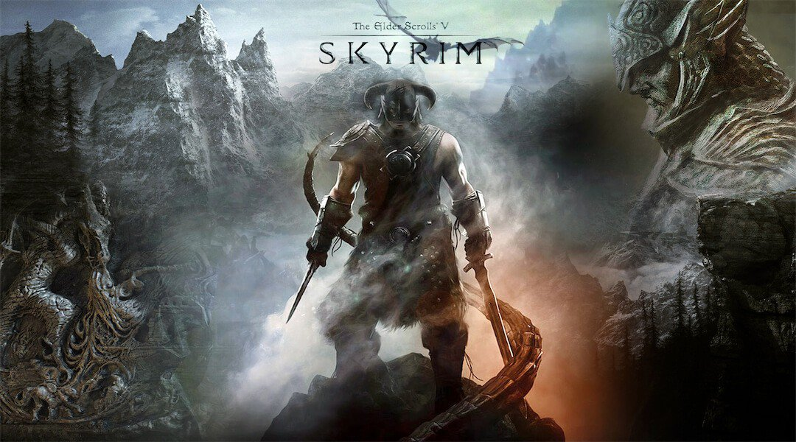

EXISTING

Slide 5


USABILITY KIT

