Slide 1
R-Trees
Accessing Spatial Data

Slide 2
In the beginning…
The B-Tree provided a foundation for R-Trees. But what’s a B-Tree?
A data structure for storing sorted data with amortized run times for insertion and deletion
Often used for data stored on long latency I/O (filesystems and DBs) because child nodes can be accessed together (since they are in order)

Slide 3
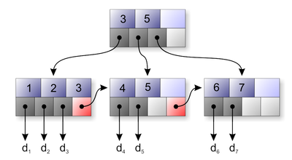
B-Tree
From wikipedia

Slide 4
What’s wrong with B-Trees
B-Trees cannot store new types of data
Specifically people wanted to store geometrical data and multi-dimensional data
The R-Tree provided a way to do that (thanx to Guttman ‘84)

Slide 5
R-Trees
R-Trees can organize any-dimensional data by representing the data by a minimum bounding box.
Each node bounds it’s children. A node can have many objects in it
The leaves point to the actual objects (stored on disk probably)
The height is always log n (it is height balanced)

Slide 6
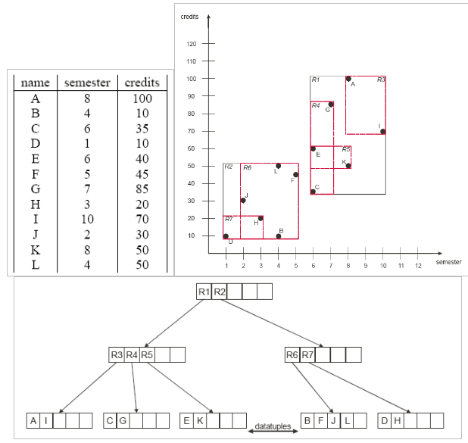
R-Tree Example
From http://lacot.org/public/enst/bda/img/schema1.gif

Slide 7
Operations
Searching: look at all nodes that intersect, then recurse into those nodes. Many paths may lead nowhere
Insertion: Locate place to insert node through searching and insert.
If a node is full, then a split needs to be done
Deletion: node becomes underfull. Reinsert other nodes to maintain balance.

Slide 8
Splitting Full Nodes
Linear – choose far apart nodes as ends. Randomly choose nodes and assign them so that they require the smallest MBR enlargement
Quadratic – choose two nodes so the dead space between them is maximized. Insert nodes so area enlargement is minimized
Exponential – search all possible groupings
Note: Only criteria is MBR area enlargement

Slide 9
Demo
How can we visualize the R-Tree
By clicking here

Slide 10
Variants - R+ Trees
Avoids multiple paths during searching.
Objects may be stored in multiple nodes
MBRs of nodes at same tree level do not overlap
On insertion/deletion the tree may change downward or upward in order to maintain the structure

Slide 11
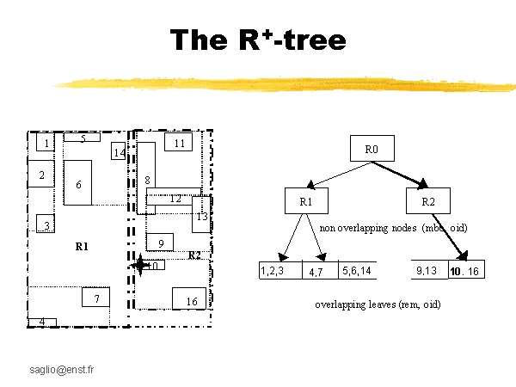
R+ Tree
http://perso.enst.fr/~saglio/bdas/EPFL0525/sld041.htm

Slide 12
Variants: Hilbert R-Tree
Similar to other R-Trees except that the Hilbert value of its rectangle centroid is calculated.
That key is used to guide the insertion
On an overflow, evenly divide between two nodes
Experiments has shown that this scheme significantly improves performance and decreases insertion complexity.
Hilbert R-tree achieves up to 28% saving in the number of pages touched compared to R*-tree.

Slide 13
Hilbert Value??
The Hilbert value of an object is found by interleaving the bits of its x and y coordinates, and then chopping the binary string into 2-bit strings.
Then, for every 2-bit string, if the value is 0, we replace every 1 in the original string with a 3, and vice-versa.
If the value of the 2-bit string is 3, we replace all 2’s and 0’s in a similar fashion.
After this is done, you put all the 2-bit strings back together and compute the decimal value of the binary string;
This is the Hilbert value of the object.
http://www-users.cs.umn.edu/research/shashi-group/CS8715/exercise_ans.doc

Slide 14
R*-Tree
The original R-Tree only uses minimized MBR area to determine node splitting.
There are other factors to consider as well that can have a great impact depending on the data
By considering the other factors, R*-Trees become faster for spatial and point access queries.

Slide 15
Problems in original R-Tree
Because the only criteria is to minimize area
Certain types of data may create small areas but large distances which will initiate a bad split.
If one group reaches a maximum number of entries, the rest of assigned without consideration of their geometry.
Greene tried to solve, but he only used the “split axis” – more criteria needs to be used

Slide 16
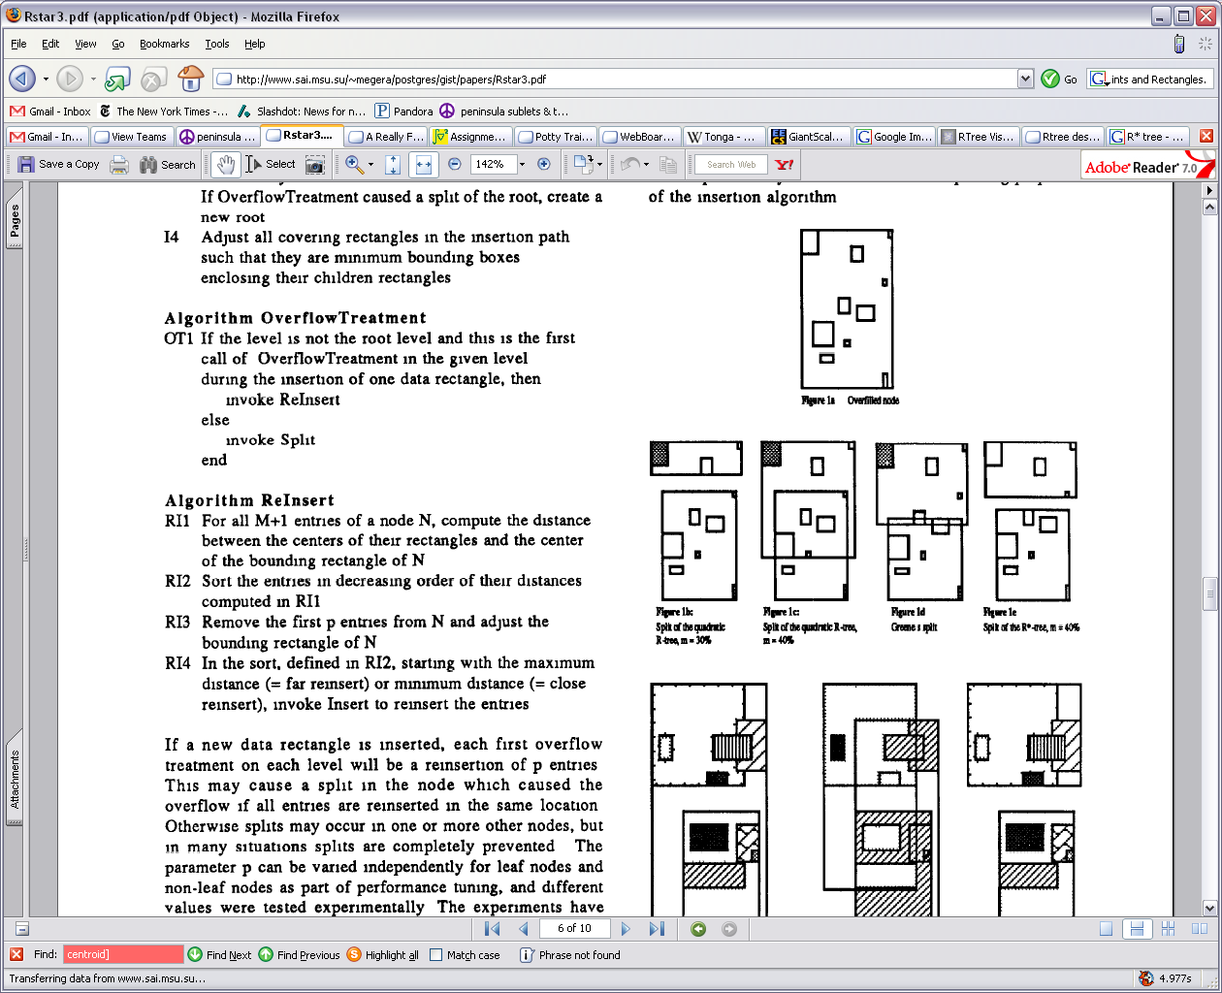
Splitting overfilled nodes
Why is this overfull?

Slide 17
R*-Tree Parameters
Area covered by a rectangle should be minimized
Overlap should be minimized
The sum of the lengths of the edges (margins) should be minimized
Storage utilization should be maximized (resulting in smaller tree height)

Slide 18
Splitting in R*-Trees
Entries are sorted by their lower value, then their upper value of their rectangles. All possible distributions are determined
Compute the sum of the margin values and choose the axis with the minimum as the split axis
Along the split axis, choose the distribution with the minimum overlap
Distribute entries into these two groups

Slide 19
Deleting and Forced Re-insertion
Experimentally, it was shown that re-inserting data provided large (20-50%) improvement in performance.
Thus, randomly deleting half the data and re-inserting is a good way to keep the structure balanced.

Slide 20
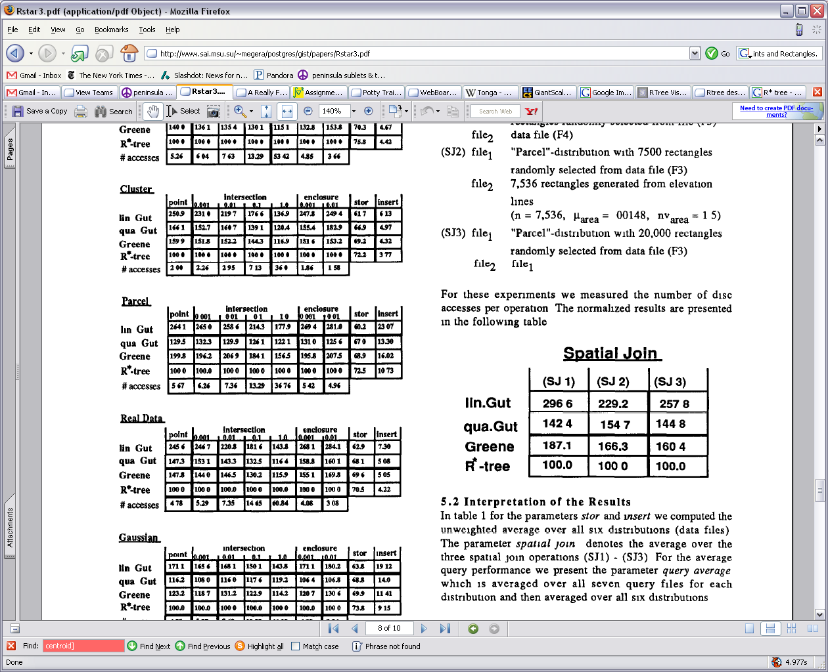
Results
Lots of data sets and lots of query types.
One example: Real Data: MBRs of elevation lines. 100K objects
Disk accesses
On insert
Query
Storage util.
After build up

Slide 21
RC-Trees
Changing motivations:
Memory large enough to store objects
It’s possible to store the object geometry and not just the MBR representation.
Data is dynamic and transient
Spatial objects naturally overlap (ie: stock market triggers)

Slide 22
RC-Trees
Take advantage of dynamic segmentation
If the original geometry is thrown away, then later on the MBR cannot be modified to represent new changes to the tree
RC Tree does
Clipping
Domain Reduction
Rebalancing

Slide 23
Discriminators
A discriminator is used to decide (in binary) which direction a node should go in. (It means it’s a binary tree, unlike other R-Trees)
It partitions the space
If an object intersects a discriminator, the object can be clipped into two parts
When an object is clipped, the space it takes up (in terms of its MBR) is reduced (aka domain reduction)
This allows for removal of dead space and faster point query lookups

Slide 24
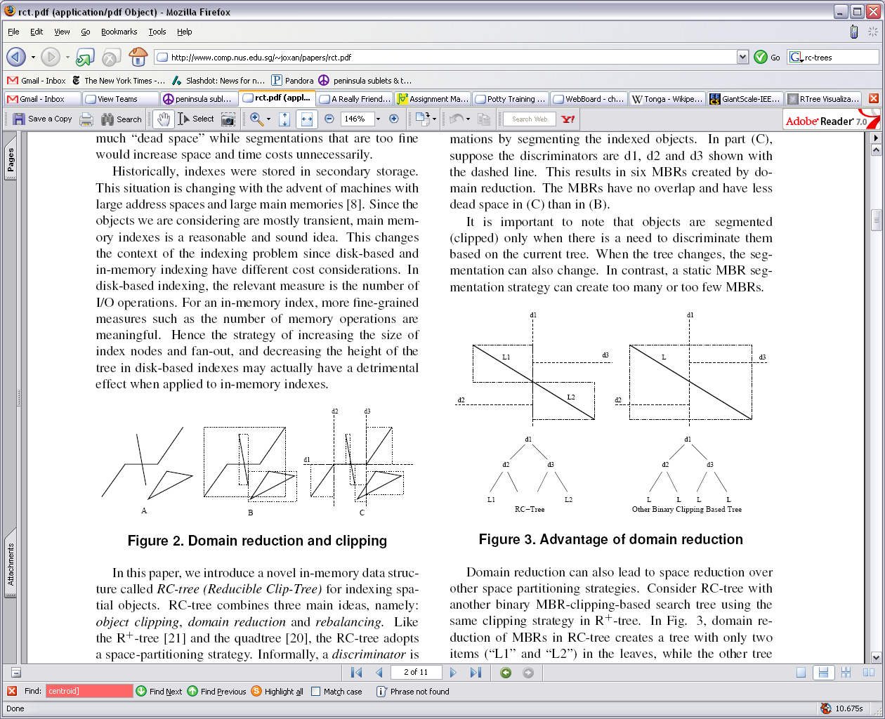
Domain Reduction and Clipping

Slide 25
Operations
Insert, Delete and Search are straightforward
What happens on an node that has been overflowed?
Choose a discriminator to partition the object into balanced sets
How is a discriminator chosen?

Slide 26
Partitioning
Two methods for finding a discriminator for a partition
RC-MID – faster, but ignores balancing and clipping. Uses pre-computed data to determine and average discriminator.
Problems?
Different distributions greatly affect partition
Space requirements can be huge

Slide 27
Partitioning Take 2
RC-SWEEP
sorts objects.
Candidates for discriminators are the boundaries of the MBRs
Assign a weight to each candidate using a formula not shown here
Choose the minimum
Problems?
Slower, but space costs much better than RC-MID (which keeps info about nodes)

Slide 28
Rebuilding
The tree can take a certain degree of flexibility in its structure before needing to be rebalanced
On an insert, check if the height is too imbalanced
If so, go to the imbalanced subtree and flush the items, sort and call split on them to get a better balancing

Slide 29
Experimentation
CPU execution time not a good measure. (although they still calculate it)
Instead use number of discriminators compared
Lots of results
Result summary:
Insertion a little more expensive (because of possible rebalancing)
Querying for point or spatial data faster (and fewer memory accesses) than all previous incarnations
Storage requirements not that bad
Dynamic segmentation (ie recalculating MBRs) can help a lot
Controlling space with “γ” factor (by disallowing further splitting) controls space costs

