Slide 1
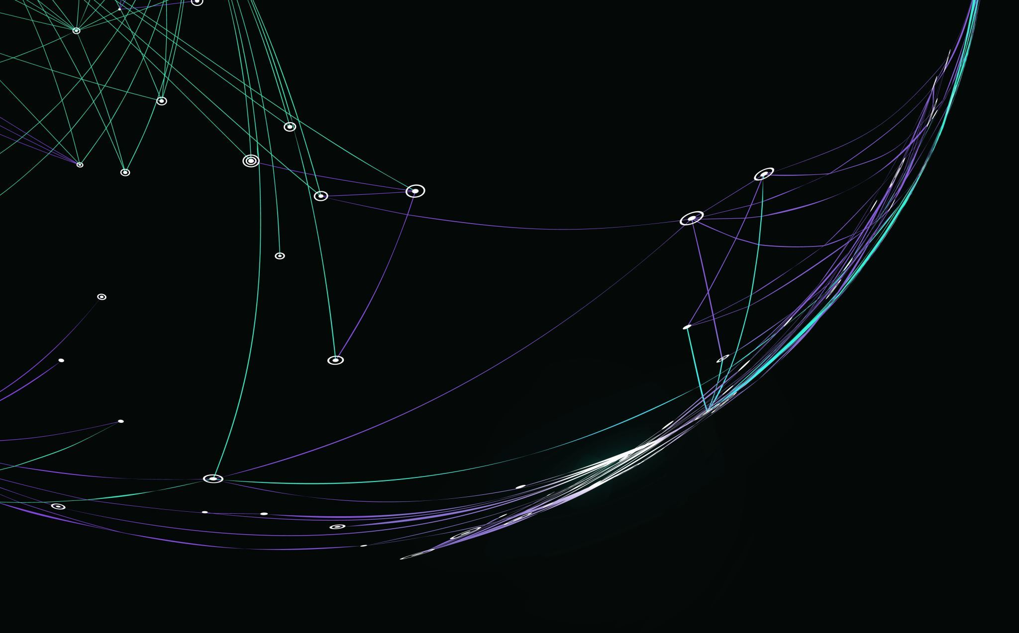
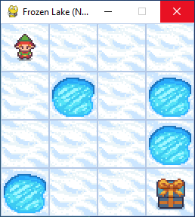
Sarsa on Frozen Lake
( with decreasing epsilon)

Slide 2
Problem
Grid World
Reward +1 if get goal
Hole ends episode (0 rewards)
Slipper : probability of wrong action

Slide 3
Solution
Sarsa
Epsilon-Greedy action selection
Test initial Q random
Test decreasing epsilon close to argmax

Slide 4
Result
Converge
Slippery do not allow determinism
Initial Q random learn slow compared to initial Q zero
Decreasing epsilon reach optimality faster

