Slide 1

Compressed Neural Network
Project Work of Intelligent Systems

Slide 2
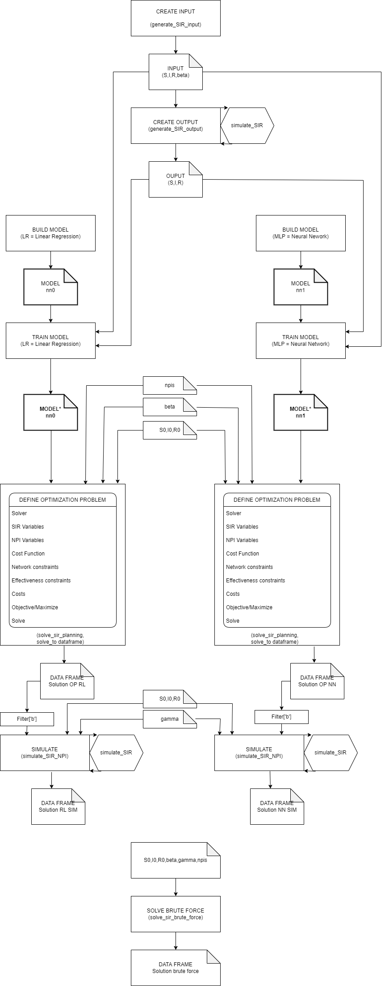
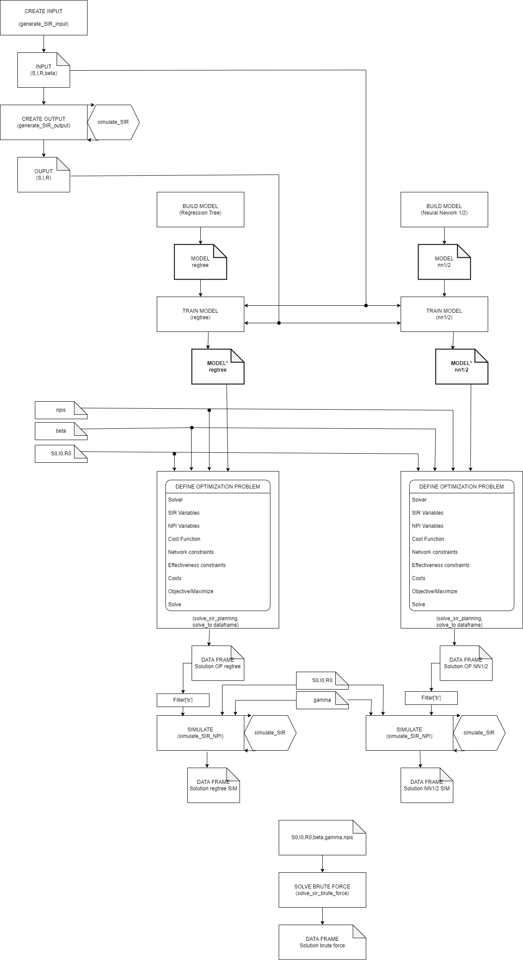
Epidemics Rebuild pipelines
From
DecisioneTree and single NN
To
DecisionTree and multiple NN
Pipeline
Data
Train
Encode
Solve
Simulate
Brute Force

Slide 3

TensorFlow Model Optimization Toolkit
Epidemics
Post Training Quantization
Pro : reduce size , most technique do not lose accuracy
Cons : does not allow encoding in EML
Pruning
Pro : does not lose accuracy , allows encoding in EML
Cons : increase file size

Slide 4
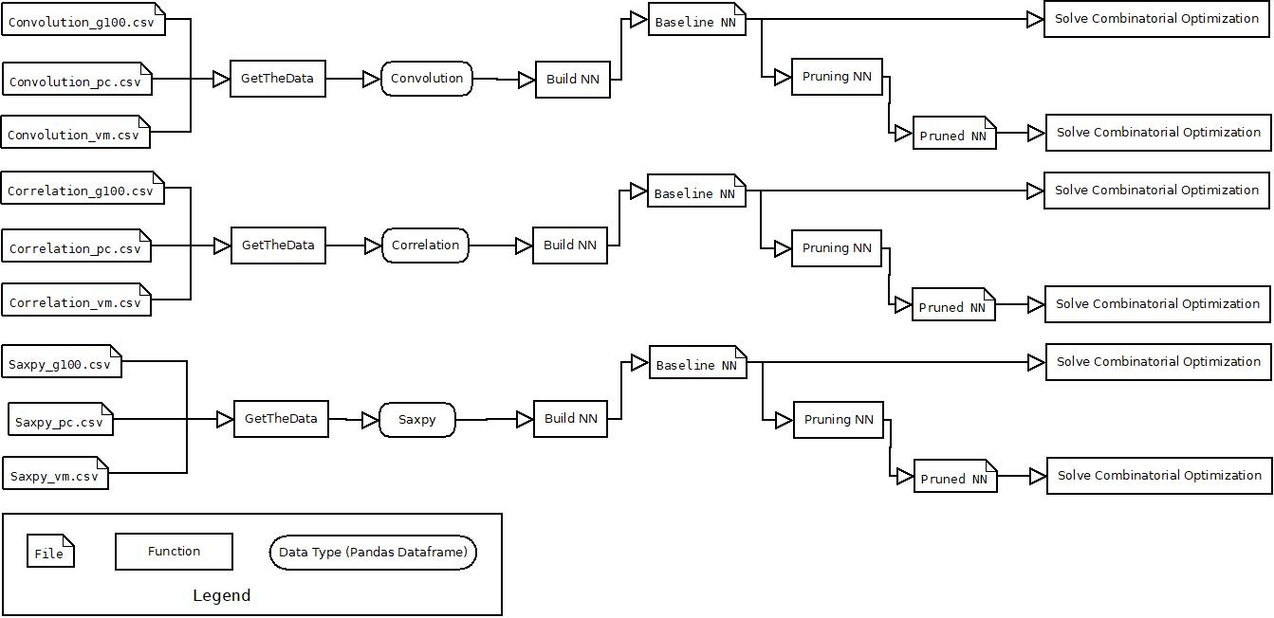
Transprecision Computing
Pipeline

Slide 5
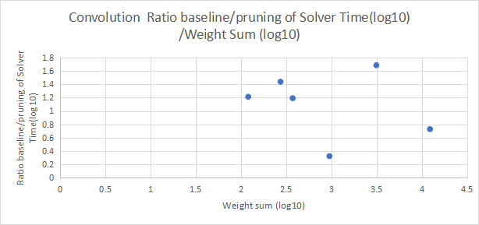
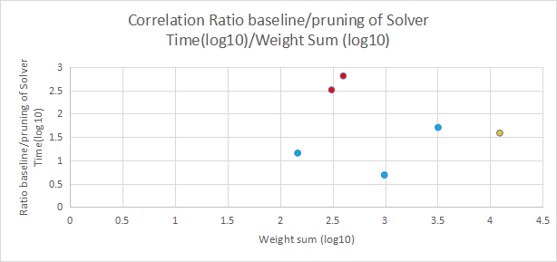
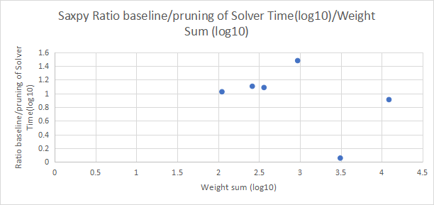
Result

