Slide 1
Proton RAnGe measure Using silicon carbidE
Alma Kurmanova

Slide 2
Scientific background
Range uncertainty
    imaging, patient setup, beam delivery and dose calculation
    Tool for a precise beam range detection and measure
Development of proton beam accelerated by laser-matter interaction
  high-intensity dose rate regime
  Tool for accurate dosimetry of a shot-to-shot and intense ion bunch length

Slide 3
Scientific background
Quality assurance program
  time-saving for percentage depth-dose distribution measurements
  Tool for daily QA with good linearity against dose, high radiation hardness, independent response, tissue equivalent, and time-saving for PDD distribution measurement
  A detector to measure PDD distribution in real-time
  and with high spatial resolution

Slide 4
The aim of PRAGUE
Design and construct a detector, based on a new silicon carbide multilayer detector, to measure proton depth-dose distributions in real-time and with high spatial resolution

Slide 5
Justification for the material choice
Properties | Diamond | Silicon | 4H-Silicon Carbide
Energy gap [eV] | 5.45 | 1.12 | 3.26
Hole lifetime | 10-9 | 2.5*10-3 | 6*10-7
Relative dielectric constant | 5.7 | 11.9 | 9.7
e-h pair energy [eV] | 13 | 3.62 | 7.78
Density [gr/cm3] | 3.52 | 2.33 | 3.21
Thermal conductivity [W/cm 0C] | 20 | 1.5 | 3-5
Electron mobility [cm2/Vs] | 1800-2200 | 1400-1500 | 800-10000
Hole mobility [cm2/Vs] | 1200-1600 | 40-600 | 100-115
Breakdown electric field [MV/cm] | 10 | 0.2-0.3 | 2.2-4.0
Max working temperature [0C] | 1100 | 300 | 1240
Displacement [eV] | 43 | 13-20 | 25
///

Slide 6
SiC detector
Adopted detector will be fabricated to guarantee high performance in terms of
  spatial resolution
  radiation hardness
  dose linearity
  independence of dose rate and particle LET

Slide 7
Main steps
Fabrication and characterization of the new generation of SiC with the highest spatial resolution
Simulation and optimization of the assembled detectors in stack configuration
Detector assembling and electronic chain realization
Calibration procedure and test with conventional proton beams
Characterization, calibration procedures and test with laser-driven ion beams

Slide 8

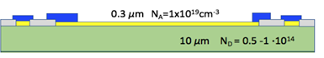
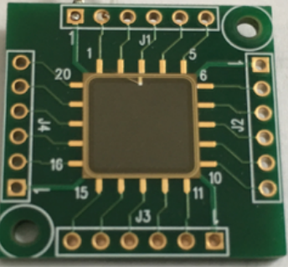
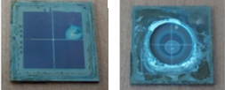
Detectors
Properties | Standard SiC | New SiC
Thickness of p layer [µm] | 0.3 | 0.3
Doping concentration [cm-3] | 1019 | 1019
Thickness of n layer [µm] | 10 | 10
Doping concentration [cm-3] | 0.5-1*1014 | 0.5-1*1014
Active area [mm2] | 15x15 | 15x15
Thickness of substrate [µm] | 100 | dead-layer free
Doping concentration [cm-3] | 1018 | dead-layer free
Layout
SiC detector

Slide 9

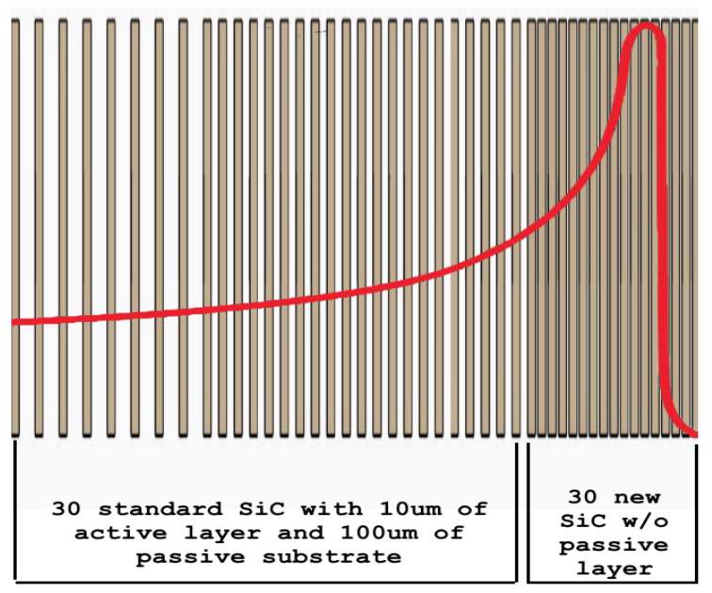

Simulation
Geant4 Monte Carlo (MC) simulation has been set up, with a preliminary not-optimized geometry implementation of the PRAGUE detector, to evaluate its dimension and the impact on the BP reconstruction of SiC material as compared to water equivalent.
A task of the project will be to complete the optimization procedure by means of appropriate MC simulation of the assembled system.

Slide 10
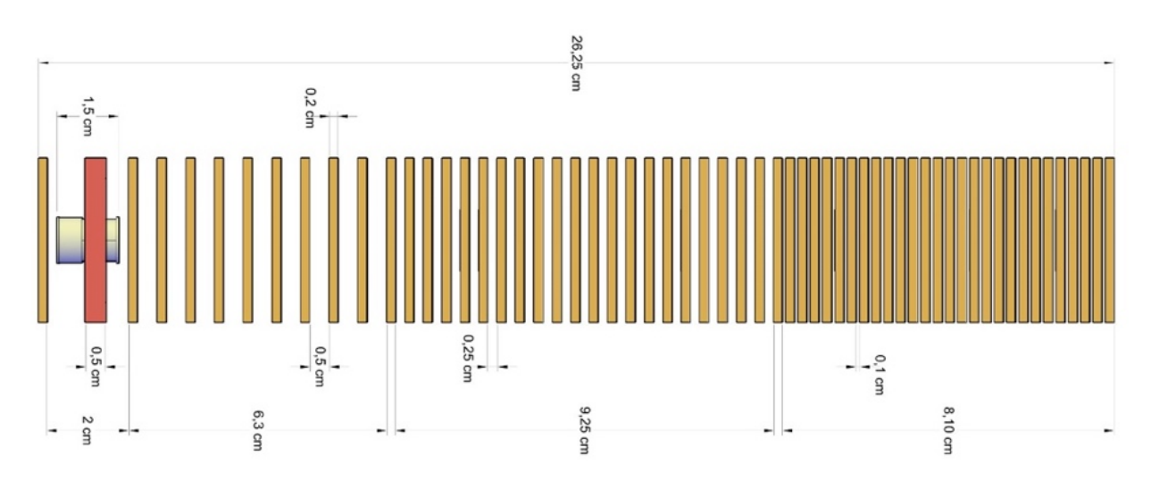
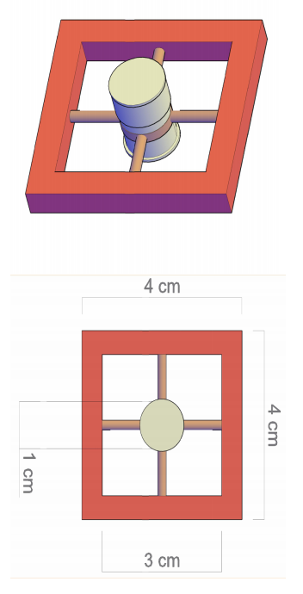
Detector
Preliminary layout of the custom biological flask coupled with its holder and
of PRAGUE configuration for biological sample irradiation

Slide 11
Electronic chain/Read-out
Operation modality
  continuous
  pulsed beam

Slide 12
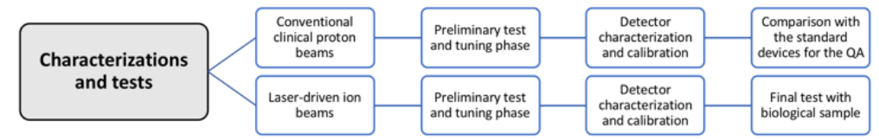
Calibration and testing
Calibration procedure and test with conventional proton beams
Characterization, calibration procedures and test with laser-driven ion beams

Slide 13
Scientific Impact
A new detector technology capable of providing online information of dose delivered at a biological sample
FLASH radiotherapy (or radiotherapy at the high-dose rate)
Development of devices based on this technology for space application and conventional clinical dosimetry
QA in conventional ion therapy providing a device with a limited time-consuming and high spatial resolution

Slide 14
THANK YOU
GRAZIE MILLE

