Slide 1
Preliminary simulation of SiC prototype detector
Alma KURMANOVA

Slide 2
Aim
Design, realization and characterization of a real-time depth-dose distribution detector system based on thin SiC multilayers for conventional and laser-accelerated proton beam in the energy range between 30 MeV and 150 MeV

Slide 3
Scientific background
WHAT?
WHY?
HOW?
A detector based on a new generation of Silicon Carbide devices
real-time measure
high spatial resolution
radiation-hardness
time-saving
Prototype
design/assemble
simulation
experiment
conventional
laser-driven beam
New SiC
design
…..

Slide 4
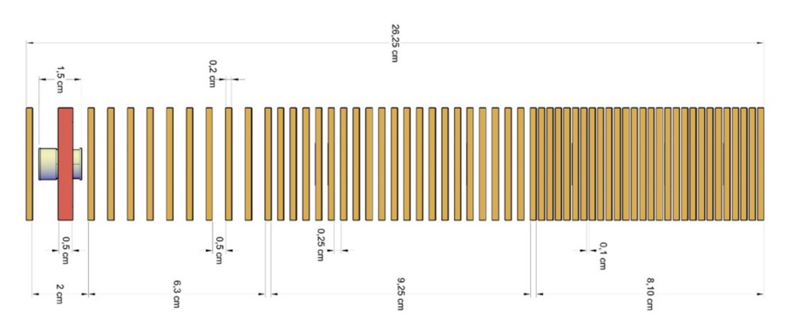
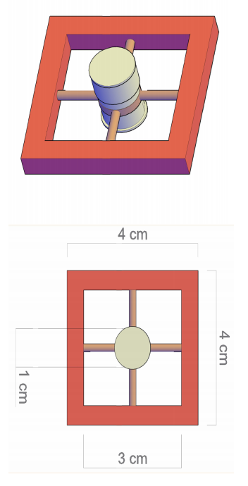

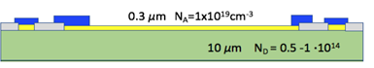
Detector configuration
Preliminary layout of the custom biological flask coupled with its holder and of PRAGUE configuration for biological sample irradiation

Slide 5
Scientific background
WHAT?
WHY?
HOW?
A detector based on a new generation of Silicon Carbide devices
real-time measure
high spatial resolution
radiation-hardness
time-saving
Prototype
design/assemble
simulation
experiment
conventional
laser-driven beam
New SiC
design
…..

Slide 6
Material properties
Properties | Diamond | Silicon | 4H-Silicon Carbide
Energy gap, eV | 5.45 | 1.12 | 3.26
Hole lifetime | 10⁻⁹ | 2.5*10⁻³ | 6*10⁻⁷
Relative dielectric constant | 5.7 | 11.9 | 9.7
e-h pair energy, eV | 13 | 3.62 | 7.78
Density, gr/cm3 | 3.52 | 2.33 | 3.21
Thermal conductivity, W/cm °C | 20 | 1.5 | 3-5
Electron mobility cm2/Vs | 1800-2200 | 1400-1500 | 800-1000
Hole mobility cm2/Vs | 1200-1600 | 450-600 | 100-115
Breakdown electric field, MV/cm | 10 | 0.2-0.3 | 2.2-4.0
Max working temperature, °C | 1100 | 300 | 1240
Displacement, eV | 43 | 13-20 | 25
Wide bandgap
lower leakage current than silicon
High signal
more charge than diamond
Fast response time
High Radiation hardness

Slide 7
Scientific background
WHAT?
WHY?
HOW?
A detector based on a new generation of Silicon Carbide devices
real-time measure
high spatial resolution
radiation-hardness
time-saving
Prototype
design/assemble
simulation
experiment
conventional
laser-driven beam
New SiC
design
…..

Slide 8
Simulation

Slide 9
Objectives
to define the proton beam
to define the prototype of SiC detector
to simulate primary configuration of SiC detectors with the proton beam

Slide 10
Beam
Energy - 18 MeV
Energy spread - 0.14 MeV
Transverse profile - Gaussian elliptical
Standard deviation
σ_{x} = 12 mm and σ_{y}= 20 mm

Slide 11
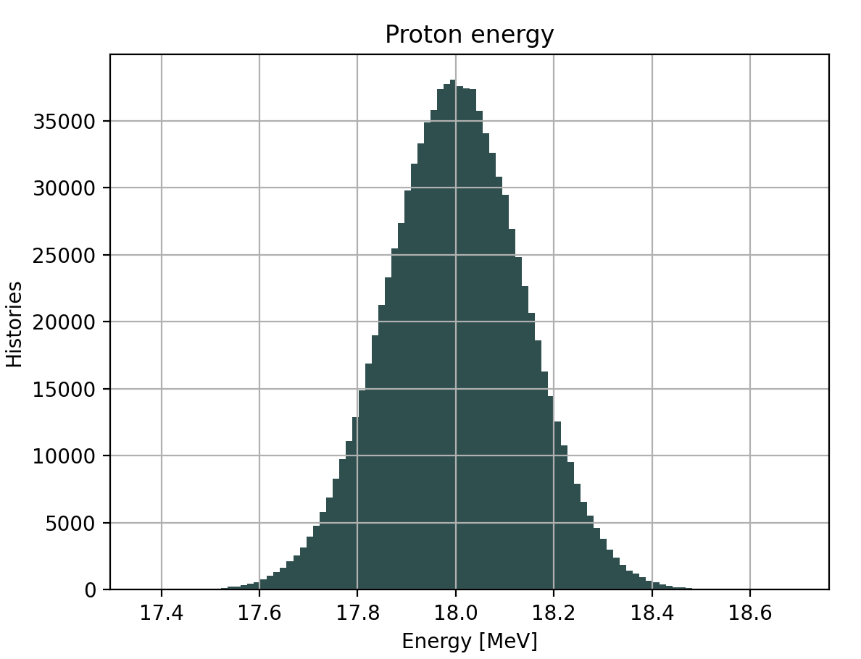
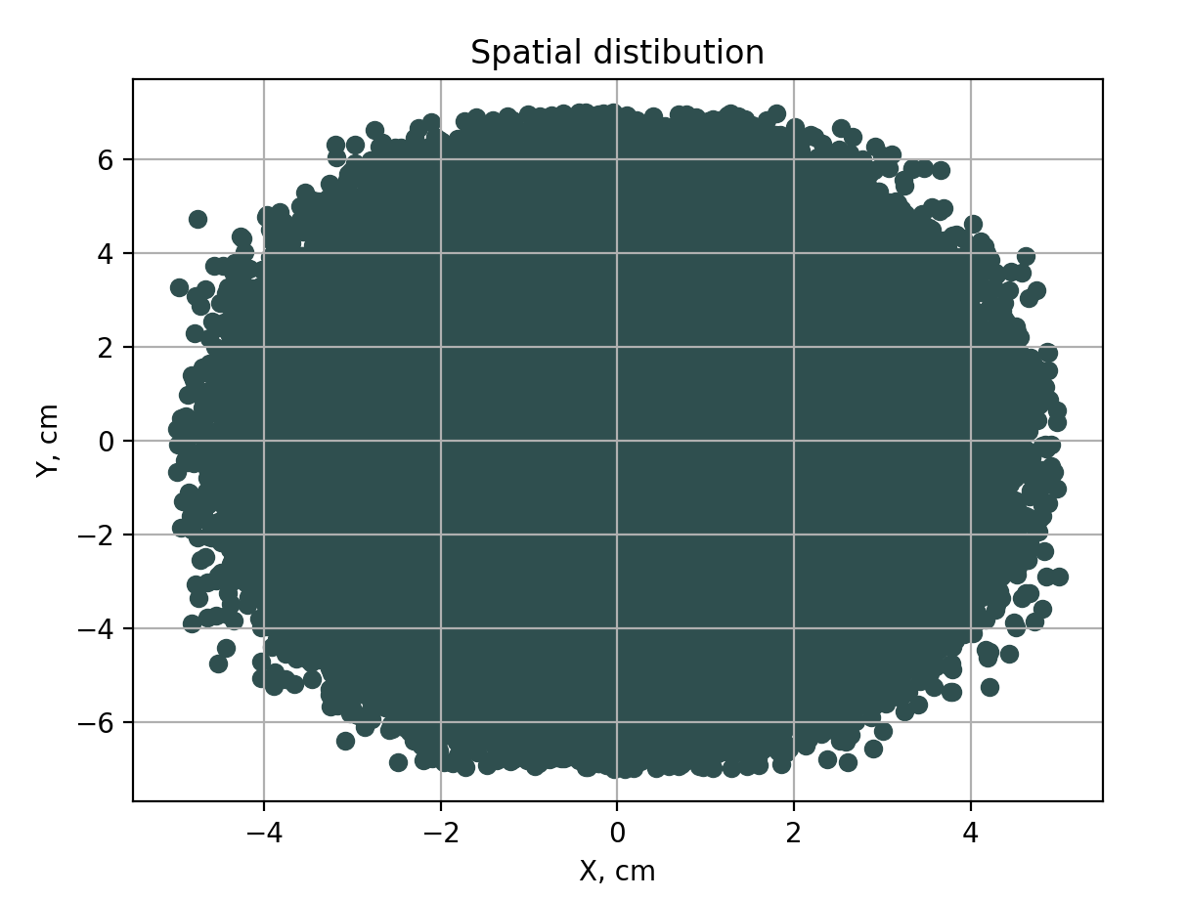
Energy and spatial distribution
Notes:
1. I fit gaussian distribution profile.
2. to verify the TOPAS generates the correct beam profile.
3. this allows me to check quantitatively beam characteristics after each interacrion.
4. quantitive data is presented below (ppt notes)
In order to verify the correctness of TOPAS code for the proton beam 2D Gaussian model is created and compared with the obtained data from the simulation. The comparison presents a good match.
[[Fit Statistics]]
# fitting method = leastsq
# function evals = 25
# data points = 2500
# variables = 5
chi-square = 1062124.82
reduced chi-square = 425.701332
Akaike info crit = 15139.3400
Bayesian info crit = 15168.4602
[[Variables]]
height: 1007774.48 +/- 738.398942 (0.07%) (init = 1000000)
centroid_x: 0.00466023 +/- 0.00109611 (23.52%) (init = 0.001)
centroid_y: -0.00693949 +/- 0.00139449 (20.09%) (init = 0.001)
sigma_x: 1.49610051 +/- 0.00109643 (0.07%) (init = 1.2)
sigma_y: 1.90340642 +/- 0.00139454 (0.07%) (init = 2)
[[Correlations]] (unreported correlations are < 0.100)
C(height, sigma_x) = 0.500
C(height, sigma_y) = 0.500
None

Slide 12
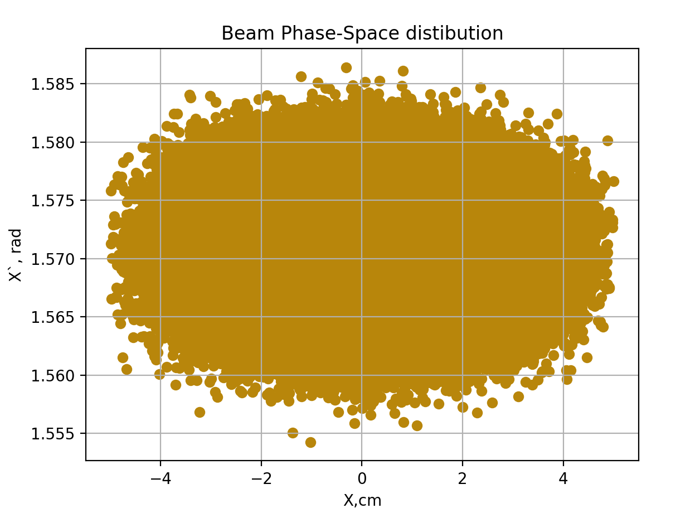
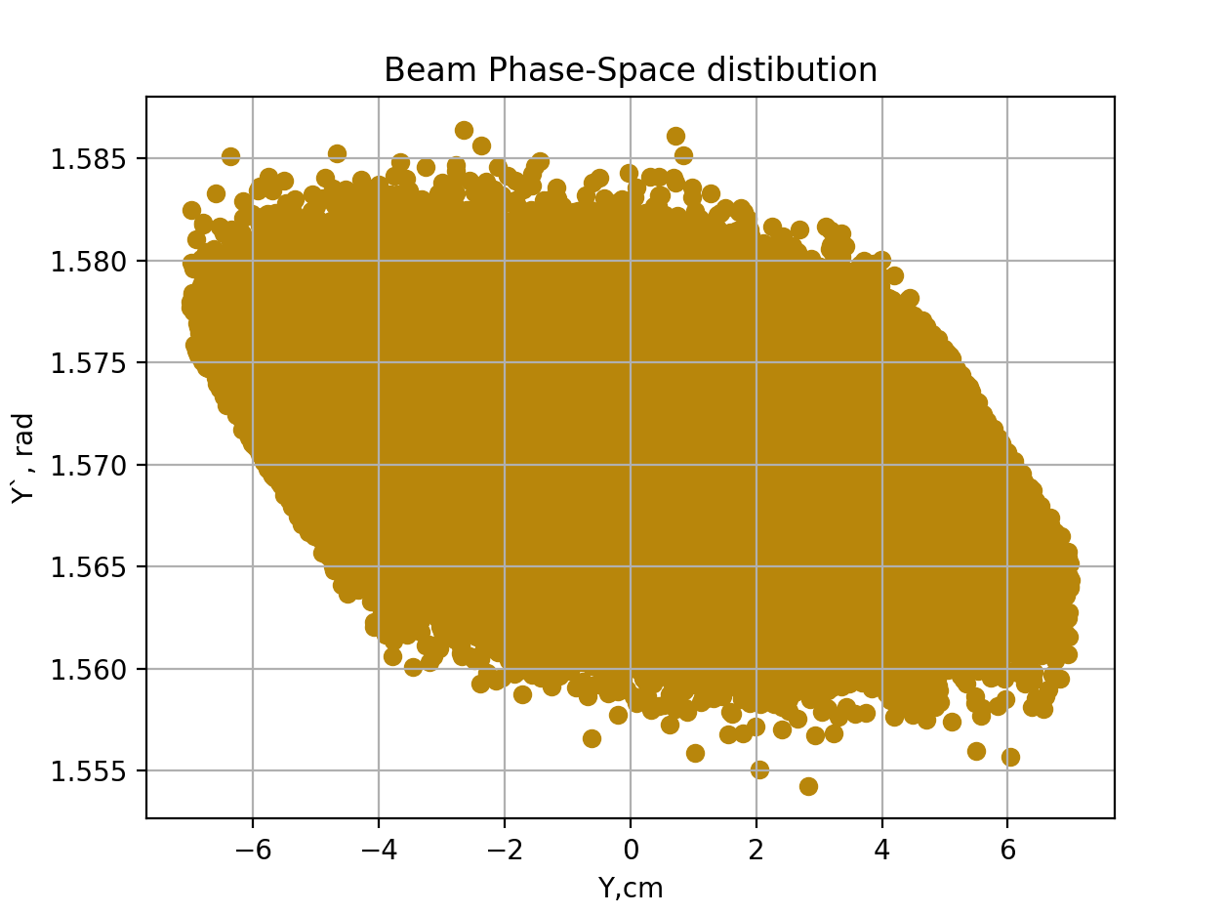
Phase space distribution

Slide 13
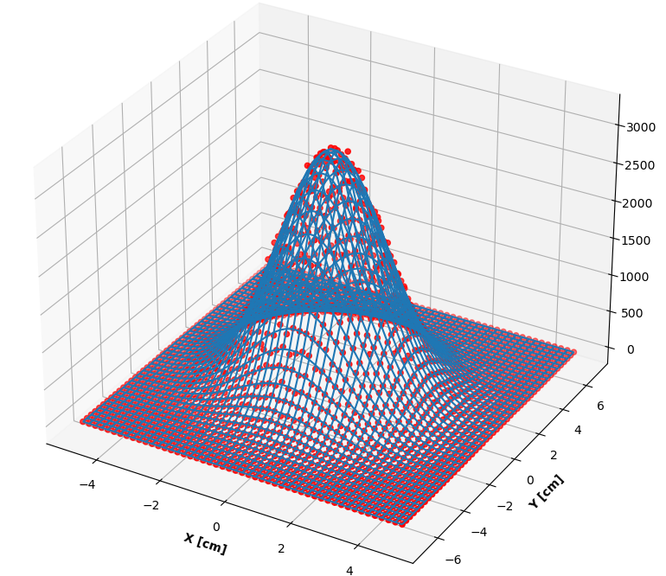
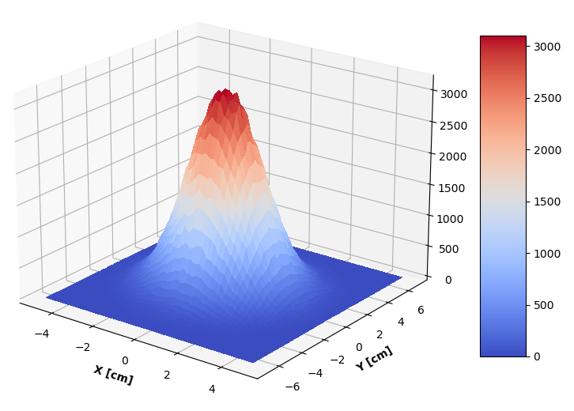

Verification of TOPAS code
Simulation data and 2D Gaussian model
Simulation data
Notes:
[[Fit Statistics]]
# fitting method = leastsq
# function evals = 25
# data points = 2500
# variables = 5
chi-square = 1062124.82
reduced chi-square = 425.701332
Akaike info crit = 15139.3400
Bayesian info crit = 15168.4602
[[Variables]]
height: 1007774.48 +/- 738.398942 (0.07%) (init = 1000000)
centroid_x: 0.00466023 +/- 0.00109611 (23.52%) (init = 0.001)
centroid_y: -0.00693949 +/- 0.00139449 (20.09%) (init = 0.001)
sigma_x: 1.49610051 +/- 0.00109643 (0.07%) (init = 1.2)
sigma_y: 1.90340642 +/- 0.00139454 (0.07%) (init = 2)
[[Correlations]] (unreported correlations are < 0.100)
C(height, sigma_x) = 0.500
C(height, sigma_y) = 0.500
None

Slide 14
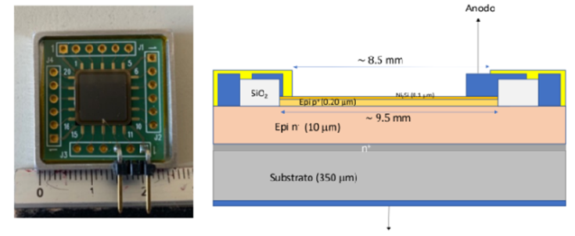
Prototype detector design

Slide 15
Characteristics
Type A
Type B
Ni₂Si with a thickness of 0.1 μm
SiC with a thickness of 0.2 μm
SiC with a thickness of 10 μm
SiC with a thickness of 350 μm
Al with a thickness of 0.1 μm
Ni₂Si with a thickness of 0.1 μm
SiC with a thickness of 0.2 μm
SiC with a thickness of 10 μm
SiC with a thickness of 350 μm
Al with a thickness of 0.1 μm
Cu with a thickness of 53.34 μm
FR4 with a thickness of 1016 μm
Cu with a thickness of 53.34 μm

Slide 16
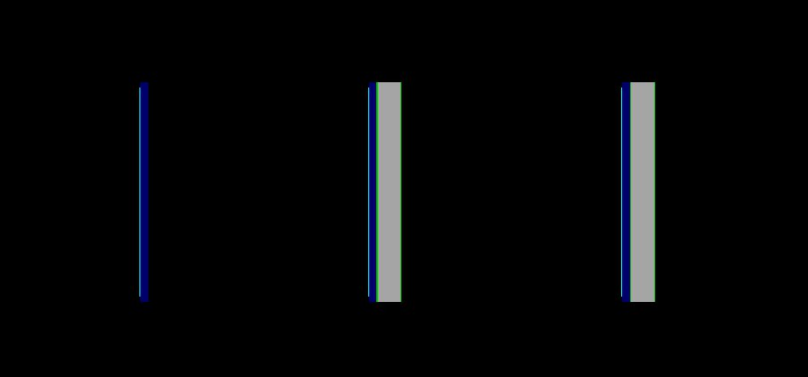
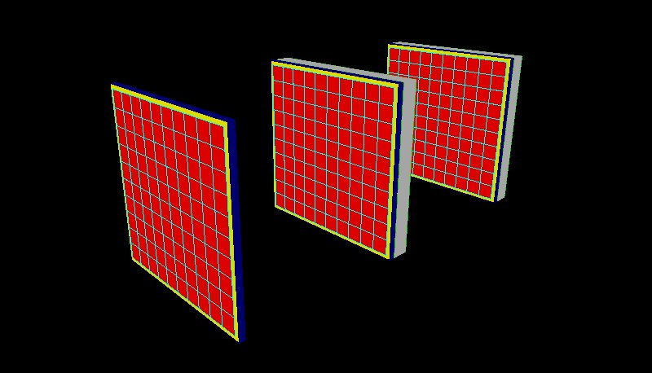
Detector arrangement
PCB
!1 1 cm
!1 1 cm
Det 1 Det 2 Det 3
Y and Z view of SiC detectors
Perspective view of SiC detectors

Slide 17
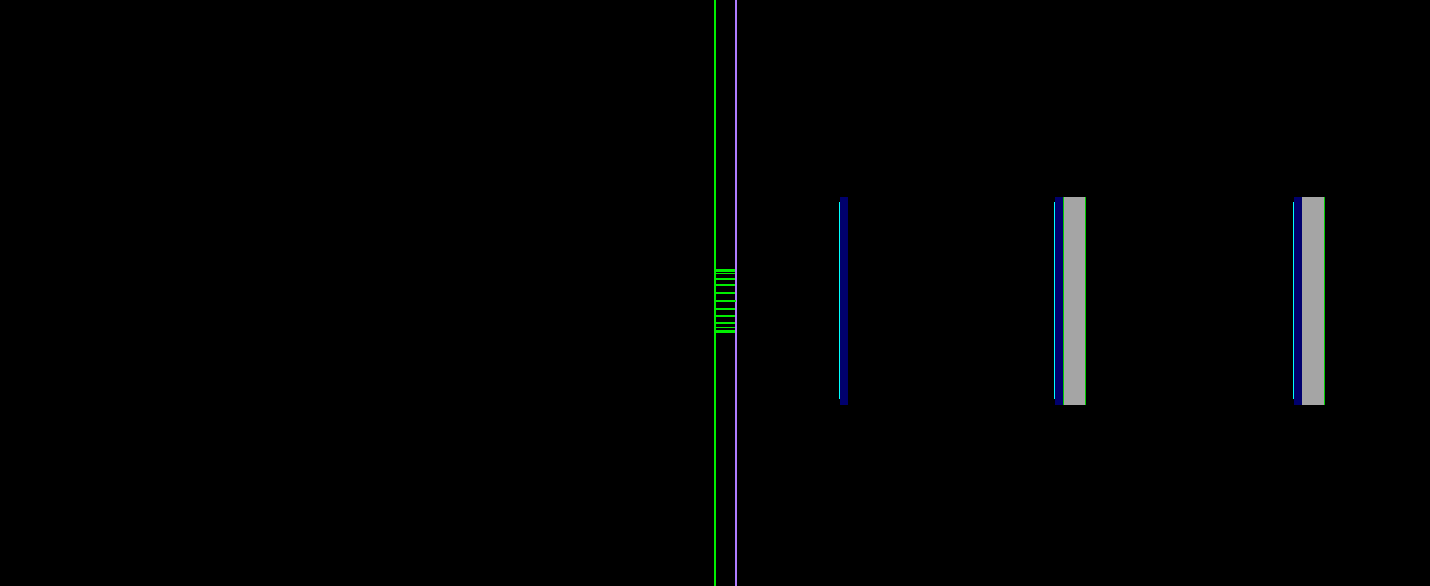
Preliminary simulation
PCB
2 m
0.5 cm
!1 1 cm
!1 1 cm
Beamline
Det 1 Det 2 Det 3
Vacuum
Collimator
Air
SiC detectors with the beam
‹#›

Slide 18
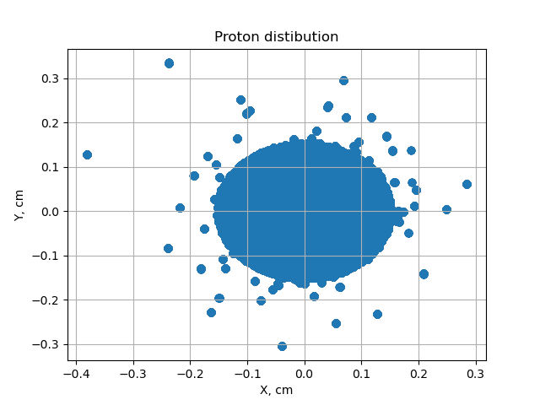
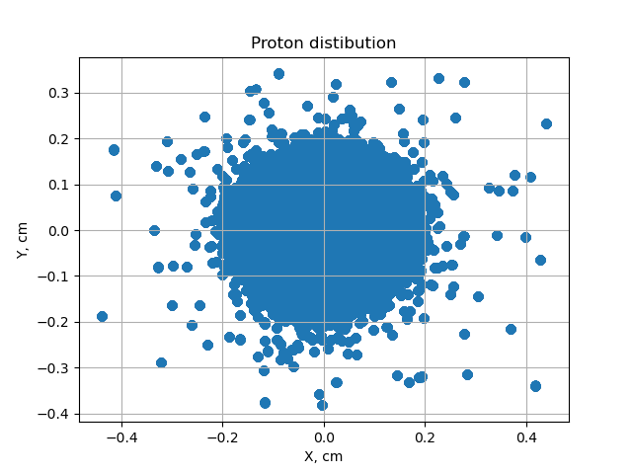
Outcome - Spatial distribution
Detector 1
Detector 2

Slide 19
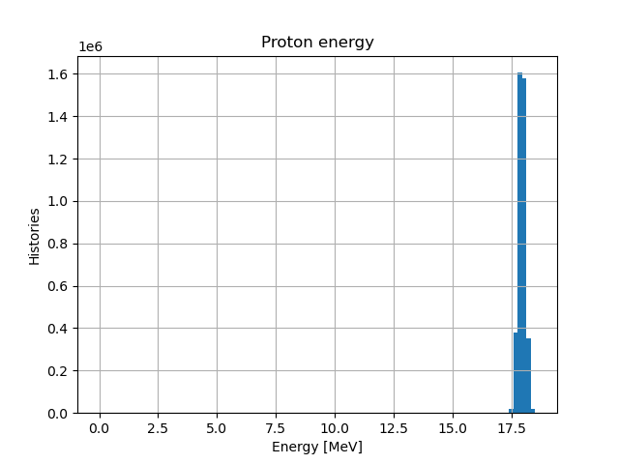
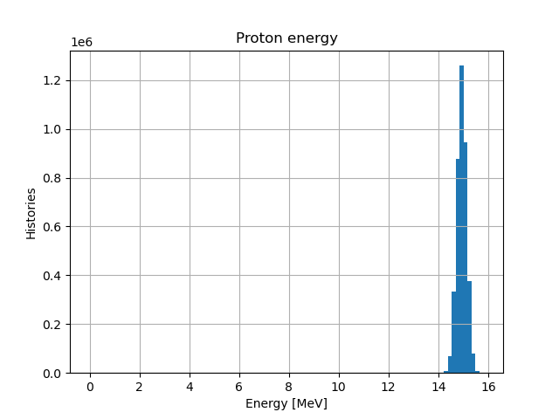
Outcome - Energy distribution
Detector 1
Detector 2
Notes:
Scorer: PhSp1
Header has been written to file: PhSp1.header
Contents has been written to file: PhSp1.phsp
Scored on surface: Layer3DEt1/ZMinusSurface
Number of Original Histories: 1000000
Number of Original Histories that Reached Phase Space: 4071
Number of Scored Particles: 40860
Number of e-: 150
Number of proton: 40710
Minimum Kinetic Energy of e-: 0.00148492 MeV
Minimum Kinetic Energy of proton: 0.469449 MeV
Maximum Kinetic Energy of e-: 0.0356116 MeV
Maximum Kinetic Energy of proton: 18.3904 MeV
Scorer: PhSp2
Header has been written to file: PhSp2.header
Contents has been written to file: PhSp2.phsp
Scored on surface: Layer3Det2/ZMinusSurface
Number of Original Histories: 1000000
Number of Original Histories that Reached Phase Space: 4033
Number of Scored Particles: 40447
Number of e-: 123
Number of proton: 40324
Minimum Kinetic Energy of e-: 0.00168685 MeV
Minimum Kinetic Energy of proton: 0.0100869 MeV
Maximum Kinetic Energy of e-: 0.0307371 MeV
Maximum Kinetic Energy of proton: 15.7174 MeV
Scorer: PhSp3
Header has been written to file: PhSp3.header
Contents has been written to file: PhSp3.phsp
Scored on surface: Layer3DEt3/ZMinusSurface
Number of Original Histories: 1000000
Number of Original Histories that Reached Phase Space: 0
Number of Scored Particles: 0

Slide 20
Outcome - Dose to water
Detector 1 - 2.031*10⁻⁵ Gy
Detector 2 - 2.442*10⁻⁵ Gy

Slide 21
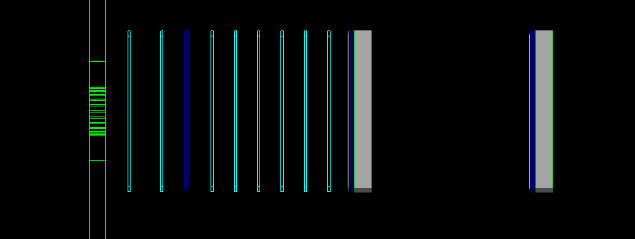
Additional simulation
Collimator
RCF SiC RCF SiC
SiC

Slide 22
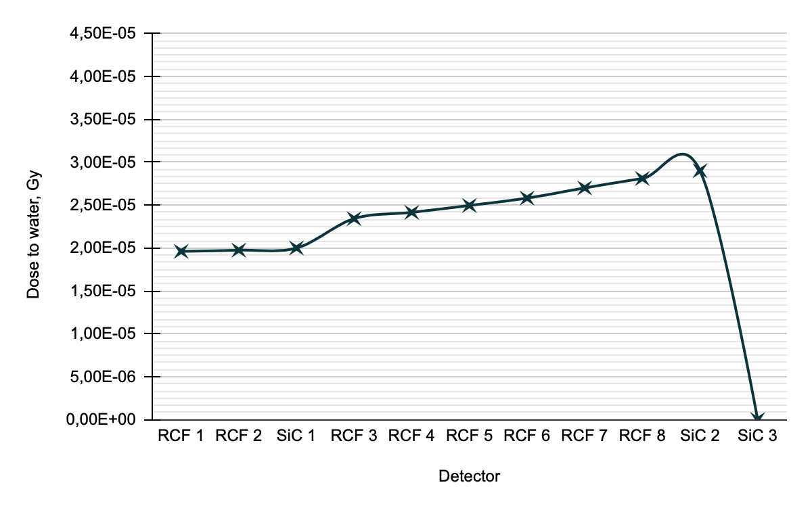
Outcome - Dose to water
Detector | Dose to water, Gy
RCF 1 | 1,96E-05
RCF 2 | 1,98E-05
SiC 1 | 2,00E-05
RCF 3 | 2,34E-05
RCF 4 | 2,42E-05
RCF 5 | 2,50E-05
RCF 6 | 2,58E-05
RCF 7 | 2,70E-05
RCF 8 | 2,81E-05
SiC 2 | 2,90E-05
SiC 3 | 0,00E+00

Slide 23
Future tasks
to perform the simulations with corrections
to complete a simulation with RCF to reconstruct Bragg peak
to prepare an experiment
to compare experimental and simulation data

