Slide 1
Schematic Design Using Quartus II
Dr. Ruba Alkhasawneh

Slide 2
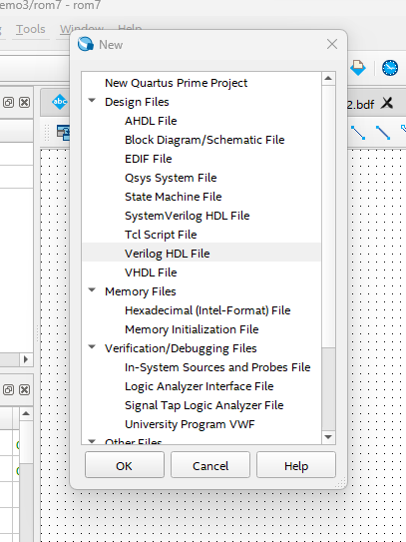
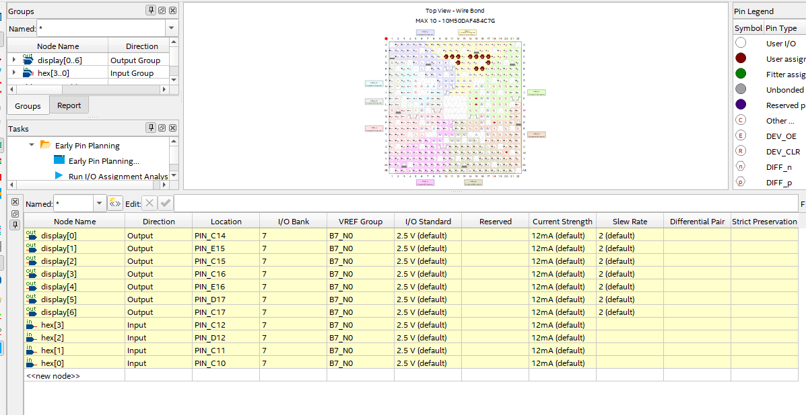
7-Segment Display
Setup a new project.
Copy the 7-segment display code we implemented before into a new Verilog file from folder week3/Day2/Schematic.
Finish the pin assignment as in the image and compile your code.
Then go to File → create/update → Create Symbol files for current file.
Create a new file but this time select: Block Diagram/Schematic File.

Slide 3
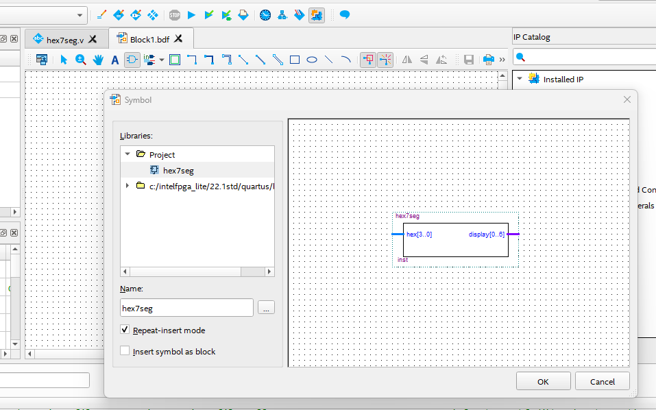
7-Segment Display
Click on the Symbol Tool
A new window will pop up. Now select the symbol we created under project.
Click ok and drop the symbol into your schematic file then hit the escape button.

Slide 4
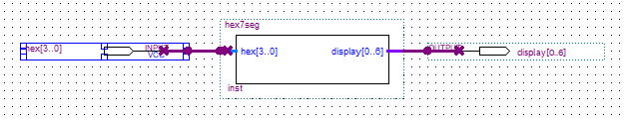
7-Segment Display
Specify the input/output pin names as in the figure below.
Now program your FPGA and check your output on the 7-segment display
Note: The pin assignment can be done after creating the block symbol. Just make sure you refer to the correct Board user guide.

Slide 5
7-Segment Display
Use the Orthognal node or orthogonal bus to connect your block
Use the pin tool to add the input/output pins.

Slide 6
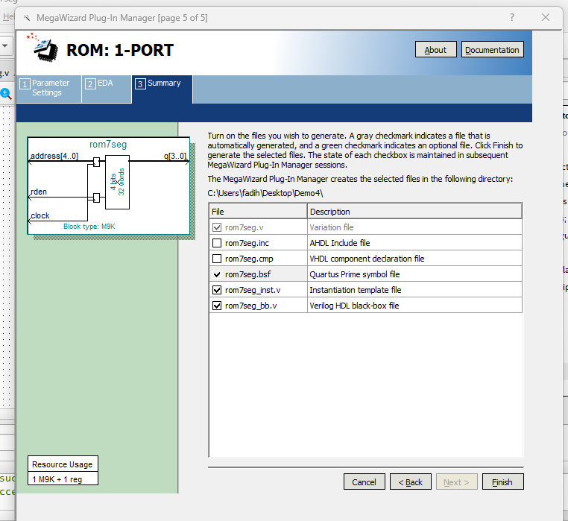
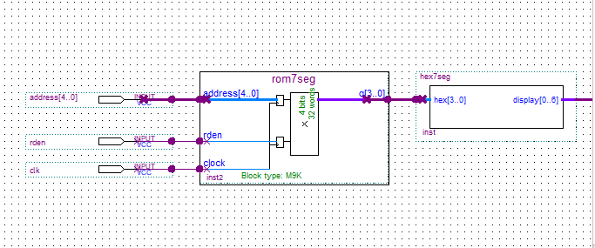
Connect ROM to 7segment display
Once you created your symbol, insert it to the schematic file the same way you did to insert the 7 segment display.

Slide 7
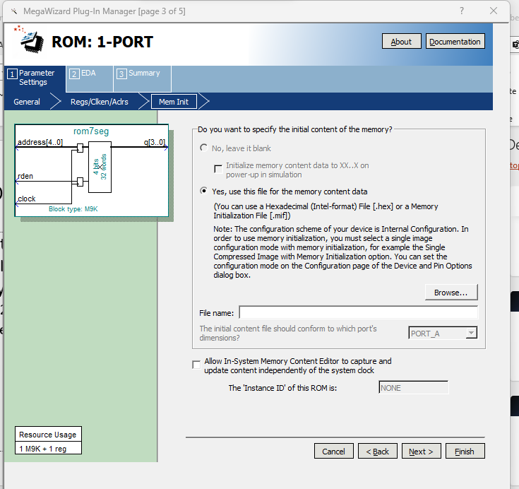
Rom 1 port
Open a new block file and set it as your top-level entity.
Go to IP catalog. Go to Library → basic functions → on chip memory → ROM:1-port.
Configure your memory
M9K 4x32.
Check the create “rden” signal and deselect the “q” output port.
Use the .mif file to initialize your memory.

Slide 8
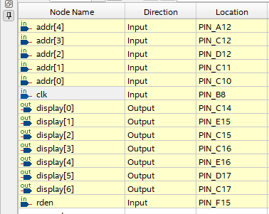
Connect ROM to 7segment display
Compile your design and assign the pins as in the image.
Program your FPGA and use KEY0 as your clock.
If you are getting the following error:
"Error (16031): Current Internal Configuration mode does not support memory initialization or ROM. Select Internal Configuration mode with ERAM."
you can fix it with the following:
Assignments -> Device -> Device and Pin Options -> Configuration -> Configuration Mode: Single uncompressed image with Memory Initialization

