Slide 1

MACHINE LEARNING PROJECT: WATER POTABILITY PREDICTION
Comparing six classification models to predict water potability based on chemical properties.
Team Members: Ahmed Yahia Mahmoud Ali
Farag Hany Abdeldim
Doha Ahmed
Shorouq Ibrahim Elmelegy
Course Instructor: Eng.Ammar Elnmery
Eng. Amr Shafek

Slide 2

BUILDING A PREDICTIVE MODEL FOR WATER POTABILITY
CORE CONCEPT
GOAL
Develop a machine learning model to predict whether a water sample is potable based on its chemical measurements.
Water Potability
Potable = 1 Not Potable = 0
DATASET
3,276 water samples, each featuring 9 numerical attributes and a "Potability" target column.
Based on 9 chemical and physical properties.
METHODOLOGY
Binary Classification Task
Data cleaning and preprocessing followed by training and evaluating 6 different classification models.

Slide 3
COMPREHENSIVE DATASET OVERVIEW
3,276
9
2
1,434
TOTAL SAMPLES
FEATURES
TARGET CLASSES
MISSING VALUES
THE NINE CHEMICAL ATTRIBUTES
pH
Hardness
Solids
Chloramines
Sulfate
Conductivity
Organic Carbon
Trihalomethanes
Turbidity

Slide 4





ANALYZING TARGET CLASS DISTRIBUTION
POTABILITY BREAKDOWN
The dataset shows that 60.99% of the samples are classified as Not Potable, while 39.01% are Potable.
DATA IMBALANCE
A slight imbalance exists between the two classes. This was strictly accounted for during model evaluation to ensure unbiased results.
STRATEGIC FOCUS
Not Potable (60.99%)
The primary challenge is ensuring the model accurately identifies potable water despite the higher frequency of non-potable samples in the data.
Potable (39.01%)

Slide 5

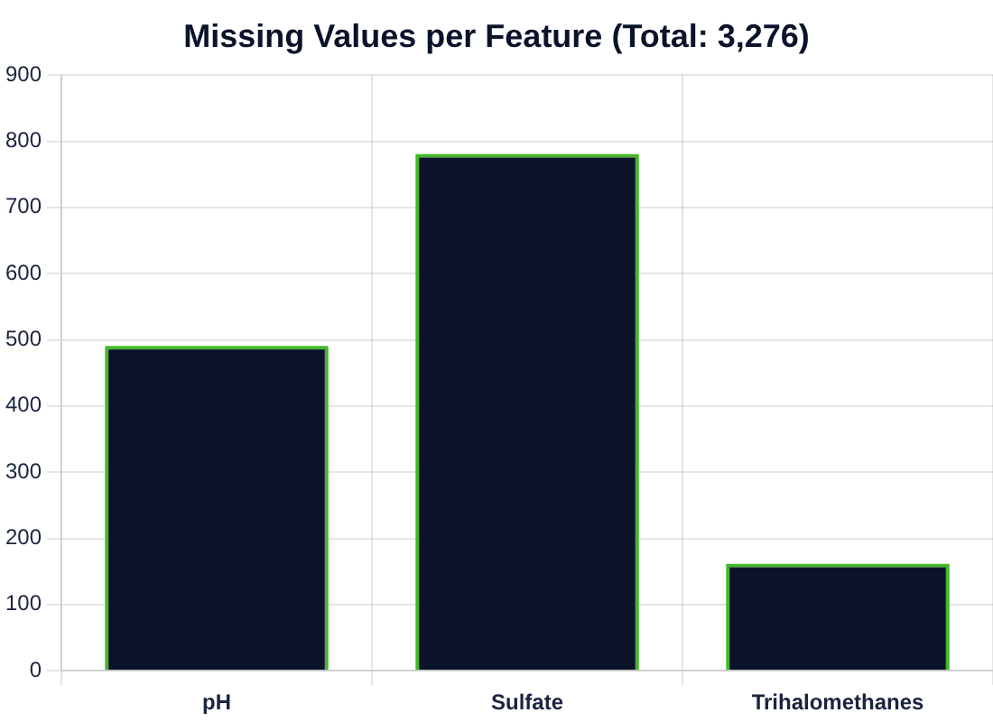
SYSTEMATIC HANDLING OF MISSING VALUES
IMPUTATION STRATEGY
pH:
491 missing values (15.0%)
Sulfate:
781 missing values (23.8%)
Trihalomethanes:
162 missing values (4.9%)
Method: Median Imputation was utilized to fill gaps based on training set statistics.
Imputation was performed after data splitting to strictly avoid data leakage from the test set.

Slide 6
ROBUST DATA PREPROCESSING PIPELINE
01
02
03
04
DATA SPLITTING
MISSING VALUES
OUTLIER REMOVAL
FEATURE SCALING
80% Train (2,620) 20% Test (656) Applied Stratified Sampling to maintain class distribution.
Utilized Median Imputation. Performed on training set first to strictly avoid Data Leakage.
Employed the Interquartile Range (IQR) method. Identified and removed statistical anomalies to improve model stability.
Applied StandardScaler. Normalized all features to a Standard Normal Distribution (Mean=0, SD=1).

Slide 7
MACHINE LEARNING MODELS & HYPERPARAMETER TUNING
Evaluated using 3-Fold Cross-Validation and GridSearchCV for optimal parameter selection.
LOGISTIC REGRESSION
DECISION TREE
RANDOM FOREST
CROSS-VAL ACCURACY
CROSS-VAL ACCURACY
CROSS-VAL ACCURACY
0.6103
0.6397
0.6767
XGBOOST
SVM
KNN
CROSS-VAL ACCURACY
CROSS-VAL ACCURACY
CROSS-VAL ACCURACY
0.6676
0.6714
0.6439

Slide 8
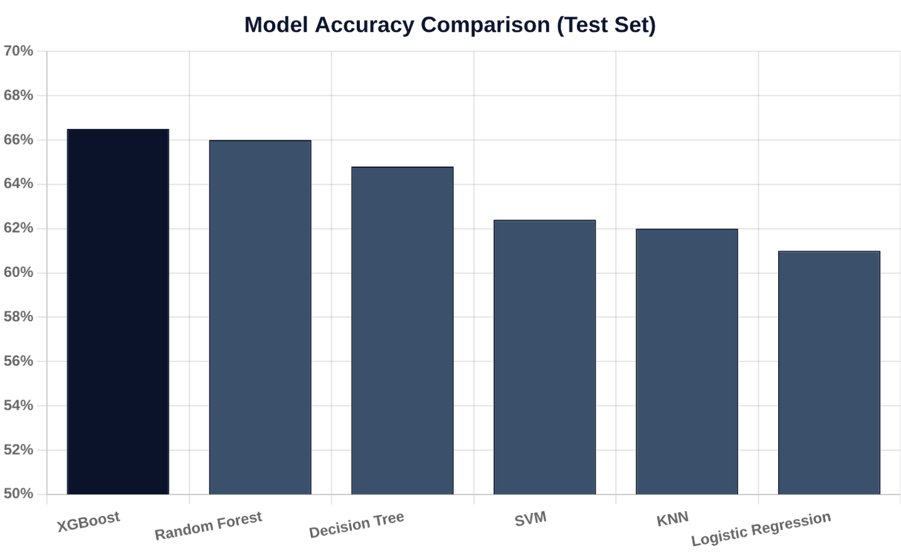
COMPARATIVE PERFORMANCE ON TEST DATA
KEY INSIGHTS
• XGBoost led the performance with 66.5% accuracy on unseen test data.
• Random Forest followed closely at 66.0%, demonstrating strong generalization.
• Baseline Logistic Regression achieved 61.0%, indicating the complexity of the non-linear relationships in the data.

Slide 9
XGBOOST: THE OPTIMAL PREDICTIVE MODEL
66.46%
46.08%
61.84%
36.72%
ACCURACY
F1-SCORE
PRECISION
RECALL
WHY XGBOOST?
XGBoost (Extreme Gradient Boosting) was selected for its superior ability to capture complex, non-linear relationships between chemical properties. It provided the most reliable trade-off between precision and recall, outperforming all other models after rigorous hyperparameter tuning.
Learning Rate: 0.05
Max Depth: 6
Estimators: 200

Slide 10







CONCLUSION & STRATEGIC FUTURE ENHANCEMENTS
PROJECT CONCLUSION
FUTURE ROADMAP
Successfully developed a full classification pipeline for water potability prediction.
Advanced Feature Engineering: Create interaction terms and domain-specific indicators.
Weak individual feature correlations limited overall accuracy, indicating complex non-linear dependencies.
Class Balancing: Implement SMOTE or cost-sensitive learning to handle target imbalance.
XGBoost provided the best performance balance with 66.46% accuracy and 46.08% F1-Score.
Ensemble Methods: Explore Stacking and Voting classifiers to combine model strengths.
The model serves as a solid baseline for further environmental data analysis.
Data Expansion: Collect additional features like seasonal variations or source types.

