Slide 1
Chat application
Alibek Kerimkulov

Slide 2
Functionality
Chat with friends
Translate message
Tracking user’s status
Profile info
List of chat
List of users

Slide 3
Used Technologies
Firebase auth
Android Studio
Kotlin
Firebase Firestore
Firebase Storage
Android development elements

Slide 4
Problem solves
Communication between users
Make people closer
Translate messages from English to Russian

Slide 5
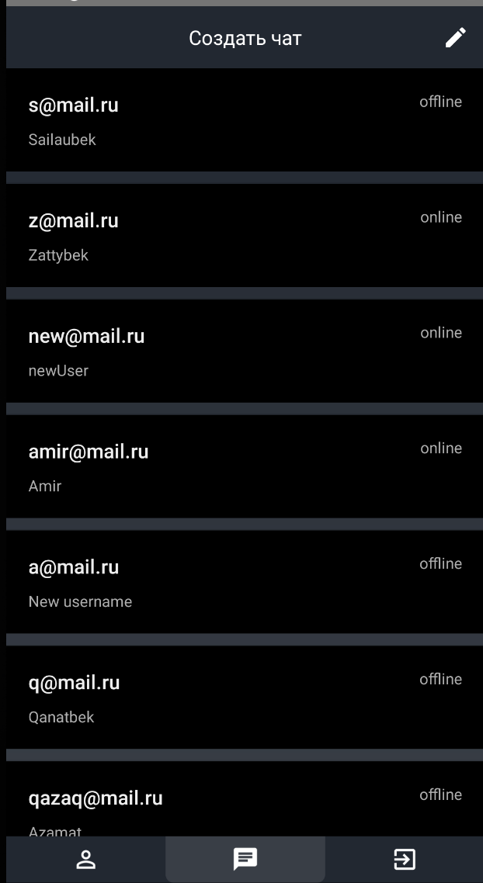
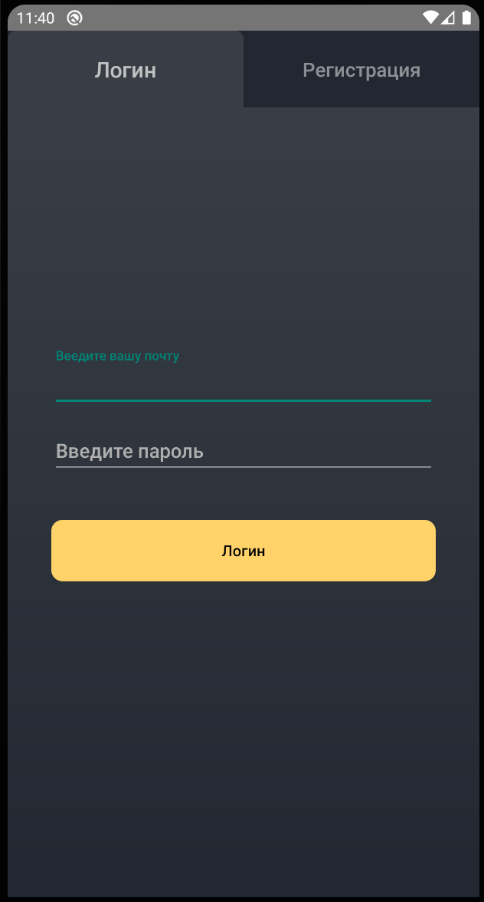
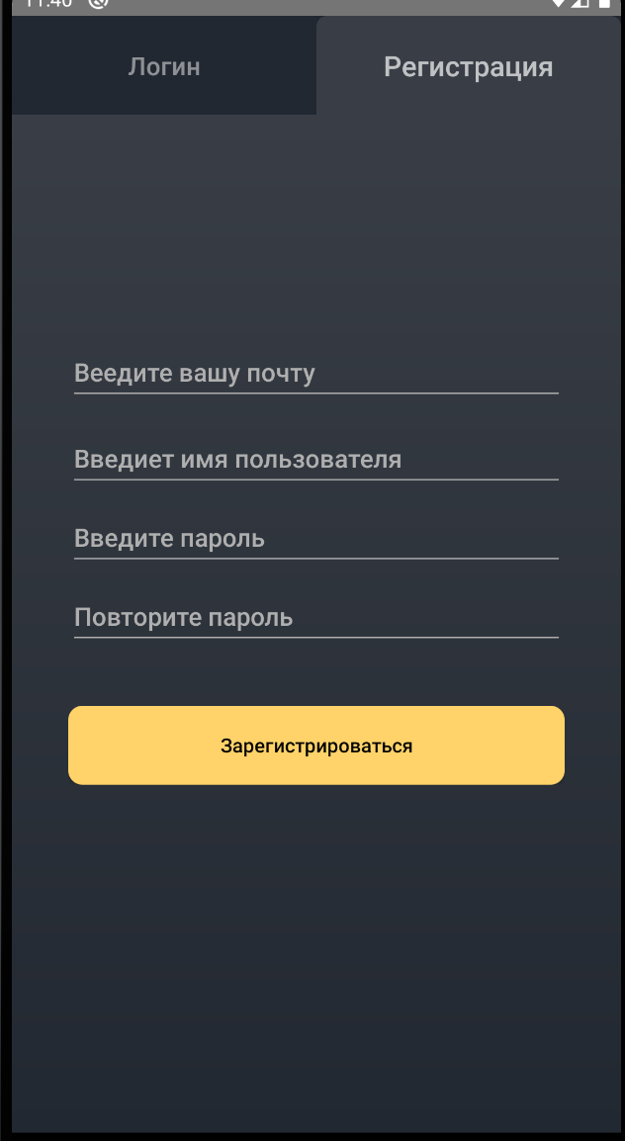

Slide 6
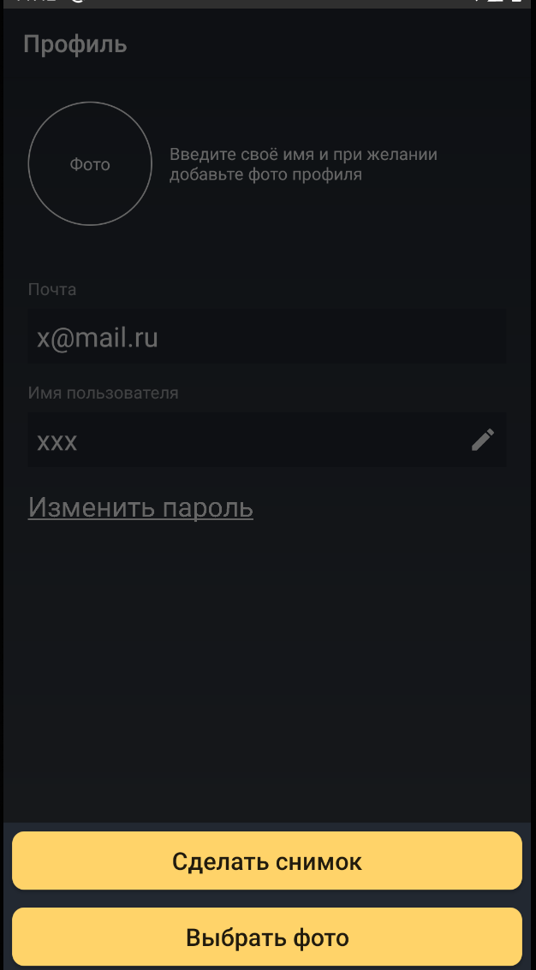
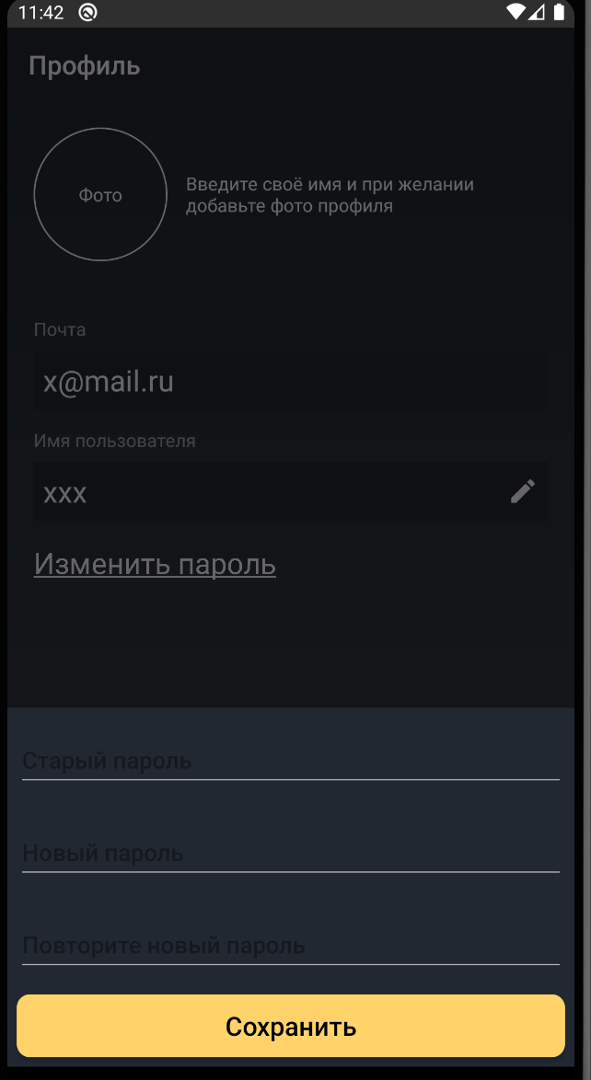
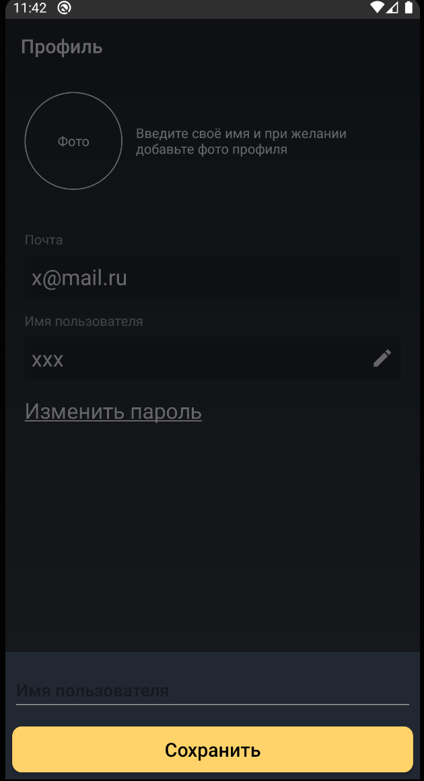

Slide 7
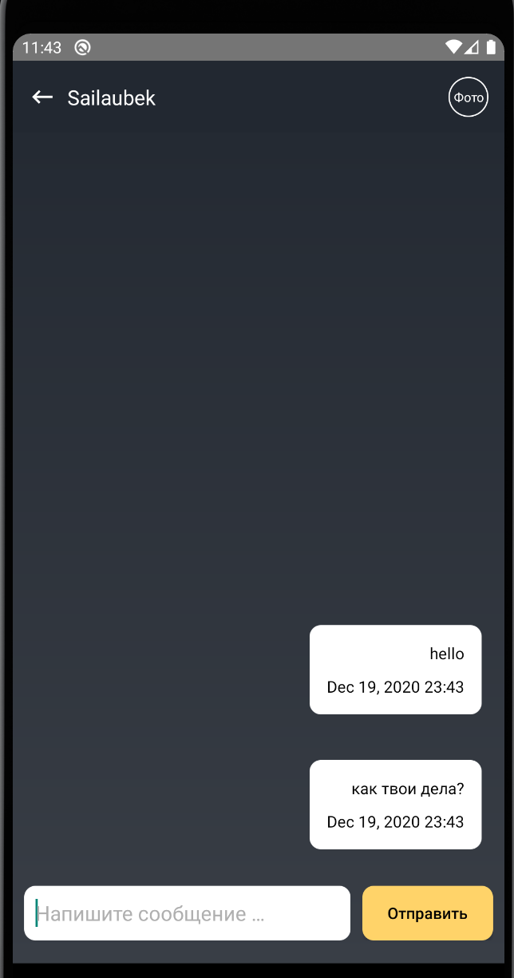
The application listens the user click on message and translate it to Russian language. However, the original message will be saved in database(not translated message).

