Slide 1
Mapping an ER Model to the Relational Model
Elarbi Badidi
College of Information Technology
United Arab Emirates University
ebadidi@uaeu.ac.ae

Slide 2
Learning objectives
Be able to map an ERD to a relational data model.
Be able to map an EER to a relational data model.

Slide 3
Outline
ERD-to-Relational Mapping Algorithm
Step 1: Mapping of Regular Entity Types
Step 2: Mapping of Multi-valued attributes
Step 3: Mapping of Weak Entity Types
Step 4: Mapping of Binary Relationship Types
Step 5: Mapping of N-ary Relationship Types
Mapping EER Model Constructs to Relations
Step 6: Options for Mapping Specialization or Generalization.
Step 7: Mapping of Union Types (Categories).

Slide 4
Mapping Rules
Following mapping rules produce a well-designed (well normalized) relational database from an ER model.

Slide 5
Transforming ER diagrams into relations
This can be done automatically by many CASE tools, but it is important to understand the process because:
CASE tools often cannot model complex data relationships such as ternary relationships and supertype/subtype relationships. For these situations you may have to perform these steps manually.
Sometimes alternative solutions exist, and you must choose the best.
You must be able to quality check the CASE tool results.

Slide 6
Step 1: Mapping of Regular Entity Types
Each regular entity type in an ER diagram is transformed into a relation.
The name given to the relation is generally the same as the entity type.
Each simple attribute of the type becomes an attribute of the relation
The identifier (key attribute) of the entity type becomes the primary key of the corresponding relation.

Slide 7
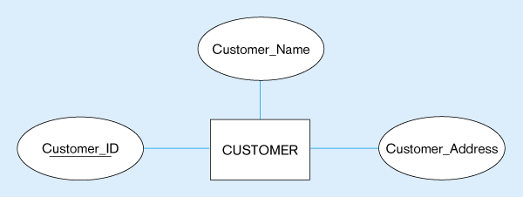
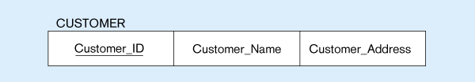
Mapping a Regular Entity Type
(a) CUSTOMER entity type with simple attributes
(b) CUSTOMER relation

Slide 8
Composite attributes
When a regular entity type has composite attributes, only the simple component attributes of the composite attribute are included in the new relation.
The following Figure shows a variation on the previous one, where Customer_Address is represented as a composite attribute with components Street, City, State and Zip

Slide 9
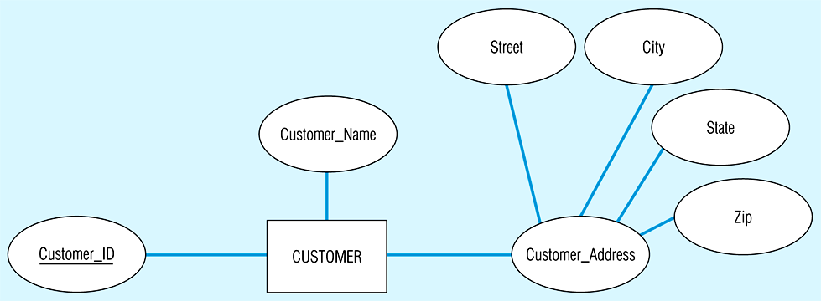
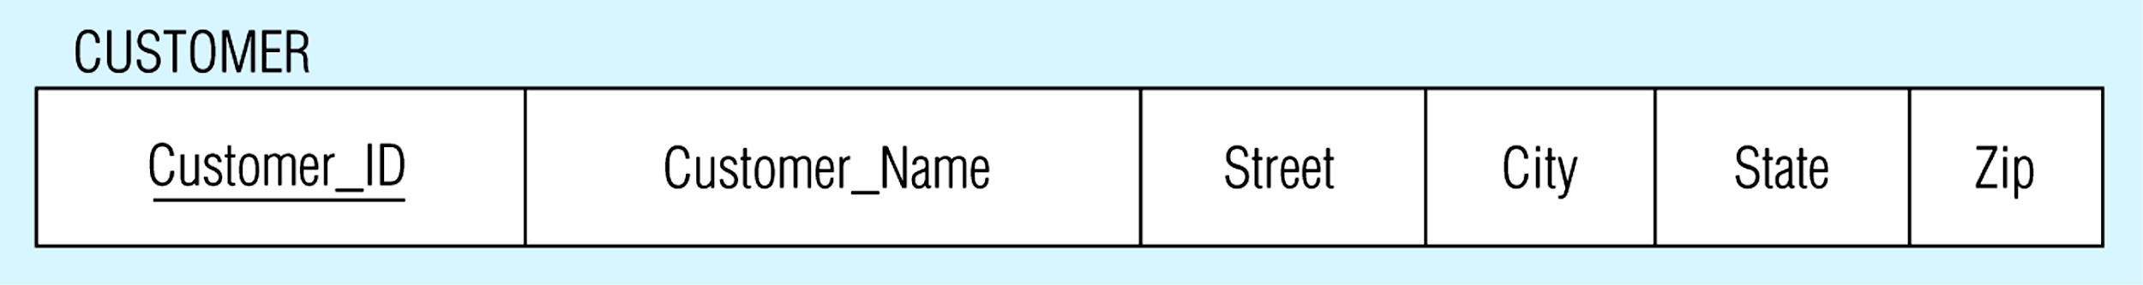
Mapping a composite attribute
(a) CUSTOMER entity type with composite attribute
(b) CUSTOMER relation with address detail

Slide 10
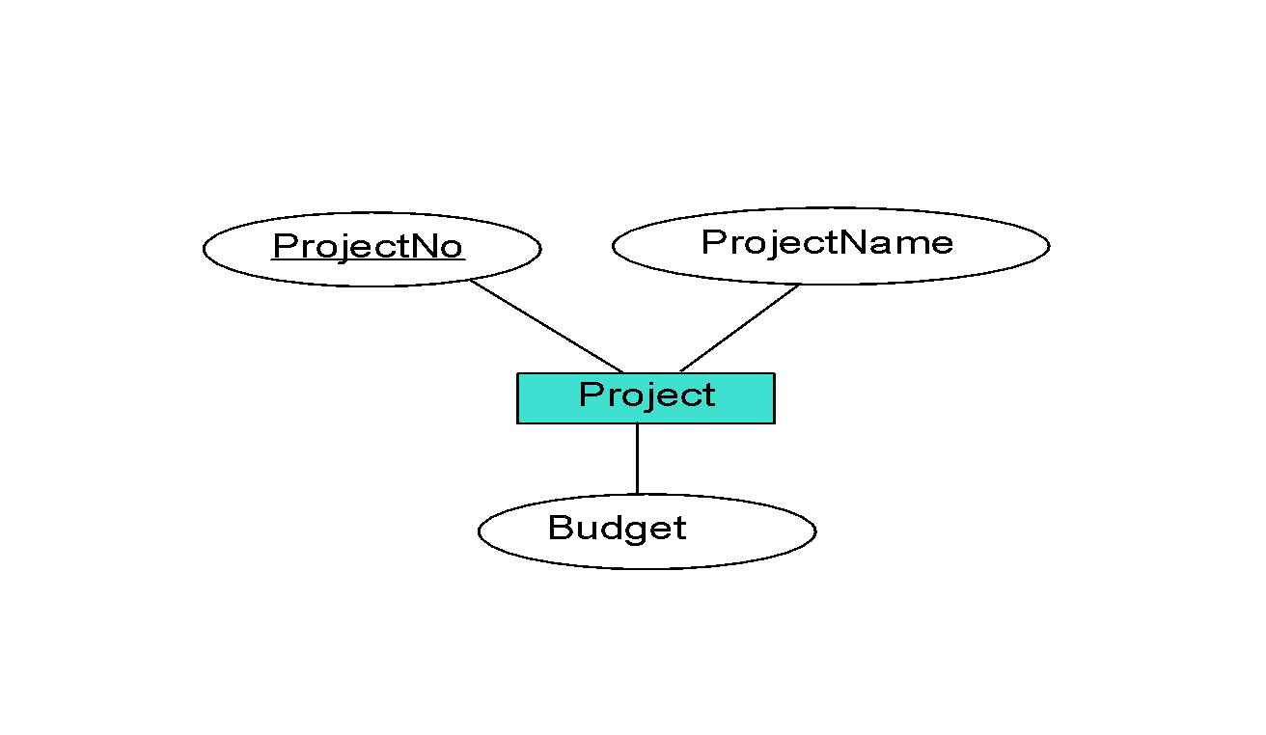
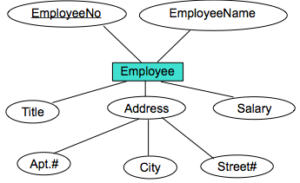
Activity 1
Do the mapping of the following diagrams:

Slide 11
Project (ProjectNo, ProjectName, Budget)
Employee (EmployeeNo, EmployeeName, Title, Salary, Apt#, City, Street#)

Slide 12
Step 2: Mapping of Multi-valued attributes
Here two new relations (rather than one) are created.
First relation contains all of the attributes of the entity type except the multi-valued attribute.
Second relation contains two attributes that form the primary key of the second relation:
The first of these is the primary key for the first relation, which becomes a foreign key in the second relation.
The second is the multi-valued attribute.

Slide 13
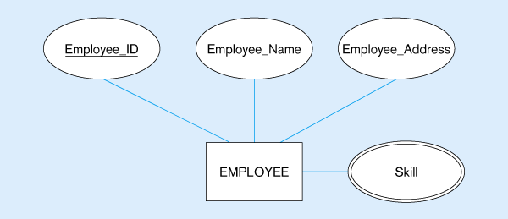
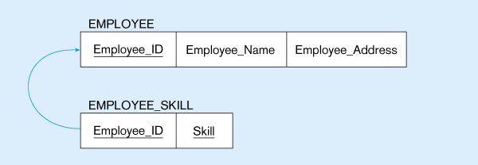
Example: Mapping of Multi-valued attributes
In the following Fig. EMPLOYEE has ‘Skill’ as a multi-valued attribute.
The first relation EMPLOYEE has the primary key Employee_ID.
The second relation EMPLOYEE_SKILL has the two attributes Employee_ID and Skill, which form the primary key.
The relationship between foreign and primary keys is indicated by the arrow in the figure.
Multi-valued attribute becomes a separate relation with foreign key

Slide 14
Activity 2
Do the mapping of the following diagram:
DNumber
name
location
Department
Department (DNumber, name)
Dept-locations (DNumber, location)

Slide 15
Activity 3
Do the mapping of the following diagram:
Year
College
S_id
S_name
Major
age
PrevDegrees
Student
Student (S_id, S_name, age)
Stud-PrevDegrees (s_id, College, Year, Major)

Slide 16
Step 3: Mapping of Weak Entity Types (1)
You must already have created a relation corresponding to the identifying entity type.
For the weak entity type, create a new relation and include all its simple attributes (or simple components of composite attributes) as attributes of this relation.
Then include the primary key of the identifying relation as a foreign key attribute in this new relation.
The primary key of the new relation is the combination of this primary key of the identifying relation and the partial key of the weak entity type.

Slide 17
Step 3: Mapping of Weak Entity Types (2)
Dependent_of
Employee
Dependent
SSN
Name
firstname
birthdate
Salary
Dependent
firstname
birthdate
ssn
CREATE TABLE Dependent (
firstname CHAR(20),
birthdate DATE,
ssn CHAR(11) NOT NULL,
PRIMARY KEY (firstname, ssn),
FOREIGN KEY (ssn) REFERENCES Employee,
ON DELETE CASCADE)
When the owner entity is deleted, all owned weak entities must also be deleted.

Slide 18
Activity 4
Do the mapping of the following diagram:
type
number
balance
trans#
amount
made against
account
transaction
account (number, type, balance)
transaction (number, trans#, amount)

Slide 19
Step 4: Mapping Binary Relationship Types
The procedure for representing relationships depends on both the degree of the relationships (unary, binary, ternary) and the cardinalities of the relationships.
Translation to
relational model?
1-to-1
1-to Many
Many-to-1
Many-to-Many

Slide 20
Mapping of Binary 1:1 Relationship Types
Add to one of the participating relations a FK to the other relation:
It is better to add the FK to a relation that has total participation in the relationship.
Include any relationship attributes.
E.g. add manager’s start-date to Department.
Department (Dnumber, Dname, MGRSSN, startdate)
Employee
(0,1)
(1,1)
Manages
Department
startdate

Slide 21
Activity 5
Do the mapping of the following ERD
fname
lname
name
name
id
Ad_id
address
ADMINISTRATOR
(0,1)
Is dean of
(1,1)
SCHOOL
startdate
Administrator (Ad-id, fname, lname)
School (id, name, Ad-id, startdate)
School_address (id, address)

Slide 22
Mapping of Binary 1:N Relationship Types.
Add to the relation on the N-side a FK to the other relation.
E.g. add DNO to Employee to represent the department an employee works-for.
Include any relationship attributes
Employee
(1,1)
(1,N)
Works-for
Department

Slide 23
Example of Binary One-to-Many Relationship
Employee
Name
Duration
Project
Name
Employee No
Project No
N
1
EMPLOYEE
Works
On
WORKS ON
PROJECT
Title
Salary
Responsibility
Budget
Foreign key that references Project table
Table 1: Employee (EmployeeNo, EmployeeName, Title, Salary, ProjectNo, Duration, Responsibility)
Table 2: Project (ProjectNo, ProjectName, Budget)

Slide 24
Mapping of Binary M:N Relationship Types
Create a new relation containing
FKs to both participating relations
relationship attributes
E.g. see Works-On
PK is the combination of both FKs
Sometimes you also need to add one or more of the relationship attributes to form the PK.

Slide 25
Example of Binary Many-to-Many Relationship
Employee
Name
Duration
Project
Name
Employee No
Project No
N
M
EMPLOYEE
Works
On
WORKS ON
PROJECT
Title
Salary
Responsibility
Budget
Table 1: Employee (EmployeeNo, EmployeeName, Title, Salary)
Table 2: Project (ProjectNo, ProjectName, Budget)
Table 3: WorksOn (EmployeeNo, ProjectNo, Duration, Responsibility)
Foreign key that references Project table
Foreign key that references Employee table

Slide 26
Activity 6
Do the mapping of the following ERD
Fname
Dnum
Dname
Emp_id
Lname
PROFESSOR
(1,1)
Is assigned to
(1,N)
DEPARTMENT
(1,N)
teaches
(1,N)
Section
Professor (Emp-id, Fname, Lname, Dnum)
Department (Dnum, Dname)
Section (Sec-id, N-stud)
Teaches (Emp-id, Sec-id)
Sec_id
N_stud

Slide 27
Mapping of n-ary Relationship Types
As you did in step 1, create n tables T₁ and T₂, T₃, T₄, …T_{n} for entities E₁ and E₂, E₃, E₄, …, E_{n} that relate to each other by n-ary relationship.
Create a new Table T
Include as foreign key attributes in T the primary keys of T₁, T₂, T₃, T₄, …T_{n}. Include any simple attributes (or simple components of composite attributes) of the n-ary relationship as attributes of T
The primary key of T is the combination of all the foreign keys that reference T₁, T₂, T₃, T₄, …T_{n}
Summary: Each n-ary relationship becomes a table with foreign keys to the participants

Slide 28
Example of Ternary Relationship
Supplier
Name
Project
Name
SupplierNo
Project No
Location
Budget
SUPPLIER
PROVIDES
PROJECT
PartNo
QTY
PART
Part
Name
Price
Table 1: Supplier (SupplierNo, SupplierName, Location)
Table 2: Project (ProjectNo, Project Name, Budget)
Table 3: Part (PartNo, PartName, QTY, Price)
Table 4: Provides (SupplierNo, PartNo, ProjectNo)
PART
Foreign key that references Project table
Foreign key that references Part table
Foreign key that references Supplier table

Slide 29
Activity 7
Do the mapping of the following ERD
IName
Rank
Semester
Year
Offer
Instructor
Semester
Course
C_code
Title
Instructor (IName, Rank)
Semester (Semester, Year)
Course (C_code, Title)
Offer (IName, Semester, C_code)

Slide 30
Outline
ERD-to-Relational Mapping Algorithm
Step 1: Mapping of Regular Entity Types
Step 2: Mapping of Multi-valued attributes
Step 3: Mapping of Weak Entity Types
Step 4: Mapping of Binary Relationship Types
Step 5: Mapping of N-ary Relationship Types
Mapping EER Model Constructs to Relations
Step 6: Options for Mapping Specialization or Generalization.
Step 7: Mapping of Union Types (Categories).

Slide 31
Mapping EER Model Constructs to Relations
Step 6: Options for Mapping Specialization or Generalization.
Convert each specialization with m subclasses {S1, S2,….,Sm} and generalized super-class C, where the attributes of C are {k,a1,…an} and k is the (primary) key, into relational schemas using one of the four following options:
Option A: Multiple relations- Super-class and subclasses
Option B: Multiple relations- Subclass relations only
Option C: Single relation with one type attribute
Option D: Single relation with multiple type attributes

Slide 32
Mapping EER Model Constructs to Relations
Option A: Multiple relations- Super-class and subclasses
Create a relation L for C with attributes Attrs(L) = {k,a1,…an} and PK(L) = k.
Create a relation Li for each subclass Si, 1 < i < m, with the attributes Attrs(Li) = {k} U {attributes of Si} and PK(Li)=k. This option works for any specialization (total or partial, disjoint or overlapping).

Slide 33
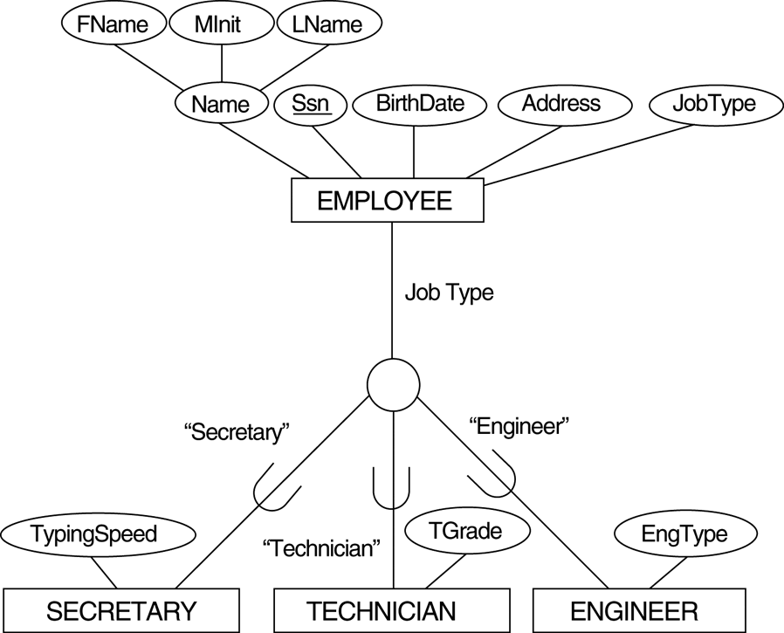
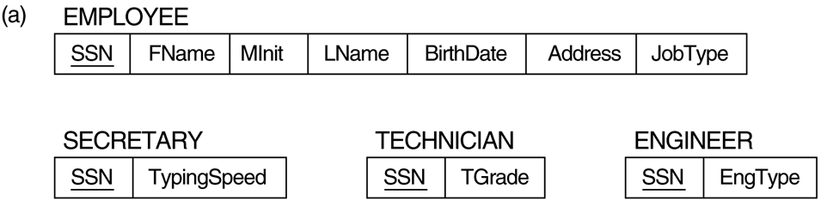
Example - relations- Super-class and subclasses

Slide 34
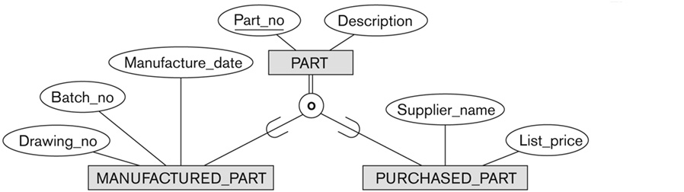
Activity 8
Do the mapping of the following EER using Option A.
Part (Part-no, Description)
Manufactured-part (Part-no, Batch-no, Drawing-no, Manufacture-date)
Purchased-part (Part-no, Supplier-name, List-price)

Slide 35
Mapping EER Model Constructs to Relations
Option B: Multiple relations- Subclass relations only
Create a relation Li for each subclass Si, 1 < i < m, with the attributes Attr(Li) = {attributes of Si} U {k,a1…,an} and PK(Li) = k.
This option only works for a specialization whose subclasses are total (every entity in the superclass must belong to (at least) one of the subclasses).

Slide 36
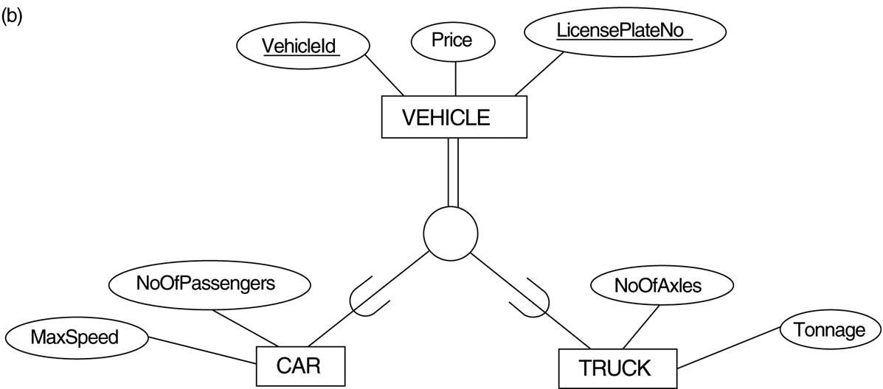
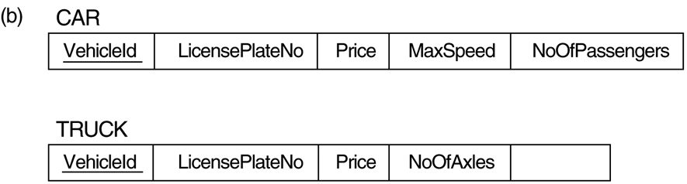
Example - subclass relations only
Tonnage

Slide 37

Activity 9
Do the mapping of the following EER using Option B.

Slide 38
Mapping EER Model Constructs to Relations
Option C: Single relation with one type attribute
Create a single relation L with attributes Attrs(L) = {k,a₁,…a_{n}} U {attributes of S₁} U…U {attributes of S_{m}} U {t} and PK(L) = k.
The attribute t is called a type (or discriminating attribute) that indicates the subclass to which each tuple belongs.

Slide 39
Example: Single relation with one type attribute
EngType

Slide 40

Activity 10
Do the mapping of the following EER using Option C.

Slide 41
Mapping EER Model Constructs to Relations
Option D: Single relation with multiple type attributes
Create a single relation schema L with attributes Attrs(L) = {k,a₁,…a_{n}} U {attributes of S₁} U…U {attributes of S_{m}} U {t₁, t₂,…,t_{m}} and PK(L) = k.
Each t_{i}, 1 < i < m, is a Boolean type attribute indicating whether a tuple belongs to the subclass S_{i}.

Slide 42
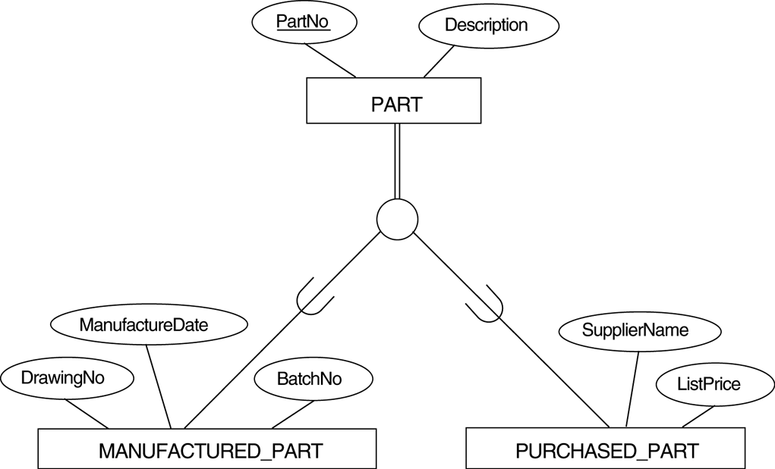
Example: Single relation with multiple type attributes
Boolean type fields: Mflag and Pflag

Slide 43
Mapping EER Model Constructs to Relations (contd.)
Mapping of Shared Subclasses (Multiple Inheritance)
A shared subclass, such as STUDENT_ASSISTANT, is a subclass of several classes, indicating multiple inheritance. These classes must all have the same key attribute; otherwise, the shared subclass would be modeled as a category.
We can apply any of the options discussed in Step 6 to a shared subclass, subject to the restriction discussed in Step 6 of the mapping algorithm. Below both Option C and Option D are used for the shared class STUDENT_ASSISTANT.

Slide 44
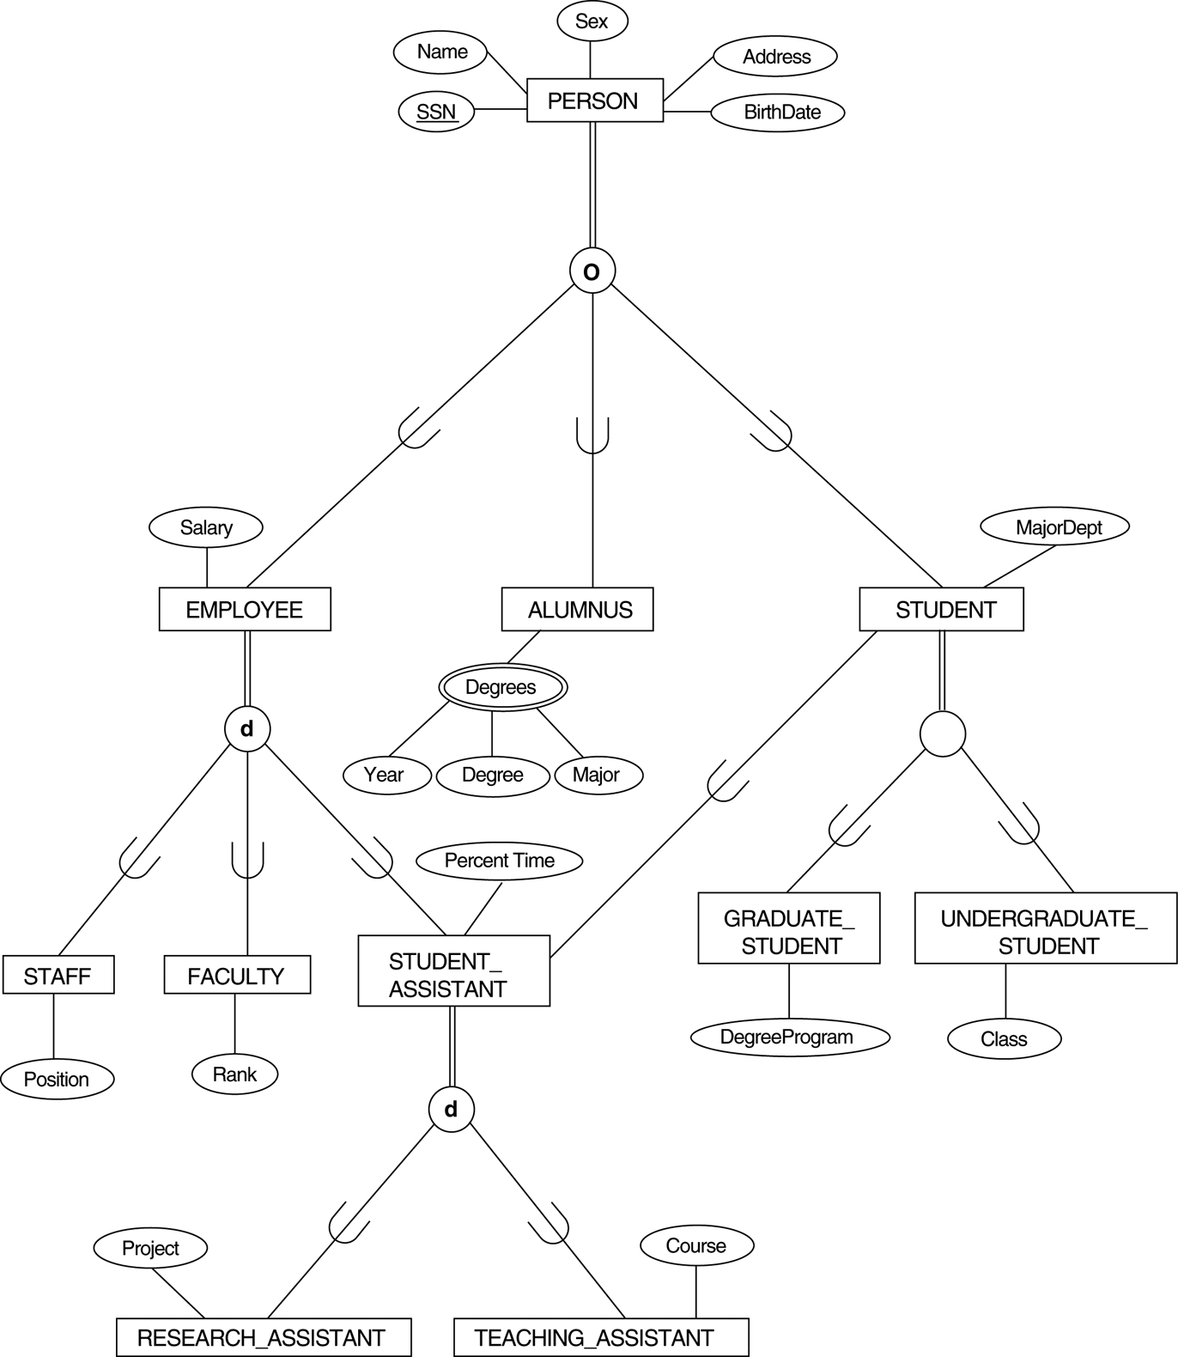
Activity 11​
Mapping the EER specialization lattice using multiple options.
A
C
D
D
D

Slide 45
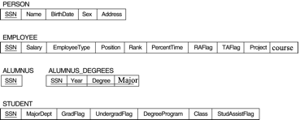
Mapping the EER specialization lattice using multiple options.
A
C
D
D
D

Slide 46
Mapping EER Model Constructs to Relations
Step 7: Mapping of Union Types (Categories).
For mapping a category whose defining superclass have different keys, it is customary to specify a new key attribute, called a surrogate key, when creating a relation to correspond to the category.
In the example below we can create a relation OWNER to correspond to the OWNER category and include any attributes of the category in this relation. The primary key of the OWNER relation is the surrogate key, which we called OwnerId.

Slide 47
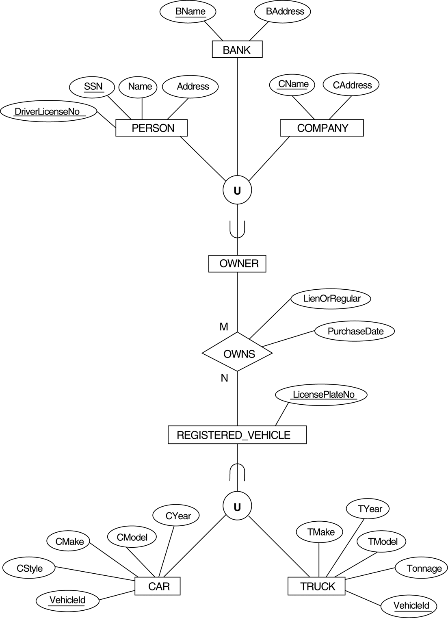
Two categories (union types): OWNER and REGISTERED_VEHICLE

Slide 48
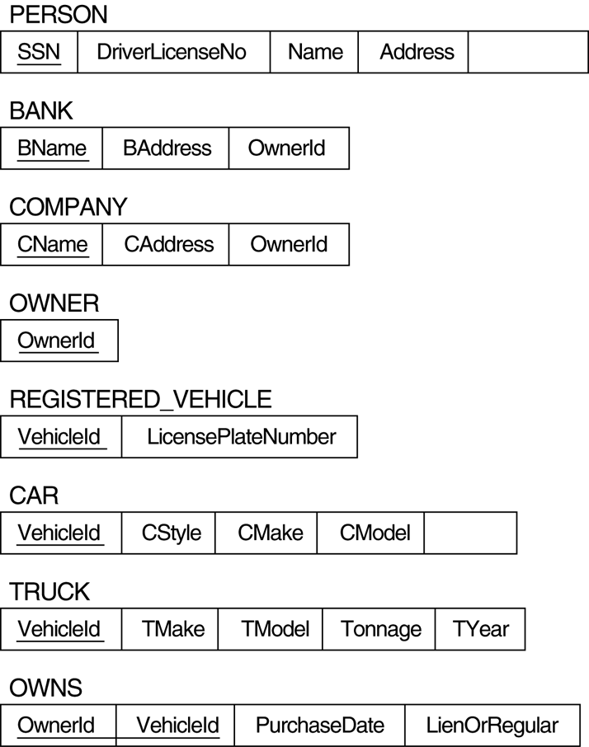
Mapping the EER categories (union types)
OwnerId

Slide 49
Chapter Summary
ERD-to-Relational Mapping Algorithm
Step 1: Mapping of Regular Entity Types
Step 2: Mapping of Multi-valued attributes
Step 3: Mapping of Weak Entity Types
Step 4: Mapping of Binary Relationship Types
Step 5: Mapping of N-ary Relationship Types
Mapping EER Model Constructs to Relations
Step 6: Options for Mapping Specialization or Generalization.
Step 7: Mapping of Union Types (Categories).

