Slide 1
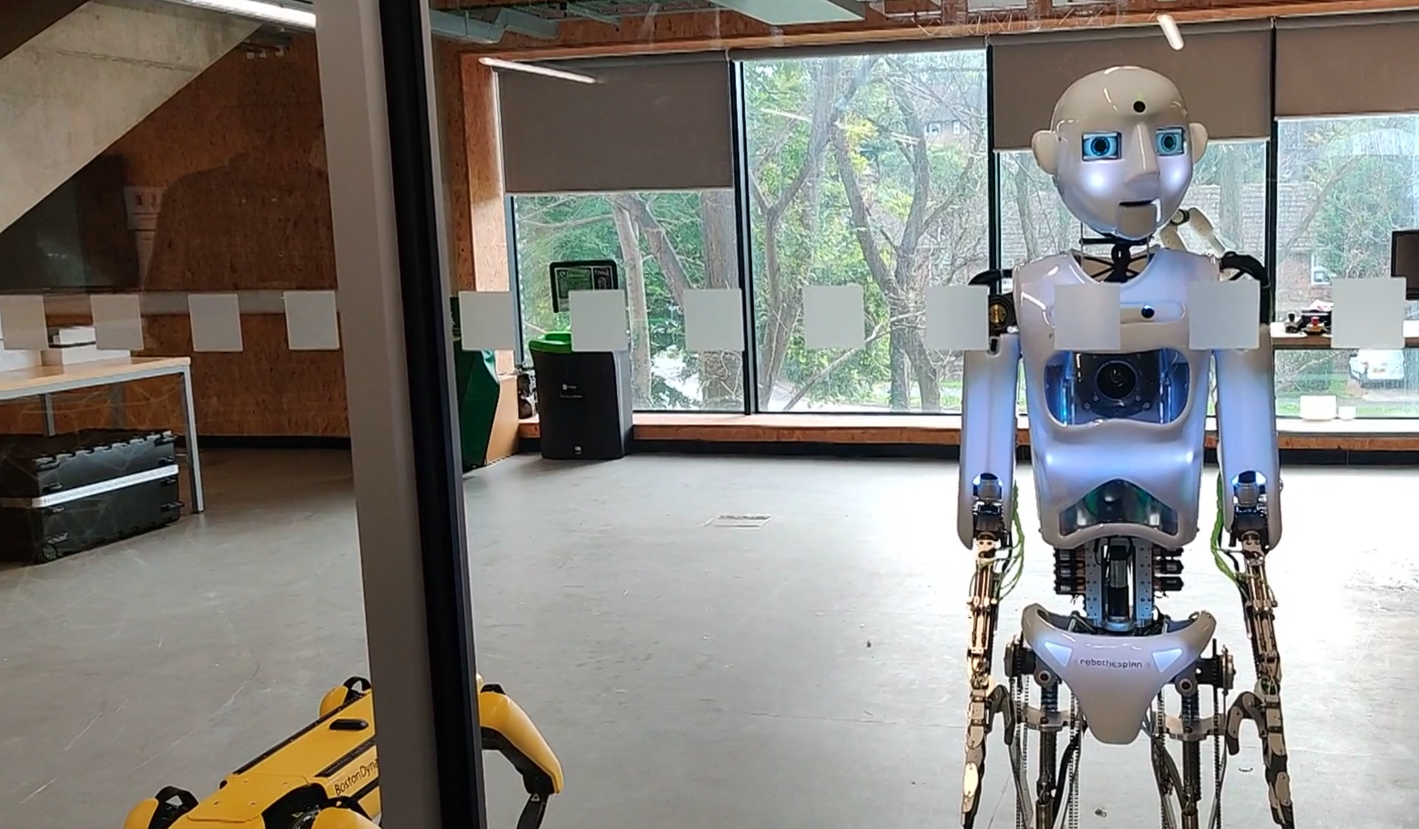
Seamless Human-Robot Interaction (HRI) for Defence Applications
Dr Almas Baimagambetov

Slide 2
Outline
Research Questions (problem)
Motivation (why)
Contribution (what)
Background (what exists)
Solution (how – abstract)
Solution (how – concrete)
Results (prototype so far)
Future Work (what’s next)

Slide 3
Research Questions
RQ1: How to make HRI effective and robust
RQ2: How to make HRI real-time
Effective – functionality
Robust – accuracy
Real-time – performance

Slide 4
Motivation
A wide range of application domains, including defence and healthcare, significantly benefit from this [1-4]
[1] Dautenhahn, K. (2007). Socially intelligent robots: dimensions of human–robot interaction.
[2] Sheridan, T. B. (2016). Human–robot interaction: status and challenges.
[3] Goodrich, M. A., & Schultz, A. C. (2008). Human–robot interaction: a survey.
[4] Hancock, P. A., Billings, D. R., Schaefer, K. E., Chen, J. Y., De Visser, E. J., & Parasuraman, R. (2011). A meta-analysis of factors affecting trust in human-robot interaction

Slide 5
Contribution
A novel approach for natural non-expert-friendly HRI
Based on embedding NLP pre-processing into the HRI pipeline

Slide 6
Background on Controls
Contact-based:
Manual
Remote via a controller
Non-contact-based:
Gesture control
Speech / neuro control
Autonomous control

Slide 7
Solution (Theory)
Begin ->
* Speech-to-Text ->
* Text-grammar generation ->
* NLP & Input Normalisation ->
* Language Model ->
* Post-process on Robot ->
* Text-to-Speech -> End
High-level overview of the theoretical approach

Slide 8
Solution (Implementation)
Begin ->
* OS Speech Recognition (JavaScript) ->
* Grammy TGG (Kotlin) ->
* NLP (Python) & Pre-process (Java) ->
* OpenAI Language Model (REST API) ->
* Robot Functionality (Python) -> End
High-level overview of the implementation approach

Slide 9
Results (Outcome so far)
A brief video demonstration of preliminary results:
https://youtu.be/Oab_f7WyBYI?t=36

Slide 10
Future Work
Refine language model
Consider gesture control
Generalise to other devices

Slide 11
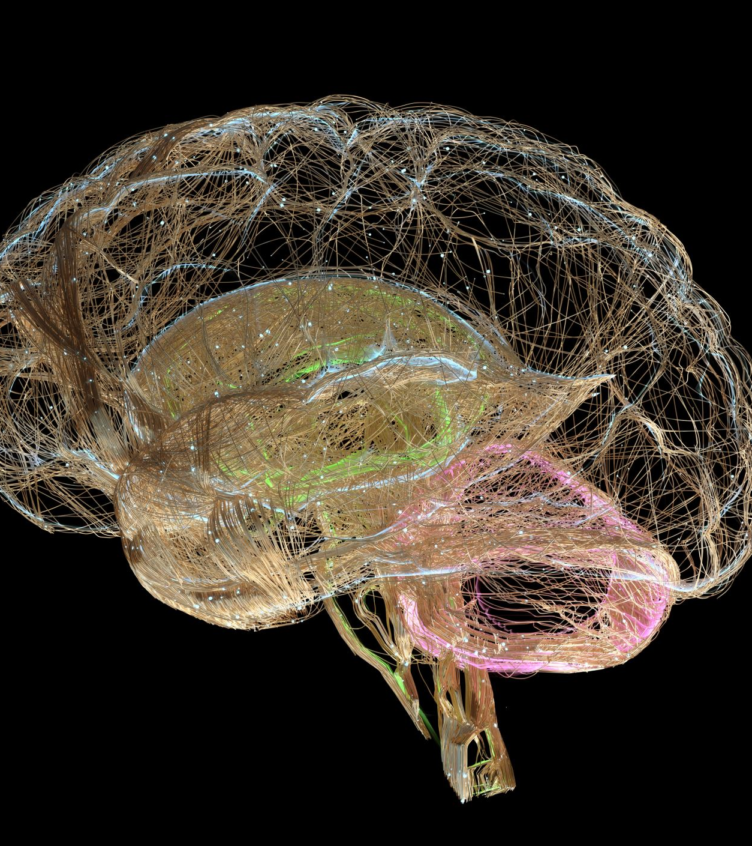
Brain-Computer Interfaces (BCI) for Defence Applications
Dr M. Tariq Sadiq

Slide 12
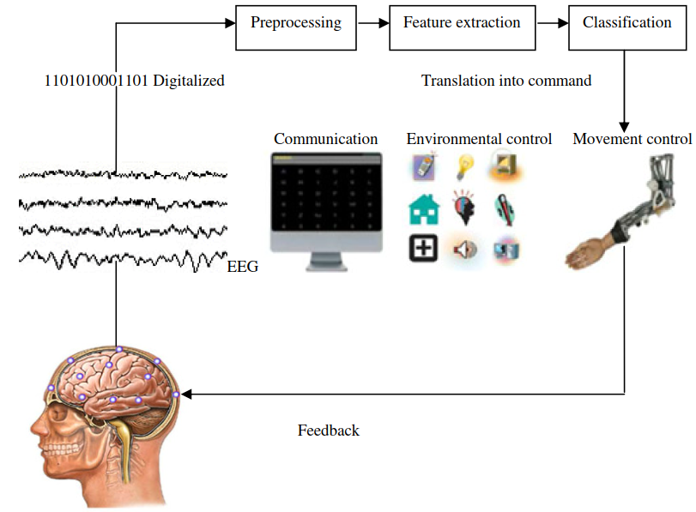
BCI Overview

Slide 13
BCI could allow soldiers to control weapons with their thoughts An injected tiny computer device could suppress their fear and anxiety, allowing them to carry out combat missions more efficiently

Slide 14
BCI could allow soldiers to communicate with each other and with the unit commander This form of direct three-way communication would enable real-time updates and more rapid responses to threats.

Slide 15
Questions Ethical Considerations

