Slide 1
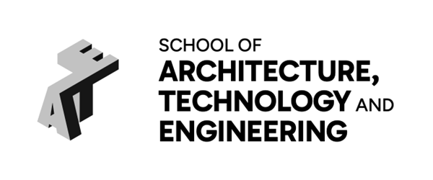

Use of AI in School ATE
Empowering with Efficiency and Effectiveness
Dr Almas Baim
Computing and Maths Subject Lead

Slide 2
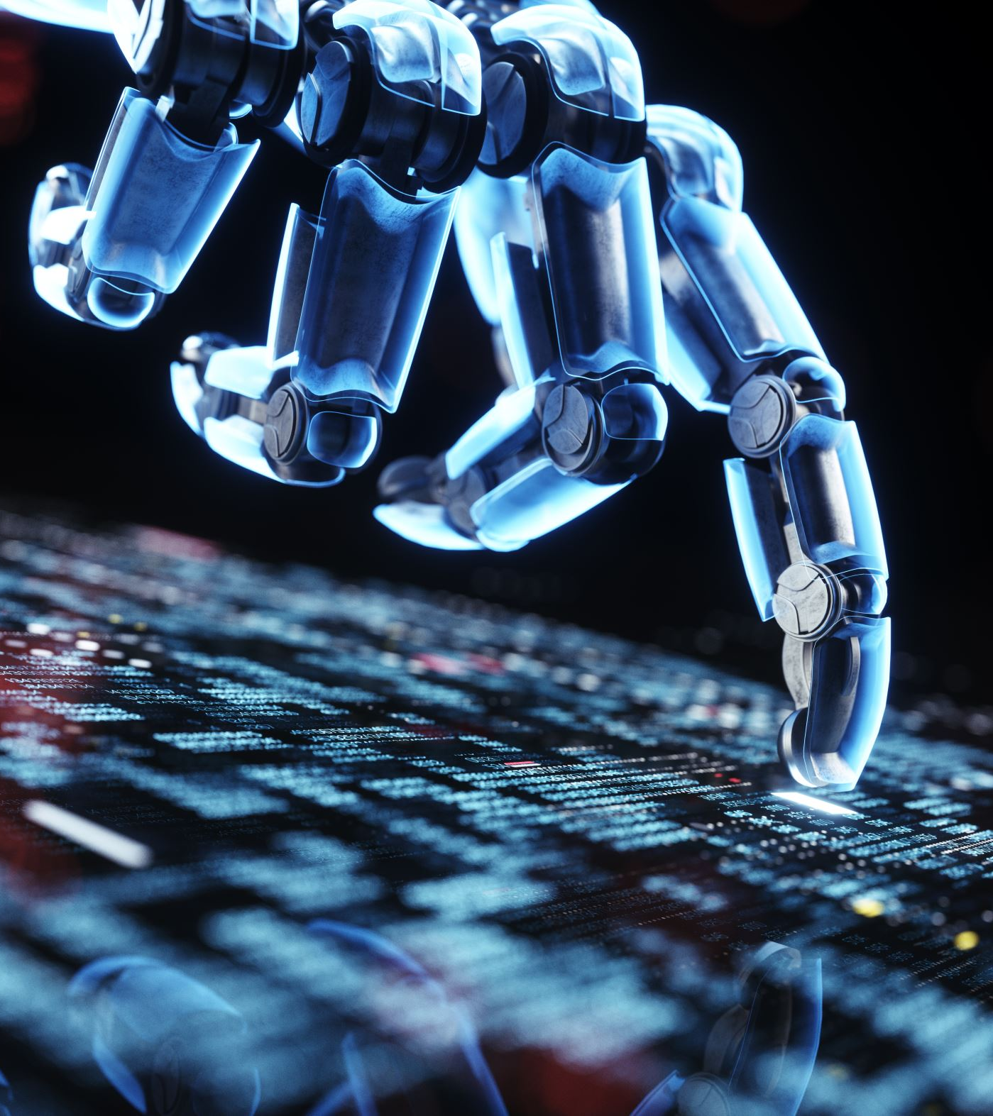
Overview
What is Artificial Intelligence (AI)?
Why is AI important?
What does AI look like in practice?
How can AI help at work?
AI in ATE roadmap
Q&A

Slide 3
Introduction
What is AI?
In this talk, AI definition is broader. We define it as the ability of a computing device to make informed decisions (by simulating human intelligence).

Slide 4
Importance of AI
Productivity
(do things in parallel)
Effectiveness
(do things more accurately)
Efficiency
(do things quicker)

Slide 5

Examples of AI (General)
Media (audio, image, video) generation
Text (presentation, talk, seminar, novel, essay) generation
Brainstorming ideas, translating content
Writing code (in specific contexts)
Powering smart devices and homes
Data analysis, pattern recognition, trend prediction
… and many more

Slide 6
Examples of AI (in ATE)
Exam Board paperwork automation
Timetable data generation
Workload data export
External Examiner folders automation
Missing mandatory training reminders
(in development) Annual leave reminders
(in development) Student information desks
Exam workflow automation
(in development) HR query processing

Slide 7
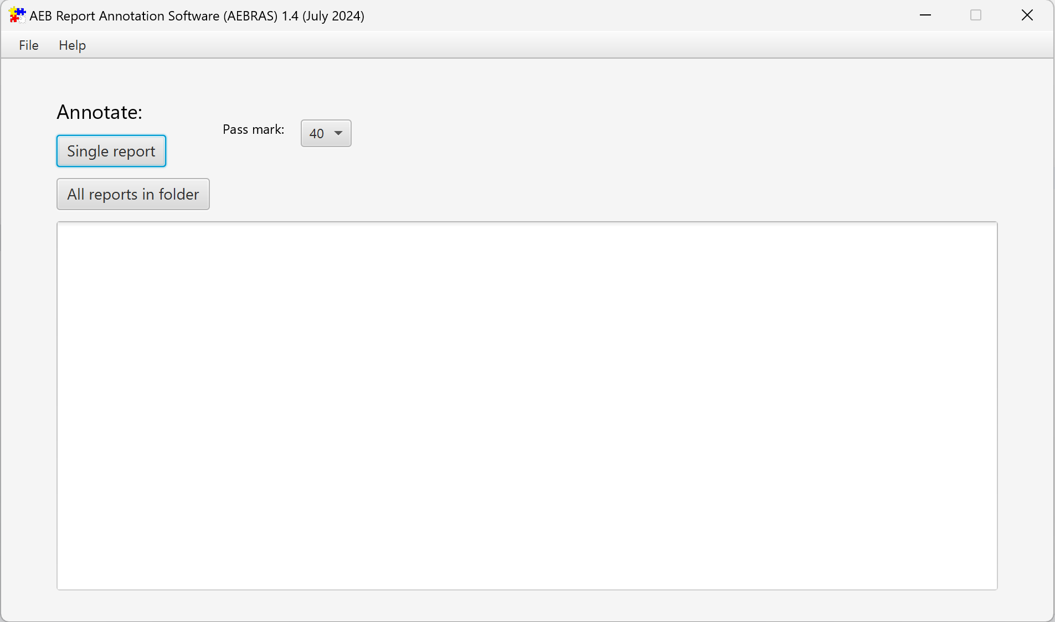
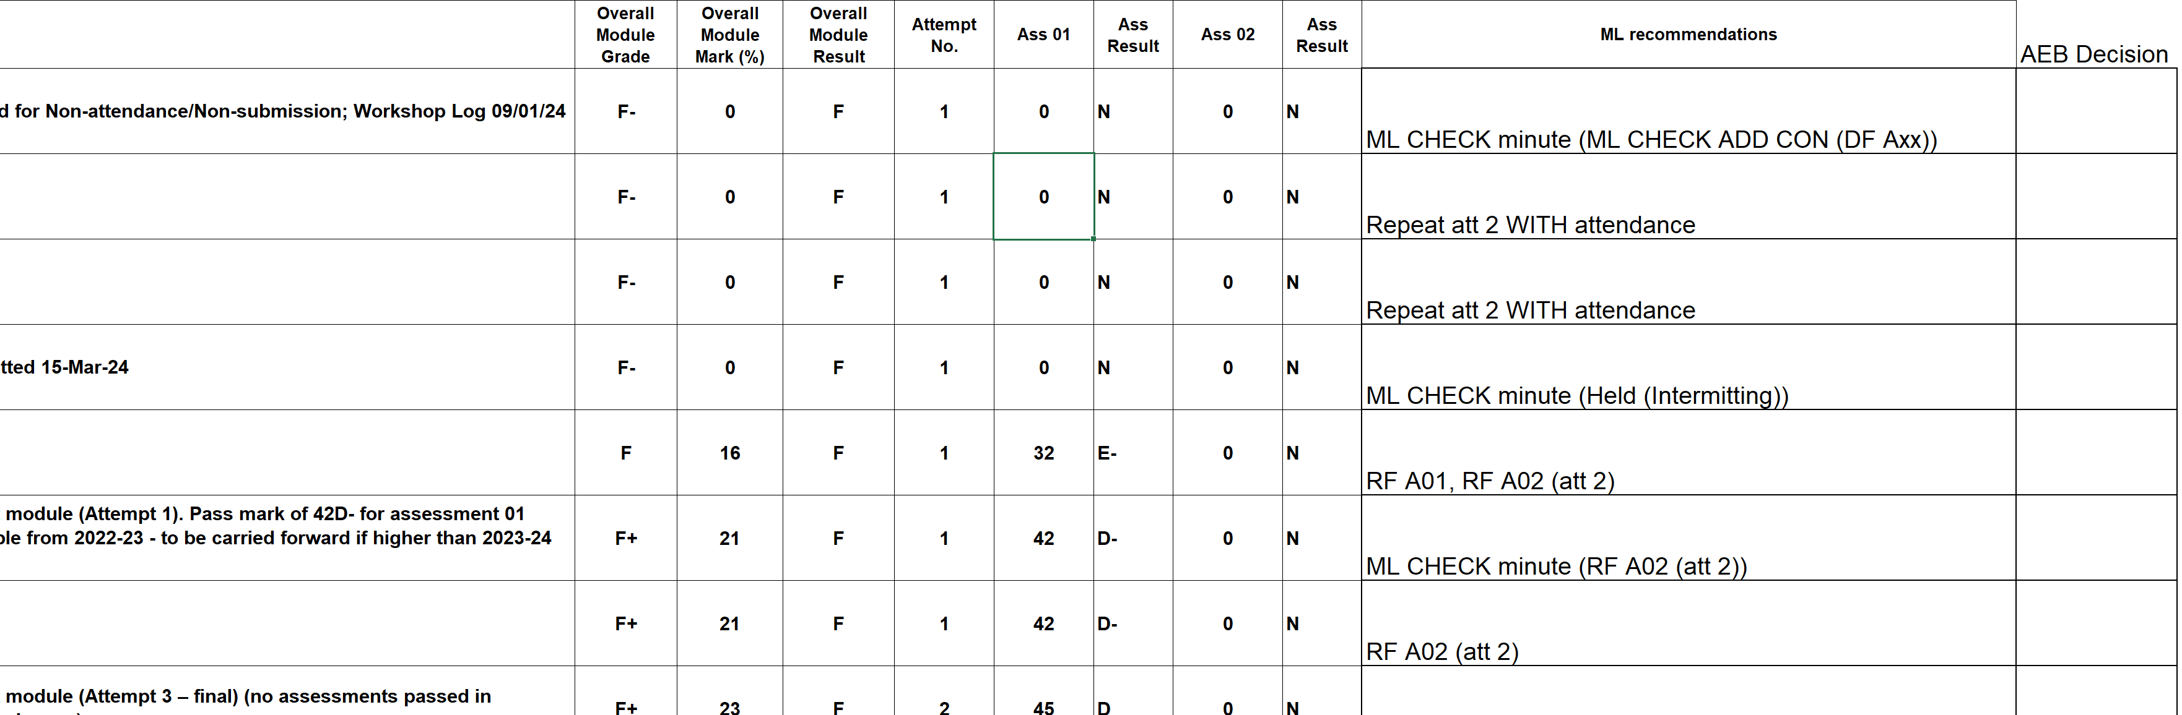
Examples (AEBRAS)

Slide 8
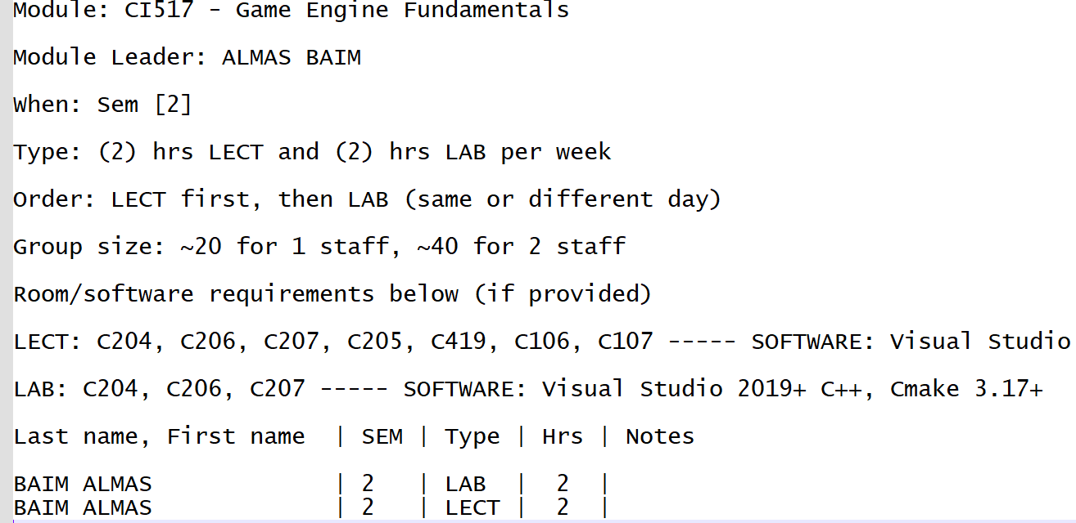
Examples (Timetabling)

Slide 9
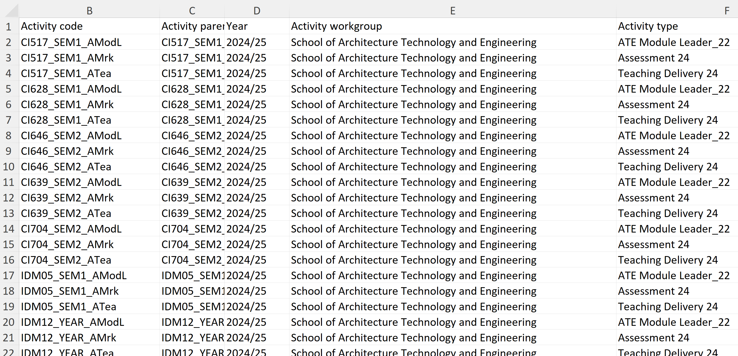
Examples (WAMS)

Slide 10
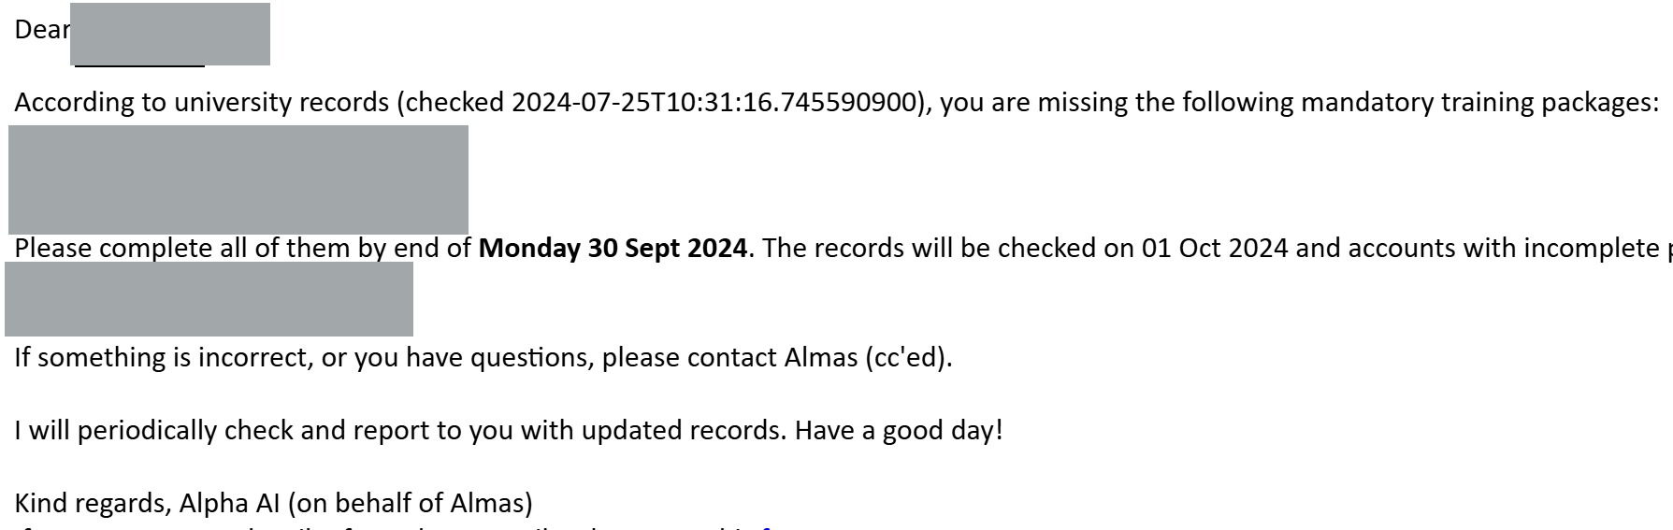
Examples (Mandatory Training)

Slide 11
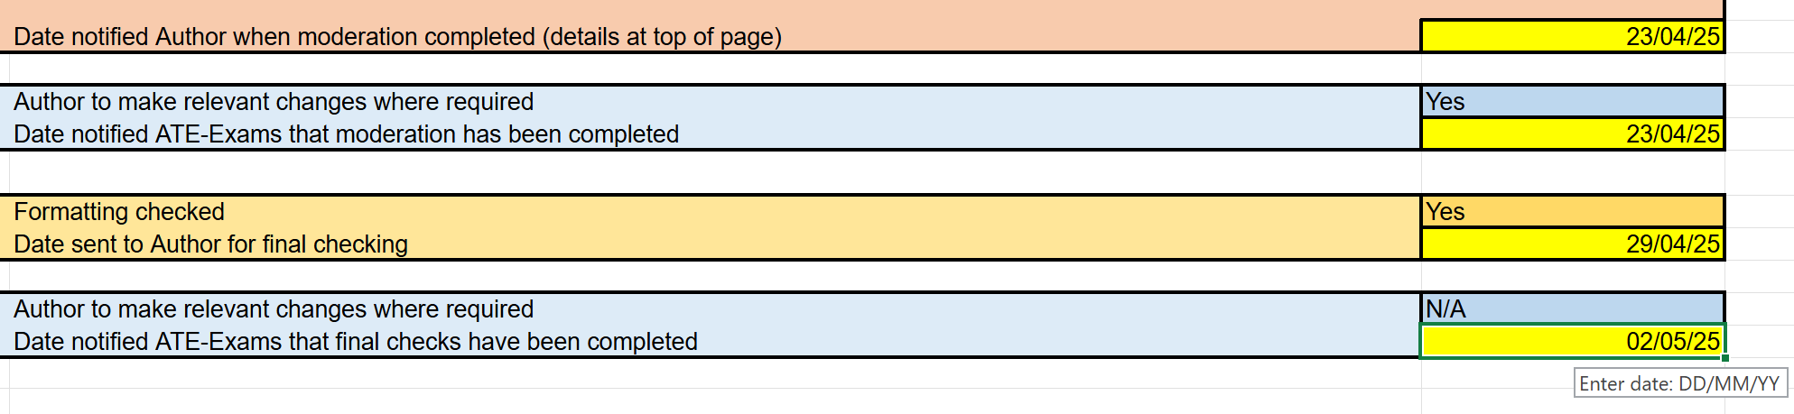
Examples (Exam Workflow)

Slide 12
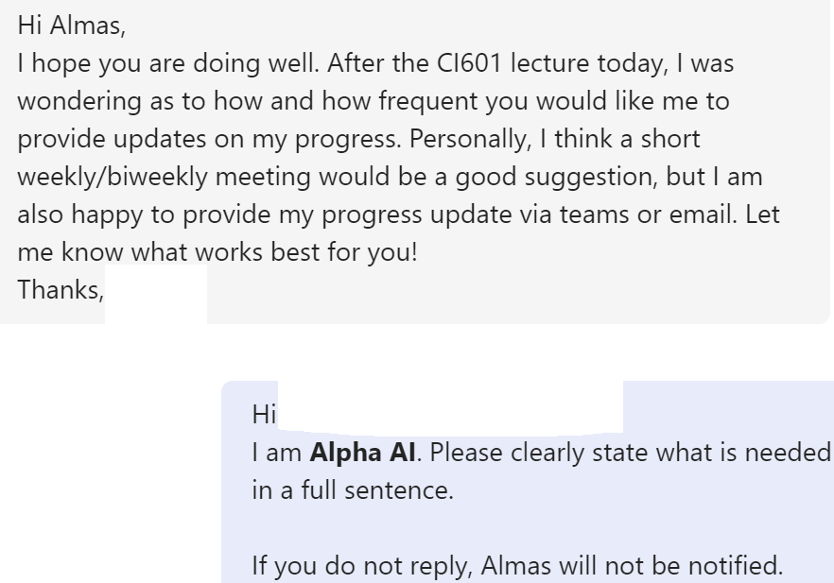
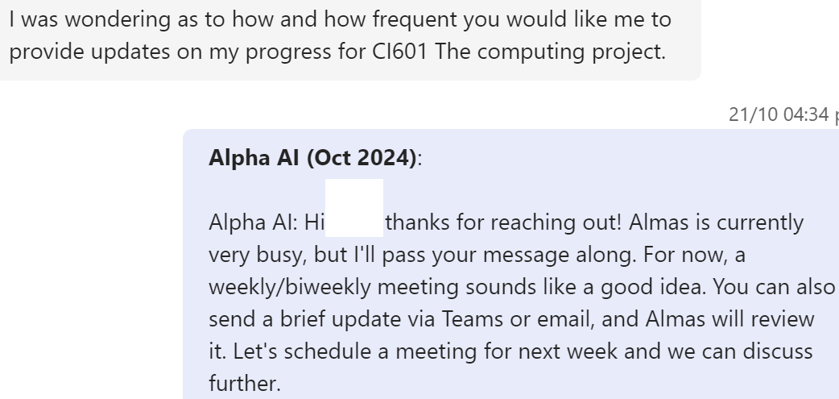
Examples (Personal Assistant Alpha AI)

Slide 13
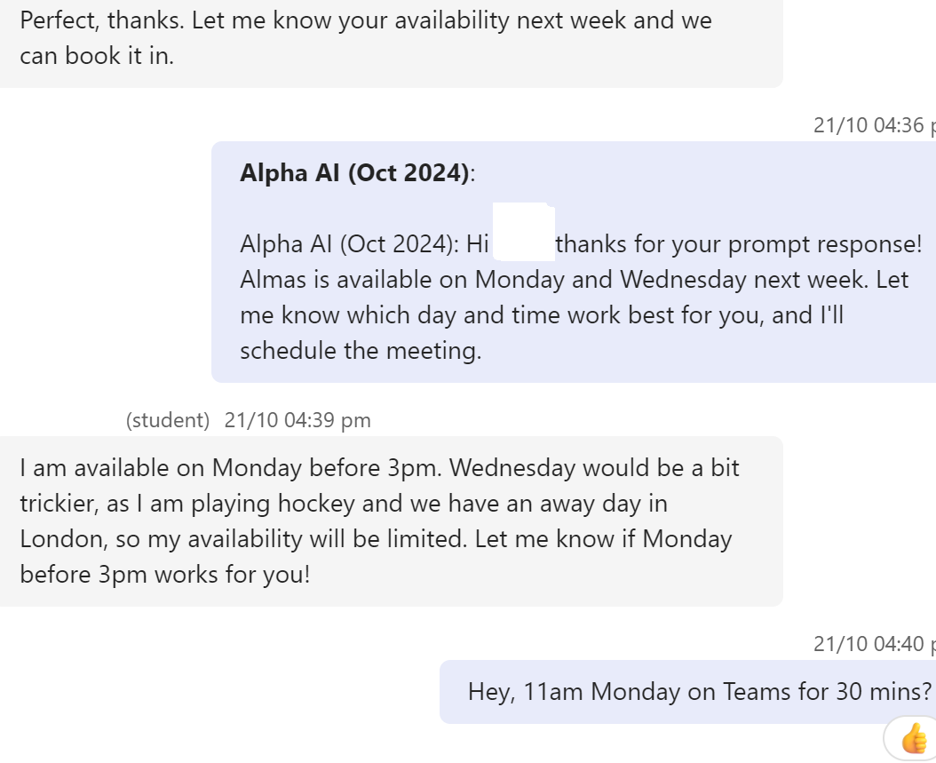
Examples (Personal Assistant Alpha AI)
Only 1 user response, the rest is resolved by AI

Slide 14
Exercise
Can you think of repetitive tasks in your area where AI can be used?
Sorting files
Data entry and/or migration
Sending links to guidance and/or FAQ documents
Emailing induction steps to new colleagues

Slide 15

Alpha AI
Live Demo

Slide 16
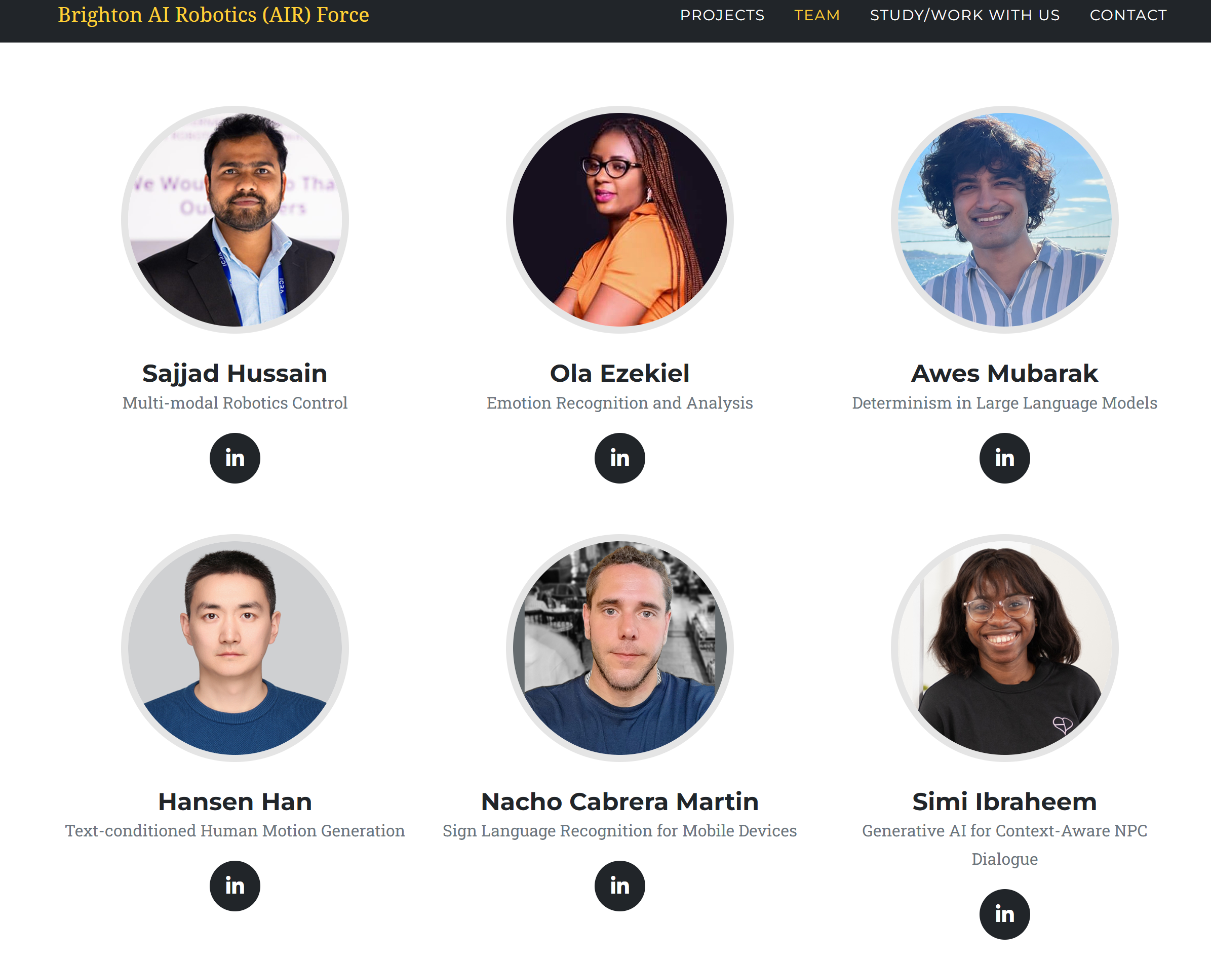


ATE AI
Roadmap
Establish and nurture sustainable research environments
Automate workflows
and processes
Empower colleagues through technology
and innovation

Slide 17
Thank you
Questions & Answers
Can AI learn by itself to send emails, control my devices, use my data?
Will AI replace my job?
How can I use AI in my work?
Does AI think?

