Slide 1
HAPPIEST HEALTH • DIGITAL TWIN CHALLENGE 2026
TwinPulse
A Dynamic Digital Twin for
Cardiovascular Event Risk Research
A research-oriented proof of concept for hypertensive-patient state tracking and exploratory risk modelling.
TEAM TWINPULSE
Almas Banu — Sri Venkateshwara College of Engineering, Bengaluru
Ansu Kumar — GITAM Deemed to be University, Bengaluru
Research prototype • Not clinically validated

Slide 2
01 • PROBLEM
A patient's risk is not a static snapshot
TwinPulse explores how historical clinical context and changing physiology could be represented together.
STATIC VIEW
DYNAMIC SIGNAL
DECISION SUPPORT
Clinical history and measurements provide baseline context but may not capture every physiological change.
ECG-derived RR intervals and HRV describe cardiac rhythm variability when signal quality is adequate.
A Digital Twin can organize patient state, derived features and experimental model output in a doctor-facing view.
Project question
Can a software-based patient representation combine historical clinical data with physiological observations to support research into cardiovascular/cerebrovascular event risk?
TWINPULSE • DIGITAL TWIN CHALLENGE 2026
02

Slide 3
02 • PROPOSED SOLUTION
TwinPulse: a patient-state workflow
The Digital Twin state engine and ML predictor are separate components.
Historical
clinical data
Physiological
observations
Processing &
features
Digital Twin
state
Dashboard &
model output
Demographics BP
→
ECG / RR / HRV
→
Quality • extraction
→
Patient context
→
State • score
Implementation status: simulated physiological updates change the Digital Twin state, but do not currently alter the ML prediction. Full physiological-to-prediction fusion remains future work.
TWINPULSE • DIGITAL TWIN CHALLENGE 2026
03

Slide 4
03 • DIGITAL TWIN
What the virtual patient represents
A maintained software state—not a physical replica or a medical device.
HISTORICAL STATE
OBSERVED STATE
RISK STATE
Demographics
Blood pressure and clinical measurements
Baseline context
Physiological observation concept
RR/HRV summary when available
Recent state changes
Exploratory model output
Input context and model version
Visible uncertainty
Design principle: keep the twin state, signal processing and ML model separate so each can be tested independently.
TWINPULSE • DIGITAL TWIN CHALLENGE 2026
04

Slide 5
04 • DATA
SHAREE: useful but constrained research data
Dataset coverage and signal quality limit what can responsibly be concluded.
COHORT
PHYSIOLOGY
LOCAL AVAILABILITY
139 hypertensive patients
17 recorded vascular-event labels
122 without a recorded event
Approx. 24-hour, 3-channel ECG
128 Hz sampling
Automated QRS annotations are unaudited
25 ECG signal files (.dat) in current local subset
Signal coverage is incomplete
Quality caveat
The signal subset is small and labels are imbalanced. Automated annotations and suspicious RR intervals require review; this affects HRV reliability and generalization.
TWINPULSE • DIGITAL TWIN CHALLENGE 2026
05

Slide 6
05 • ARCHITECTURE
How the components fit together
Conceptual architecture of the current prototype and intended extension.
Clinical input
Validation
ML predictor
Patient-level features
→
Patient-level splits
→
Clinical features today
Twin engine
Maintain patient state
→
ECG subset
Feature pipeline
Web dashboard
RR / HRV pipeline
→
Filter / derive / inspect
→
State + output
Current gap: physiological features are explored offline; they are not yet wired into the live predictor interface.
TWINPULSE • DIGITAL TWIN CHALLENGE 2026
06

Slide 7
06 • ML METHODOLOGY
Exploratory baseline modelling
A transparent baseline is preferable to overstating performance from a tiny subset.
MODEL
FEATURES
VALIDATION
Logistic Regression
Class-weighted baseline
Seeded evaluation
Clinical: age, BMI, SBP, DBP, IMT, LVMI, EF, gender, smoker
HRV extension evaluated offline
4-fold stratified CV on 25-record subset
Preprocessing within folds
Small, imbalanced sample
The current output is an exploratory score, not a calibrated clinical probability. Outcome and horizon definitions must follow verified dataset documentation.
TWINPULSE • DIGITAL TWIN CHALLENGE 2026
07

Slide 8
07 • EVALUATION
Results: no evidence of useful discrimination yet
4-fold stratified cross-validation on the current 25-record subset; preliminary research results.
Metric | Clinical-only | Clinical + HRV | Interpretation
Precision | 0.6875 | 0.6667 | Similar; subset-dependent
Recall | 0.6471 | 0.5882 | Lower with HRV
ROC-AUC | 0.4118 | 0.4191 | Both below 0.5
Conclusion: HRV did not improve observed precision, recall, F1 or average precision in this run. The sample is too small to support reliable individual event prediction.
TWINPULSE • DIGITAL TWIN CHALLENGE 2026
08

Slide 9
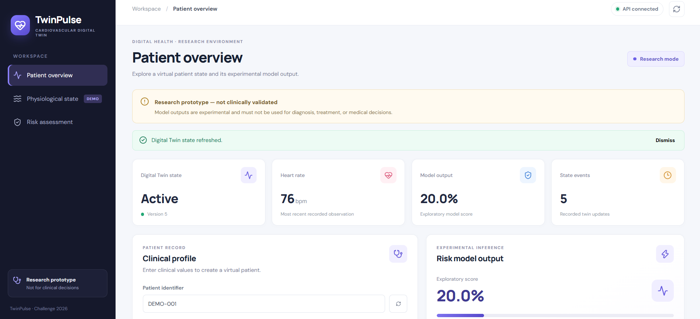
08 • DASHBOARD DEMONSTRATION
Patient overview
Actual app view: API connection, research warning, patient summary and exploratory model output.
TWINPULSE • DIGITAL TWIN CHALLENGE 2026
09

Slide 10
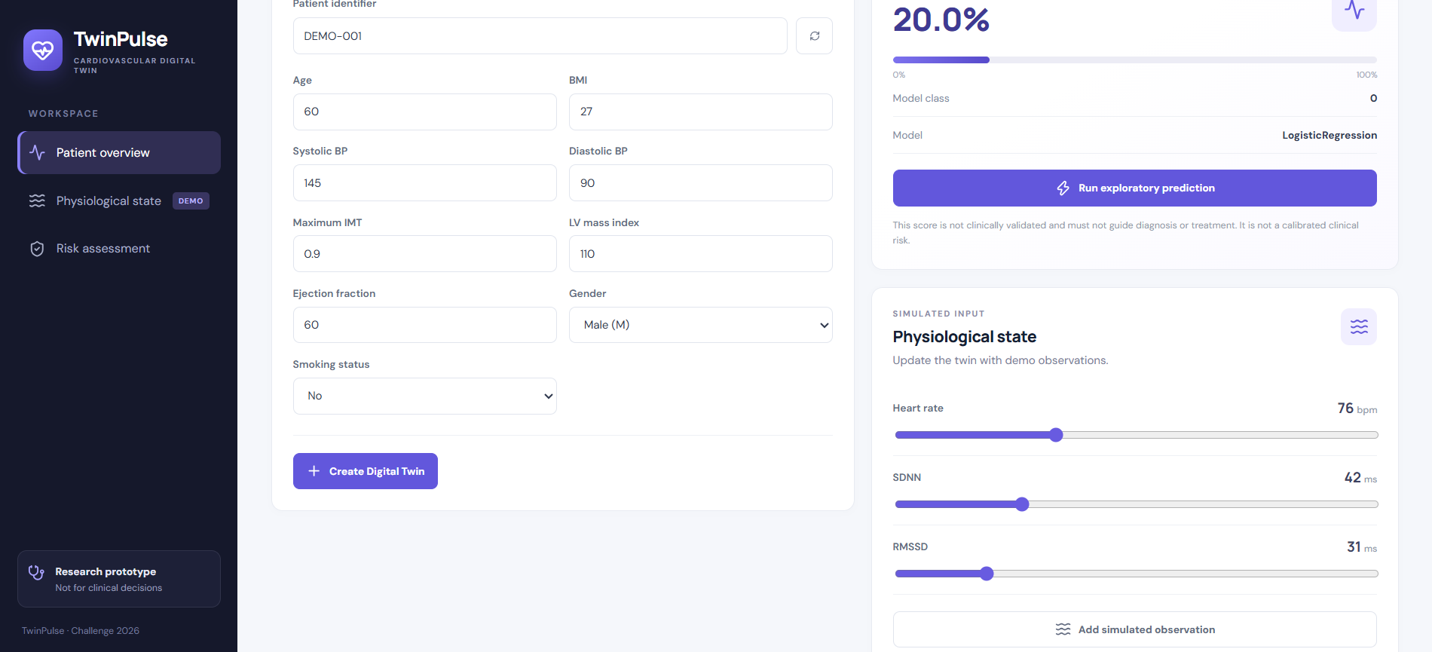
08 • DASHBOARD DEMONSTRATION
Clinical profile and simulated observations
The prototype accepts clinical values and lets the user add demonstration physiological observations.
TWINPULSE • DIGITAL TWIN CHALLENGE 2026
10

Slide 11
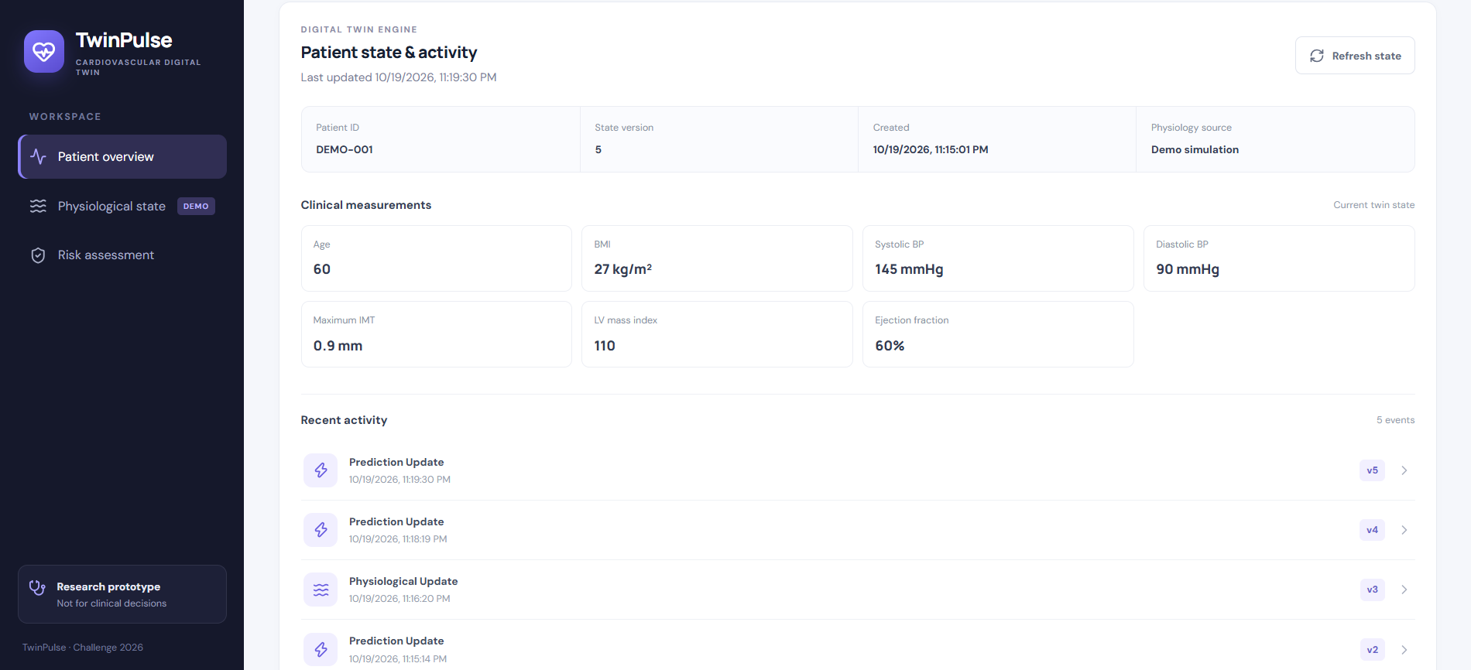
08 • DASHBOARD DEMONSTRATION
Patient state and activity history
Actual app view: twin version, clinical measurements, physiology source and recent state/prediction events.
TWINPULSE • DIGITAL TWIN CHALLENGE 2026
11

Slide 12
09 • FINDINGS & LIMITATIONS
What the prototype demonstrates—and what it does not
The contribution is a transparent research workflow with clearly stated gaps.
DEMONSTRATED
NOT YET DEMONSTRATED
NEXT STEPS
API-connected dashboard
Clinical profile and twin state
State event history
Live ECG replay into app
Physiology affecting ML output
Clinical-grade risk estimate
Review signal quality
Connect validated features
Patient-level evaluation and expert review
Research limitations
• Only 25 ECG signal files are available in the current local subset.
• Automated QRS annotations and suspicious RR intervals need quality review.
• Small, imbalanced data limits reliability and generalization.
• The exploratory score is not calibrated; the system is not clinically validated.
TwinPulse is an educational/research prototype—not for diagnosis, treatment, or clinical decisions.
TWINPULSE • DIGITAL TWIN CHALLENGE 2026
12

Slide 13
10 • CLOSING
TwinPulse: build the twin, validate the evidence
A research proof of concept for dynamic patient-state representation in hypertension.
Key takeaway
A Digital Twin needs maintained patient state, traceable inputs, and validated links between observations and model outputs.
TEAM TWINPULSE
GitHub:
https://github.com/AlmasBanu1/TwinPulse
Thank you
Research prototype only. Not for diagnosis, treatment, or clinical decisions.
TWINPULSE • DIGITAL TWIN CHALLENGE 2026
13

