Slide 1


Python essentials for MLOps

Slide 2
Сontent
Overview of Python Libraries for Data Scientists
Reading Data; Selecting and Filtering the Data; Data manipulation, sorting, grouping, rearranging
Plotting the data
Descriptive statistics
Inferential statistics

Slide 3
Python Libraries for Data Science
Many popular Python toolboxes/libraries:
  NumPy
  SciPy
  Pandas
  SciKit-Learn
Visualization libraries
  matplotlib
  Seaborn
  and many more …
All these libraries are installed on the SCC

Slide 4

Python Libraries for Data Science
NumPy:
  introduces objects for multidimensional arrays and matrices, as well as functions that allow to easily perform advanced mathematical and statistical operations on those objects
  provides vectorization of mathematical operations on arrays and matrices which significantly improves the performance
  many other python libraries are built on NumPy
Link: http://www.numpy.org/

Slide 5

Python Libraries for Data Science
SciPy:
  collection of algorithms for linear algebra, differential equations, numerical integration, optimization, statistics and more
  part of SciPy Stack
  built on NumPy
Link: https://www.scipy.org/scipylib/

Slide 6
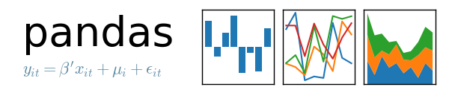
Python Libraries for Data Science
Pandas:
  adds data structures and tools designed to work with table-like data (similar to Series and Data Frames in R)
  provides tools for data manipulation: reshaping, merging, sorting, slicing, aggregation etc.
  allows handling missing data
Link: http://pandas.pydata.org/

Slide 7

Python Libraries for Data Science
SciKit-Learn:
  provides machine learning algorithms: classification, regression, clustering, model validation etc.
  built on NumPy, SciPy and matplotlib
Link: http://scikit-learn.org/

Slide 8

Python Libraries for Data Science
matplotlib:
  python 2D plotting library which produces publication quality figures in a variety of hardcopy formats
  a set of functionalities similar to those of MATLAB
  line plots, scatter plots, barcharts, histograms, pie charts etc.
  relatively low-level; some effort needed to create advanced visualization
Link: https://matplotlib.org/

Slide 9
Python Libraries for Data Science
Seaborn:
  based on matplotlib
  provides high level interface for drawing attractive statistical graphics
  Similar (in style) to the popular ggplot2 library in R
Link: https://seaborn.pydata.org/

Slide 10
Loading Python Libraries
In [ ]:
#Import Python Libraries
import numpy as np
import scipy as sp
import pandas as pd
import matplotlib as mpl
import seaborn as sns

Slide 11
Reading data using pandas
In [ ]:
#Read csv file
df = pd.read_csv("http://rcs.bu.edu/examples/python/data_analysis/Salaries.csv")
Note: The above command has many optional arguments to fine-tune the data import process.
There is a number of pandas commands to read other data formats:
pd.read_excel('myfile.xlsx',sheet_name='Sheet1', index_col=None, na_values=['NA'])
pd.read_stata('myfile.dta')
pd.read_sas('myfile.sas7bdat')
pd.read_hdf('myfile.h5','df')

Slide 12
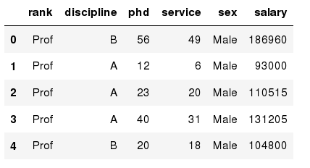
Exploring data frames
In [3]:
#List first 5 records
df.head()
Out[3]:

Slide 13

Hands-on exercises
Try to read the first 10, 20, 50 records;
Can you guess how to view the last few records; Hint:

Slide 14
Data Frame data types
Pandas Type | Native Python Type | Description
object | string | The most general dtype. Will be assigned to your column if column has mixed types (numbers and strings).
int64 | int | Numeric characters. 64 refers to the memory allocated to hold this character.
float64 | float | Numeric characters with decimals. If a column contains numbers and NaNs(see below), pandas will default to float64, in case your missing value has a decimal.
datetime64, timedelta[ns] | N/A (but see the datetime module in Python’s standard library) | Values meant to hold time data. Look into these for time series experiments.

Slide 15
Data Frame data types
In [4]:
#Check a particular column type
df['salary'].dtype
Out[4]: dtype('int64')
In [5]:
#Check types for all the columns
df.dtypes
Out[4]:
object
object
int64
int64
object
int64
rank
discipline
phd
service
sex
salary
dtype: object

Slide 16
Data Frames attributes
Python objects have attributes and methods.
df.attribute | description
dtypes | list the types of the columns
columns | list the column names
axes | list the row labels and column names
ndim | number of dimensions
size | number of elements
shape | return a tuple representing the dimensionality
values | numpy representation of the data

Slide 17
Hands-on exercises
Find how many records this data frame has;
How many elements are there?
What are the column names?
What types of columns we have in this data frame?

Slide 18
Data Frames methods
Unlike attributes, python methods have parenthesis.
All attributes and methods can be listed with a dir() function: dir(df)
df.method() | description
head( [n] ), tail( [n] ) | first/last n rows
describe() | generate descriptive statistics (for numeric columns only)
max(), min() | return max/min values for all numeric columns
mean(), median() | return mean/median values for all numeric columns
std() | standard deviation
sample([n]) | returns a random sample of the data frame
dropna() | drop all the records with missing values

Slide 19
Hands-on exercises
Give the summary for the numeric columns in the dataset
Calculate standard deviation for all numeric columns;
What are the mean values of the first 50 records in the dataset? Hint: use head() method to subset the first 50 records and then calculate the mean

Slide 20
Selecting a column in a Data Frame
Method 1: Subset the data frame using column name:
df['sex']
Method 2: Use the column name as an attribute:
df.sex
Note: there is an attribute rank for pandas data frames, so to select a column with a name "rank" we should use method 1.

Slide 21
Hands-on exercises
Calculate the basic statistics for the salary column;
Find how many values in the salary column (use count method);
Calculate the average salary;

Slide 22
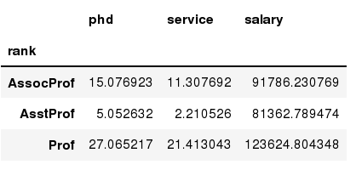
Data Frames groupby method
Using "group by" method we can:
  Split the data into groups based on some criteria
  Calculate statistics (or apply a function) to each group
  Similar to dplyr() function in R
In [ ]:
#Group data using rank
df_rank = df.groupby(['rank'])
In [ ]:
#Calculate mean value for each numeric column per each group
df_rank.mean()

Slide 23
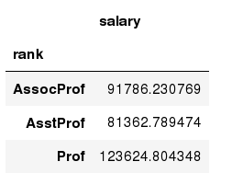
Data Frames groupby method
Once groupby object is create we can calculate various statistics for each group:
In [ ]:
#Calculate mean salary for each professor rank:
df.groupby('rank')[['salary']].mean()
Note: If single brackets are used to specify the column (e.g. salary), then the output is Pandas Series object. When double brackets are used the output is a Data Frame

Slide 24
Data Frames groupby method
groupby performance notes:
  - no grouping/splitting occurs until it's needed. Creating the groupby object only verifies that you have passed a valid mapping
  - by default the group keys are sorted during the groupby operation. You may want to pass sort=False for potential speedup:
In [ ]:
#Calculate mean salary for each professor rank:
df.groupby(['rank'], sort=False)[['salary']].mean()

Slide 25
Data Frame: filtering
To subset the data we can apply Boolean indexing. This indexing is commonly known as a filter. For example if we want to subset the rows in which the salary value is greater than $120K:
In [ ]:
#Calculate mean salary for each professor rank:
df_sub = df[ df['salary'] > 120000 ]
Any Boolean operator can be used to subset the data:
> greater; >= greater or equal;
< less; <= less or equal;
== equal; != not equal;
In [ ]:
#Select only those rows that contain female professors:
df_f = df[ df['sex'] == 'Female' ]

Slide 26
Data Frames: Slicing
There are a number of ways to subset the Data Frame:
  one or more columns
  one or more rows
  a subset of rows and columns
  Rows and columns can be selected by their position or label

Slide 27
Data Frames: Slicing
When selecting one column, it is possible to use single set of brackets, but the resulting object will be a Series (not a DataFrame):
In [ ]:
#Select column salary:
df['salary']
When we need to select more than one column and/or make the output to be a DataFrame, we should use double brackets:
In [ ]:
#Select column salary:
df[['rank','salary']]

Slide 28
Data Frames: Selecting rows
If we need to select a range of rows, we can specify the range using ":"
In [ ]:
#Select rows by their position:
df[10:20]
Notice that the first row has a position 0, and the last value in the range is omitted:
So for 0:10 range the first 10 rows are returned with the positions starting with 0 and ending with 9

Slide 29
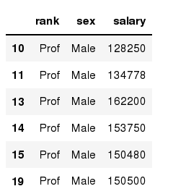
Data Frames: method loc
If we need to select a range of rows, using their labels we can use method loc:
In [ ]:
#Select rows by their labels:
df_sub.loc[10:20,['rank','sex','salary']]
Out[ ]:

Slide 30
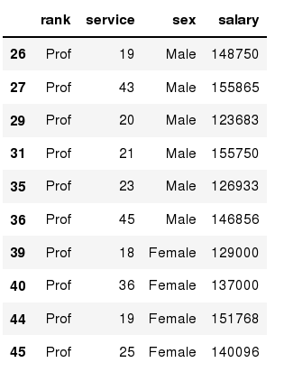
Data Frames: method iloc
If we need to select a range of rows and/or columns, using their positions we can use method iloc:
In [ ]:
#Select rows by their labels:
df_sub.iloc[10:20,[0, 3, 4, 5]]
Out[ ]:

Slide 31
Data Frames: method iloc (summary)
df.iloc[0] # First row of a data frame
df.iloc[i] #(i+1)th row
df.iloc[-1] # Last row
df.iloc[:, 0] # First column
df.iloc[:, -1] # Last column
df.iloc[0:7] #First 7 rows
df.iloc[:, 0:2] #First 2 columns
df.iloc[1:3, 0:2] #Second through third rows and first 2 columns
df.iloc[[0,5], [1,3]] #1st and 6th rows and 2nd and 4th columns

Slide 32
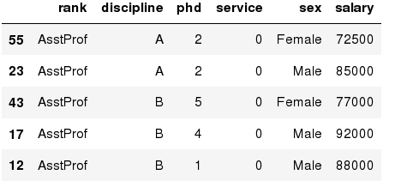
Data Frames: Sorting
We can sort the data by a value in the column. By default the sorting will occur in ascending order and a new data frame is return.
In [ ]:
# Create a new data frame from the original sorted by the column Salary
df_sorted = df.sort_values( by ='service')
df_sorted.head()
Out[ ]:

Slide 33
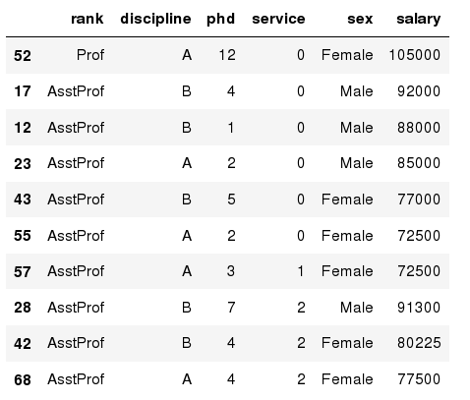
Data Frames: Sorting
We can sort the data using 2 or more columns:
In [ ]:
df_sorted = df.sort_values( by =['service', 'salary'], ascending = [True, False])
df_sorted.head(10)
Out[ ]:

Slide 34
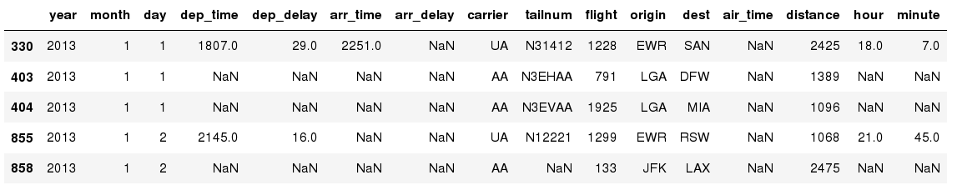
Missing Values
Missing values are marked as NaN
In [ ]:
# Read a dataset with missing values
flights = pd.read_csv("http://rcs.bu.edu/examples/python/data_analysis/flights.csv")
In [ ]:
# Select the rows that have at least one missing value
flights[flights.isnull().any(axis=1)].head()
Out[ ]:

Slide 35
Missing Values
There are a number of methods to deal with missing values in the data frame:
df.method() | description
dropna() | Drop missing observations
dropna(how='all') | Drop observations where all cells is NA
dropna(axis=1, how='all') | Drop column if all the values are missing
dropna(thresh = 5) | Drop rows that contain less than 5 non-missing values
fillna(0) | Replace missing values with zeros
isnull() | returns True if the value is missing
notnull() | Returns True for non-missing values

Slide 36
Missing Values
When summing the data, missing values will be treated as zero
If all values are missing, the sum will be equal to NaN
cumsum() and cumprod() methods ignore missing values but preserve them in the resulting arrays
Missing values in GroupBy method are excluded (just like in R)
Many descriptive statistics methods have skipna option to control if missing data should be excluded . This value is set to True by default (unlike R)

Slide 37
Aggregation Functions in Pandas
Aggregation - computing a summary statistic about each group, i.e.
  compute group sums or means
  compute group sizes/counts
Common aggregation functions:
  min, max
  count, sum, prod
  mean, median, mode, mad
  std, var

Slide 38
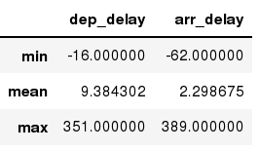
Aggregation Functions in Pandas
agg() method are useful when multiple statistics are computed per column:
In [ ]:
flights[['dep_delay','arr_delay']].agg(['min','mean','max'])
Out[ ]:

Slide 39
Basic Descriptive Statistics
df.method() | description
describe | Basic statistics (count, mean, std, min, quantiles, max)
min, max | Minimum and maximum values
mean, median, mode | Arithmetic average, median and mode
var, std | Variance and standard deviation
sem | Standard error of mean
skew | Sample skewness
kurt | kurtosis

Slide 40
Graphics to explore the data
Seaborn package is built on matplotlib but provides high level interface for drawing attractive statistical graphics, similar to ggplot2 library in R. It specifically targets statistical data visualization
To show graphs within Python notebook include inline directive:
In [ ]:
%matplotlib inline

Slide 41
Graphics
 | description
distplot | histogram
barplot | estimate of central tendency for a numeric variable
violinplot | similar to boxplot, also shows the probability density of the data
jointplot | Scatterplot
regplot | Regression plot
pairplot | Pairplot
boxplot | boxplot
swarmplot | categorical scatterplot
factorplot | General categorical plot

