Slide 1
ONLINE BOOKSTORE MANAGMENT WEBSITE
// FEBRUARY 2021
Using Flask
MADE BY
Saparov Almas, Serik Sanshar, Esengaliev Arsen

Slide 2

ABOUT THE PROJECT
ONLINE BOOKSTORE WEBSITE
In this project we created website for online bookstore😀
This website include:
Catalog
Authorization pages
Page to order book
Page to add book

Slide 3
TABLE OF CONTENTS
01
02
03
04
DATABASE
FRONTEND
Database of this website
Tailwind, template etc.
USER API
DEMONSRATION
REST API
Overview of website

Slide 4
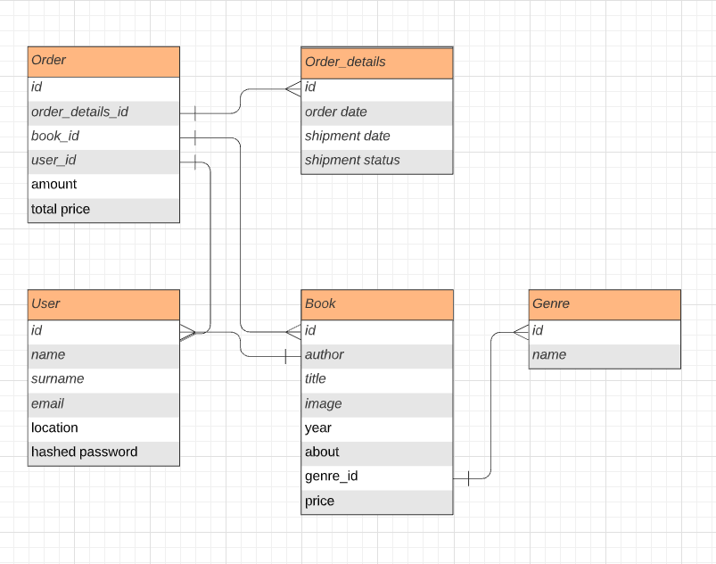
DATABASE
Represents order, connecting all tables
ORDER
Represents orders date, status etc.
ORDER DETAILS
Represents book and contains all book info
BOOK
VENUS
USER
Represents user
GENRE
Contains all genres

Slide 5

Frontend
TAILWIND
TEMPLATES
In order to make the styling process much faster, we used open-source CSS framework - Tailwind
We’ve also used templates to do frontend much faster.

Slide 6
USER API
REST API
To make our app more flexible we’ve used REST API
@blueprint.route('/api/users/<int:user_id>/purchase', methods=['GET']) def get_users_purchase(user_id): session = db_session.create_session() orders = session.query(Orders).filter(Orders.user_id == user_id).all() if not orders: return jsonify({'error': 'Not found'}) return jsonify({ 'order': [order.to_dict(only=('total_price', 'amount')) for order in orders], 'book': [session.query(Book).get(order.book_id).to_dict(only=('id', 'title', 'year')) for order in orders], 'genre': [session.query(Genre).get(session.query(Book).get(order.book_id).genre_id).to_dict(only=('name',)) for order in orders], 'user': [session.query(User).get(order.user_id).to_dict(only=('name', 'surname')) for order in orders], 'order_details': [session.query(Order_details).get( order.order_details_id).to_dict(only=('order_date', 'shipment_date', 'shipment_status')) for order in orders] })

Slide 7
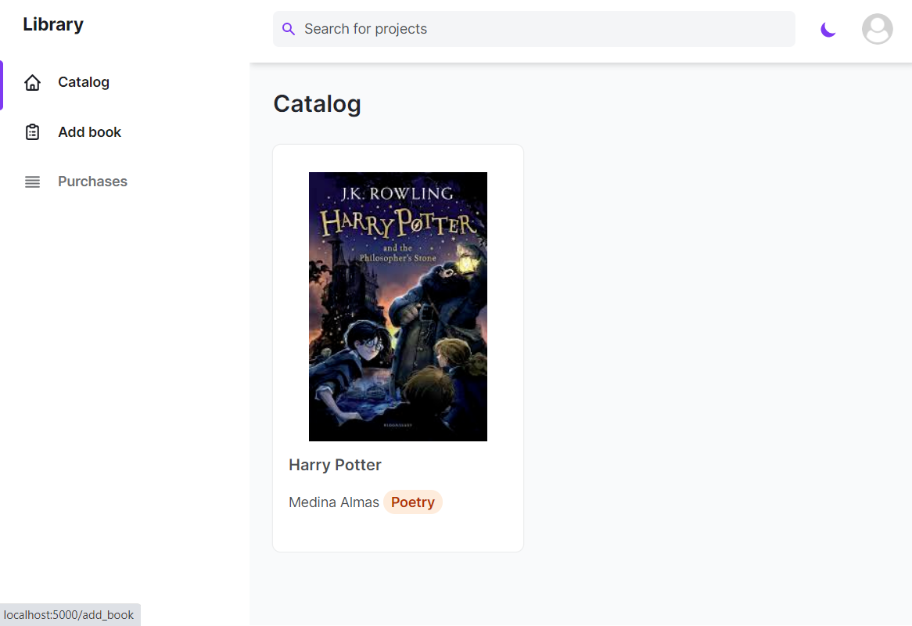

DEMONSTRATION TIME
Show time!
Demonstration

Slide 8
THANKS!
ONLINE BOOKSTORE WEBSITE
DO YOU HAVE ANY QUESTIONS?
Please keep this slide for attribution

