Slide 1
DOOdle jump
Yandex lyseum project
By Saparov Almas

Slide 2
ABOUT PROJECT
In this project I created doodle jump game. Game devolepment concepts included in this project:
Jump mechanics
Gravity and Friction
Random Level Generation
Creating a Score counter
and much more!
Game devolepment concepts

Slide 3
IMPLEMENTING JUMP AND MOVEMENT MECHANICS
Plan
IMPLEMENTING DOODLER, MOBS AND PLATFORMS
RANDOM LEVEL GENERATION
SCORING SYSTEM START AND END SCREEN

Slide 4
Mobs and platform
There 5 types of mobs:
There 8 types of mobs:
Platform
Moving Platform
Trap Platform
Cloud Platform
Explosion Platform
Flying Blob
Flying Bug
Flying Spider
Walking Monster
Jumping Floor
Jumping Wall
Jumping Bug
Bulky Blue
Bulky Green
Monster
Walking Monster
Jumping Monster
Jumping Floor
Jumping Wall
Jumping Bug
Bulky Blue
Bulky Green
Flying Monster
Flying Blob
Flying Bug
Flying Spider

Slide 5
Level Generation
bioms = {'normal': [[Platform] * 60 + [Trap_Platform] * 19 + [Moving_Platform] * 15 + [Explosion_Platform] * 5 + [Cloud_Platform], 35, 4.5, pygame.sprite.Group(), 2000], 'explosive lands': [[Explosion_Platform], 16, 1, pygame.sprite.Group(), 1000], 'clouds': [[Cloud_Platform], 16, 1, pygame.sprite.Group(), 1000], 'moving platforms': [[Moving_Platform], 7, 0.5, pygame.sprite.Group(), 1000]}
Biom Generation
There are 4 bioms game and each of them have their own palettes of platform types to generate.
Platform generation
Each platform generates on top of another with additional space. Vertical moving platforms have their space box to prevent overlapping while moving

Slide 6
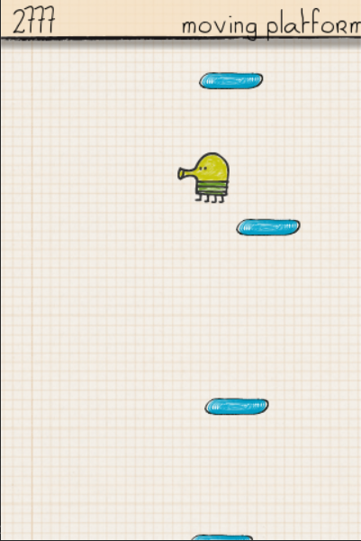
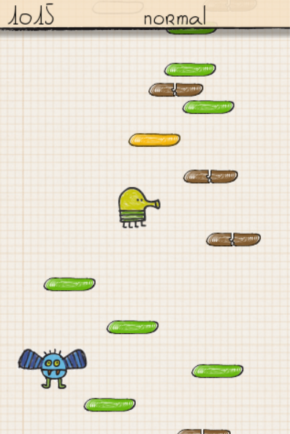
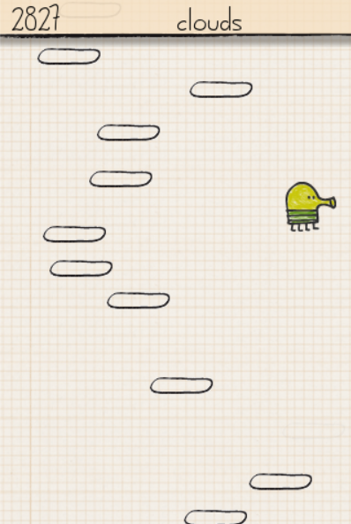
SCREENSHOTS

Slide 7
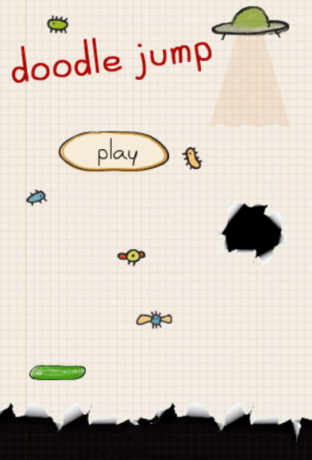
DEmonstration
Gameplay time!

Slide 8
Thank you
Any question?

