Slide 1
Deep Learning Project
Automated Detection of
Cyberbullying and Toxic Behavior
Input comment
“You are awful...”
Week 1–4 final presentation with results and Streamlit application
Predicted labels
toxic
insult
Student: Nagashybai Almat

Slide 2
Dataset & Task
Jigsaw toxic comment classification dataset from Hugging Face
159,571
1
6
Multi-label
rows
text column
target labels
task type
Target labels
Why multi-label?
One comment can belong to several categories at the same time.
Example: a comment can be both toxic and insulting.
This makes the task harder than simple binary classification.
toxic
— harmful, rude, or disrespectful comment.
severe_toxic
— extremely abusive or highly aggressive comment.
obscene
— comment with vulgar, inappropriate, or offensive language.
threat
— comment that expresses harm, intimidation, or danger.
insult
— comment that mocks, humiliates, or attacks another person.
identity_hate
— hate speech targeting a person or group based on identity.
Main challenge: some toxic categories appear less often, so the model has difficulty learning them.

Slide 3
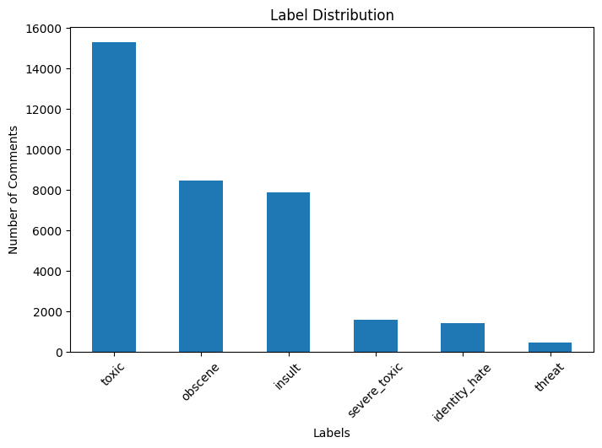
Week 1 — Exploratory Data Analysis
Understanding dataset structure, missing values, and label distribution
Key outputs
0
missing values in main columns
toxic
most frequent label
threat
Week 1 focused on understanding the dataset before model training. We checked missing values, dataset size, and label distribution. The dataset has no missing values in the main columns. The most frequent label is toxic, while the least frequent label is threat. The chart shows that the dataset is imbalanced. Some categories appear much more often than others, which makes rare labels harder to predict.
least frequent label

Slide 4
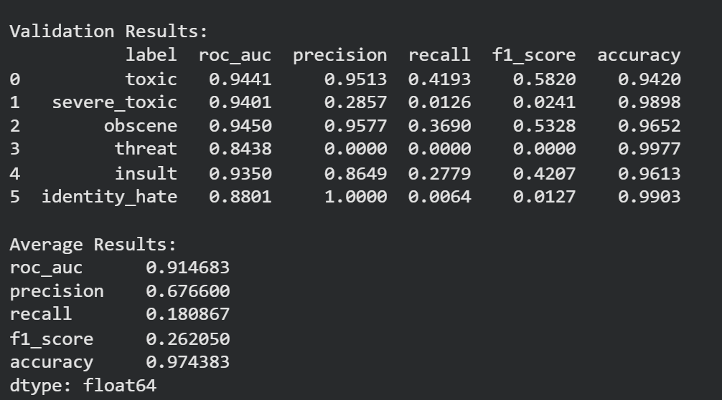
Week 2 — Preprocessing & Baseline Model
Clean text data and build the first machine learning model
Pipeline
Raw comment
Clean text
TF-IDF vectorizer
Naive Bayes
Metrics
Validation results --->
Interpretation
The baseline model was fast and achieved strong ROC-AUC. However, recall was low because the dataset is imbalanced and rare toxic labels are harder to detect. This model gave us a clear starting point for comparison with the LSTM deep learning model.

Slide 5
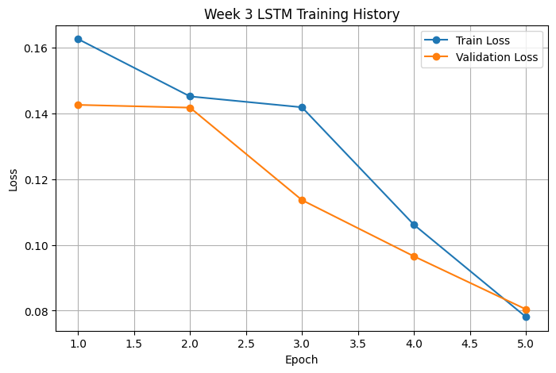
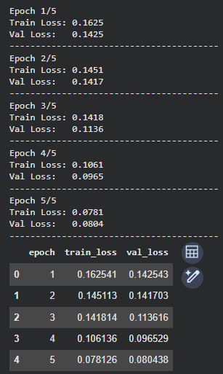
Week 3 — LSTM Deep Learning Model
Toxic Comment Classification • Week 1–4
Learning word sequence patterns with PyTorch
Model architecture
Training loss decreased, and validation loss also decreased. This shows that the model learned useful patterns and generalized better on validation data.
Embedding
LSTM
Linear
Sigmoid
In Week 3, we implemented an LSTM model in PyTorch. We converted comments into word sequences, created DataLoader, and trained the model for 5 epochs. The model architecture included Embedding, LSTM, Linear, and Sigmoid layers. Both train loss and validation loss decreased, showing that the model learned useful text patterns.

Slide 6
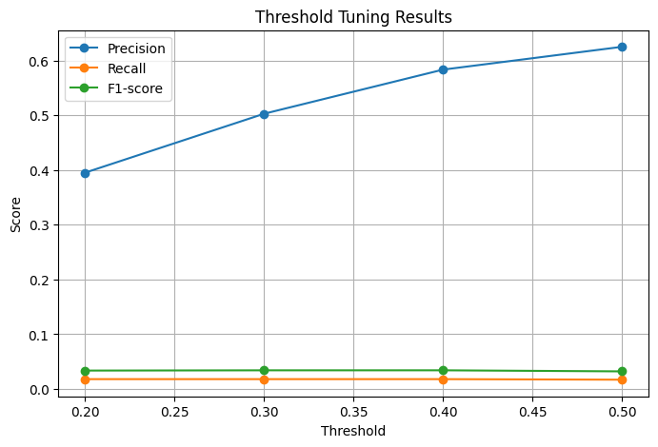
Week 4 — Comparison & Tuning
Toxic Comment Classification • Week 1–4
Final experiments and model selection
Model comparison
Model
ROC-AUC
Precision
Recall
F1
TF-IDF + NB
0.8815
0.4957
0.0651
0.1136
LSTM + tuning
0.5667
0.5833
0.0181
0.0342
Final observation
Higher precision means fewer false alarms, but lower recall means the model still misses many toxic comments. Class imbalance remains the main limitation.
Week 4 focused on final model comparison and threshold tuning.
We tested several threshold values to control the balance between precision and recall.
Higher threshold increased precision, meaning fewer false alarms.
However, recall stayed low, so the model still missed some toxic comments.
Final result: class imbalance remained the main limitation of the project.

Slide 7
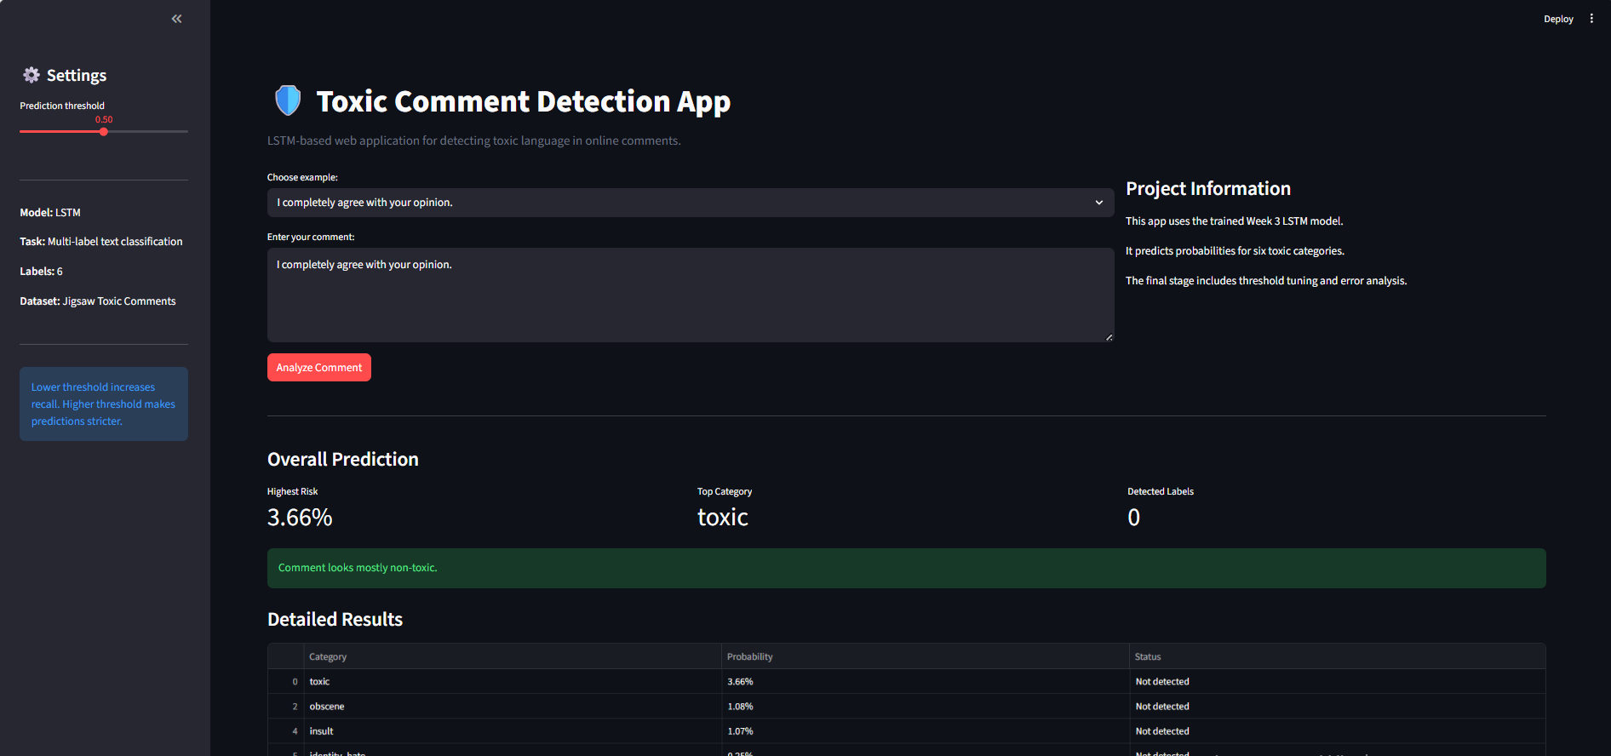
Final Prototype — Streamlit Application
A simple editable interface for testing toxic comment predictions
What the app does
Final conclusion
User enters a comment
Text is cleaned and encoded
Trained model predicts probabilities
App shows toxic categories and scores
The project covers the full ML pipeline from data analysis to a working prototype. Future improvements: better class balancing, longer training, BERT model, and separate thresholds for each label.

