Slide 1


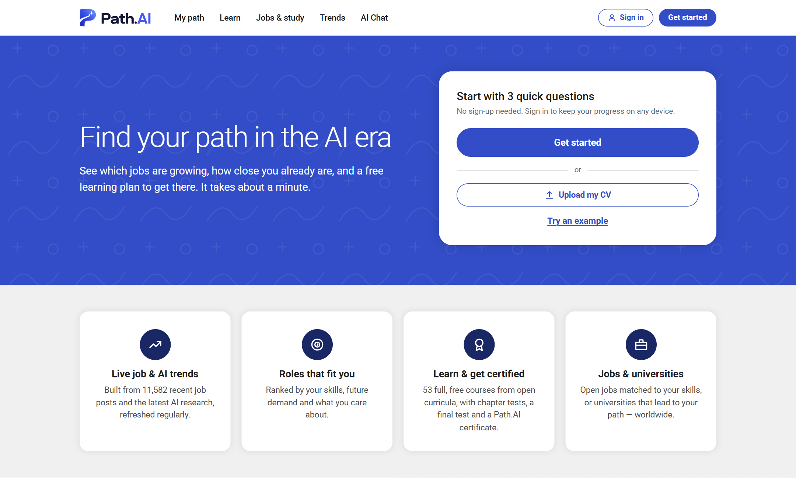
Find your path in the AI era
An explainable AI career navigator: from your skills today to a future-proof job, with a free learning plan.
pathai.lol
Team ASEA · Xiamen University Malaysia
SDC Hackathon 2026 · Domain 1: The Aiversecity Future-Ready Workforce
Notes:
0:00–0:20. We are team ASEA, and this is Path.AI.

Slide 2
AI is already costing people their jobs
54,836
71,825
−28%
US job cuts in 2025 were blamed directly on AI, out of 1,206,374 announced cuts
job cuts attributed to AI since 2023, when this reason was first tracked
jobs for data entry clerks in Malaysia by 2030, as surveyed employers expect
Challenger, Gray & Christmas, 2025 year-end report
Challenger, Gray & Christmas
WEF Future of Jobs Report 2025, Malaysia profile
Jobs disappearing fastest, 2025–2030 (WEF)
Data entry clerks
Accounting and payroll clerks
Cashiers and ticket clerks
Administrative assistants
Bank tellers
Graphic designers
Telemarketers
In Malaysia 56% of professionals use AI at work, but only 26% were trained (Hays 2025).
Notes:
0:20–1:20. AI is not a future risk; it is cutting jobs now. In 2025 US employers blamed AI for 54,836 job cuts. In Malaysia, employers expect data-entry jobs to shrink by 28% by 2030, and clerks, cashiers and designers are among the fastest-declining jobs. People in these jobs need to know where to go next.

Slide 3
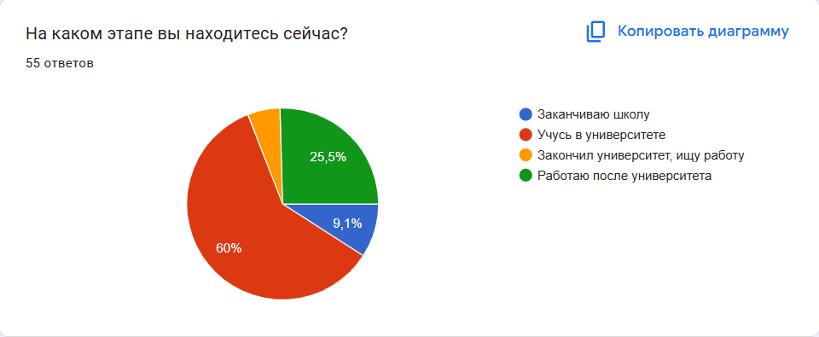
We tested the problem: 55 people answered our survey
60%
University students
33 people
25.5%
Working after university
14 people
9.1%
Finishing school
5 people
Google Form, 10 questions, 22–25 October 2026. Chart labels are in Russian; translation on the right.
5.5%
Graduates looking for work
3 people
Students, school leavers and young professionals: exactly the people choosing a career in the AI era.
Notes:
1:20–1:50. Before building, we checked the problem with a survey: 55 answers. 60% university students, a quarter already working, plus school leavers and job seekers.

Slide 4
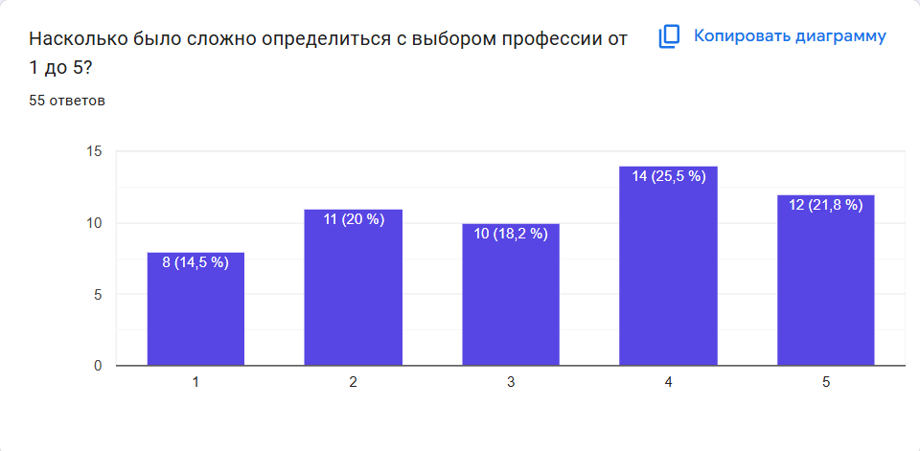
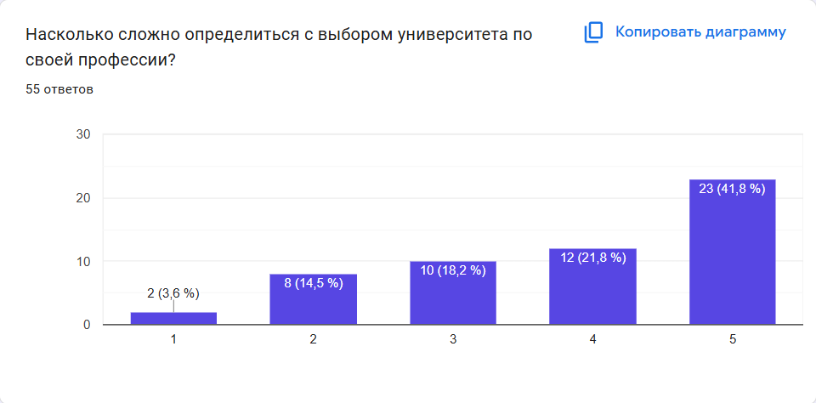
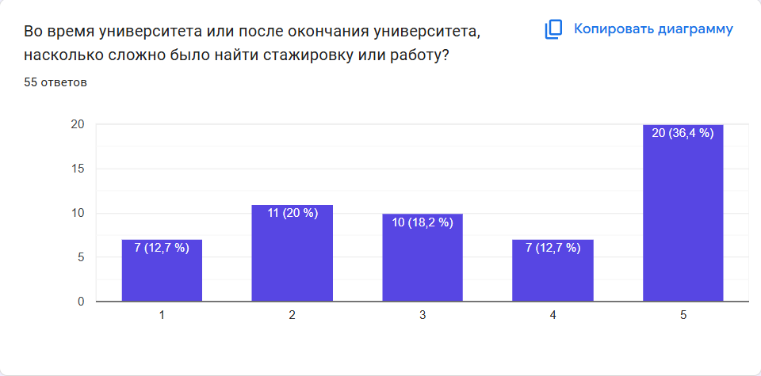
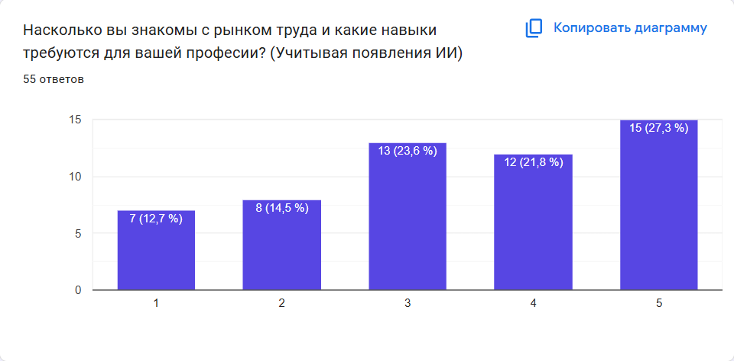
For about half of them, every career decision is hard
53%
36%
found choosing a profession hard
found choosing a university hard
51%
51%
found getting an internship or job hard
rate their knowledge of AI-era job skills 3 or lower
“Hard” = a rating of 1, 2 or 3, where 1 = very hard and 5 = easy (knowledge question: 1 = don't know, 5 = know well). n = 55. Charts from our Google Form, labels in Russian.
Notes:
1:50–2:30. Half found choosing a profession hard; half struggled to get a first internship or job, mostly because every posting asks for experience; and half do not know which skills AI-era jobs need.

Slide 5
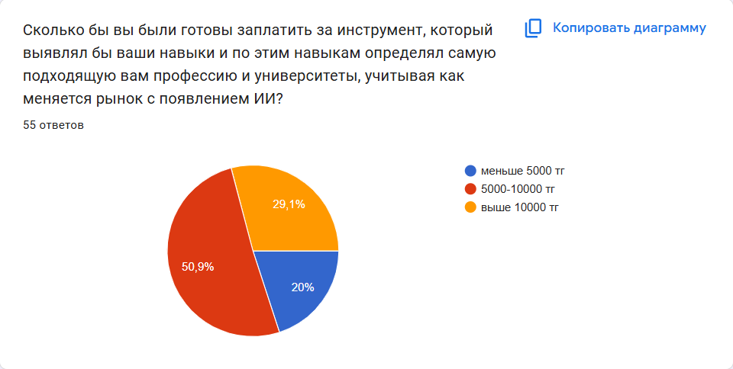
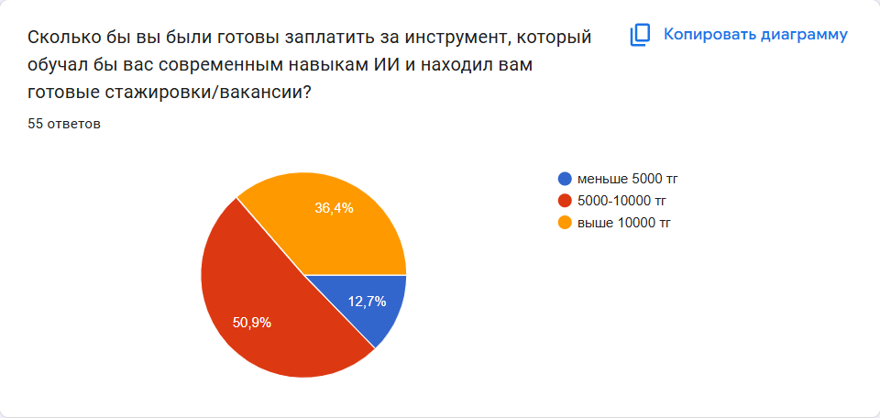
And they are ready to pay for help
A tool that finds the best profession for your skills, given how AI changes the market
A tool that teaches important AI skills and finds internships and jobs
20% under 5,000 KZT
12.7% under 5,000 KZT
50.9% 5,000–10,000 KZT
50.9% 5,000–10,000 KZT
29.1% over 10,000 KZT
36.4% over 10,000 KZT
83.5%
would pay at least 5,000 KZT (about $11) for at least one of the two tools. There is real demand for a platform that does both: Path.AI.
50.9% people are ready to pay about $11-$20, while 32.75% approved to pay at least $20
n = 55, mostly young people in Kazakhstan; 447.94 KZT per US$ (National Bank of Kazakhstan, 23 Oct 2026). Stated willingness, to be confirmed with pre-orders.
Notes:
2:30–3:10. 93% would pay at least 5,000 tenge, about 11 dollars, for at least one of the two tools, and more people value learning with internships. Path.AI does both.

Slide 6
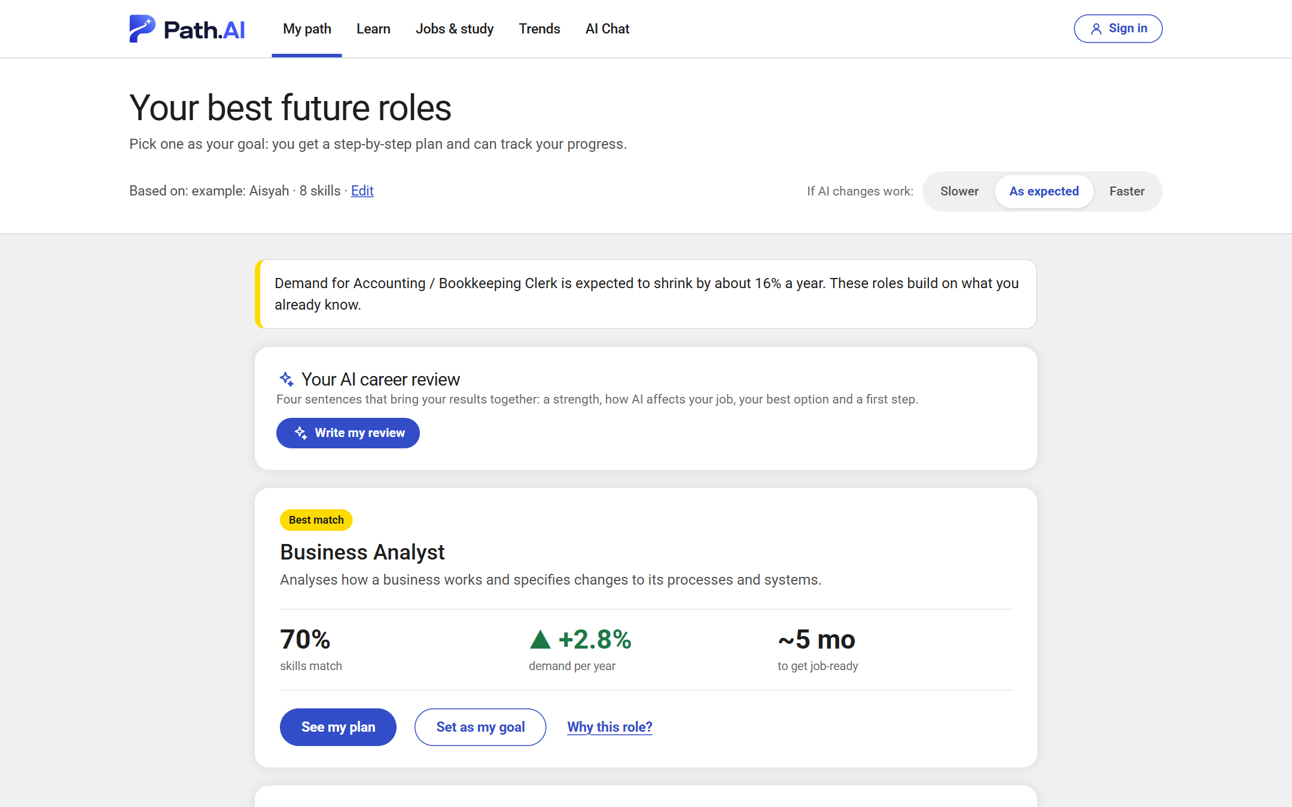





Path.AI: from your skills to a future job in minutes
1. Your profile
Upload a CV or answer 3 questions
2. Live trends
Which skills AI makes rise or fall, with source and date
3. Best roles
43 future jobs ranked, with a score you can check
4. Your plan
Ordered steps, hours and weeks, free courses
5. Jobs
Real postings matched to you, or universities
Example: Aisyah, an accounts clerk → Business Analyst, 70% skills match, a 122-hour plan
63 professions · 53 free courses · English, Malay and Chinese
Notes:
3:10–3:50. Path.AI reads your skills, shows how AI is changing demand, ranks 43 future jobs for you, builds an ordered free learning plan and matches real job postings.

Slide 7
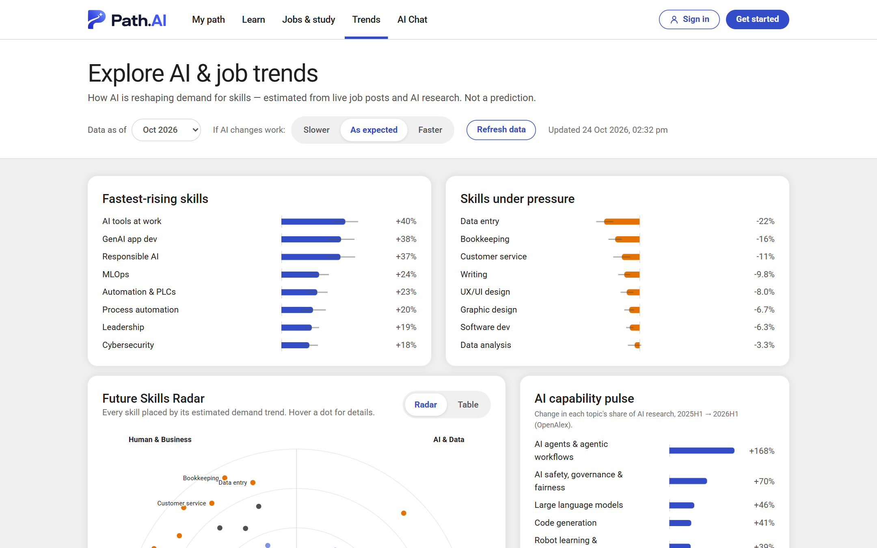
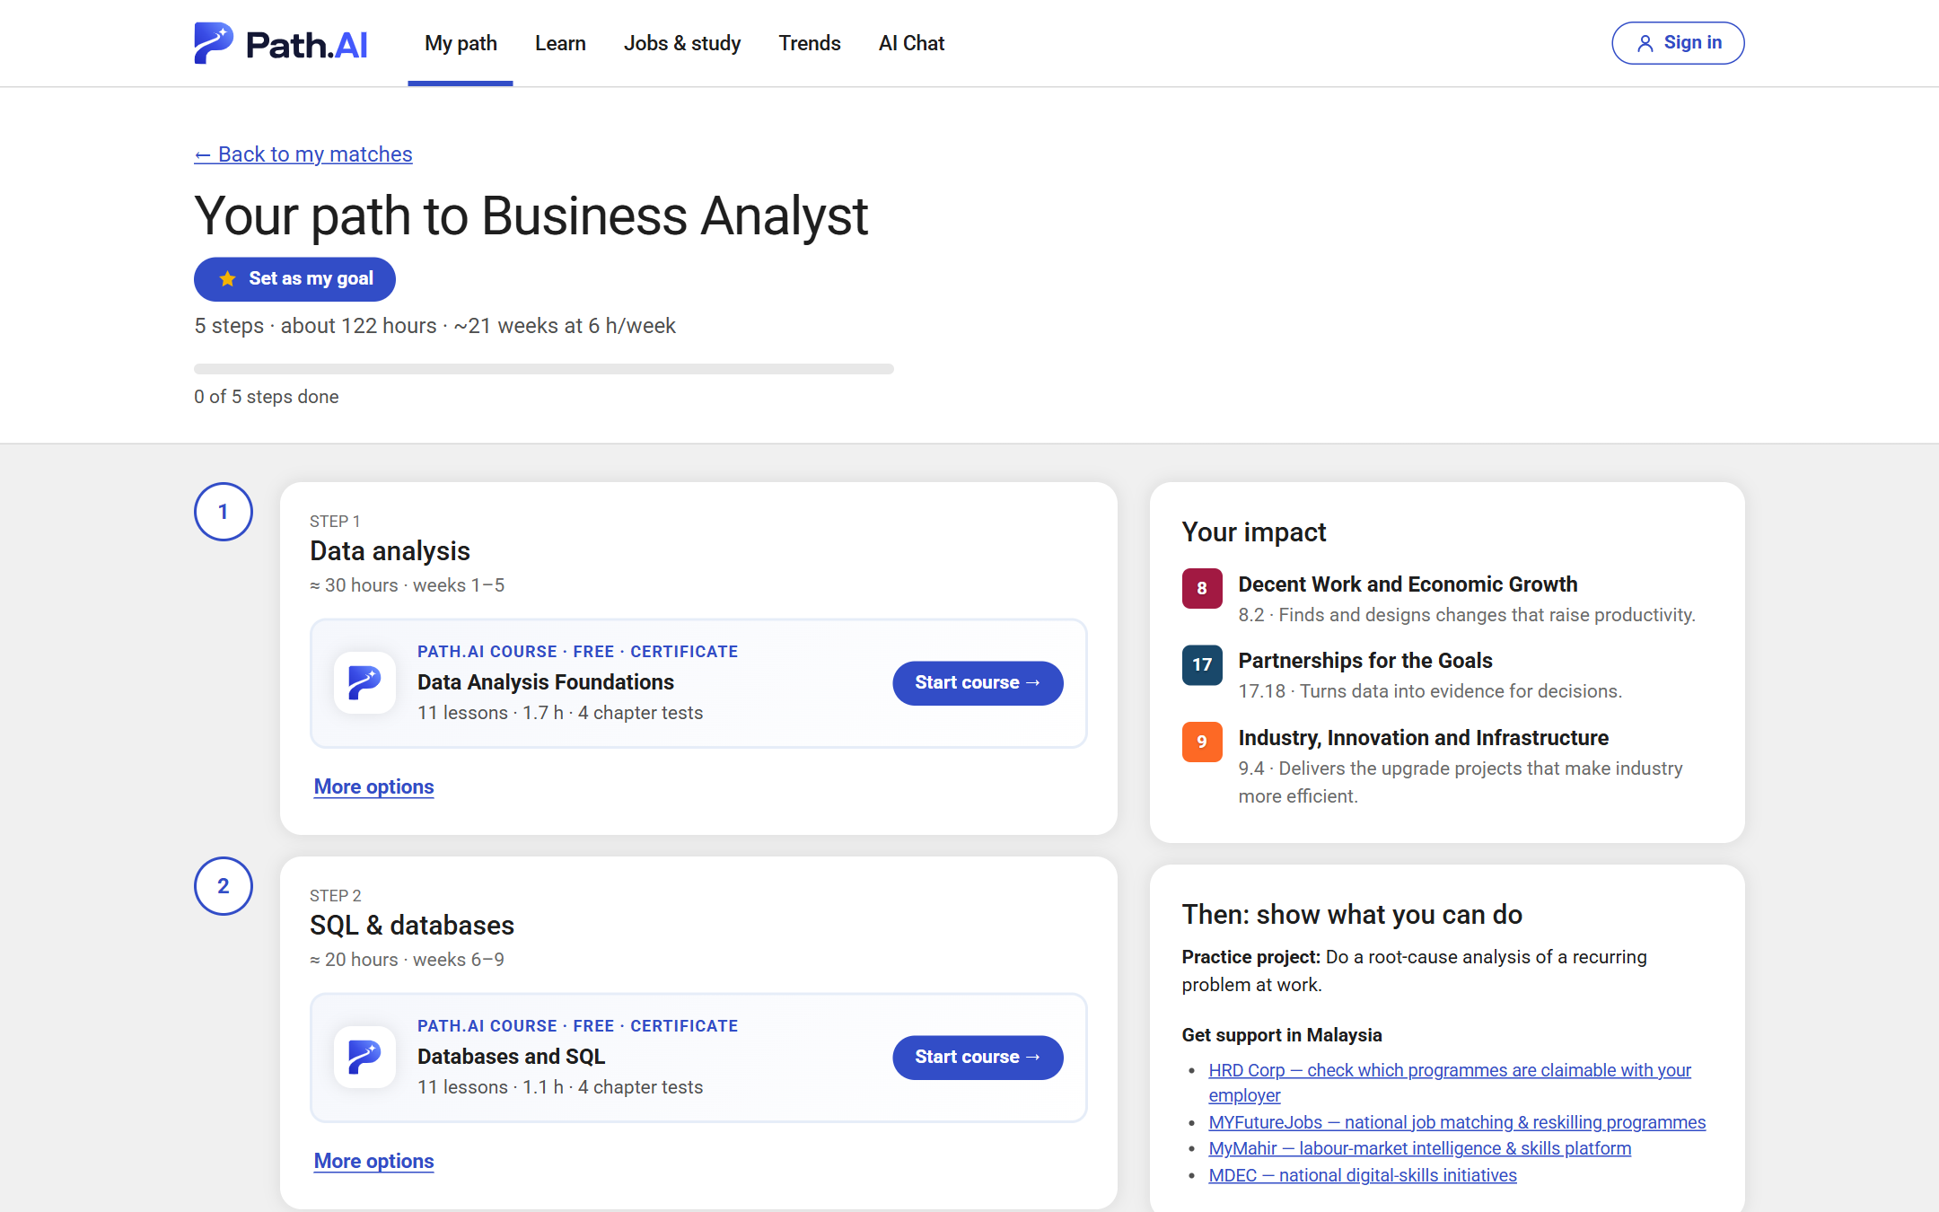
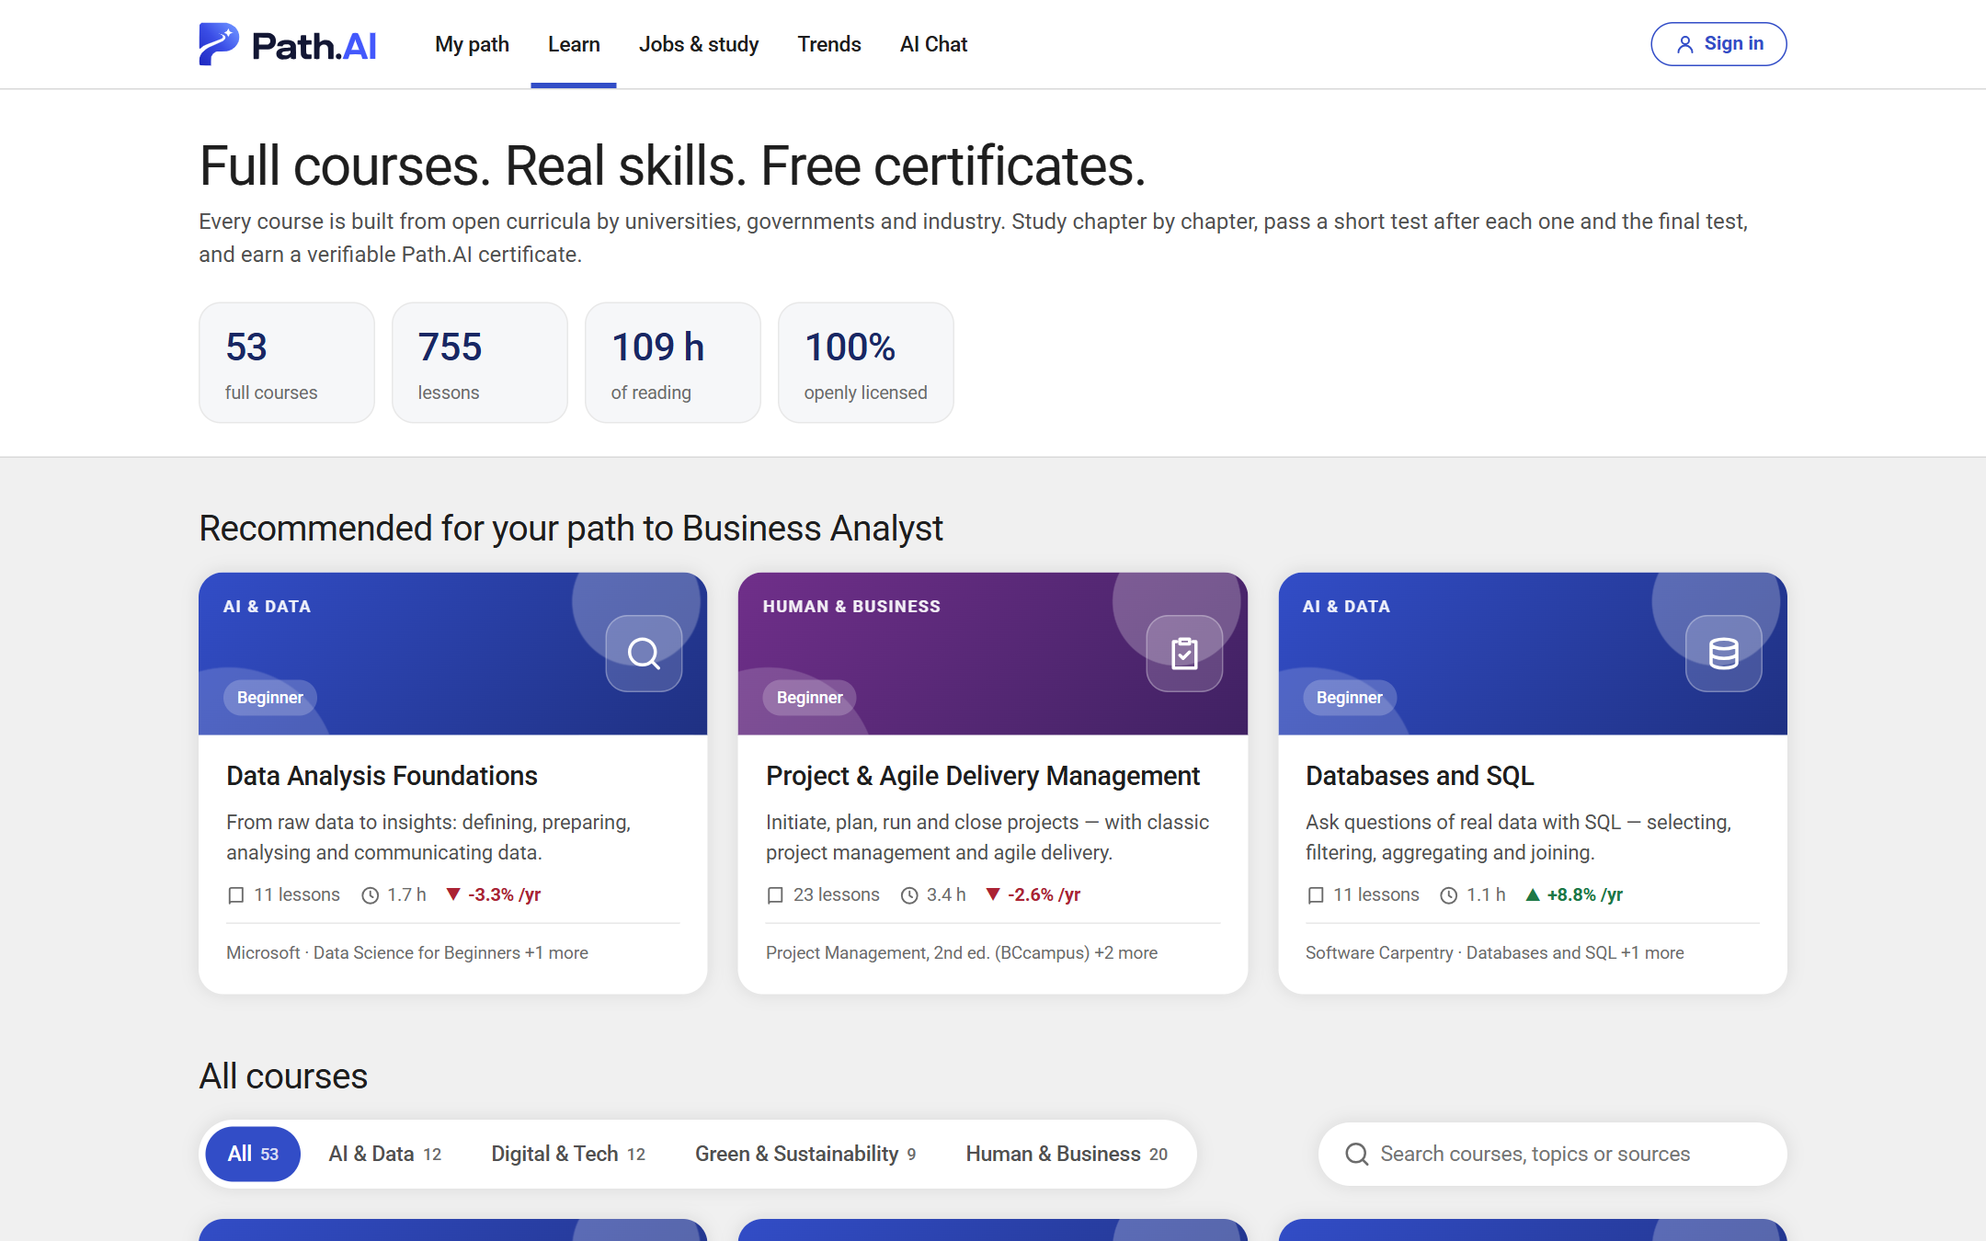



Every recommendation is explained, sourced and free to follow
Live data
A score you can check
Free, real learning
11,582 job posts (Hacker News) and AI research (OpenAlex), each with its date
Slower, expected or faster AI: switch the scenario, the ranking changes
Overall = 0.5 × skills fit + 0.3 × demand + 0.2 × interests and SDGs
Shows the missing skills and what would raise the score
53 full courses, 755 lessons, tests and certificates
Every role and skill is linked to UN SDG targets 4.4, 4.3, 8.5 and 8.2
The AI model (open-weight Qwen3.8-27B) only puts computed facts into words: any number it invents is rejected.
Notes:
3:50–4:30. Three things make it trustworthy: live dated data, a score anyone can take apart, and free real courses. The AI explains, it never invents numbers, jobs or courses.

Slide 8
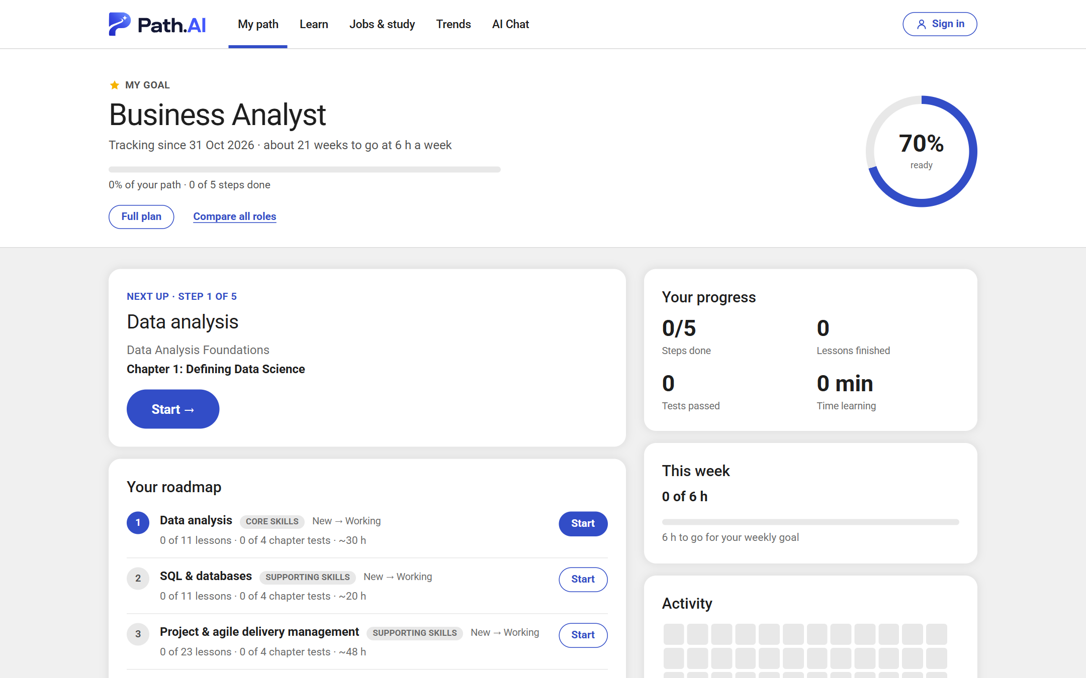
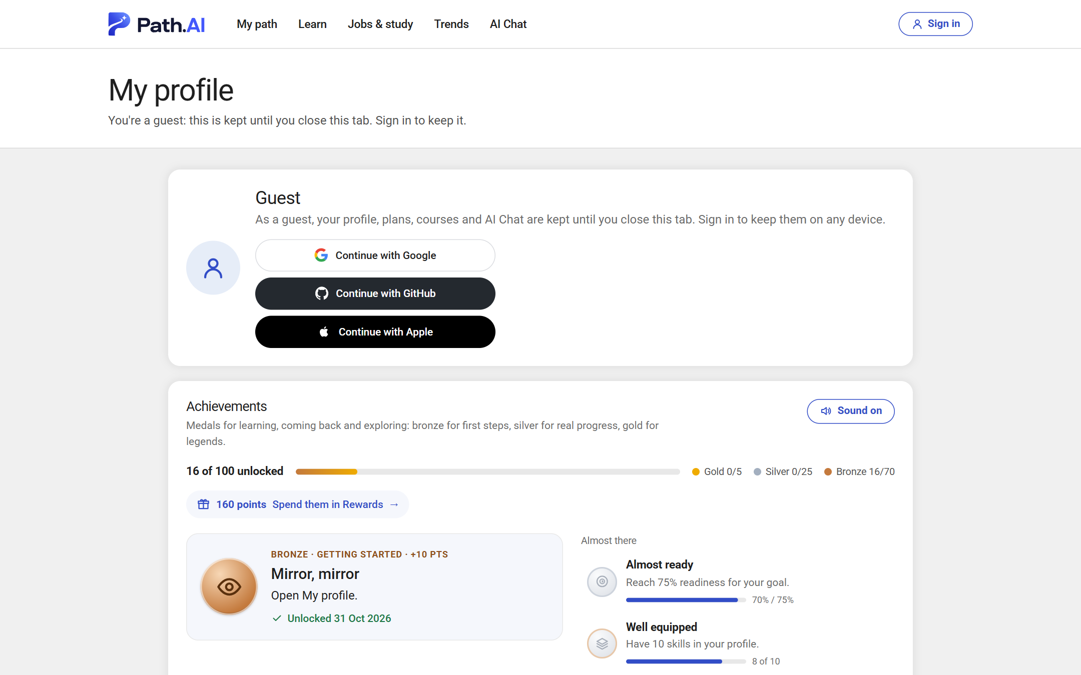
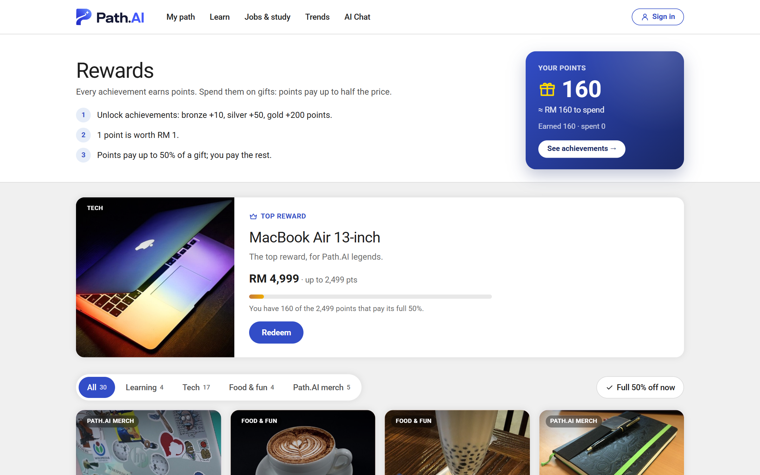



Built to keep people learning until they get there
Goal and daily streak
100 achievements
Points for real gifts
Set a goal job: readiness %, roadmap, weekly hours and a streak that forgives one missed day
70 bronze, 25 silver and 5 gold medals for lessons, tests, certificates and streaks, with a chime
Medals earn points (1 point ≈ RM 1) that pay up to half of 30 gifts, from stickers to a MacBook Air
Sign in with Google, GitHub or Apple to keep progress on every device; guests' data never leaves their browser tab.
Notes:
4:30–5:10. A plan alone is not enough; people quit. So we added a goal with a daily streak, 100 medals and points that pay for real gifts. Rewards are a demo for now; partners could sponsor them.

Slide 9
Let's see it live
pathai.lol
Demo: Aisyah, 34, accounts clerk whose company is rolling out AI invoice processing
Profile from her CV
Live trends: press Refresh data
Ranked roles and Why this role?
Her plan: 5 steps, 122 hours
SDG badge and the AI-pace switch
My path, medals and rewards
github.com/Almatikooo/Competition_Repo
Estimates, not predictions: AI supports career decisions, people decide.
Team ASEA · Xiamen University Malaysia · SDC Hackathon 2026
Notes:
5:10–10:00. Switch to the browser and run the live demo along these six steps, then take questions. More than one teammate should answer.

